Slide 1
Equality, Diversity and Inclusion in [insert department (i.e. Engineering)]
Tutorial 8 – Read and Critique
[insert speaker’s names]

Slide 2
Menti - Attendance
[insert menti meter code]
[insert menti meter QR code]

Slide 3
Term 2 Structure – Week by Week
Jan 10
2 hour tutorial
Jan 17
Jan 23
Assignment
“Justify”
2x 1h tutorial
Jan 24
2x 1h tutorial
Jan 31
2x 1h tutorial
Feb 6
Assignment
“Design”
Feb 7
2x 1h tutorial
Feb 14
2x 1h tutorial
Feb 20
Assignment
“Evaluate”
Feb 21
2x 1h tutorial
Feb 28
2x 1h tutorial
Mar 5
Assignment
“Comms”
Mar 6
2x 1h tutorial
Peer Review
Mar 28
Assignment
Essay
Getting Started
Feedback & Evaluate
Reflect & Estimate
Implement & Finalise
Present & Review
Draft and Test
Comms Efficacy
Read & Critique
Notes:
[Change dates]

Slide 4
Today’s Structure
Self Reflection
Reflect on Peers
Consider Positionality
Feedback Notes
Assignment Briefing
Formative Submission

Slide 5
Assessment Criteria | Example Outcome
Ability to critique feedback | Peer feedback is treated analytically and with respect whilst considering its validity and relevance
Critique relates to EDI issues / positionality | Positionality of self and team is considered in relation to EDI issues and the feedback received
Applies feedback to self appropriately | Able to reflect on own behaviours in the teamwork effectively with the support of the peer feedback
Action plans relate to self and feedback | Based on the reflection and peer feedback, can create plans to improve upon teamworking skills and behaviours and/or teamworking methodologies
Action plans relate to EDI issues | EDI issues and positionality are taken into consideration in the development of future plans

Slide 6
Submission Requirements
Submission requirements:
Maximum of two A4 pages
No front page nor appendices
References required if relevant, style is student choice
Submit via Blackboard – March 28th
Notes:
[Change dates]

Slide 7
Q&A
[insert QR code for mentimeter quiz]

Slide 8
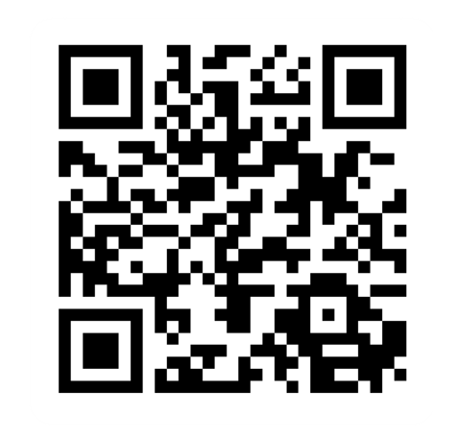
Provide feedback!
https://forms.office.com/e/pHBZpniFvB
If you used this resource, please take the time to fill out this form to provide your feedback.
If you have any questions or require more information about the REET (Resources for Embedding EDI in Teaching) project, please contact the Project Lead using the following contact details:
Chloe Agg c.agg@imperial.ac.uk

