Slide 1
Equality, Diversity and Inclusion in [insert department (i.e. Engineering)]
Tutorial 7 – Communication Efficacy
[insert speaker’s names]

Slide 2
Menti - Attendance
[insert menti meter code]
[insert menti meter QR code]

Slide 3
Term 2 Structure – Week by Week
Jan 10
2 hour tutorial
Jan 17
Jan 23
Assignment
“Justify”
2x 1h tutorial
Jan 24
2x 1h tutorial
Jan 31
2x 1h tutorial
Feb 6
Assignment
“Design”
Feb 7
2x 1h tutorial
Feb 14
2x 1h tutorial
Feb 20
Assignment
“Evaluate”
Feb 21
2x 1h tutorial
Feb 28
2x 1h tutorial
Mar 5
Assignment
“Comms”
Mar 6
2x 1h tutorial
Peer Review
Mar 28
Assignment
Essay
Getting Started
Feedback & Evaluate
Reflect & Estimate
Implement & Finalise
Present & Review
Draft and Test
Comms Efficacy
Read & Critique

Slide 4
Today’s Structure
On Module Comms
Other EDI Comms
What works and why?
Differences within team
Audience
Content
Method
Refine from Reflection

Slide 5
Communicate: Create a poster/video we can use to share your finalised initiative idea to generate interest amongst participants or other stakeholders. Explain why you have chosen this methodology and its limitations.
Develop communications strategy and materials (25%) Poster/video plus max 500 words | [Materials] | The video/poster is of high quality and communicates the initiative well.
 | Justification of strategy | The reason for this methodology and design is explained relative to the other choices made around the EDI initiative.
 | Critique of strategy | The limits or issues of the communication strategy are understood and explained.
 | Appropriateness of strategy | The selected strategy is appropriate for the target group and intended audience.

Slide 6
Evaluate the Initiative
Materials
Justify Strategy
Critique Strategy
Appropriate-ness

Slide 7
Q&A
[insert QR code for mentimeter quiz]

Slide 8
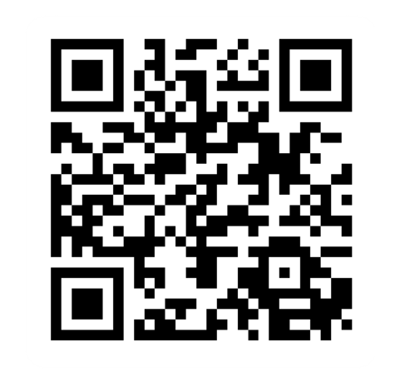
Provide feedback!
https://forms.office.com/e/pHBZpniFvB
If you used this resource, please take the time to fill out this form to provide your feedback.
If you have any questions or require more information about the REET (Resources for Embedding EDI in Teaching) project, please contact the Project Lead using the following contact details:
Chloe Agg c.agg@imperial.ac.uk

