Slide 1
Equality, Diversity and Inclusion in [insert department (i.e. Engineering)]
Tutorial 6 – Draft and Test
[insert speaker’s names]

Slide 2
Menti - Attendance
[insert menti meter code]
[insert menti meter QR code]

Slide 3
Term 2 Structure – Week by Week
Jan 10
2 hour tutorial
Jan 17
Jan 23
Assignment
“Justify”
2x 1h tutorial
Jan 24
2x 1h tutorial
Jan 31
2x 1h tutorial
Feb 6
Assignment
“Design”
Feb 7
2x 1h tutorial
Feb 14
2x 1h tutorial
Feb 20
Assignment
“Evaluate”
Feb 21
2x 1h tutorial
Feb 28
2x 1h tutorial
Mar 5
Assignment
“Comms”
Mar 6
2x 1h tutorial
Peer Review
Mar 28
Assignment
Essay
Getting Started
Feedback & Evaluate
Reflect & Estimate
Implement & Finalise
Present & Review
Draft and Test
Comms Efficacy
Read & Critique

Slide 4
Today’s Structure
Quantify and Measure “Success”
Develop Exemplar
Reflect on “being surveyed”
Refine from Reflection
Fill in peer exemplar
Add comments
Compare to own
Refine from Feedback

Slide 5
Evaluate: You will create an evaluation tool which demonstrates how you will evaluate two intended impacts of your initiative. You will justify your choice and submit details (e.g. a template and/or example) of this tool and how it will work.
Plan the evaluation (25%) Exemplar plus max 500 words | Description of chosen evaluation method | Means of measuring the efficacy and impact of the initiative have been chosen and described.
 | Justification of evaluation method | The method has been selected with good reason which is well explained.
 | Limitations of evaluation method | The group are able to identify what the flaws in the evaluation method might be and how they might account for this.
 | [Materials] | Exemplar is clear and appropriate.

Slide 6
Evaluate the Initiative
Describe Method
Justify Method
Identify Limitations
Materials [Exemplar]

Slide 7
Q&A
[insert QR code for mentimeter quiz]

Slide 8
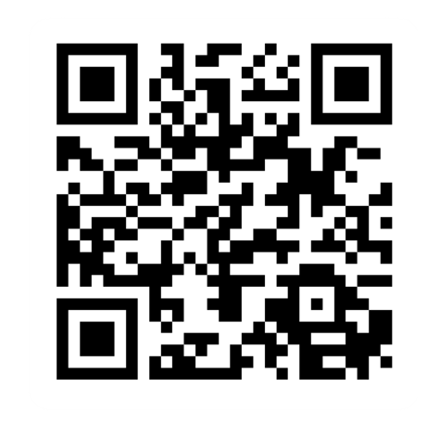
Provide feedback!
https://forms.office.com/e/pHBZpniFvB
If you used this resource, please take the time to fill out this form to provide your feedback.
If you have any questions or require more information about the REET (Resources for Embedding EDI in Teaching) project, please contact the Project Lead using the following contact details:
Chloe Agg c.agg@imperial.ac.uk

