Slide 1
Equality, Diversity and Inclusion in [insert department (i.e. Engineering)]
Tutorial 1 – Getting Started
[insert speaker’s names]

Slide 2
Menti - Attendance
[insert code for mentimeter]
[insert QR code for mentimeter]

Slide 3
Term 2 Structure - General
Wednesdays
9-10am & 10-11am
2 hours – inform us of clashes
Facilitated sessions & opportunities for coursework development
Primary access to feedback & feedforward

Slide 4
Term 2 Structure – Week by Week
Jan 10
2 hour tutorial
Jan 17
Jan 23
Assignment
“Justify”
2x 1h tutorial
Jan 24
2x 1h tutorial
Jan 31
2x 1h tutorial
Feb 6
Assignment
“Design”
Feb 7
2x 1h tutorial
Feb 14
2x 1h tutorial
Feb 20
Assignment
“Evaluate”
Feb 21
2x 1h tutorial
Feb 28
2x 1h tutorial
Mar 5
Assignment
“Comms”
Mar 6
2x 1h tutorial
Peer Review
Mar 28
Assignment
Essay
Getting Started
Feedback & Evaluate
Reflect & Estimate
Implement & Finalise
Present & Review
Draft and Test
Comms Efficacy
Read & Critique

Slide 5
Today’s Structure
Icebreakers
Positionality Mapping
Mind Mapping
Assignment Briefing

Slide 6
Group Allocations
Refer to Blackboard for full groups and project titles
Room Rearrangement?
Ensure you are seated with your teammates, in an arrangement which allows you to easily – move the tables if needed

Slide 7
Icebreaker Time

Slide 8
Group Positionality Mapping
Why?
Supports cohesive teamworking
Assists well informed group coursework
Enables reflective work in individual essay
Rules:
Do not disclose anything you are not comfortable with
Do not disclose details of team mates to others

Slide 9

[1] Lydia, “Privilege Wheel,” York Disability Rights Forum, Sep. 19, 2021. https://ydrf.org.uk/2021/09/19/privilege-wheel/
‌

Slide 10
Group Positionality Mapping - Discuss
What are your gaps?
How do these relate to your project topic?
How will your positionality impact your ability to work as a team?
        individually and as a group
How will your positionality impact your EDI initiative?
How will you address, mitigate or build upon your strengths and limitations?

Slide 11
Mind Mapping
What do you already know about your topic?
        Lecture content
        Readings and other literature/theory
        Personal experience
        Observations
        Google!
Map structure, consider;
        Content
        Connectivity
        Hierarchy
Gaps?
What Next?

Slide 12
Submission | Assessment criteria | Example Outcome
Justify: This submission requires you to clearly identify what EDI area you plan to address, why it needs to be addressed, and what target group you will address it through. You will also need to consider the ethical implications of your idea, and how your team’s own lived experience might affect your work in this area.
Justify your chosen area of initiative (25%) Max 2 sides A4 | Equity issue being addressed with evidence | A specific issue is defined, evidenced using published literature, and its importance/relevance to STEM/Engineering is explained.
 | Intended impact | It is clear what the project hopes to achieve, and this is realistic.
 | Project title | A title is given which enables the reader, participant, or funder to quickly understand and remember the project.
 | Target group with justification | The group of participants / recruits etc is clearly defined, with good reasons for who has been included or excluded from the group.
 | Consideration of Equalities Act/Ethical issues | The legal and moral implications of the initiative are accounted for.
 | Reflection on your own positionality | How the group’s positionality might impact their choices, or the efficacy of the project, is discussed.

Slide 13
Justify Your Initiative
Equity issue being addressed with evidence
Intended impact
Project title
Target group with justification
Consideration of Equalities Act / Ethical issues
Reflection on your own positionality

Slide 14
Q&A
[insert QR code to quiz]

Slide 15
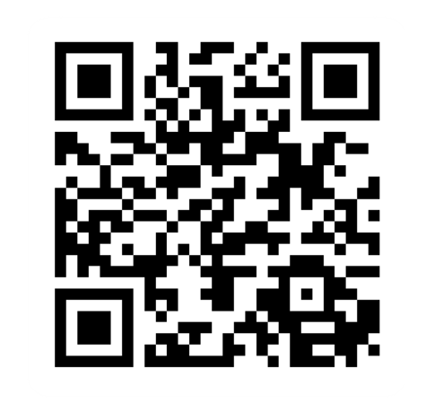
Provide feedback!
https://forms.office.com/e/pHBZpniFvB
If you used this resource, please take the time to fill out this form to provide your feedback.
If you have any questions or require more information about the REET (Resources for Embedding EDI in Teaching) project, please contact the Project Lead using the following contact details:
Chloe Agg c.agg@imperial.ac.uk

