Slide 1
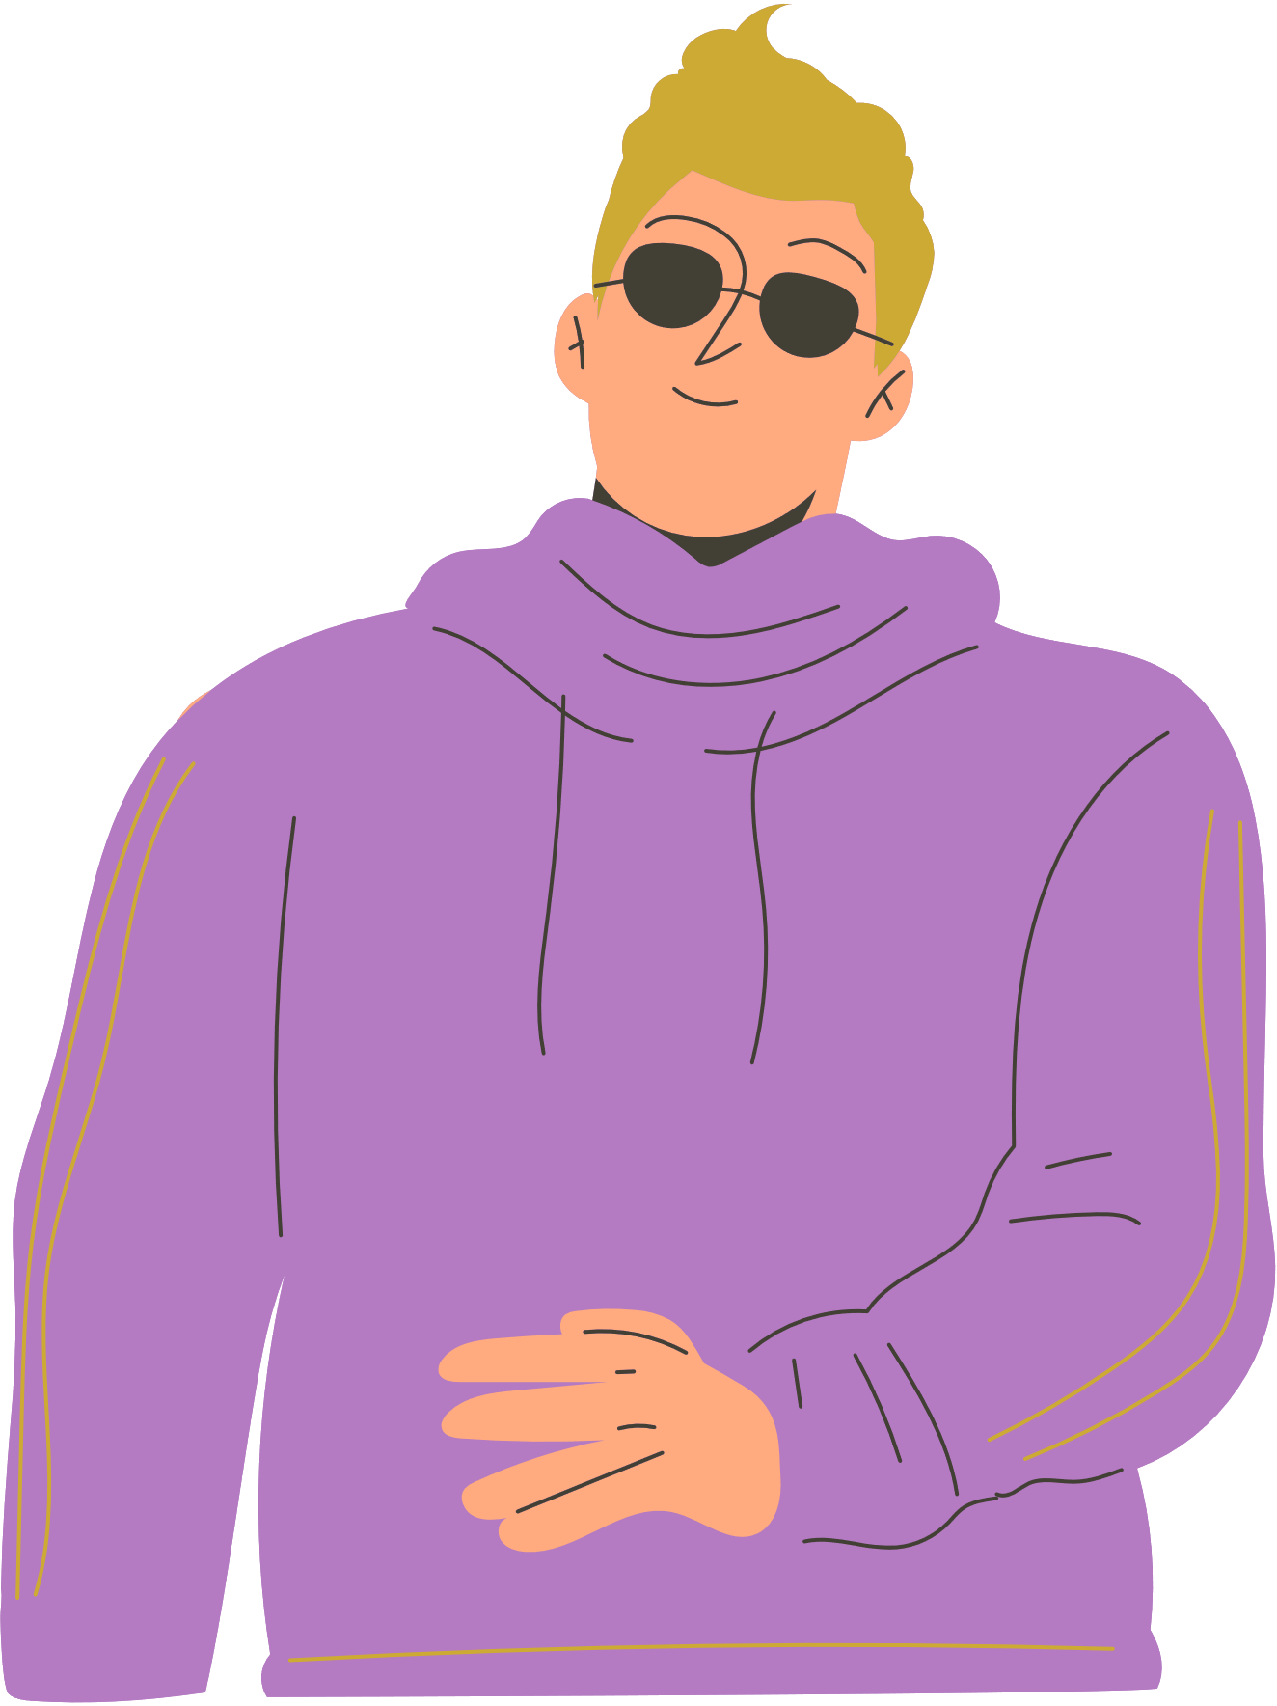

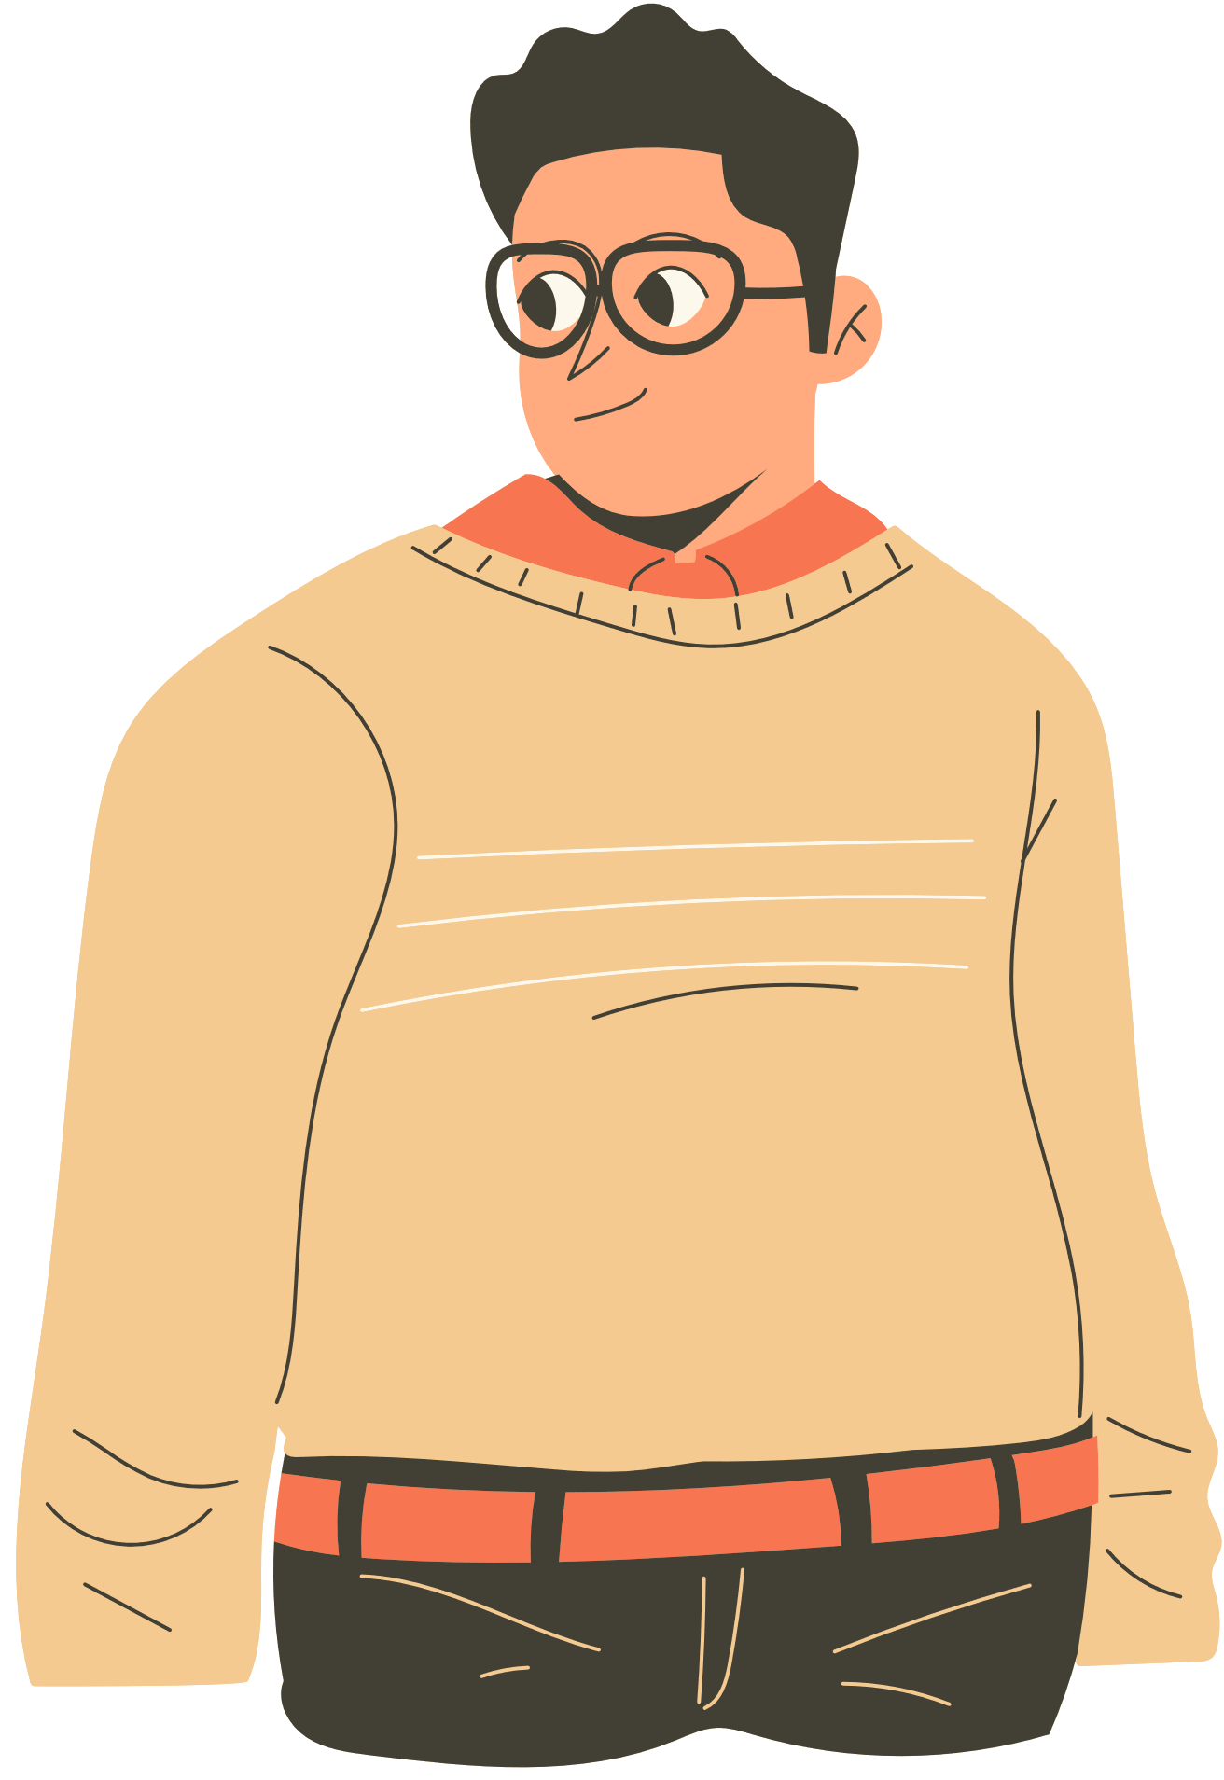
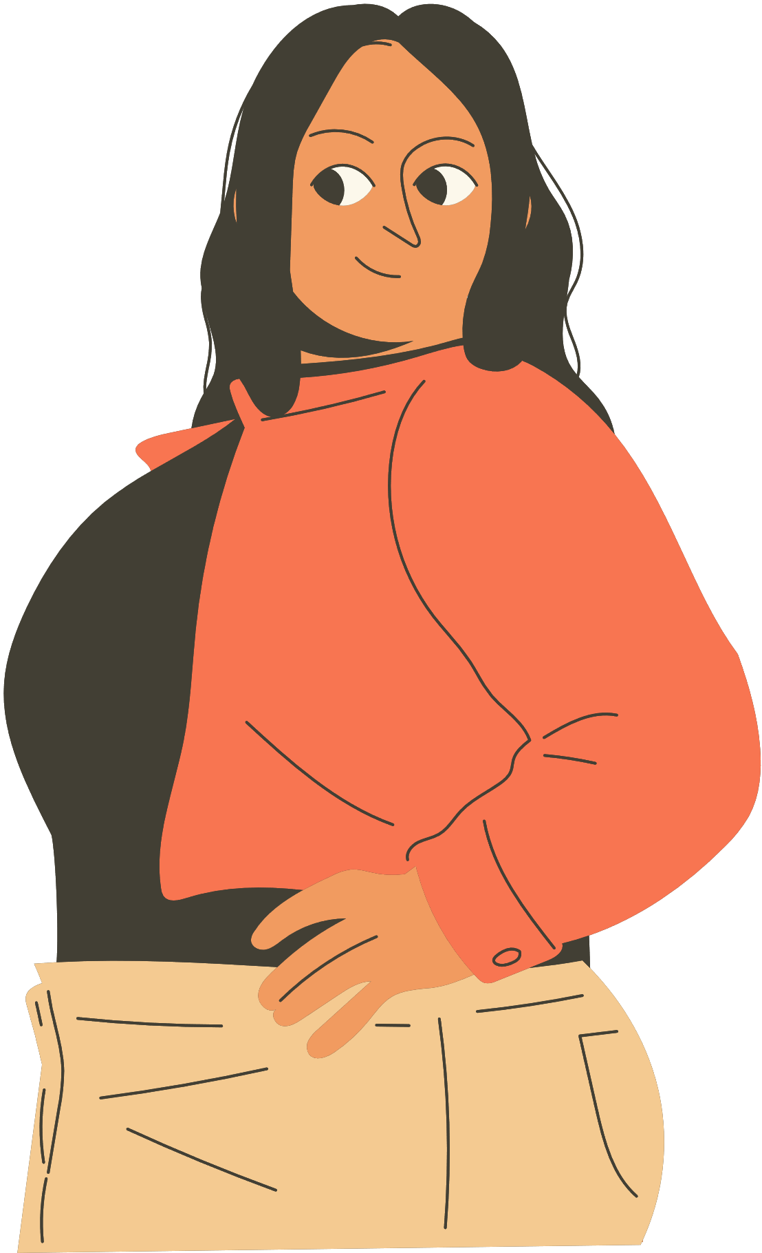

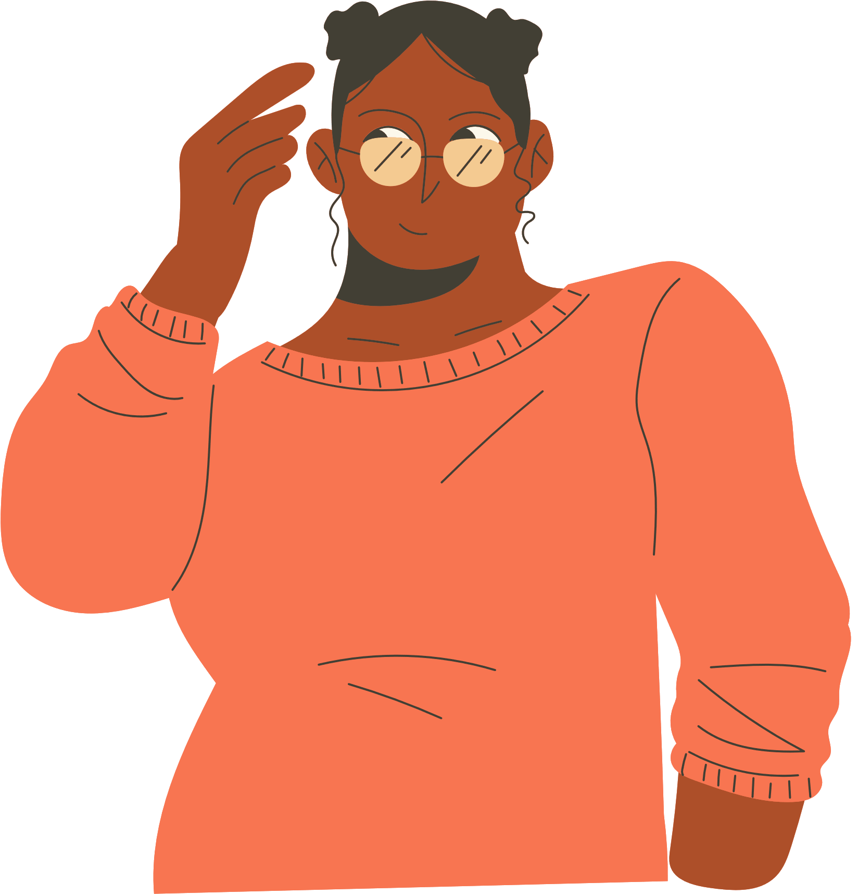
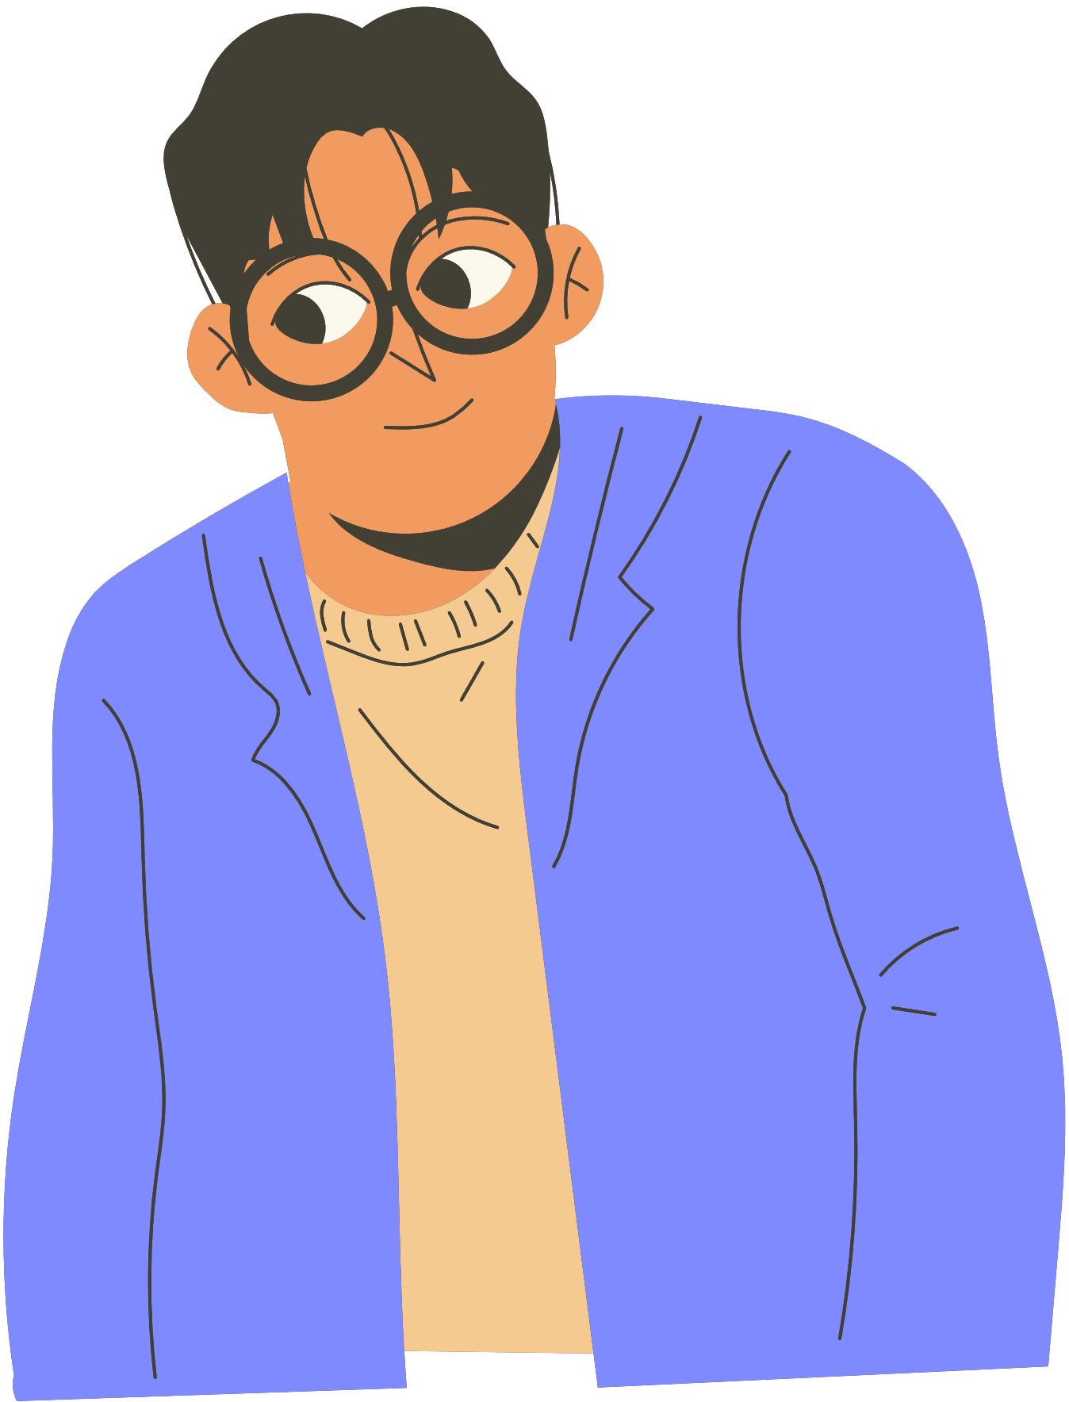
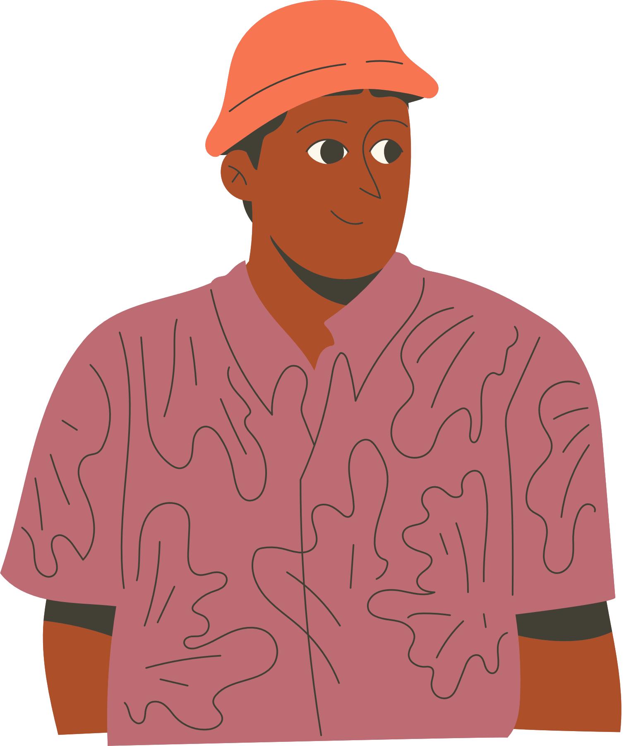

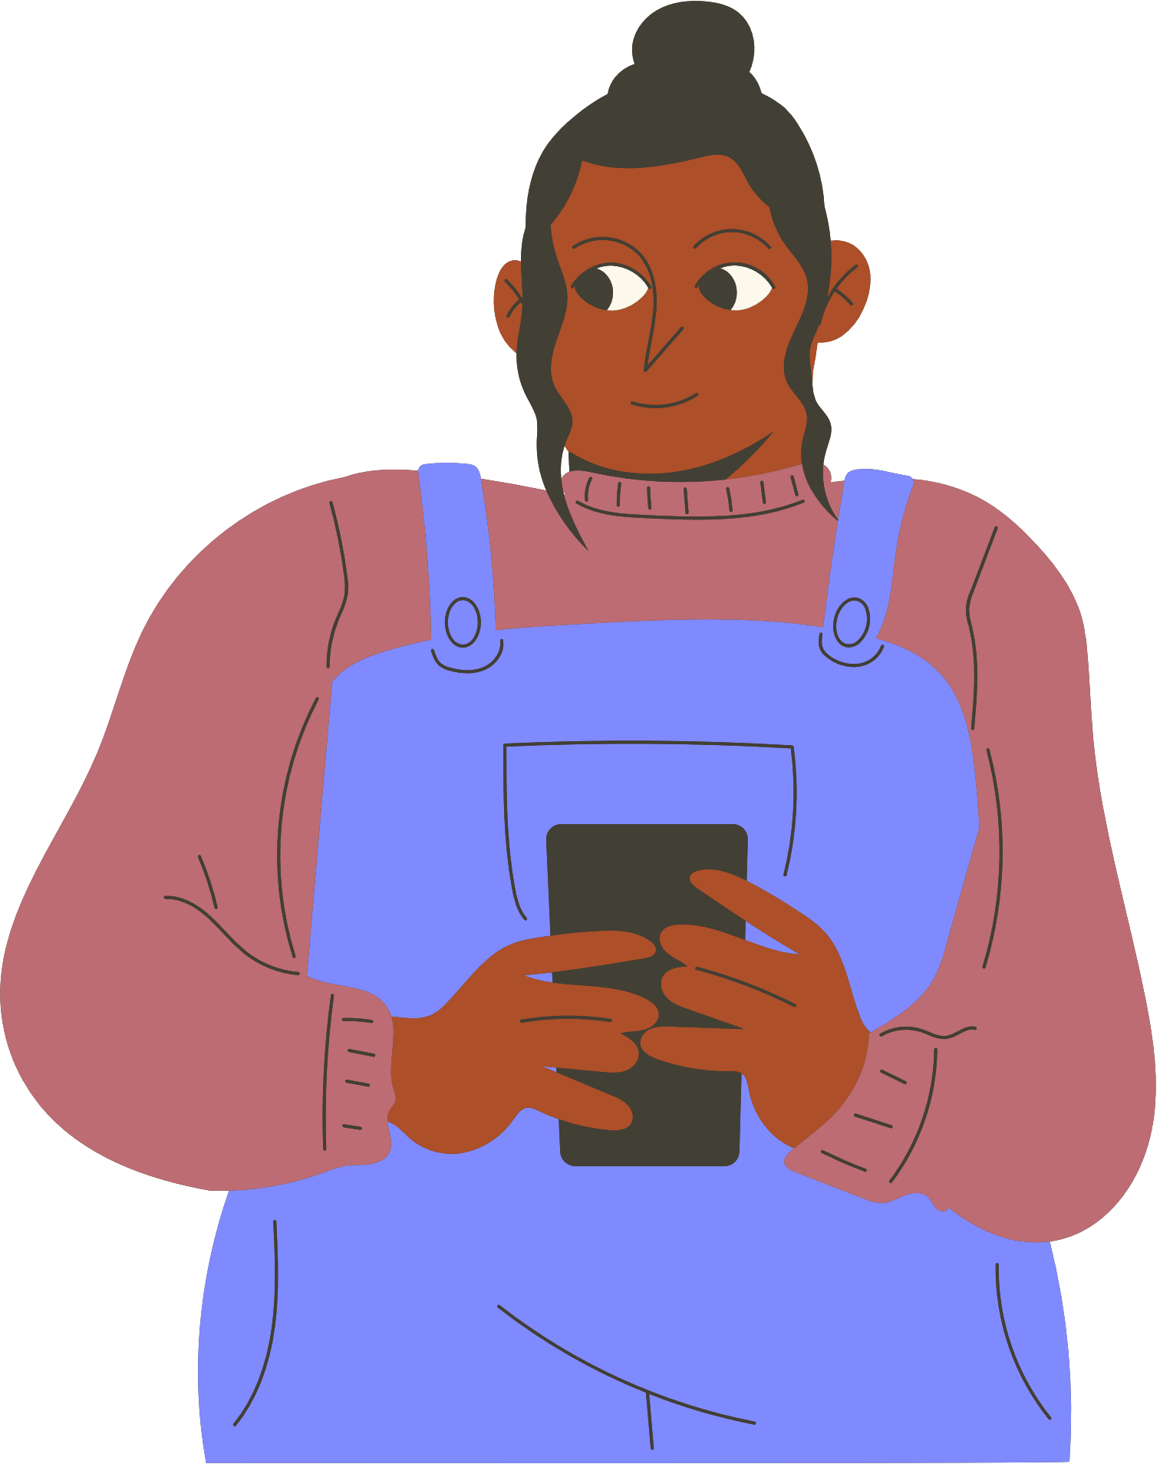
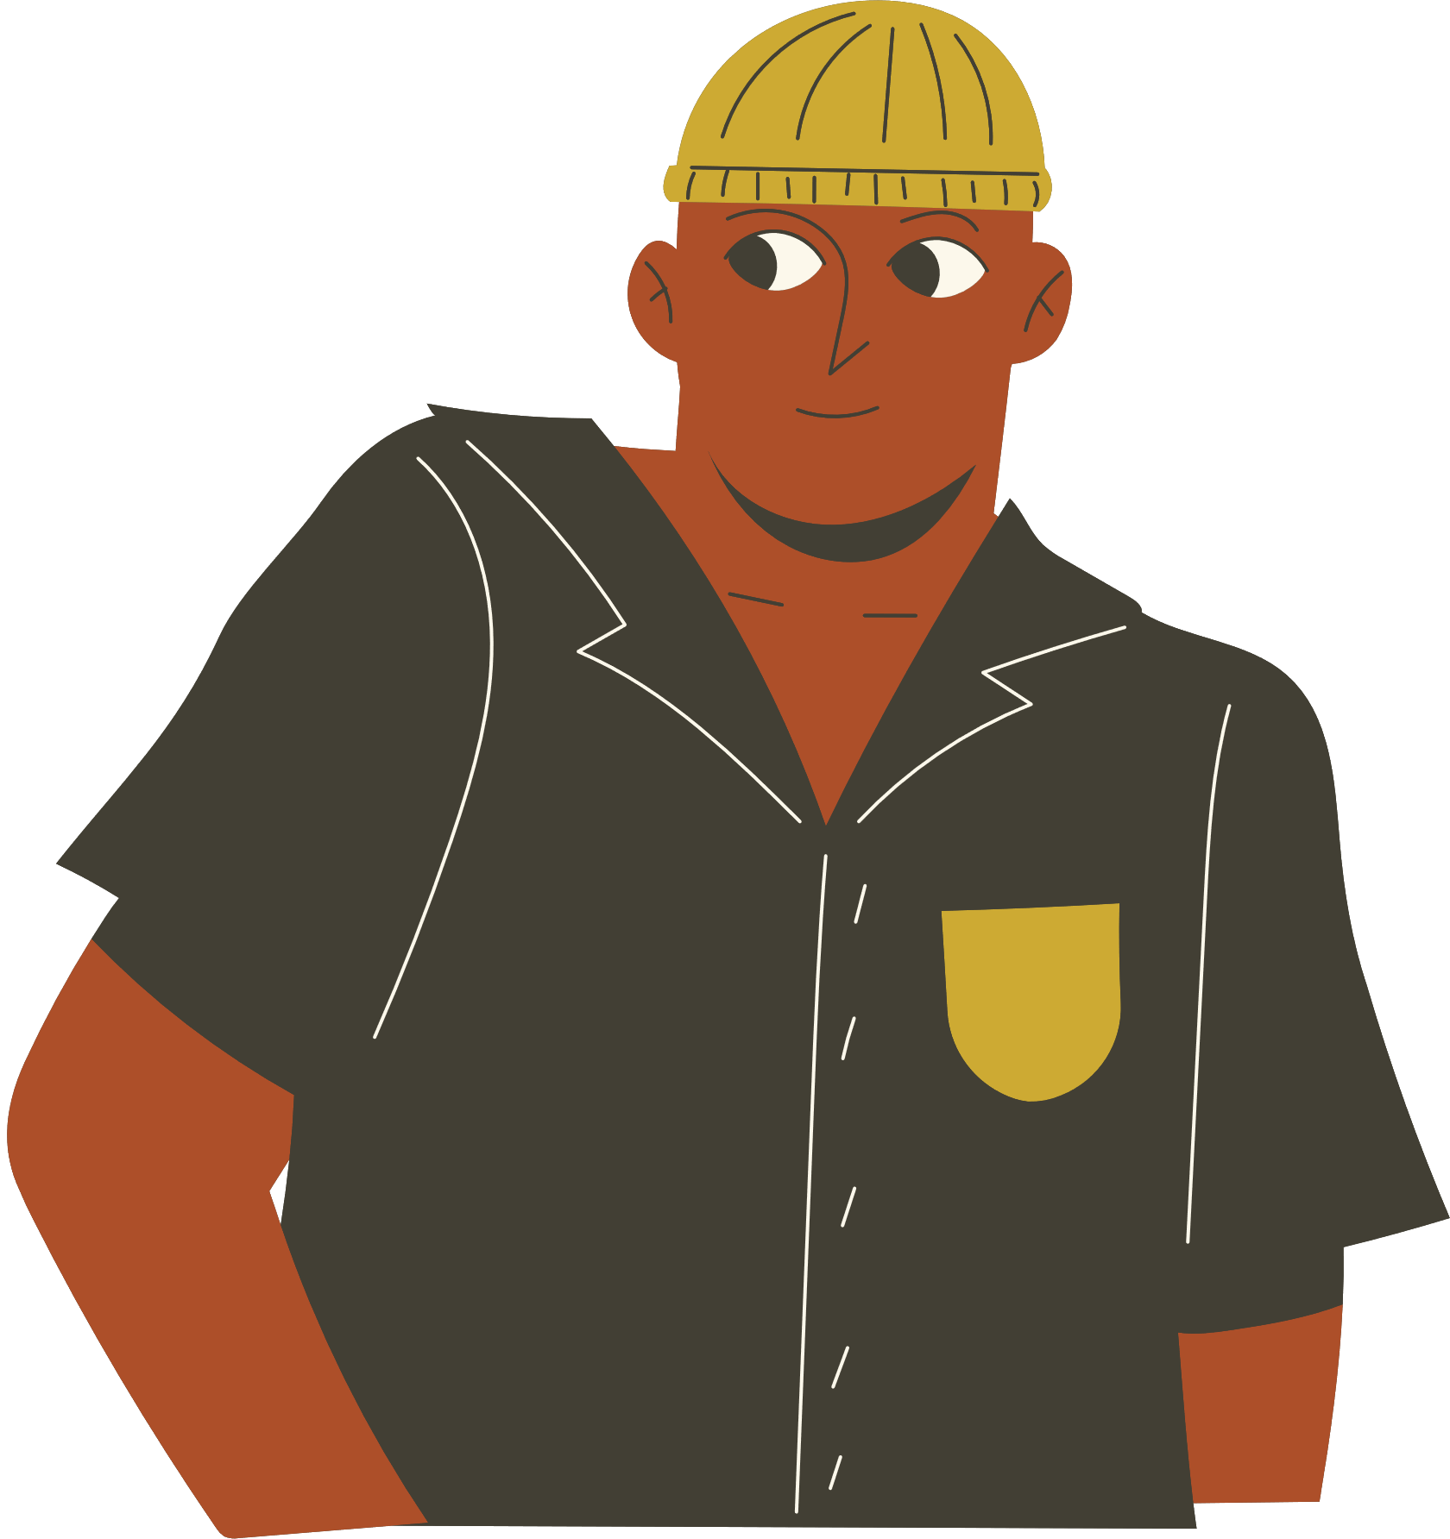
Allyship

Slide 2
Learning Outcomes
01
02
03
What is allyship?
Why is this important to me and my studies?
How to be a good ally whilst enjoying London (& beyond!)

Slide 3
Recap of previous session
Unconscious Bias
Active Bystander
We are all biased
Our brains make thousands of decisions a day…we will slip up
Ways to intervene
The 4 D’s
Notes:
The 4 D's:
Direct action
Delay
Distraction
Delegation

Slide 4
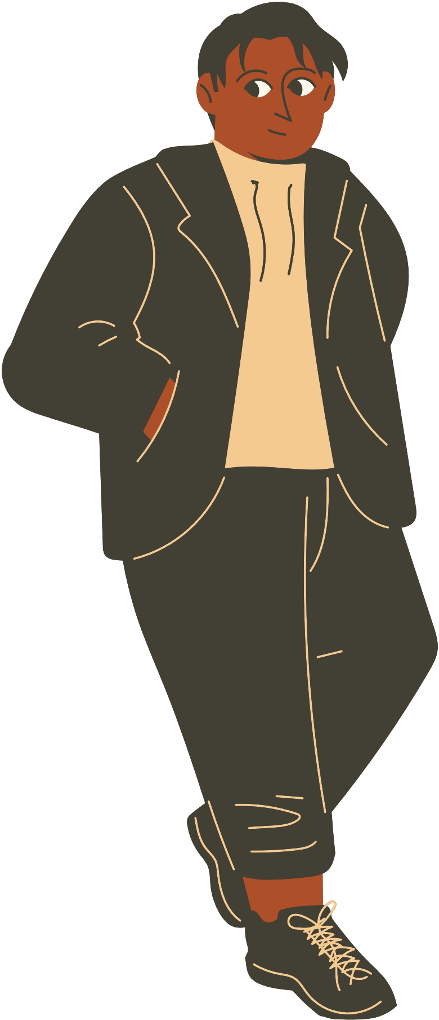
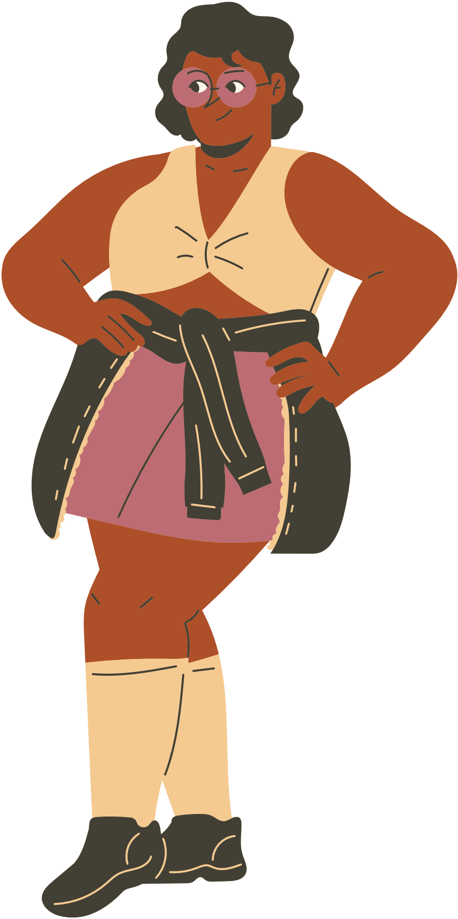
?
?
?
What is allyship?
Notes:
Oxford English Dictionary definition: The state or condition of being or having an ally (in various senses). Now chiefly: spec. the state or condition of being a person who supports the rights of a minority or marginalized group without being a member of it

Slide 5
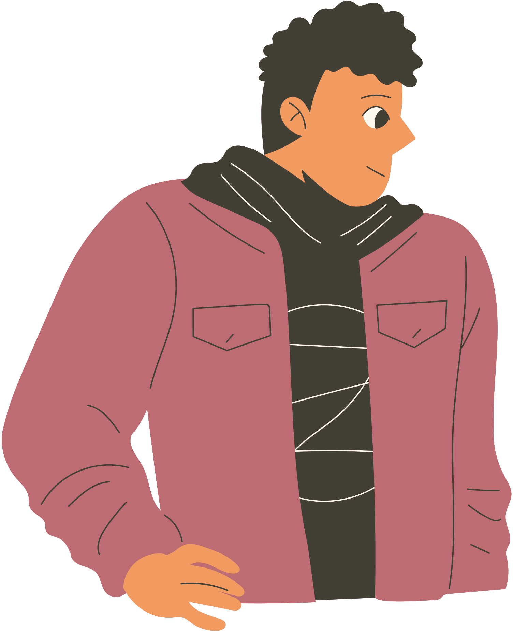
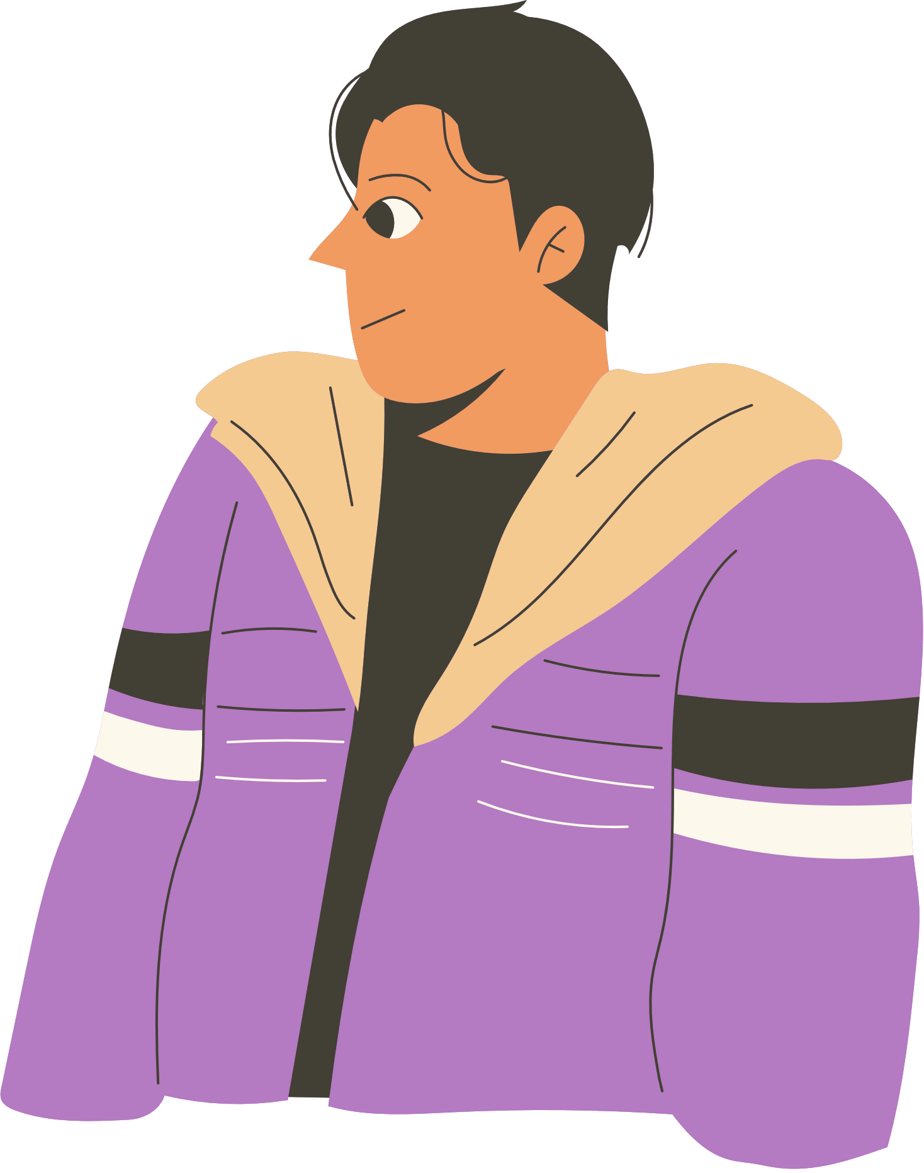
Allyship
  Learning and taking action
  Accepting differences in experience
  Using privilege
  On-going and sustained
Notes:
It’s an ongoing process of learning and taking action
Accept that people from marginalised groups are disproportionately impacted by power imbalances & ‘troublemakers’ if they stand up for themselves.
Use your privilege to support and advocate for people with less privilege
Privilege: unearned advantage from being a part of a dominant group whose needs are prioritised. You may experience privilege because of any protected characteristic.
Identity is complex: privileged in some areas and marginalised in others: white woman can experience privilege because of ethnicity, but disadvantage due to gender.
Allies are not a member of the marginalised group who they are supporting.
Recognise own privileges, want to take action to help that group achieve long term, sustained change.
Actions are not reactive/one-off, but are consistent and maintained.

Slide 6
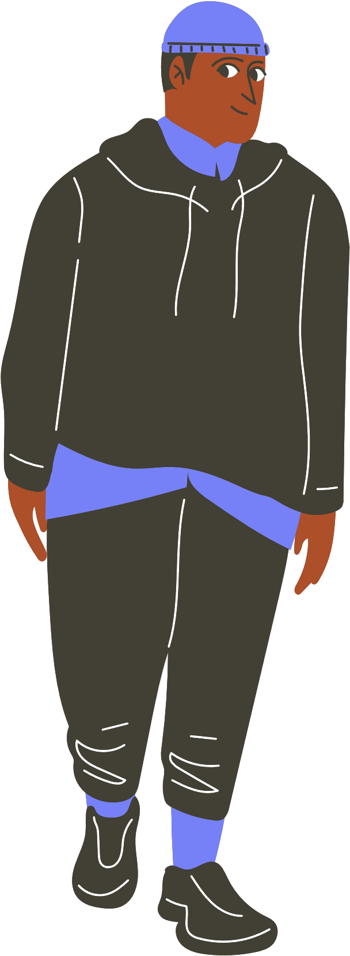
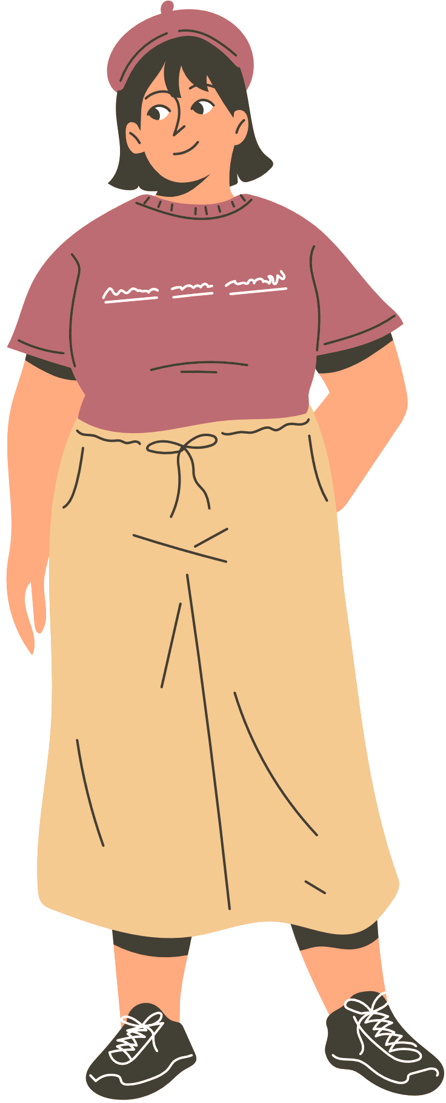
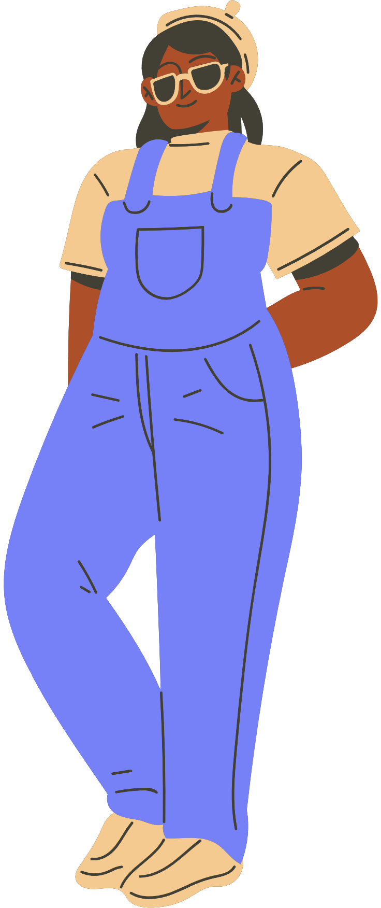
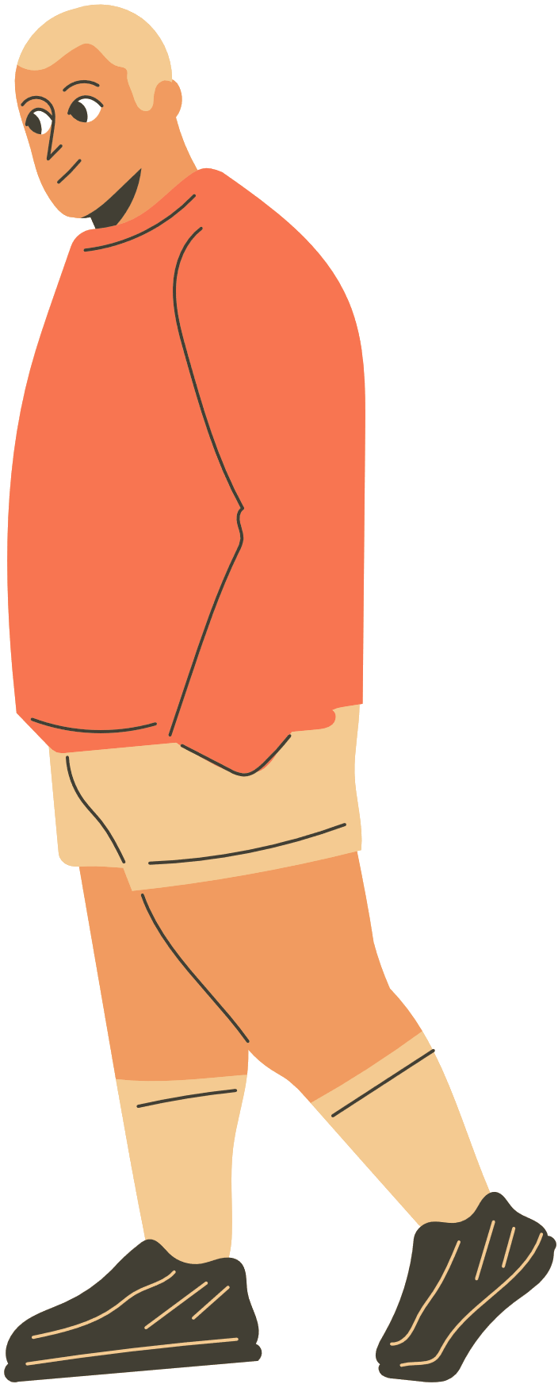

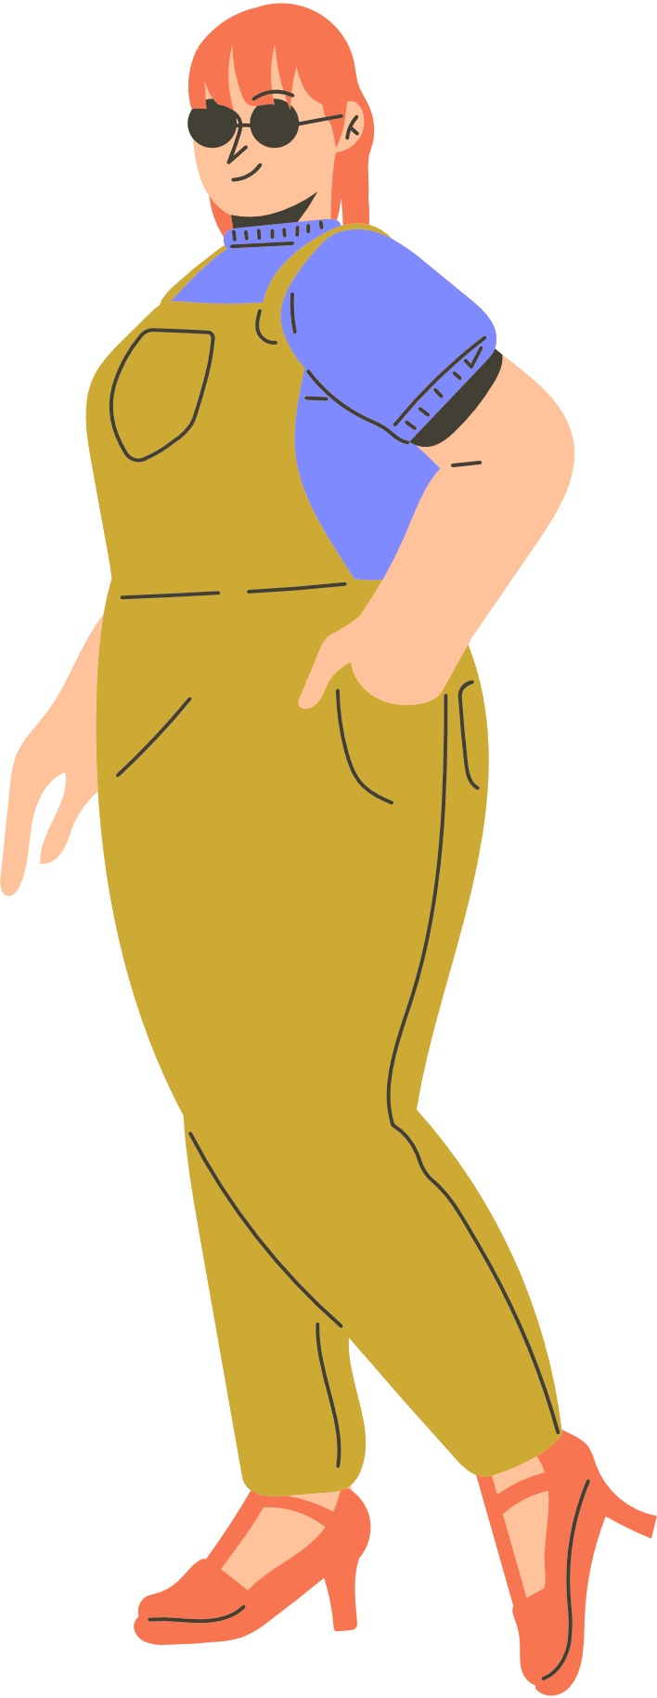
?
?
?
Privilege
Notes:
[Speakers] to list examples of privilege based on their protected characteristics and how one can be more privileged than the other depending on the context

Slide 7
Why?
  Social responsibility: it’s the right thing to do.
  Better diversity: new ideas, new perspectives, speedier problem solving.
  More inclusive research culture: improved sense of belonging, higher productivity.
  Increased innovation: makes us more creative, more diligent and harder-working.
  Attract and keep talented people.
Inclusive workplaces:
Employees of organizations that foster strong allyship and inclusion cultures are 50% less likely to leave, 56% more likely to improve their performance, and up to 167% more likely to recommend their organizations as great places to work. (Harvard Business Review)
Notes:
https://hbr.org/2022/11/7-ways-to-practice-active-allyship
To progress your career, or think out of the box, it's in your best interest to be a good ally and consider diversity
From UB, crash test dummy
Fenty Beauty - diverse shade range when developing makeup
Eric Collins - Marshmallow

Slide 8
What can I do?
?
?
?
Some actions you can take.

Slide 9
Actions
  Listen, actively listen
  Look out for each other
  Do not act for people without them
  Embrace discomfort and learn from mistakes
  Amplify
  Don’t patronize people
  Seek out perspectives different to your own

Slide 10


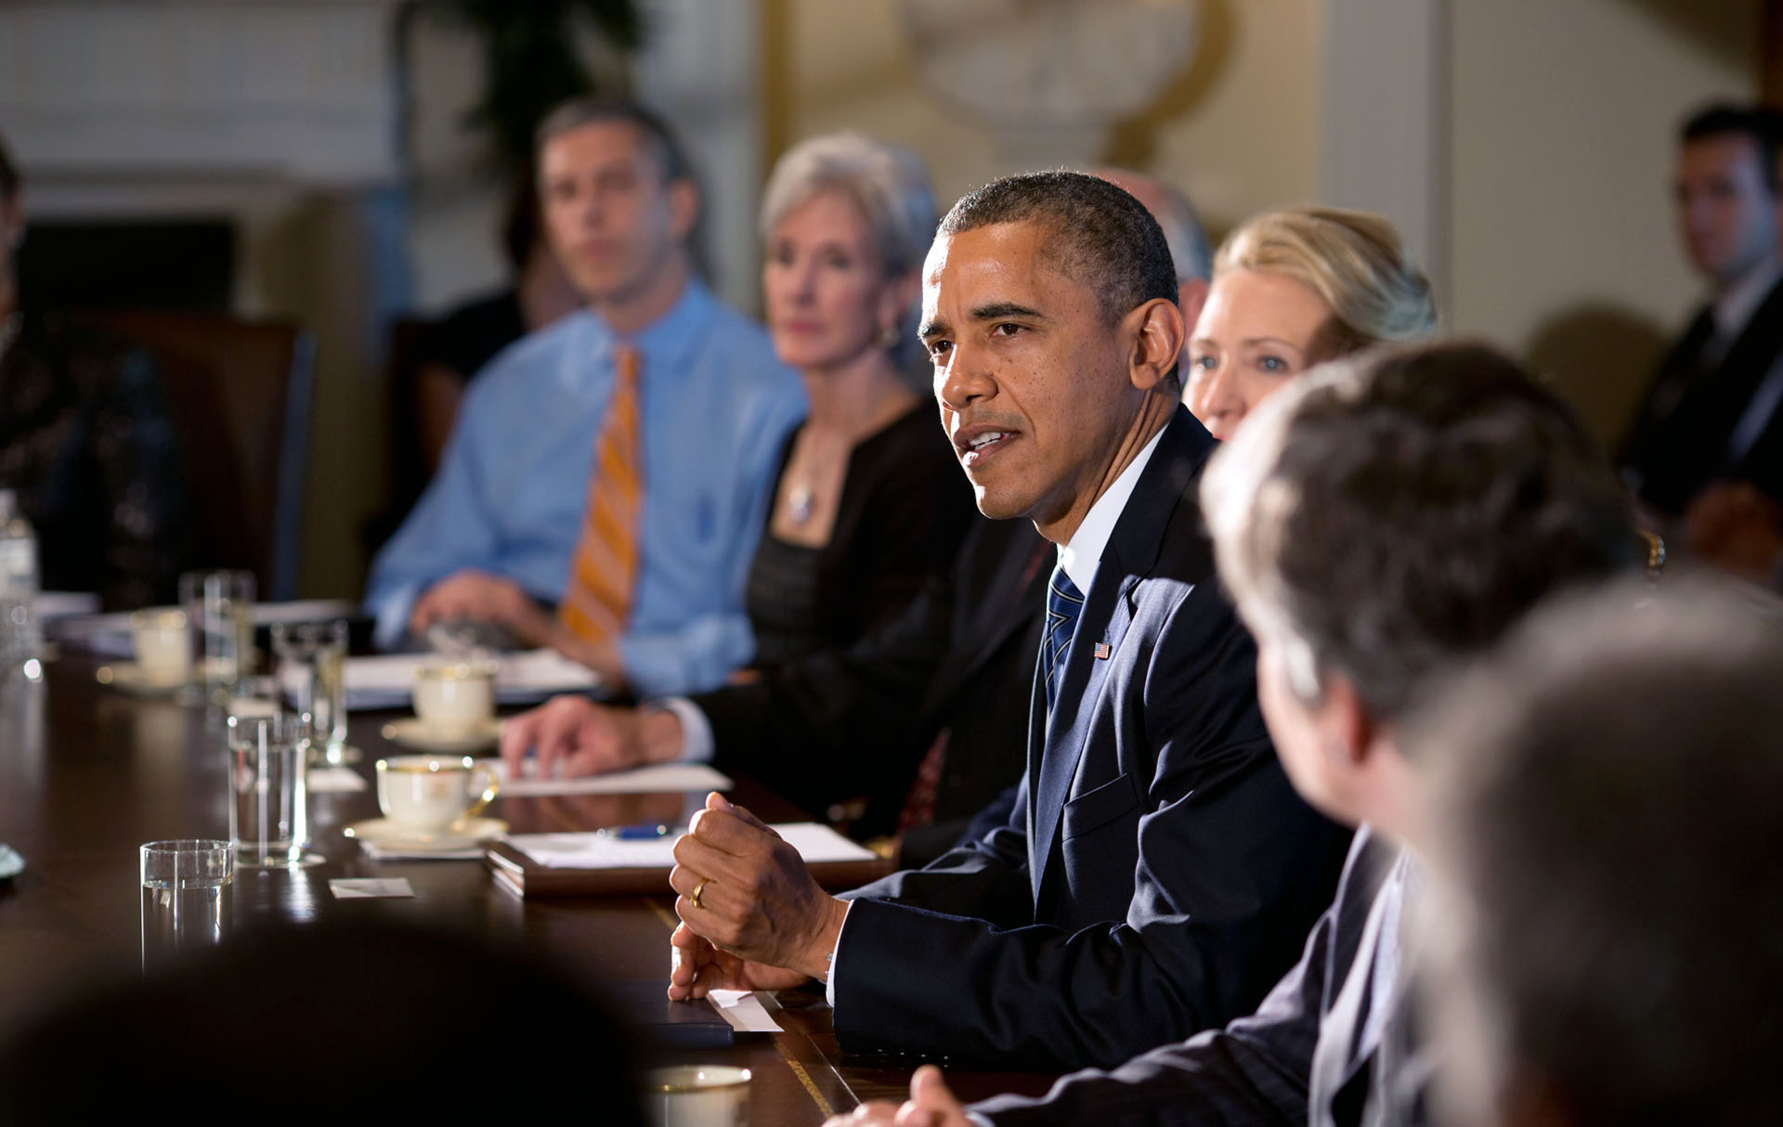
Amplification
“Amplification” strategy:
When a woman made a key point, other women would repeat it, giving credit to its author. This forced the men in the room to recognize the contribution — and denied them the chance to claim the idea as their own.
“We just started doing it, and made a
purpose of doing it. It was an everyday thing,” said one former Obama aide. Obama noticed, she and others said, and began calling more often on women and junior aides.”
Notes:
Discuss the White House example here. The main takeaway is to make sure the person’s idea is credited. Additionally, minoritized voices can be overlooked, ignored and their ideas not credited. Credit people’s work and do not claim something that is not yours.

Slide 11
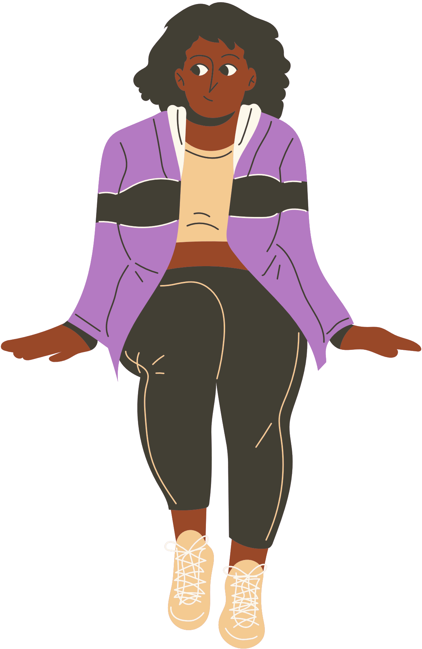
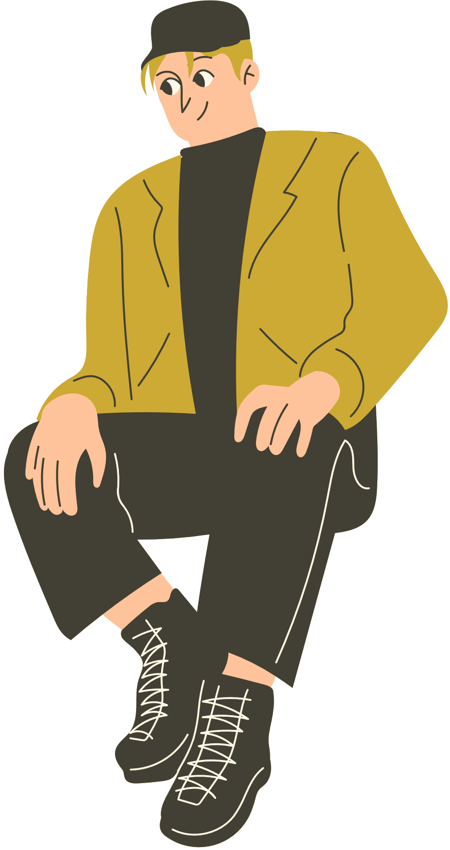
It’s okay to get things wrong, allyship is an active learning process.
Notes:
Humble acknowledgement (from Harvard Business Review article), it's okay to say 'I don't know' but you have to take action to learn and listen.

Slide 12
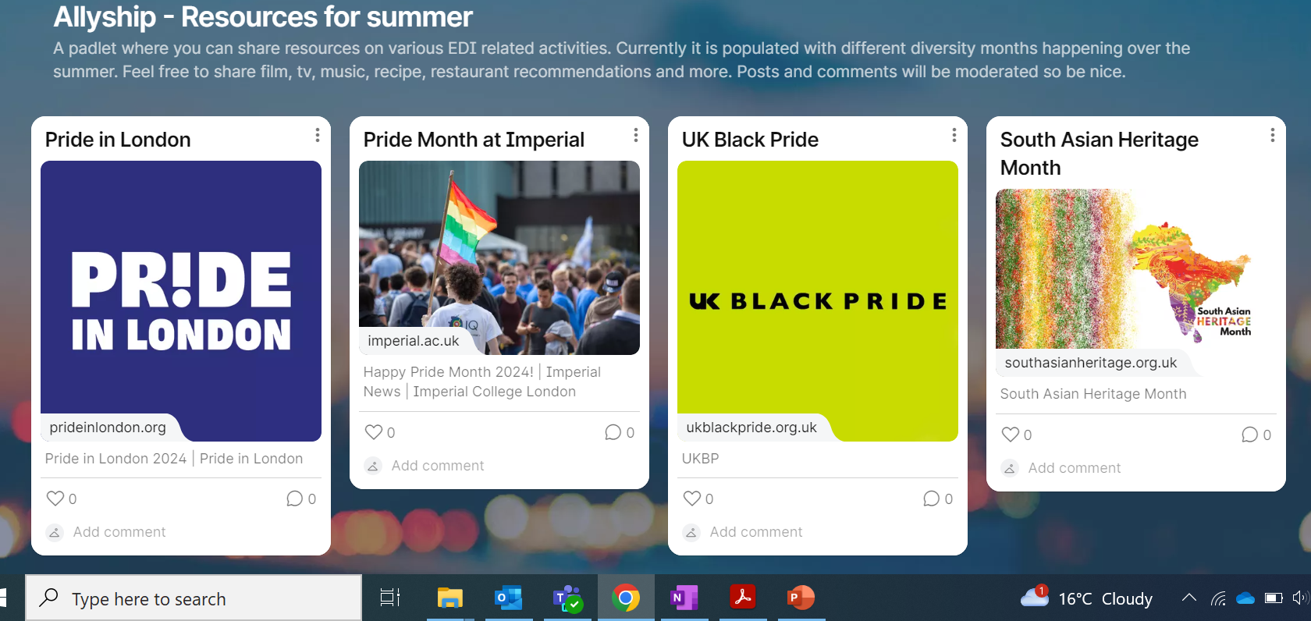
Padlet
Notes:
https://padlet.com/squazi/allyship-resources-for-summer-whedx9teeml797ig

Slide 13

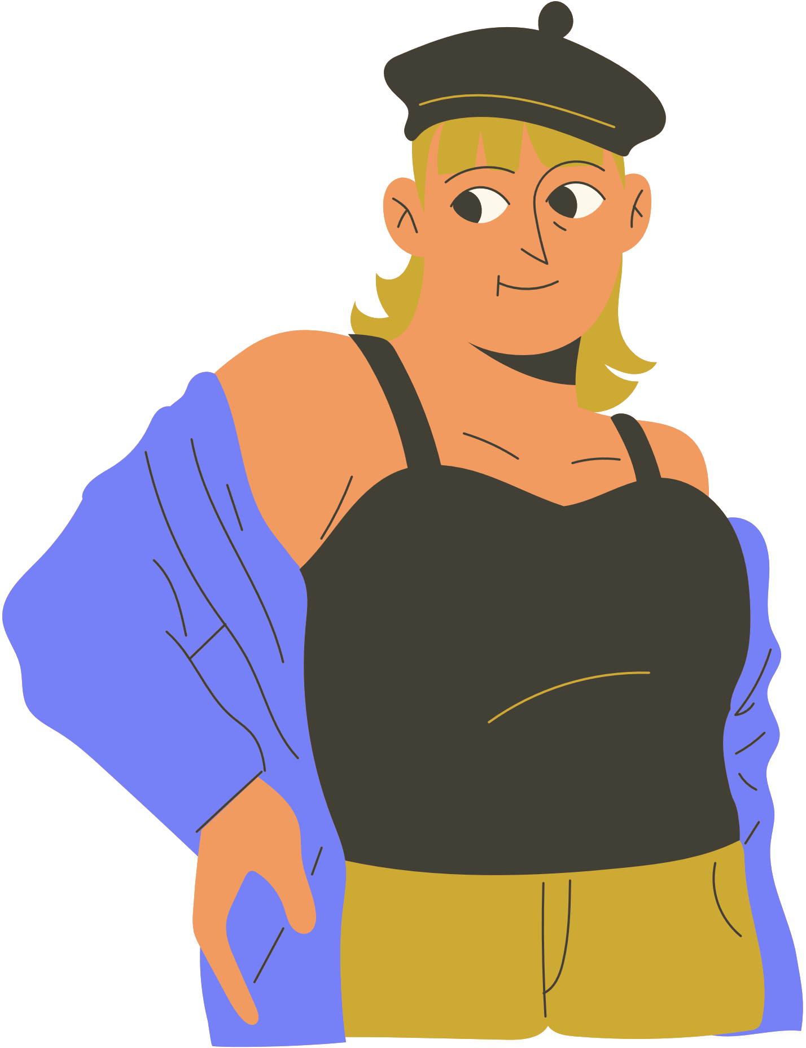
Summary
Allyship is an active process that involves continuously learning
It is okay if you get something wrong, just learn and grow from it
Engage with Padlet to learn something new over the summer

Slide 14
Thank you for listening!

Slide 15
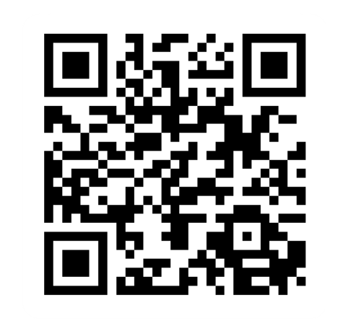
Provide feedback!
https://forms.office.com/e/pHBZpniFvB
If you used this resource, please take the time to fill out this form to provide your feedback.
If you have any questions or require more information about the REET (Resources for Embedding EDI in Teaching) project, please contact the Project Lead using the following contact details:
Chloe Agg c.agg@imperial.ac.uk

Slide 16

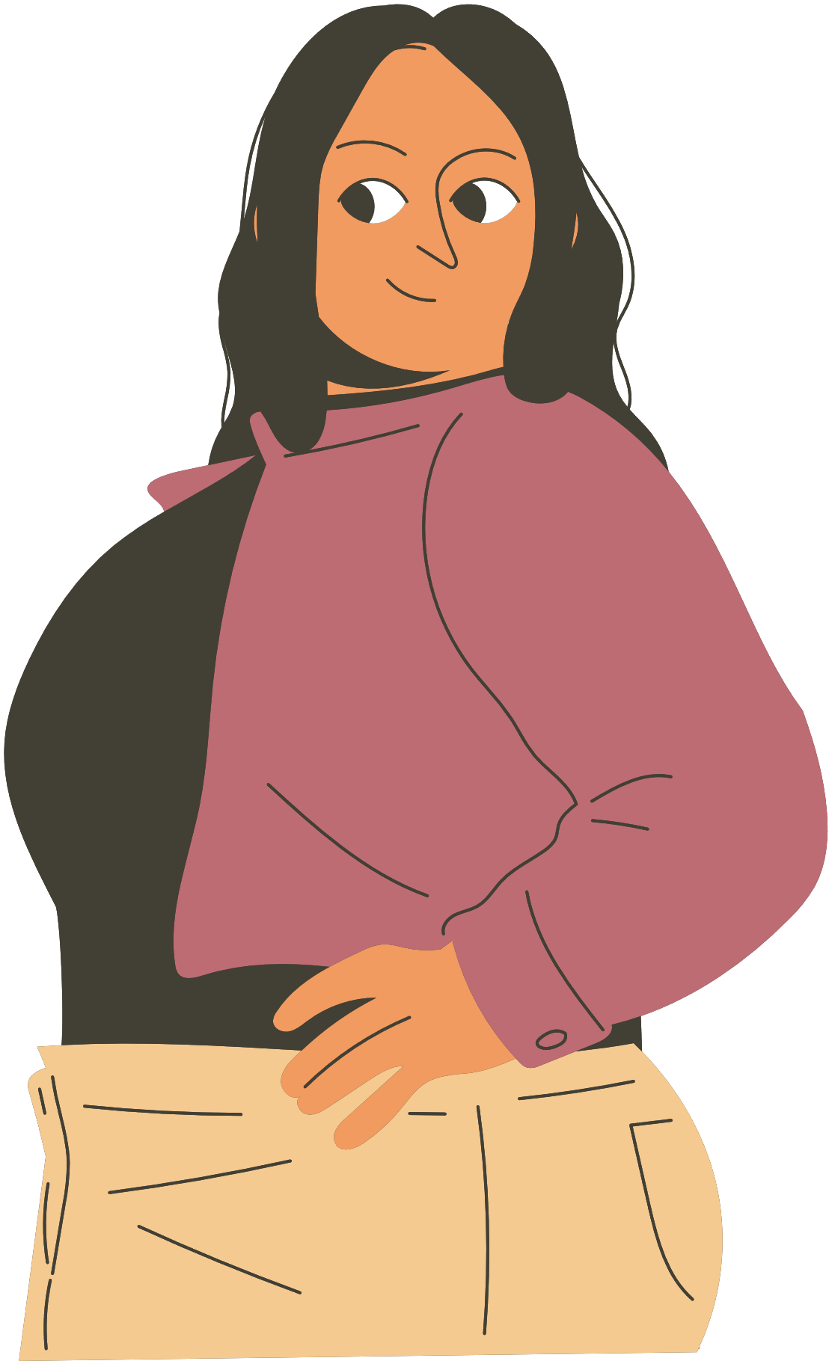

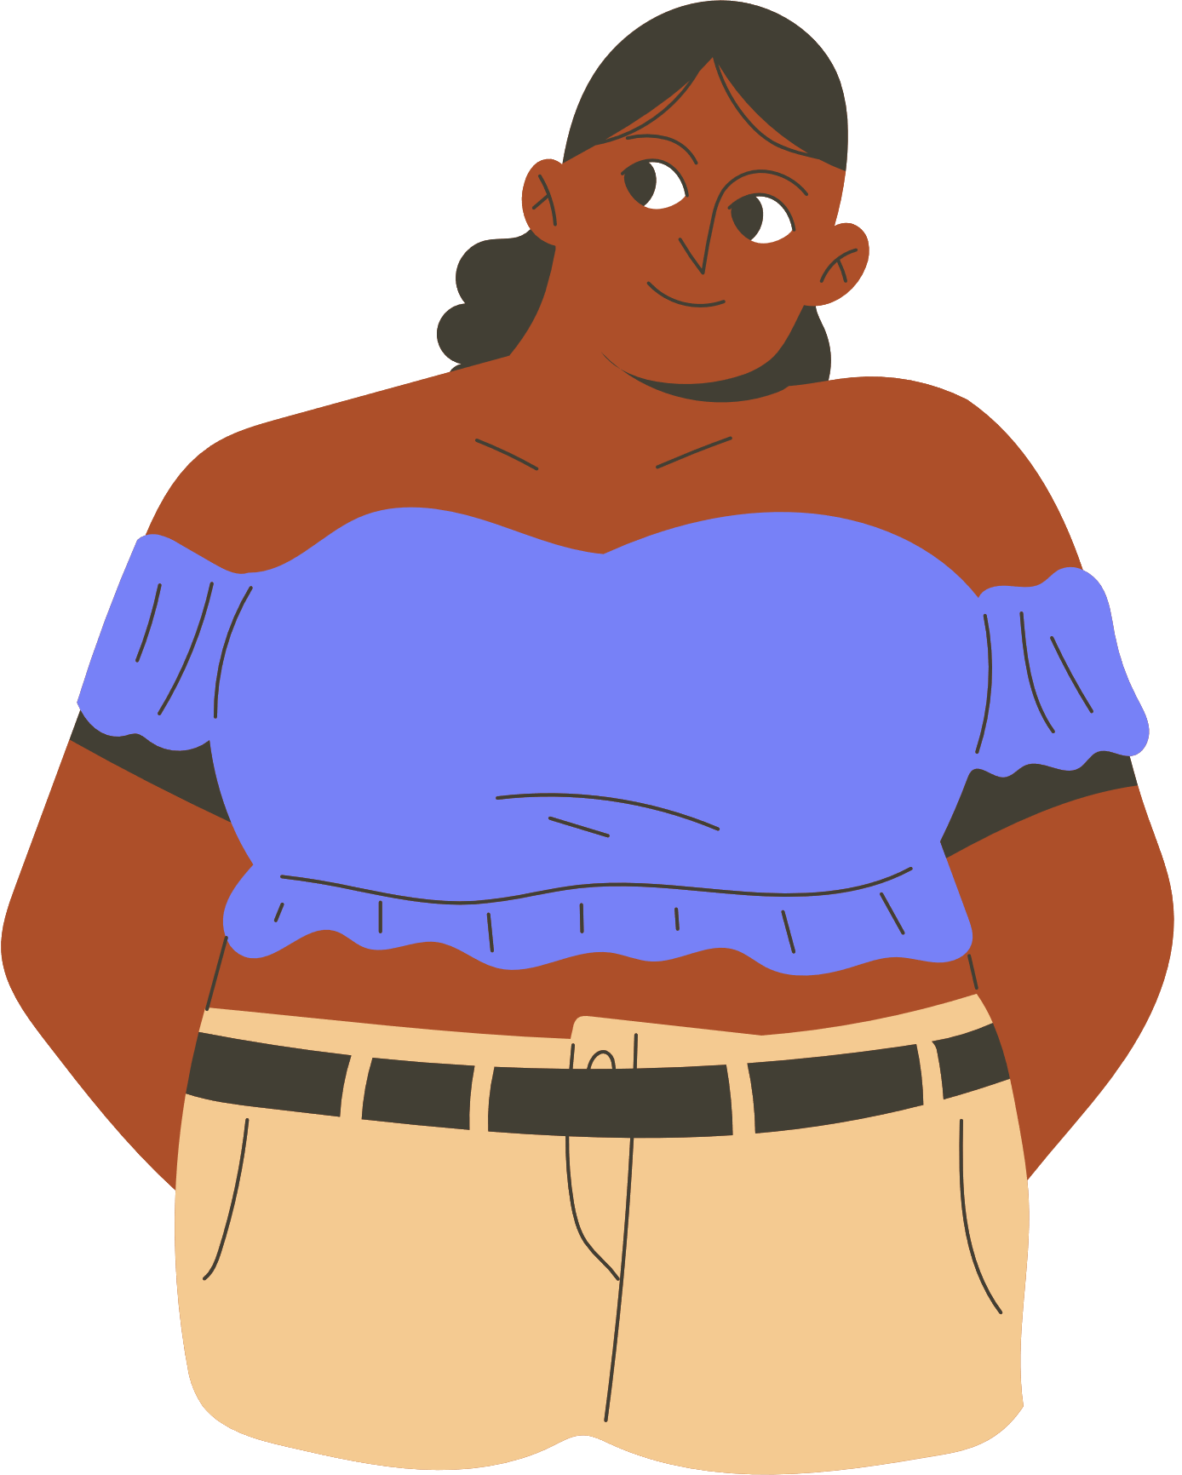


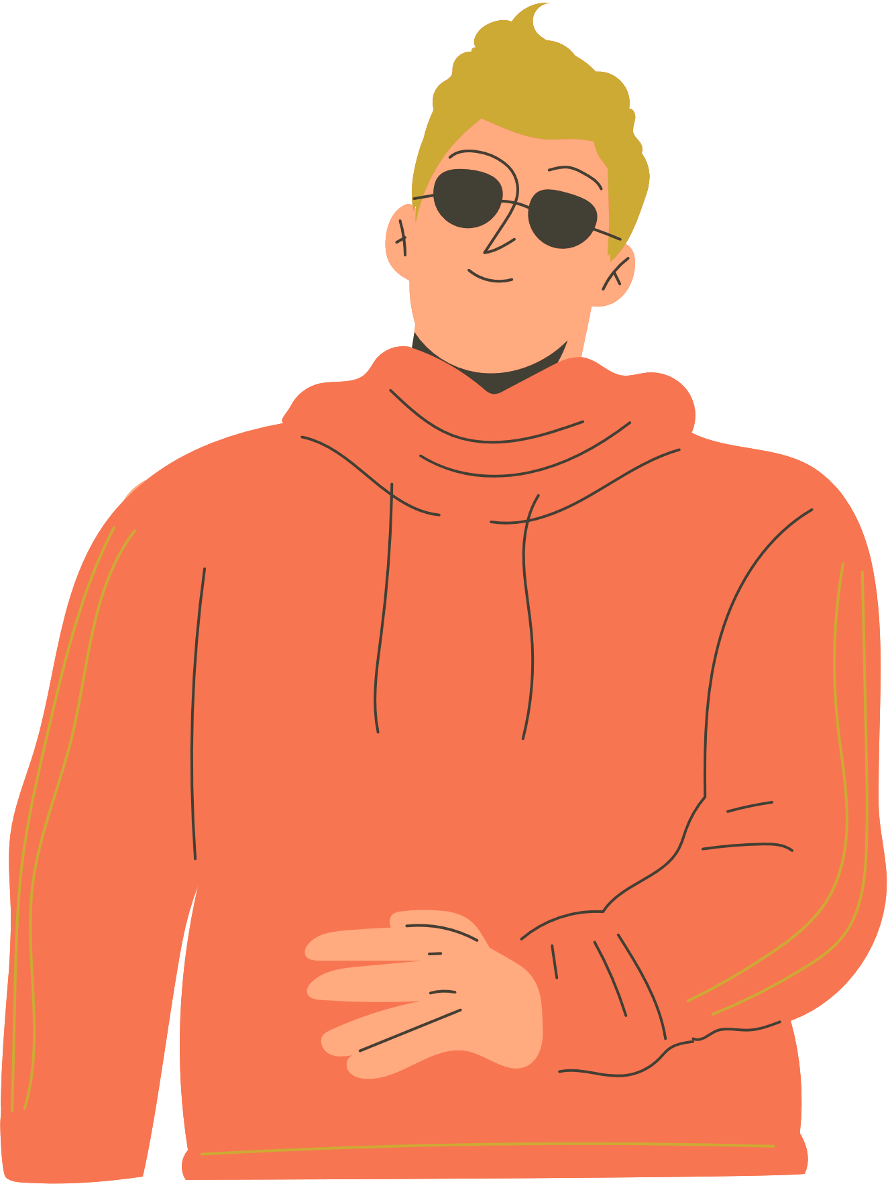

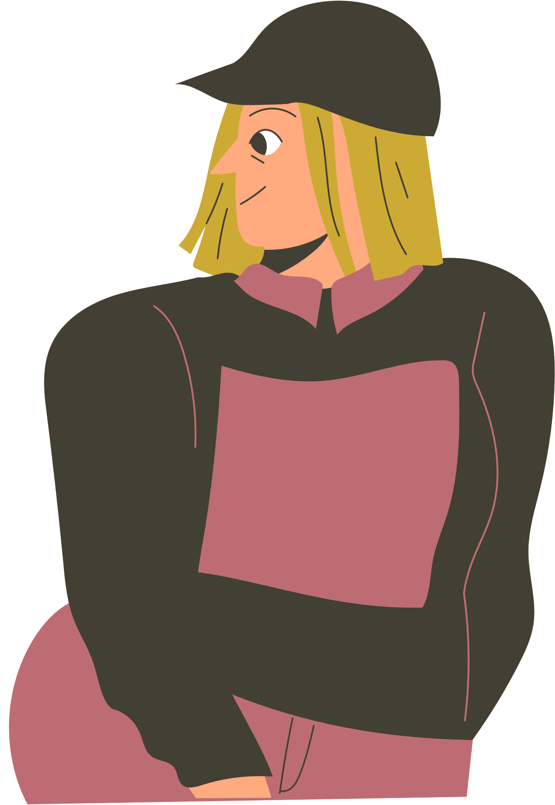



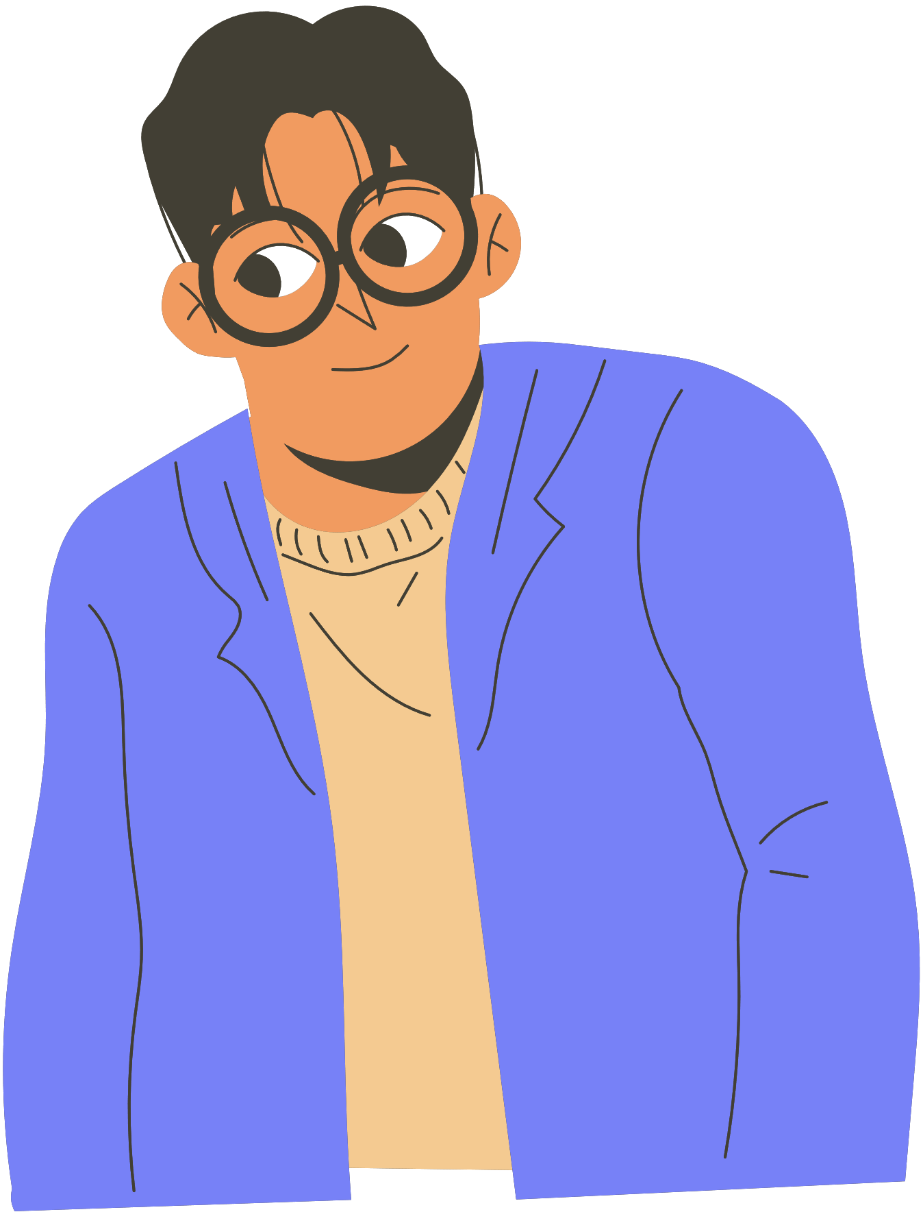
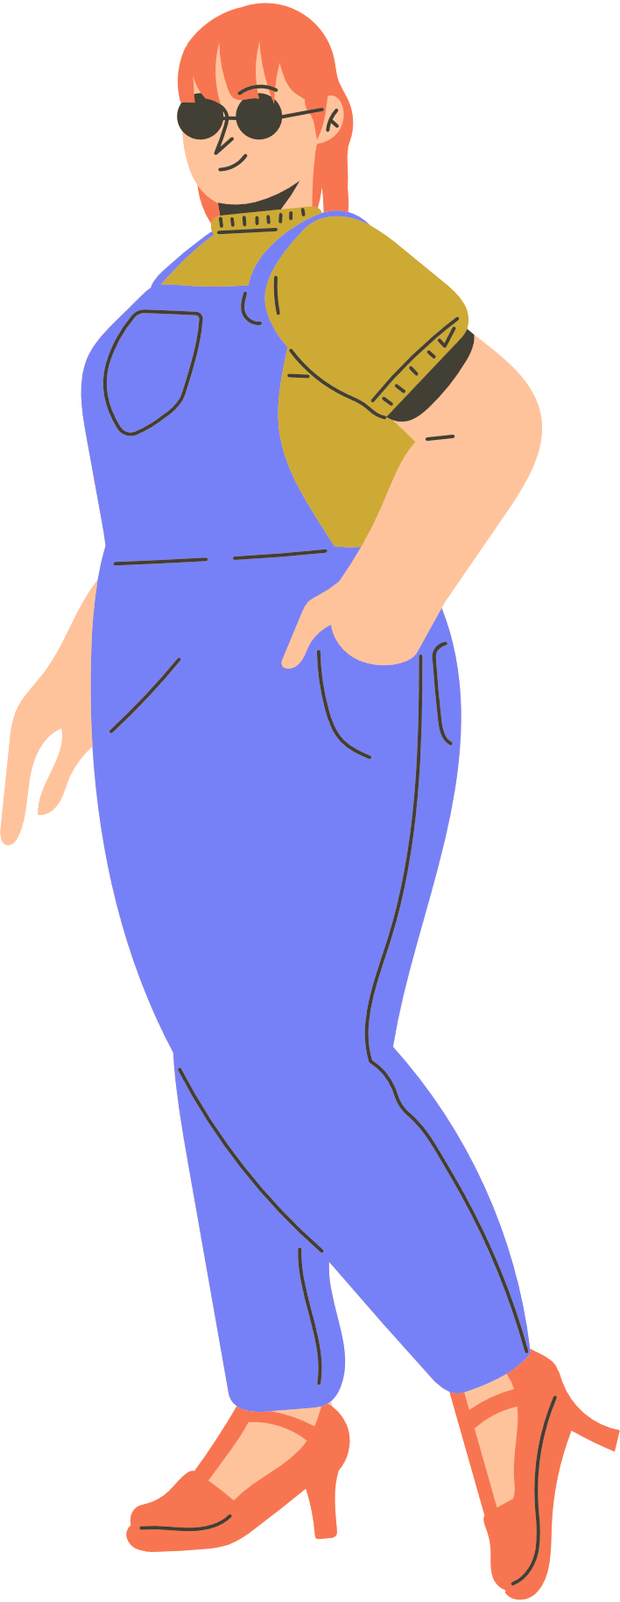
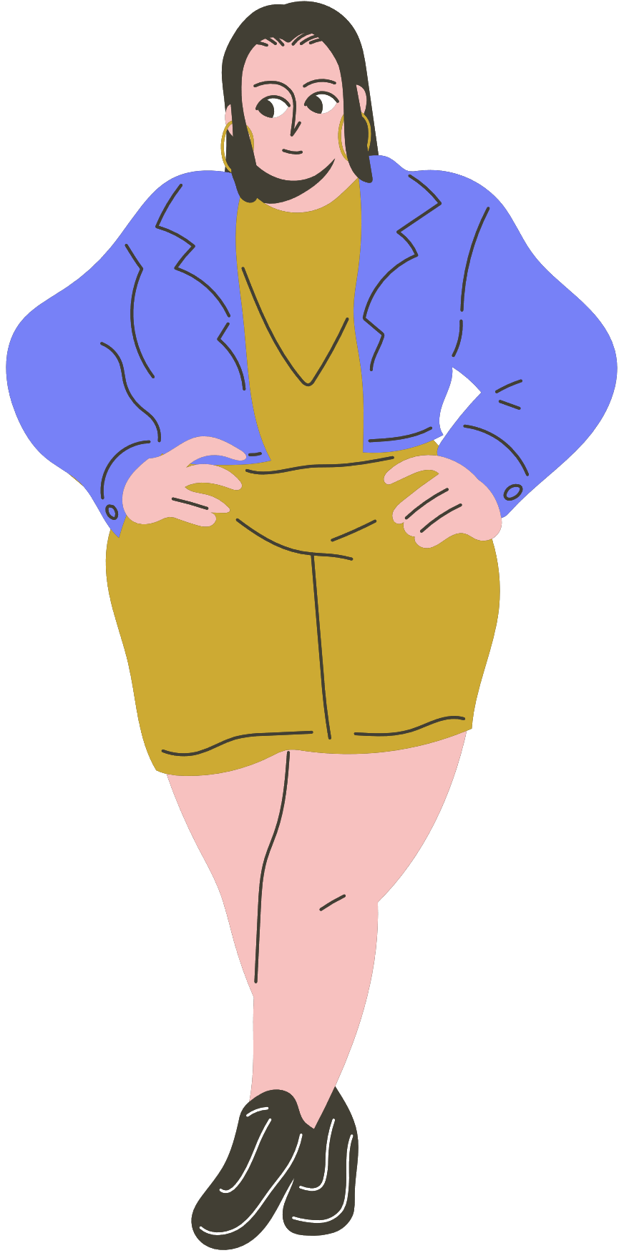
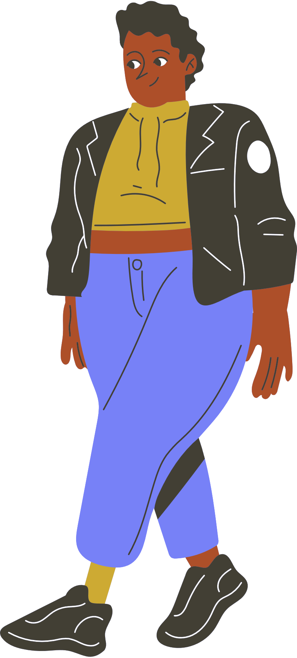
Resource
Page

