Slide 1
Becoming an Active Bystander
[Insert speaker’s names]
DD/MM/YYYY

Slide 2

Learning Objectives
To understand what it means to be an active bystander
To learn how to manage instances of discrimination, bullying and harassment
To know where to go for help

Slide 3

Before we begin…
Be respectful of others
If anyone feels uncomfortable at any time during the session (or afterwards) please let us know
Videos and examples contained in this lecture are for teaching purposes only (and may contain unsettling content)
Questions?
Notes:
If anyone feels uncomfortable during the session, or during any of the videos shown, please let me know. We can take a break, return to the content later or discuss anything in less or further detail.

Slide 4

Understanding what it means to be an active bystander
1
Notes:
In this first section we will cover what it means to be an active bystander

Slide 5

What is a bystander?
Someone who witnesses or is made aware of behaviour, language or situations that are or could be inappropriate or harmful to others.
Notes:
A Bystander is someone who witnesses or is made aware of behaviour, language, or situations that are or could be inappropriate or harmful to others.
In 1964, the New York Times reported on a murder. The murder was that of 28-year-old Kitty Genovese, a resident of Kew Gardens in Queens, who was walking home late one night, from her job as a bar manager when she was attacked and stabbed multiple times. Genovese managed to drag herself into the vestibule of her apartment building only to be re-assaulted by her assailant and ultimately killed. According to an article in The New York Times, 37 residents in Kitty Genovese’s apartment complex saw the attack and did nothing to intervene. The Kitty Genovese case became so famous that it was catalogued in most psychology textbooks and taught in schools. Termed the “Bystander effect,” or “Genovese Syndrome,” textbook authors wrote that there is a diffusion of responsibility and subsequent lack of action when multiple people are present.
The report was ultimately dismissed, with many of the residents claiming they shouted to scare the attacker, called the police, and even ran over to Kitty’s aid. However, the term ‘Bystander effect’ stuck.

Slide 6
What is an active bystander?
Someone who intervenes to stop, assist or constructively address inappropriate or harmful behaviour, language or situations.
Notes:
An active bystander is someone who intervenes to stop, assist or constructively address inappropriate or harmful behaviour, language or situations.

Slide 7

Do you want to be a bystander?
Or an active bystander?
Do you want people to be an active bystander for you?

Slide 8


Slide 9
Why don’t people intervene?
Notes:
As well as fear of retaliation, there are a number of reasons people tend not to get involved.
ASK THE AUDIENCE: Why don’t people tend to intervene when they see or hear something that’s not right?

Slide 10
Why don't students report incidents?
Notes:
As well as fear of retaliation, there are a number of reasons people tend not to get involved.
ASK THE AUDIENCE: Why don’t people tend to intervene when they see or hear something that’s not right?

Slide 11
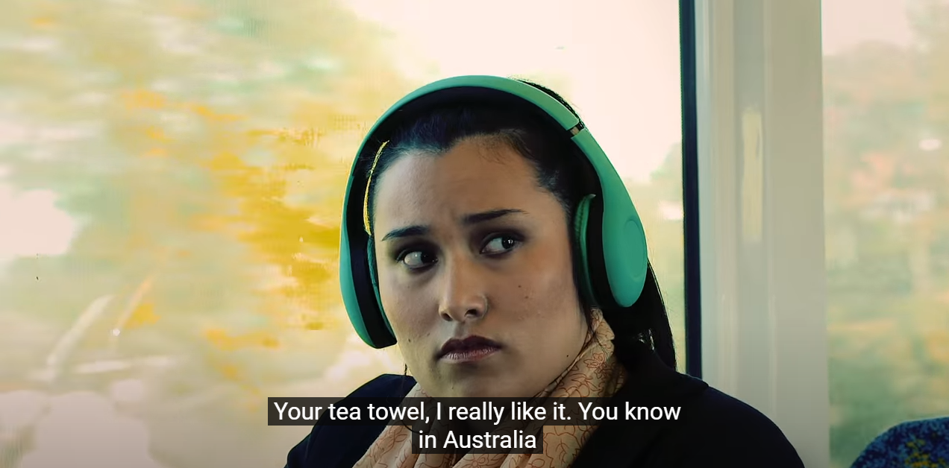
No one else is acting (Social Influence)
Notes:
The more people who witness a catastrophic event, the less likely any one person will do anything because each thinks someone else will take responsibility.
One of the biggest reasons we don’t do anything is because we look around and see that nobody else is doing anything. Therefore, we too choose not to do anything. This can be known as social influence and is one of the things we touched on during the Unconscious Bias lecture last term.
[Speaker] to talk about instances when they haven’t intervened directly when instances happen. Sometimes we are scared, or younger and inexperienced.
How many times have you seen a clip on social media where multiple people are filming but not intervening.

Slide 12
No one else is acting (Social Influence)
Does the person really need help? (Ambiguity)
Someone else will help (Diffusion of Responsibility)
What if I’m wrong? (Audience inhibition)
I’d be putting myself in danger (Fear of outcome)
Notes:
A lot of the time people don’t intervene as they don’t want the attention to shift on to them (like we saw in the video on the bus earlier)
Other reasons people may not intervene [READ FROM SLIDE]

Slide 13

Change starts with YOU
Notes:
It is important that we do act, even if it is not immediately.
Usually, one person acting makes others join in (just like we saw with the social influence study in the lift)
By acting, you can start that domino effect and bring about positive change.
But how do we know when it is safe to act? [NEXT SLIDE]

Slide 14

Before stepping in, check your ABC’s
Assess for safety: If you see someone in trouble, ask yourself if you can help safely in any way. Remember, your personal safety is a priority – never put yourself at risk.
Be in a group: It’s safer to call out behaviour or intervene in a group. If this is not an option, report it to others who can act.
Care for the victim: Talk to the person who you think may need help. Ask them if they are OK.
Never put yourself in danger – only intervene if safe to do so.
Notes:
Being an active bystander isn’t about getting violent.
When bystanders are worried about their own safety, or physically incapable of intervening, they might choose to act by going to get help or calling the police. Some have hypothesized that bystanders’ filming might even be an attempt at intervention. “They may be trying to help in videotaping it because it may be helpful in the prosecution of the crime later on,”

Slide 15
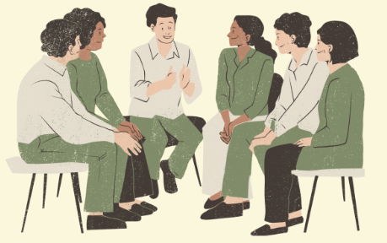
Learning how to manage instances of discrimination, bullying and harassment
2
Notes:
So, you have taken the ABC approach and it s safe to intervene – but how do you do it?
This brings us on to our second learning objective for this training session: Learning how to manage instances of discrimination, bullying and harassment

Slide 16
When to be an active bystander: what are unacceptable behaviours?
Unacceptable behaviour may be overt and direct, subtle and more hidden, can be individual incidents or ongoing behaviour.
It may be related to a protected characteristic such as age, disability, race, sex, gender identity or sexual orientation (Equality Act 2010).
Multiple incidents of seemingly minor ‘micro-aggressions’ can have a significant impact on an individual’s confidence and ability to work or study productively.
Notes:
[READ QUESTION AND BULLET POINTS ON SLIDE]
The next slide shows a video example from the 2017 film Wonder, of one of the characters using microaggressions

Slide 17

Microaggressions
Notes:
[Speaker] to describe their instances of microaggression, giving examples, and have a discussion
[PLAY FULL VIDEO]
There is a useful video in the Faculty of Engineering website with more information about different types of microaggressions: https://www.imperial.ac.uk/engineering/staff/human-resources/microaggressions/

Slide 18

What behaviours do you think are unacceptable?
Discuss with the person next to you.
Feedback to the group

Slide 19

Unacceptable Behaviours
Bullying and harassment
Micro-inequities/Micro-aggressions/Micro-assaults
Singling people out or overlooking them constantly
Interrupting a person mid-sentence constantly
Taking more questions from men than women
Rolling eyes when people are talking and sighing loudly
Being rude, mean, inconsiderate or threatening
Swearing or using inappropriate language
Disrespectful or derogatory comments about others
Raising voices in anger and frustration, or losing temper
Consistently ignoring someone for no reason
Spreading rumours
Notes:
Microaggressions: Small events which are hard to prove, often unintentional and frequently unrecognised by the perpetrator and occurs wherever people are perceived to be different (race/gender, etc.).
[Remind students of unacceptable behaviours to look out for as cues for when to act (read from the slide)]
If you experience anything like the behaviours listed here, take your cue and intervene in one of four ways [next slide]

Slide 20
Strategies for Intervention: The 4 D’s
Direct action
Directly intervene, for example, by asking the person to stop. Immediately act or call out negative behaviour, explaining why it is not ok.
Delay
Wait for the situation to pass and check in with the individual. Then take action later
– it’s never too late!
D
D
Distraction
Indirectly intervene, de-escalating by interrupting or changing the subject. Useful where the direct approach may be harmful to the target or bystander
Delegation
Inform a member of staff, student rep, your head of department, senior tutor, or personal tutor, for example.
D
D
Notes:
Direct Action:
Body language: Frowning and raising (not pointing!) one index finger shows disapproval. If you’re sitting down, stand up.
Use the offender’s name: Say their first name (or however you could normally address them) before you make your point/call out the event.
Ask questions to gain assertiveness: ‘Can I just check - do you consider that behaviour to be appropriate? I’m afraid I don’t - so can we talk about that please?’
Say what you’re going to say. For example, ‘there are two/three things which strike me here. Firstly ...secondly... (etc).’ This sets up a sequence and gets you permission to speak without interruption until you’ve made all your points. It commands attention and puts you in a position of authority in other people’s minds.
Distraction –draw attention away to something else.
Delay:
If you decide to do something about an offending situation - but not quite yet - it’s important that you reassure the target that you have good intentions, and the reasons for delay.
The most important thing they need from you at this point is your support, and the knowledge that you are on their side. You can show them this immediately, even if your intervention can’t happen straight away.
Delegation:
Inform a member of staff, student rep, your head of department, senior tutor, or personal tutor, for example

Slide 21
Questions?
Notes:
Are there any questions so far?

Slide 22


Scenario 1
Tyrone is a second-year undergraduate student in your group project team. Your group uses WhatsApp to arrange meetings and share progress.
Recently, Tyrone shared with you all that he is trans and used to identify as a woman before coming to university. Since then, two other students in your group have been posting inappropriate memes and asking Tyrone intrusive questions about his gender and sexuality in the WhatsApp chat. It is making everyone uncomfortable.
What do you do?
Notes:
[Read scenario to group, then split up into groups of 2-3 students to discuss and come up with a way to intervene using the four D’s]

Slide 23
Scenario 2
You are in the junior common room with your friends and a group of students nearby start making racist comments to one of your friends that’s sitting with you.
You’re all trying your best to ignore the comments, but you see that your friend is upset.
What do you do?
Notes:
[Read scenario to group, then split up into groups of 2-3 students to discuss and come up with a way to intervene using the four D’s]
Possible solutions:
You could tell the group making the comments to stop their sexually harassing behaviour or ask them to imagine how they’d feel if someone made that comment about one of their family members or someone else that they cared about.
You could ask your friend if they want to leave and talk to a teacher or counsellor.
Whatever you choose in the moment, you should tell an authority figure about the harassment and ask them to intervene. While it’s not physical violence, these types of harassing behaviours help foster an environment that condones domestic and sexual violence in our society.

Slide 24
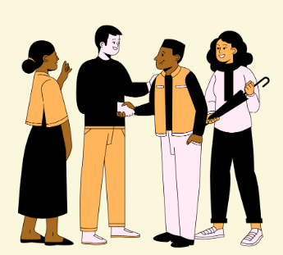
Groupwork strategies
Have a discussion at the beginning on boundaries and methods of communication
Be mindful of different lived experiences
Keep it professional
Check in with groupmates regularly
If there are problems you don’t feel confident in addressing, reach out to tutor or staff member
Notes:
Potential examples, some students might prefer online meetings because they commute really far
Senses of humour can differ

Slide 25
Two simple strategies
Ask "Can you repeat that?" / "What do you mean?"
      Non-confrontational
      Opportunity to rethink
      Benefit of the doubt
Checking in with the victim
      Safe for you
      Provides reassurance and validation

Slide 26

Knowing where to go for help
3
Notes:
It may be that you’re not quite ready, or you have exhausted all options. Or it may be that the person who is being inappropriate is your supervisor, lecturer or tutor, or simply someone with a closed mindset who no matter how much you call them out on things will never change…

Slide 27
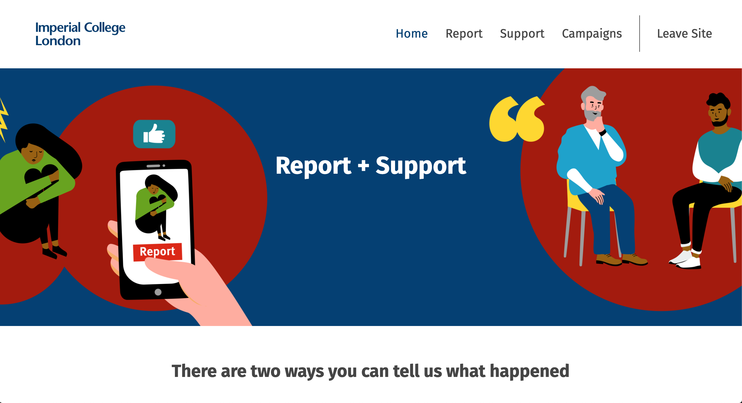


https://report-and-support.imperial.ac.uk/
Notes:
Some behaviours are not welcome or acceptable. Imperial College will support you if you experience bullying, harassment, sexual misconduct or violence, or discrimination.
Report and Support is Imperial’s online tool for you to disclose any experiences of this behaviour at the College.
Using the tool, you can report any incidences quickly and confidentially, and your case will be managed sensitively.
You can disclose anonymously, or you can provide your name.
If you provide your name when you make a disclosure, you will be offered confidential support from a trained members of staff.

Slide 28
What if I want to speak with someone directly?
[Insert names and roles of harassment support contacts]
Notes:
The college has a number of trained harassment support contacts who can listen and signpost you to relevant specialist support.

Slide 29

Learning Objectives
To understand what it means to be an active bystander
To learn how to manage instances of discrimination, bullying and harassment
To know where to go for help
Notes:
Summarise session, recapping the key learning objectives

Slide 30
Attendance Record
Enter your CID
Don’t get requested to attend a repeat!
[insert link to menti meter]
Menti Code: [insert menti number]
[insert QR Code to menti meter]

Slide 31
Thanks for listening!
[Insert speaker’s names]
[insert contact details]
DD/MM/YYYY
Notes:
[FOLLOW UP SESSION BY EMAIL, SENDING OUT SUPPORT MATERIALS (see other/attached resources)]

Slide 32
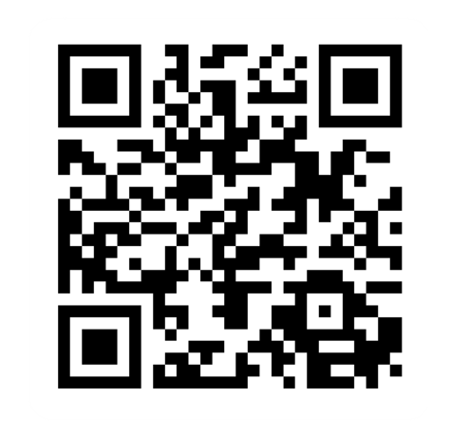
Provide feedback!
https://forms.office.com/e/pHBZpniFvB
If you used this resource, please take the time to fill out this form to provide your feedback.
If you have any questions or require more information about the REET (Resources for Embedding EDI in Teaching) project, please contact the Project Lead using the following contact details:
Chloe Agg c.agg@imperial.ac.uk

