Slide 1

AI and assessment:
lessons from secondary (computing) education
Some images courtesy of Dall-E
Peter Kemp, KCL
Notes:
https://www.imperial.ac.uk/staff/educational-development/networks-and-events/festival-of-learning-and-teaching-2023/tuesday-16-may-2023/
"What a child is able to do in collaboration today, he will be able to do independently tomorrow."
Why study what has happened in schools
Assessments validity versus reliability
Switch towards knowledge based curriculum
Coursework in schools
The Computing reform
Current computing assessment models

Slide 2
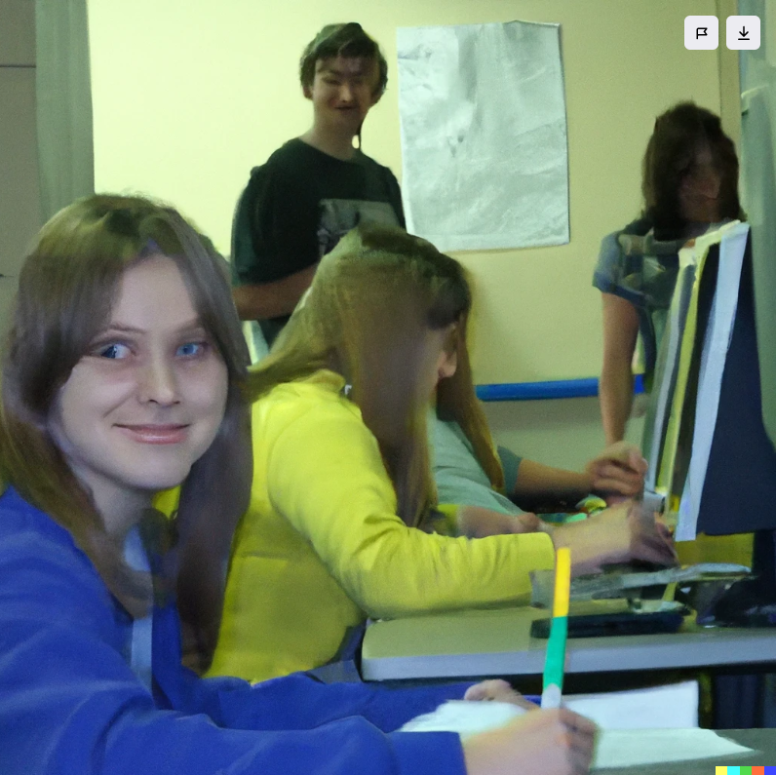
Why is the assessment story from schools important?
Some background about the education system your students are coming from
Parallels with AI
The debates behind assessment at this level and the (mistakes|successes)
How AI might change things

Slide 3
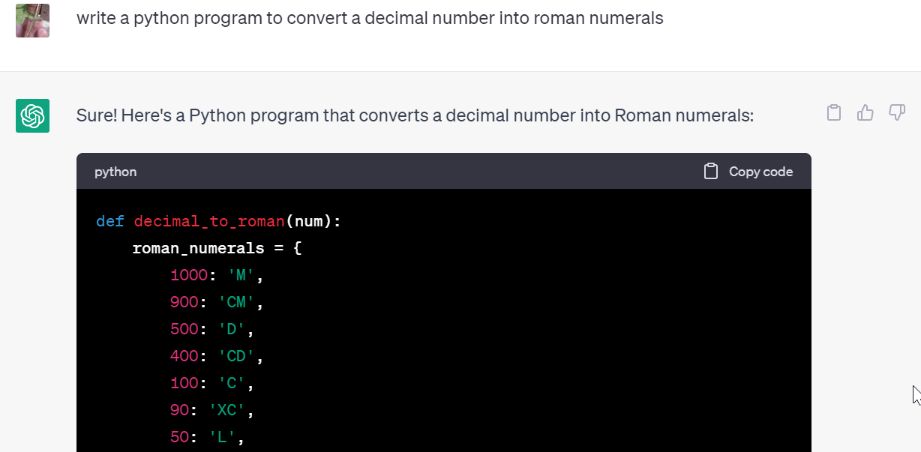
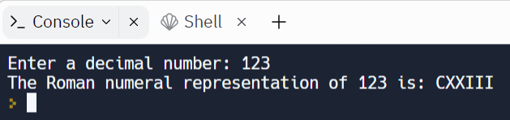

Slide 4
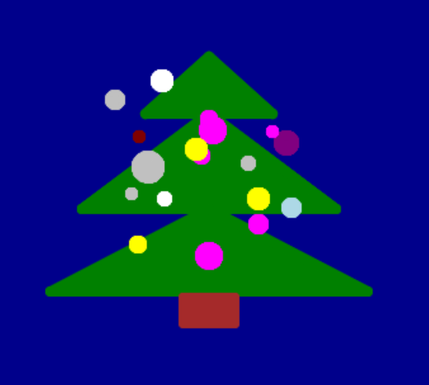
Notes:
https://trinket.io/python/00a65d745b

Slide 5
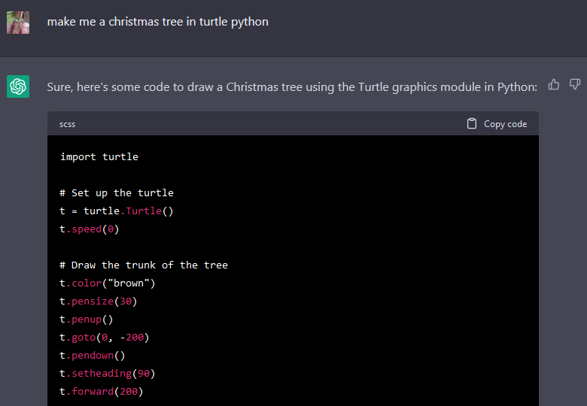
Notes:
import turtle
# Set up the turtle
t = turtle.Turtle()
t.speed(0)
# Draw the trunk of the tree
t.color("brown")
t.pensize(30)
t.penup()
t.goto(0, -200)
t.pendown()
t.setheading(90)
t.forward(200)
# Draw the green part of the tree
t.color("green")
t.pensize(1)
t.penup()
t.goto(0, -100)
t.pendown()
# Draw the branches of the tree using a loop
levels = 7
size = 180
for i in range(levels):
t.begin_fill()
t.circle(size, 90)
t.right(90)
t.forward(30)
t.right(180)
t.forward(30)
t.right(90)
t.circle(-size, 90)
t.left(90)
size -= 20
t.end_fill()
# Draw the star on top of the tree
t.penup()
t.goto(0, 100)
t.pendown()
t.color("yellow")
t.begin_fill()
for i in range(5):
t.forward(50)
t.right(144)
t.end_fill()
# Hide the turtle
t.hideturtle()
# https://www.pythonsandbox.com/turtle
# Display the tree
turtle.done()

Slide 6
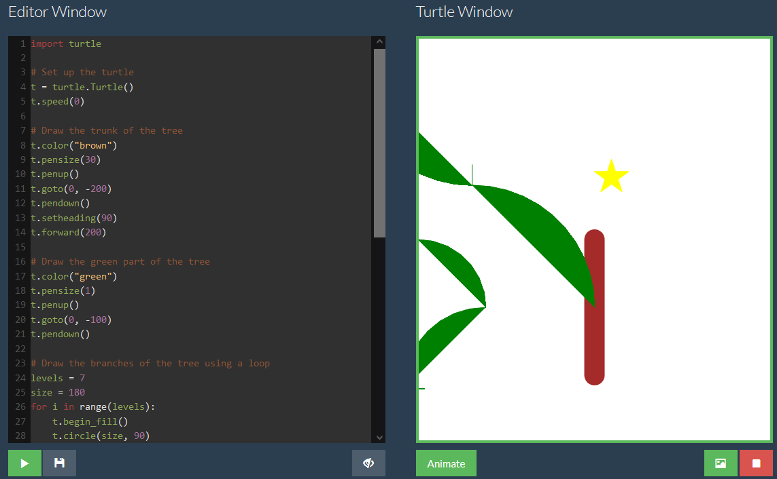
No AI <<<< Somewhere in between >>>> Everything AI
Notes:
Three groups of people
-No ai
-Everything ai
-Somewhere in between

Slide 7
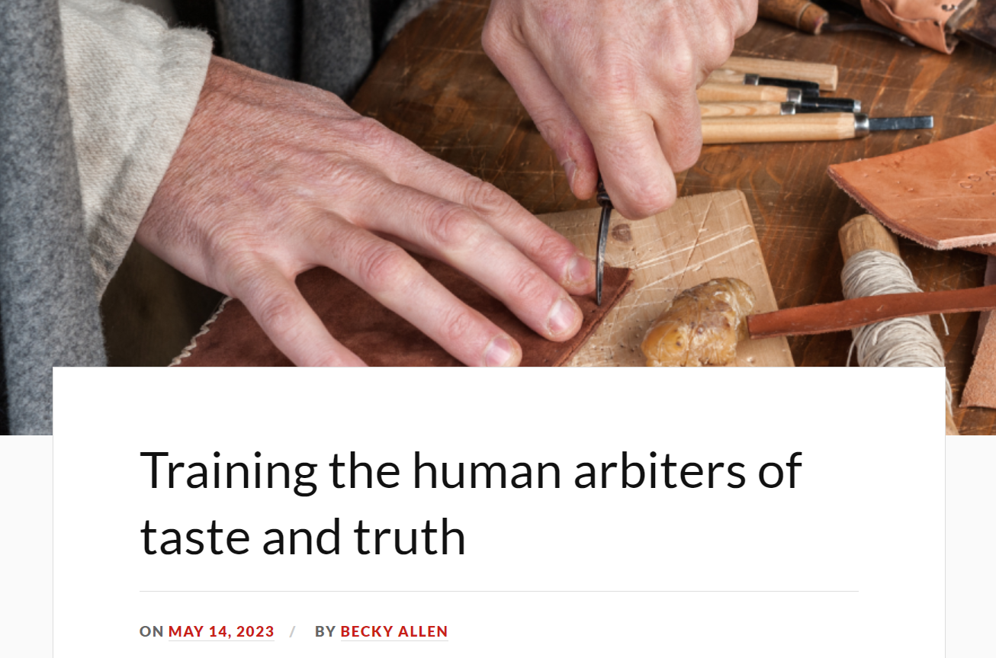
Notes:
https://rebeccaallen.co.uk/2023/05/14/training-the-human-arbiters-of-taste-and-truth/
We are creating people who can work with AI, not against it

Slide 8
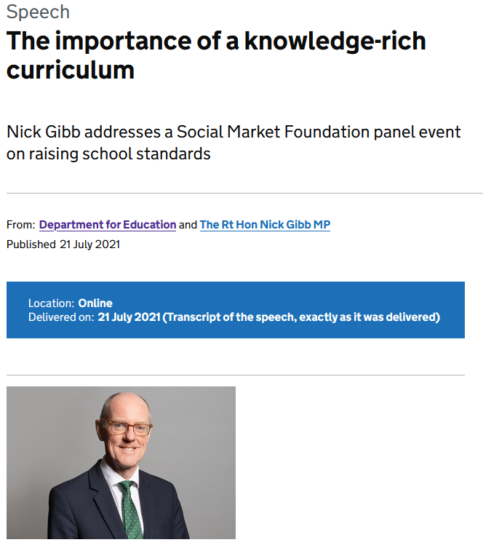
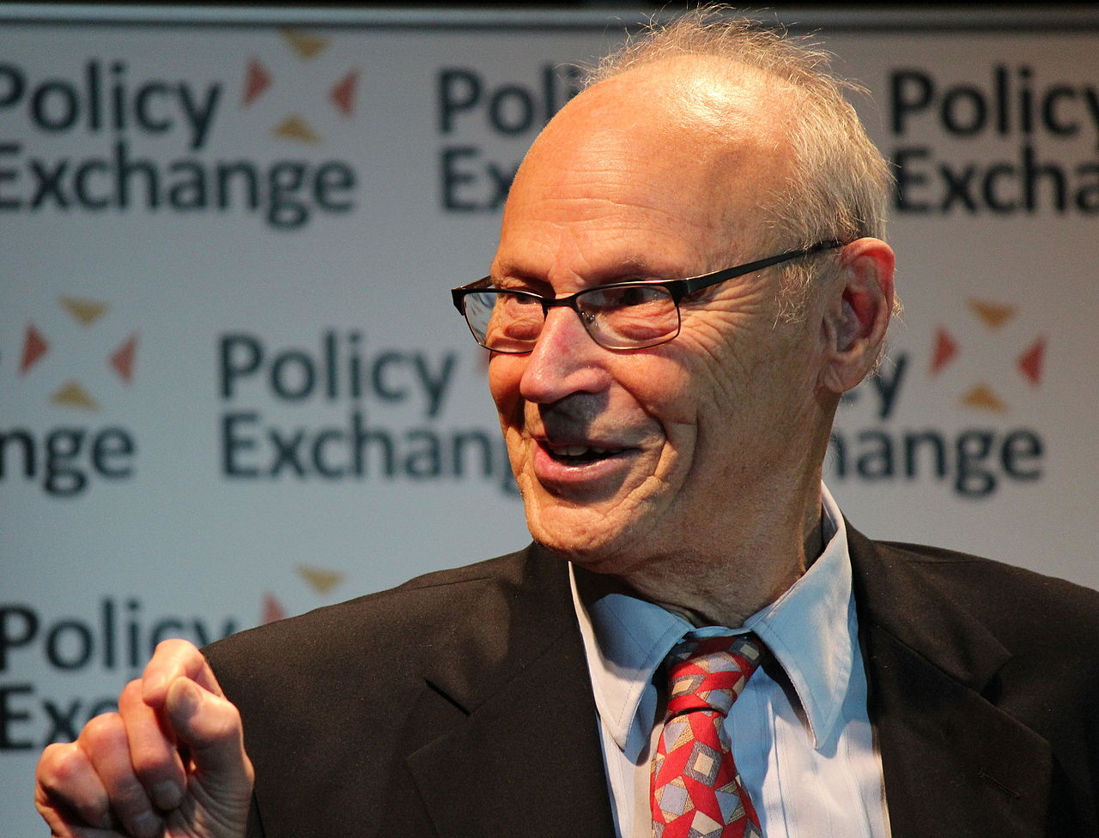
A common trope in the Western world today is that the rise of the internet has made the memorisation of knowledge redundant, akin to those in an earlier generation saying that the invention of calculators meant we did not need to teach children arithmetic.
[...]
The ability to ‘just Google it’ is highly dependent on what a person has stored in their long-term memory.
Notes:
[t]he work of E.D. Hirsch has been extremely influential in discussions about knowledge and schooling. In England and Wales, some prominent educationalists as well as senior education ministers have been convinced of the power of his arguments. Hirsch believes that a knowledge based curriculum will help disadvantaged children close the gap in attainment between themselves and their more privileged peers. He also claims that more progressive pedagogy – a skills-based approach for instance - can lead to the opposite outcome in schools (Simons & Porter, 2015)

Slide 9
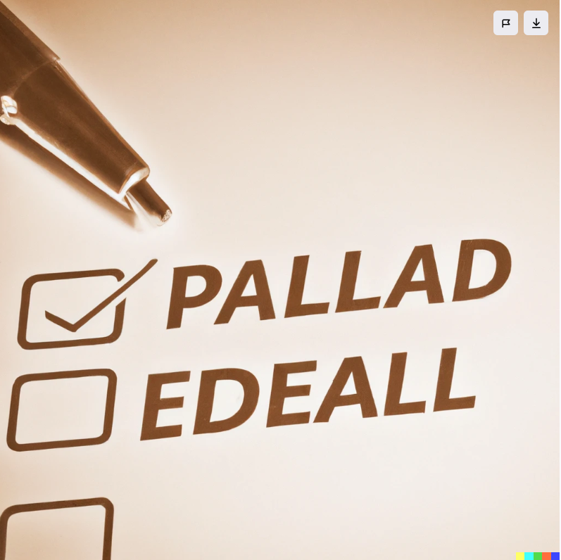
What makes a good assessment
Good assessments need to be valid and reliable
Valid - tests what you think it is testing
Reliable - consistent in measuring performance
External national assessments seen as more rigorous than teacher assessments
E.g. the recent ‘mutant’ algorithm and teacher allocated grades
Notes:
https://www.mheducation.co.uk/becoming-a-teacher-issues-in-secondary-education-6e-9780335251667-emea-group
>>> what does htis mean for coursework
In recent years, assessments created by teachers have been perceived by some stakeholders as not as rigorous or as fair as external national assessments, resulting in lower public confidence in their results. The efficacy of external national assessment, such as GCSEs and GCE A levels, is based upon validity and reliability. An assessment is valid if it is testing what you think it is testing. For example, a question designed to test use of verbs in French should correlate with pupils’ success in application of verb forms and should not be hampered by the vocabulary used, while a question that requires pupils to explain climate change should include a description and explanation of how climate change happens and so demands more than recalling a definition of the phenomenon. Reliability refers to the extent to which an assessment method or instrument consistently measures performance. Reliable assessments are usually expected to produce comparable outcomes, with consistent standards over time, and between different learners and examiners. An assessment can be reliable without being valid, however, an assessment cannot be valid unless it is reliable. Reliability and validity are both important, but validity is more important since an assessment that does not test what it is supposed to test is of little use.

Slide 10

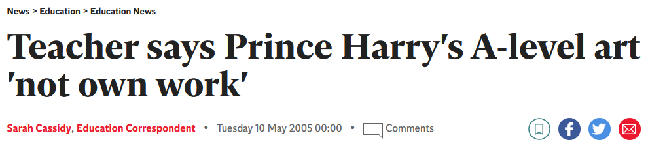
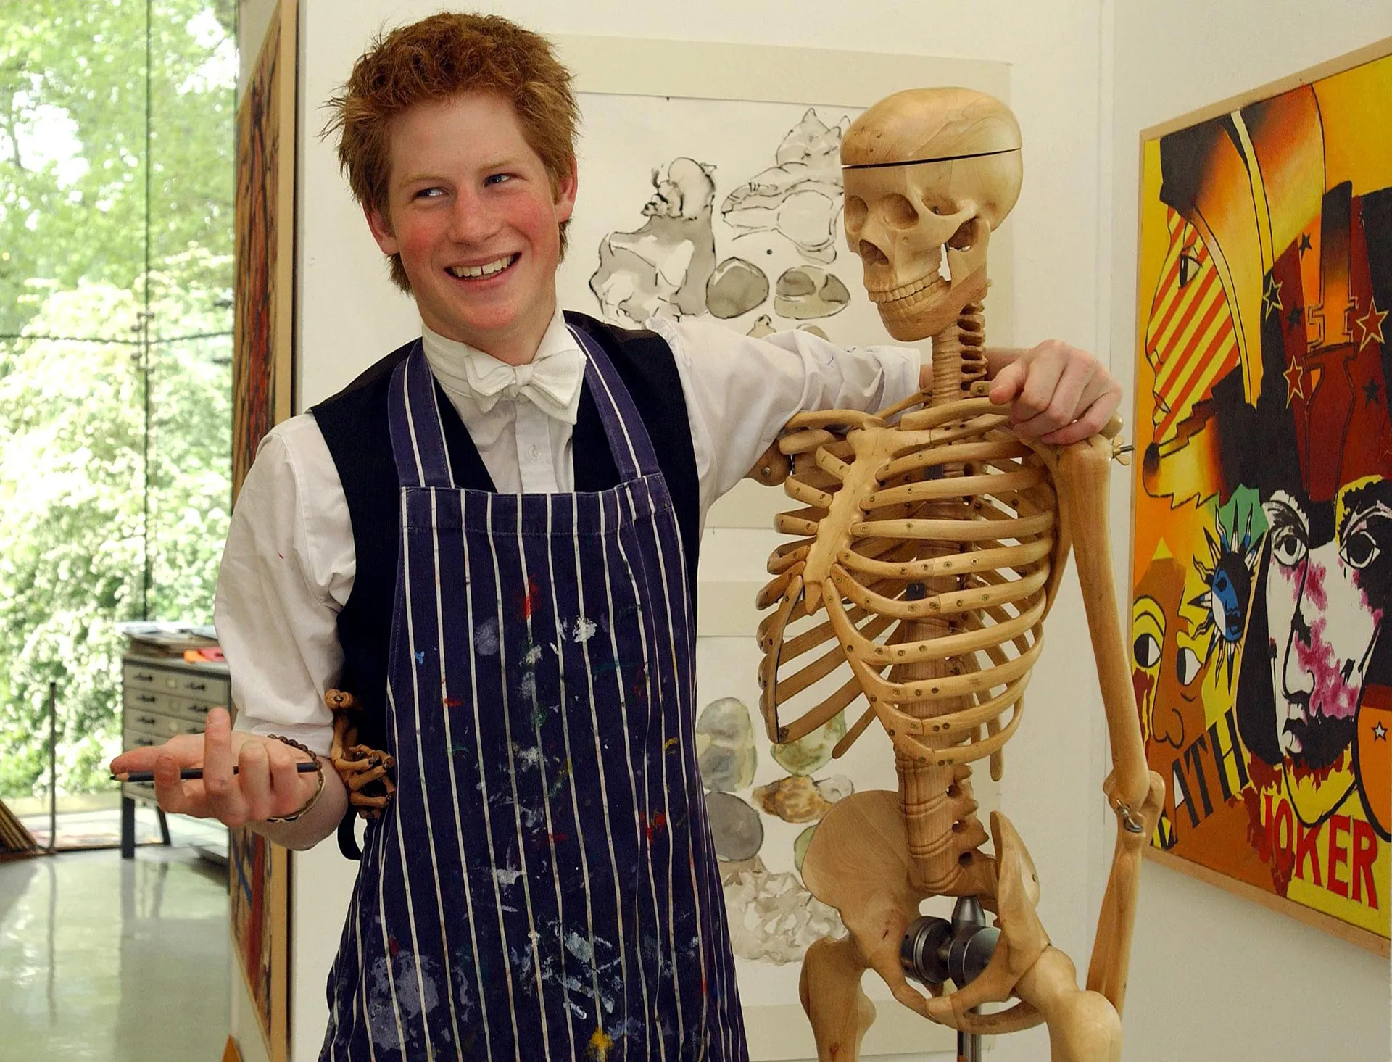
Notes:
Photo from: https://www.tatler.com/gallery/how-the-royals-did-in-their-a-levels
Story from: https://www.independent.co.uk/news/education/education-news/teacher-says-prince-harry-s-alevel-art-not-own-work-220797.html
The assessment might be reliable, but is it valid? Who are we assessing? WIth coursework how do we know that Harry’s Dad, Brother, Grandma or teacher didn’t do his homework
Mention Gareths Dad.

Slide 11
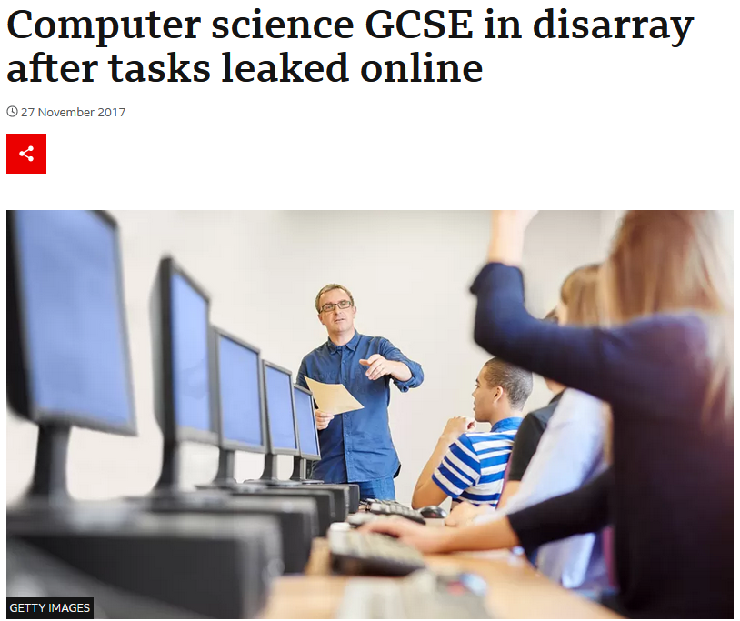
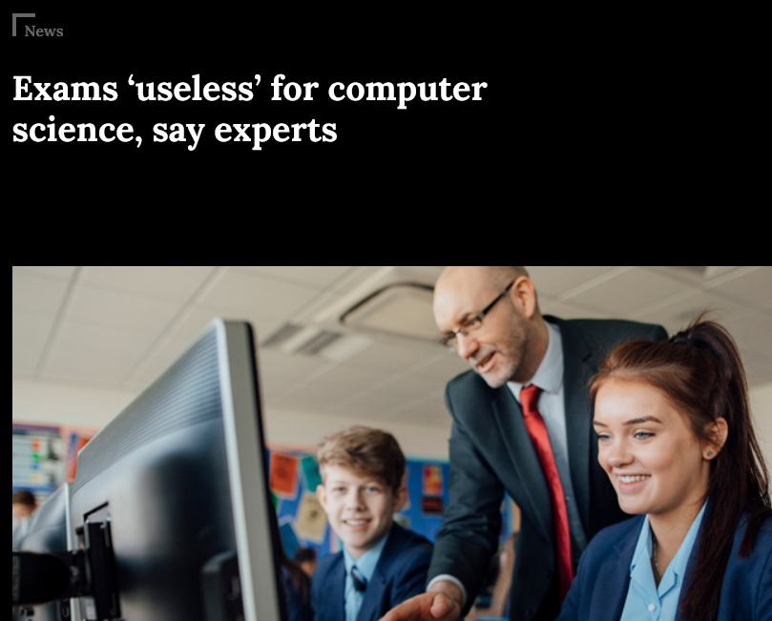
What can go wrong with coursework...
Task could be set within a given set of dates
Students sharing task online
Students sharing solutions online
But surely computer science is a highly practical subject(?!)
Notes:
What

Slide 12
A summary of recent assessment changes in schools
2000s ICT qualifications with high % of coursework seen to be easy options
2008 Ofqual set up “in response to concerns about pupils cheating in
coursework, having received help from teachers (and parents)
or copying from the Internet” (West, 2010, p. 28; cited here)
2013 Gove scraps coursework in most GCSEs
2019 Controlled assessments in computer science removed from overall grade
2020 GCSE computer science - exam room only
Notes:
https://www.theguardian.com/education/2013/jun/11/michael-gove-gcse-reforms
https://schoolsweek.co.uk/exams-useless-for-computer-science-say-experts/
Quote from: West, 2010, p. 28

Slide 13
What does this have to do with AI?
How can we know who (or what) we are testing?
Best to move everything back to paper-based exam hall assessments?
What role does authenticity have to play?

Slide 14
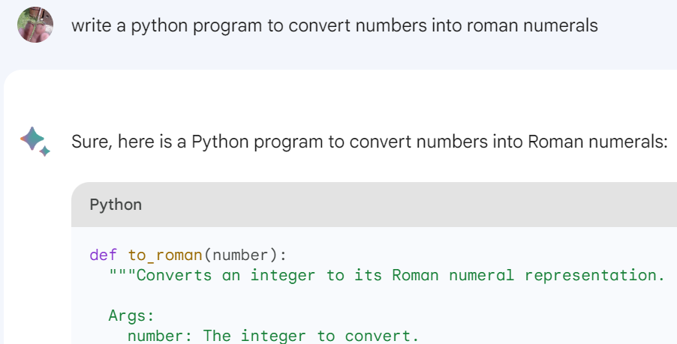


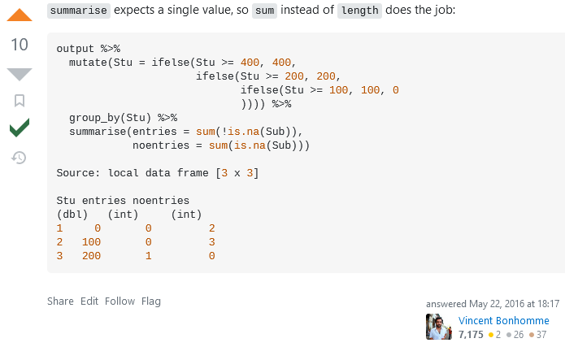
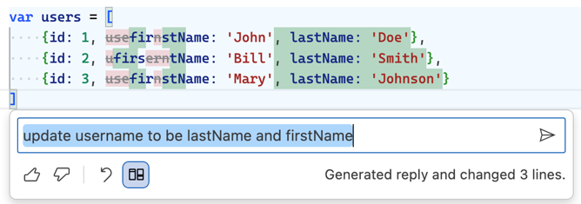
Authenticity
Task:
something real and meaningful
Process/Environment:
feedback, support, what people are used to
Notes:
If we are testing in unfamiliar environments, then the learning process becomes removed from reality

Slide 15
What do the new computer science GCSE and Alevel look like?

Slide 16
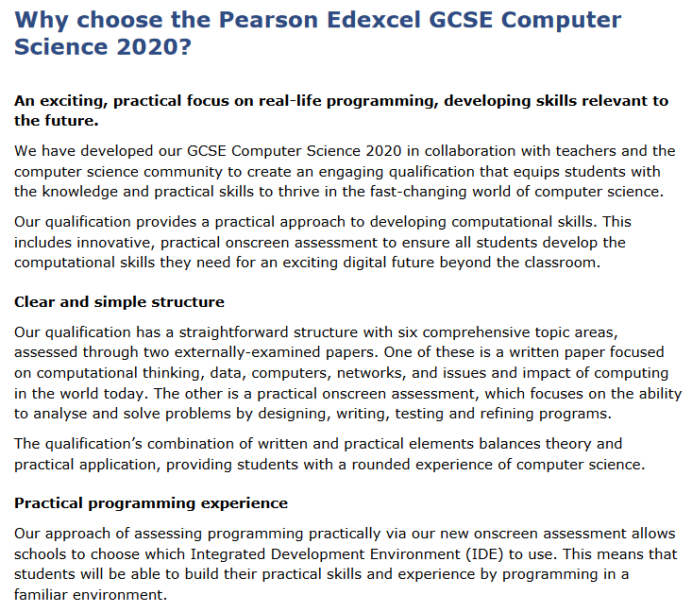

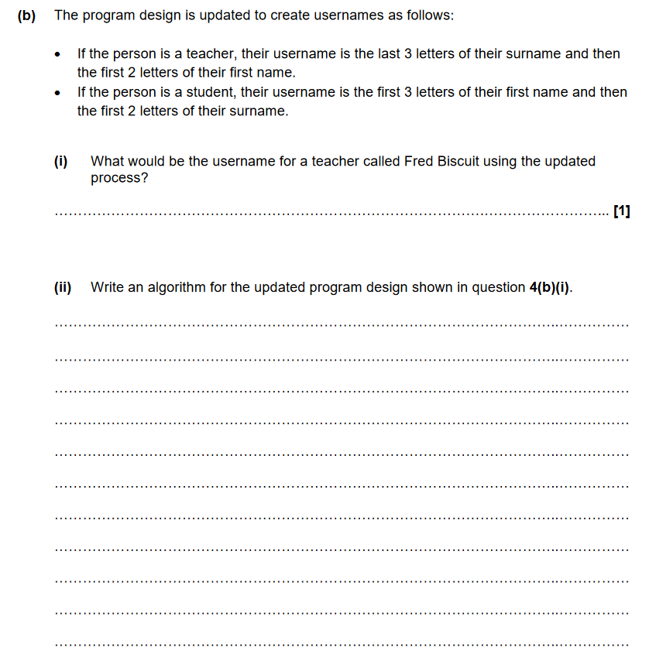
But no internet?!
Notes:
The GCSE no longer has coursework, to avoid cheating.
Pearson - on screen exams - but no internet, meaning no stack overflow and AI tools
OCR all paper based - limits that range of tasks available
Valid and reliable?
What are we testing? Ability to write code on paper? How does this correlate to their ability to write code in reality?
Authenticity?

Slide 17
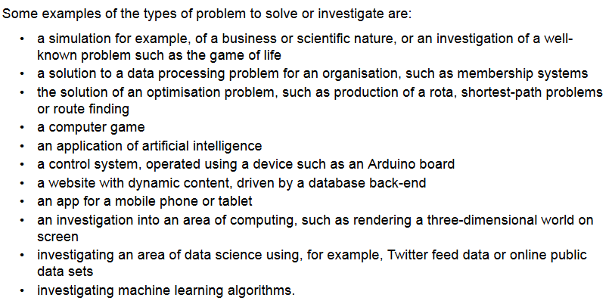
A-level Computer Science (age 16-18)
Paper 1 | Paper 2 | Project
On-screen exam: 2h30m
40% of A-level
Written exam: 2h30m
40% of A-level
Independent project
20% of A-level

Slide 18
On-screen exams vs coursework
On-screen exams potentially more valid and reliable, but less authentic
No internet
No stackoverflow
No co-pilot
No chat gpt3 / bard
Time limited
Exam rubric curtails answers
Coursework, potentially more authentic
Family / friends / teacher / AI support
What support can a student afford, corporate dominance of AI

Slide 19
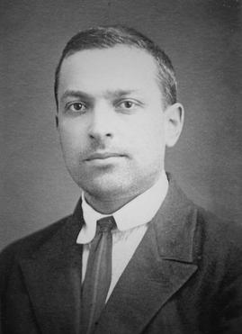
Summary: How do we respond to AI in education?
Keep coursework, don’t jettison authenticity in what you do
Accept the [documented] use of AI
Move narrow problems to closed exams - they’ll find deterministic/narrow AI made solutions
"What a child is able to do in collaboration today, he will be able to do independently tomorrow." - Vygotksy
We learn through dialogue - encourage use of AI in formative feedback
We need to create ”arbiters of taste and truth”, this requires valuing knowledge and experience in basic problem solving
Notes:
https://rebeccaallen.co.uk/2023/05/14/training-the-human-arbiters-of-taste-and-truth/

Slide 20
Won’t AI make my students less able?

Slide 21
