Slide 1

RCUK Energy Strategy Fellowship
Synthesis workshop
Royal School of Mines, Imperial College London
15 July 2013

Slide 2
Outline
Background to the workshop
Conclusions from “Strategy” workshops
Conclusions from “Expert” workshops
What we want to achieve from this workshop

Slide 3
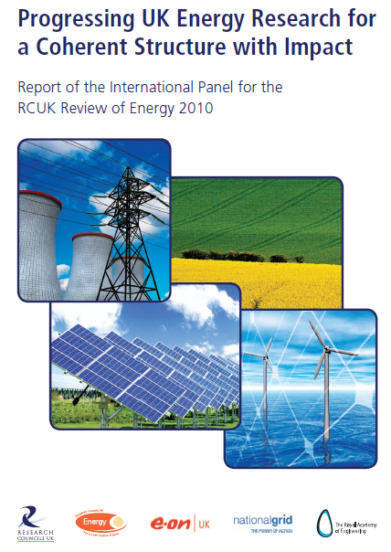
International Panel for the RCUK Review of Energy
Is the energy research funded by the UK government through the RCUK energy programme delivering impact in the UK and worldwide?
“Across almost all areas reviewed by us we found interesting, leading edge and world class research. The excellent international reputation of UK research is deservedly earned”.
Notes:
Aidan

Slide 4
But…..
Impact: On the whole, the academic community is very well regarded on the international scene. However, in terms of impact on economic benefit, industry development and quality of life, we have concerns that much more can be done.
Skills base: There is a good pipeline of doctoral students and post doctoral research associates. The availability of long-term career paths is less than clear.
Targeted programmes: These have produced impressive results. There are significant issues, in particular the communication of the balance between open ended discovery and targeted strategic programmes. There is a distinct lack of transparency of process.
Notes:
Aidan

Slide 5
Tasks of the Energy Strategy Fellow
Develop a “roadmap” of research, skills and training needs across the energy landscape to meet the UK 2050 targets
Identify gaps and misalignments of activities with UK goals
Research needs to be evaluated, prioritised and implemented
Work closely with the Research Councils and the Department of Energy and Climate Change
Organise meetings and workshops
Act as advocate for the Energy Programme
Act impartially and independently
Notes:
Aidan or Jim later? Swop to 39?

Slide 6
Energy Research and Training Prospectus
“The evidence base upon which the RCUK Energy Programme can plan its forward activities, acting in concert with Government, other RD&D funding bodies, the private sector and other relevant stakeholders.”
Key issues:
  the interface between RCEP and other RD&D activity/funders
  Not just climate change: security; affordability; economic opportunity
  Robust against uncertainty
  Ensuring links with underpinning science and engineering
  Training/human capital as well as research
Notes:
Aidan

Slide 7
Strategic Workshops
Energy Strategies and Energy Research Needs:
24 October 2012
The Role of the Environmental Sciences, Social Sciences and Economics:
13 November 2012
Research Councils and the Energy Innovation Landscape:
20 February 2013
Notes:
Aidan

Slide 8
Expert workshops: January – June 2013
Fossil Fuels and CCS
8-9 January 2013
with UK CCS Consortium
Energy in the Home and Workplace
5-6 February 2013
with EEDO
Bioenergy
14-15 May 2013
with BSBEC and Biomass SUPERGEN
Electrochemical Energy Technologies
& Energy Storage
25-26 June 2013
with Royal Society for Chemistry, IoM3
Energy Infrastructure
17-18 April 2013
with Ofgem, Smart Grid Forum
Transport Energy
11-12 June 2013
with Low Carbon Vehicle Partnership and DfT
Light-touch review:
nuclear fission; wind/wave/tide;
industrial processes
Notes:
Aidan

Slide 9
Prospectus Process: expert workshops
Workshop
Draft Workshop Summary
Working Paper: Workshop Summary
Energy Research Prospectus: Report
Participants review
Peer review
Notes:
Aidan

Slide 10
Prospectus Document Outline
Part I: Context
  Role of this aspect of energy in plausible futures
  Current research and funding landscape
  Existing roadmaps/plans for research & training
Part II: Research Challenges and Needs
Part III: Scientific Capabilities and Resource Needs
Notes:
Aidan

Slide 11
Outline
Background to the workshop
Conclusions from “Strategy” workshops
Conclusions from “Expert” workshops
What we want to achieve from this workshop

Slide 12
Strategy Workshop 1:
Energy Strategies and Energy Research Needs
Breakout Session 1
Notes:
Aidan

Slide 13
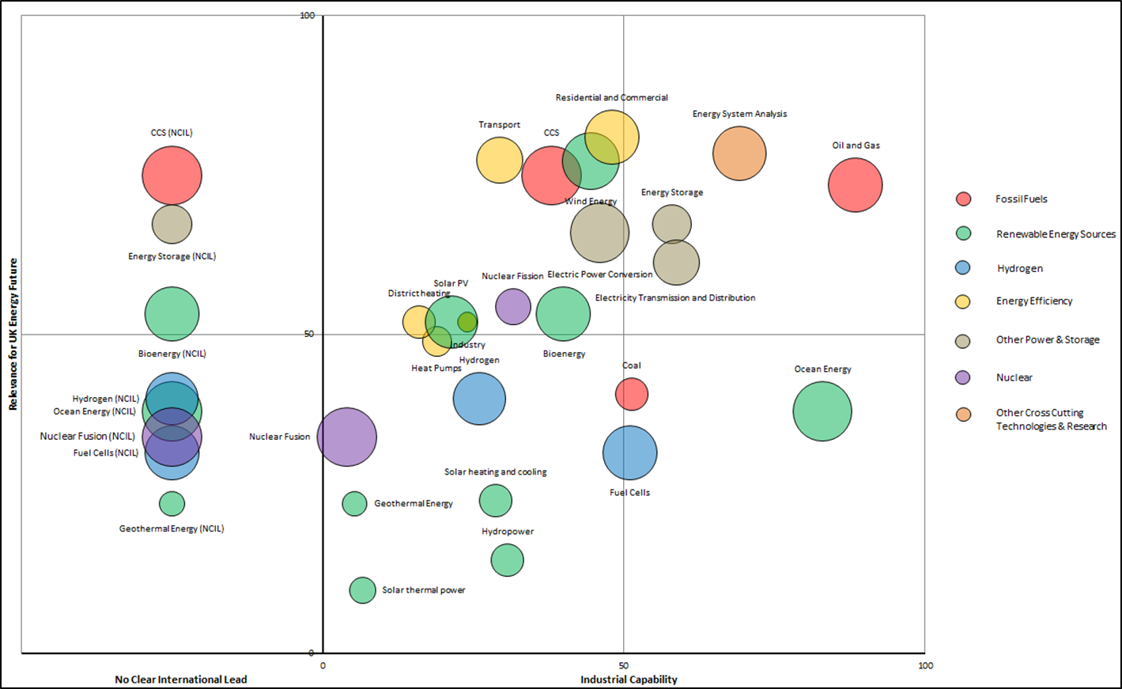
Strategy Workshop 1:
Energy Strategies and Energy Research Needs
Breakout Session 2
Notes:
Aidan

Slide 14
Strategy Workshop 2: The Role of Environmental Science,
Social Science and Economics
Less easy to summarise, but some nuggets…
Promoting energy demand research - like Sisyphus pushing his stone up the hill
A disproportionate effort put into kit as opposed to behaviour
Over-reliance on economics in the design of energy policy
Instrumental social science that helps answer policy questions is popular with funders. But instrumental social science rests on a foundation of fundamental, critical work.
Some disciplines are naturally complementary
Language matters – need a Babelfish
A social scientist’s first question when approaching subject X is often "what do you mean by X?“
Research Councils can and have forced better interdisciplinary working
Major inhibitor: the entire UK academic incentive system!
Notes:
Aidan

Slide 15
Strategy Workshop 3: The Research Councils and the Energy Innovation Landscape
Workshop exploring the relationship between the Research Councils and the rest of the innovation landscape.
Two representative case studies – Marine Renewables – use-inspired, and Molecular PV – science-inspired.
Some key findings:
  Basic Research: There needs to be stronger mechanisms for feeding back findings from later in the innovation process to basic research projects.
  Scope of the Research Councils: At which point should the handover between the RCs and the later innovation bodies (ETI, TSB) occur?
  Applied R&D: There is a need for adaptable and flexible testing facilities, and in ensuring spin-out companies can understand and access their potential markets.
  Pre-commercial Deployment: Clear policy signals and market regulations are needed so that investors feel secure.
It is important to have a clear long-term vision alongside a research programme, signalled by market, government and regulatory policies.
Notes:
Aidan

Slide 16
Outline
Background to the workshop
Conclusions from “Strategy” workshops
Conclusions from “Expert” workshops
What we want to achieve from this workshop

Slide 17
Role of the Research Councils
Research Councils should focus on “public good”
Differentiate between what RCs do and research supported through Government, Ofgem etc
Research Councils shouldn’t be bound to TRL-think
Joint funding in some areas
Close the loop – feed field trial/demonstration findings back to basic research
Horizon scanning for novel technologies/solutions
Coherence across funding bodies – increase connectivity
Policy evaluation/appraisal is for Government not the Research Councils
Understand the current landscape

Slide 18
Research “style”
Centres of Excellence with critical mass needed (but some push-back against exclusivity)
Longer-term funding (10, 20 years?) but with strong review
Interdisciplinarity should occur in large centres/labs
Silos still exist across Research Councils (bioenergy strongly noted)
Exploit international collaboration opportunities
Link qualitative and quantitative evidence in behavioural areas
“action research”/immersive methodologies needed (consumer –facing research)

Slide 19
Infrastructure and facilities
Some areas are under-provided with research infrastructure (NERC ships and satellites mentioned)
Shared test facilities
Capital bias in STFC provision – easy to get funds for kit, but reducing access to save on electricity bills…..access seen as a problem by some
Long-term field trials represent key “infrastructure” in the bioenergy field - also mentioned for fossil fuels and infrastructure – real consumers in real environments
Land access issues for bioenergy
Experimental computational tools

Slide 20
Data
Data sharing mentioned in every workshop
Curation and access
Shared data and computing facilities
Understand legal and ethical aspects
Privacy etc for consumer-facing behavioural data

Slide 21
Policy and wider links
Lack of clear long-term policy vision
Need for strategic road-mapping
Design research challenges to assist policy
Fast-track funding calls to meet immediate policy needs
Public engagement

Slide 22
Industry links
Collaboration needed!
Secondments and internships – industry and government
Education on wider implications of research/understanding of economics and markets
Commercial partnerships in behaviour-focused areas (Experian, Henley etc)
Review areas where research has been left to industry (fossil fuels). Is there a strategic need for public investment?
Close the loop – feed field trial/demonstration findings back to basic research

Slide 23
Training
Balance (or otherwise) between Centres for Doctoral Training and PhDs embedded in projects
Ensure people graduate with transferrable skills – deep skills needed as well as technology–focused
Lack of clarity about direction of energy and applicability of skills
Secondments and internships – industry and government
Education on wider implications of research/understanding of economics and markets
MScs/EngDocs as well as PhDs?

Slide 24
Outline
Background to the workshop
Conclusions from “Strategy” workshops
Conclusions from “Expert” workshops
What we want to achieve from this workshop

Slide 25
Advisory Group
Peter Taylor (Chair) Leeds
Julian Allwood Cambridge
Jo Coleman ETI
Jane Dennett-Thorpe DECC
David Infield Strathclyde
Sara Parkin Forum for the Future
Nick Pidgeon Cardiff
Jean-Benoit Ritz EDF
Robert Slade Surrey
Steve Sorrell Sussex
Gail Taylor Southampton
Jacqui Williams EPSRC

Slide 26
Key topics for further exploration proposed to
Advisory Group by Fellowship team
Basic vs. applied science
    Different Research Council approaches
    Role within the Energy Programme
Cross-Research Council activity
Training
  application v science-focused
  CDTs v projects
The role of the Research Councils vis-a-vis other energy innovation bodies
Knowledge creation and transfer – public goods and private benefit
Linking UK and European R&D activity
Policy orientation – how independent of the Government of the day?
Research infrastructure
  Data curation
  Field trials
  Scoping activity
  Longer-term funding
*
*
*
*
+ public engagement in energy research

Slide 27
Workshop topics
2.a The Role of the Research Councils in the UK Energy Innovation System
2.b Research Training
3.a Energy research and public engagement
3.b Making the best of the UK energy innovation system
The UK no longer has large energy research centres and relies instead on networking between universities and industry. How can the UK build on current arrangements to derive the benefits of a more centralised system?

Slide 28
2.a The Role of the Research Councils in the UK energy innovation system
How should research agendas be defined?
Where is the hand-over to other innovation bodies (ETI, TSB, DECC etc)
Should this be the same across all aspects of energy?
What processes are needed to maximise benefits for the UK?

Slide 29
2.b Research training
The role of the Research Councils
PhDs and Masters?
Centres for Doctoral Training and project studentships
Structured in terms of energy application or underlying basic research skills?
Subsequent career development : business/academic needs.

Slide 30
3.a Energy research and public engagement
The role of wider stakeholders in agenda setting
Engagement in developing research agendas
Communication of findings
Processes for engagement and working with key intermediaries

Slide 31
3.b Making the best of the UK energy innovation system
Infrastructure facilities and field trials
Longer-term perspectives/stable teams
Data collection and curation
EU and international engagement
Realising interdisciplinarity
(public enagagement)

Slide 32
11:30 | Session 2a: The Role of the Research Councils in the UK Energy Innovation System How should research agendas be defined? Where is the hand-over to other innovation bodies (ETI, TSB, DECC etc) Should this be the same across all aspects of energy? What processes are needed to maximise benefits for the UK? | Session 2b: Research Training The role of the Research Councils PhDs and Masters? Centres for Doctoral Training and project studentships Structured in terms of energy application or underlying skills? Subsequent career development : business/academic needs
12:45 | Report back
13:00 | Lunch
13.45 | Session 3a: Energy research and public engagement The role of wider stakeholders in agenda setting Engagement in developing research agendas Communication of findings Processes for engagement and working with key intermediaries | Session 3b: Making the best of the UK energy innovation system EU and international engagement Infrastructure facilities and field trials Longer-term perspectives/stable teams Data collection and curation Realising interdisciplinarity
15:00 | Tea break
15:15 | Report back
15:30 | Session 4: Wrap-up and next steps Overview of conclusions Peer review and publication of findings Maintenance of the energy research and training prospectus
16.00 | Close

Slide 33
Wrap-up – any (further) views on these topics?
Basic vs. applied science
    Different Research Council approaches
    Role within the Energy Programme
Cross-Research Council activity
Training
  application v science-focused
  CDTs v projects
The role of the Research Councils vis-a-vis other energy innovation bodies
Knowledge creation and transfer – public goods and private benefit
Linking UK and European R&D activity
Policy orientation – how independent of the Government of the day?
Research infrastructure
  Data curation
  Field trials
  Scoping activity
  Longer-term funding

