Slide 1
TSB Energy Activity & the Research Base
Research Councils Energy Programme
Strategy Fellowship Workshop
Feb 2013
What we do and why
TSB energy strategy for 2012 – 2015

Slide 2
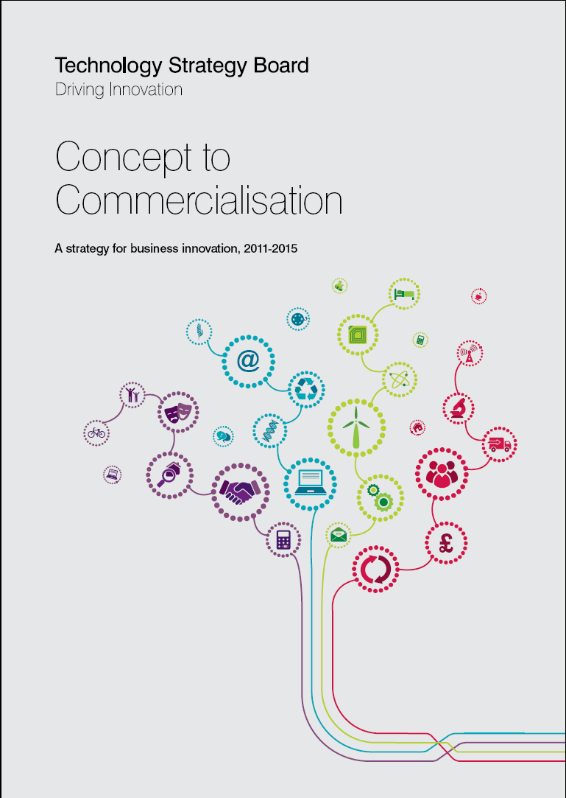
We are the UK innovation agency
  Funded by BIS
Our goal:
to accelerate economic growth by stimulating and supporting business-led innovation

Slide 3
We aim to...
Accelerate the journey from concept to commercialisation
Invest in thematic priority areas
Connect the innovation landscape
Turn government action into business opportunity
Continuously improve...

Slide 4
Thematic Programme Budget to 2014/15

Slide 5
In practice, what does that mean?
We listen to business.
We figure out what’s stopping innovation from happening and intervene.
We pick out links and patterns from a mass of complexity, uncertainty, potential, opportunity, opinion, politics and commerce.
We join people up
  Business to Business
  Business to Research
We aim to add value that others can’t or don’t.

Slide 6






And we use a range of ‘keys’ to unlock innovation
Smart
Collaborative R&D
Launchpad
Innovation Vouchers
Feasibility studies
Entrepreneur Missions

Slide 7
And some are designed to help make best use of working with the research base.
Collaborative R&D
Innovation Vouchers

Slide 8
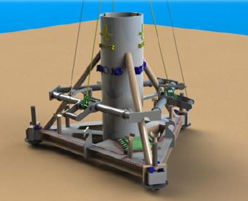


Examples of Research Base collaboration in energy
CR&D: Monopiling technology demo at EMEC:
  Exeter University key partner in project led by Bauer Renewables
KTP cohorts development
  Nuclear
  Offshore Renewables
  Power Electronics for Energy
Innovation Vouchers now open for energy.

Slide 9

New strategy published recently...
Defining our priorities in to 2015
What we are trying to achieve
What we will target
How we will go about it
Plus case studies,

Slide 10
A brief synopsis....
Energy underpins every aspect of our lives.
The energy system needs major change to address the energy trilemma
We believe that this change provides opportunity for UK business
Our role is to translate that opportunity and stimulate innovation that maximises economic benefit.
Affordable
Secure
Sustainable

Slide 11

Or....

Slide 12
Three Strategy Pillars:
Develop affordable and secure sources of energy supply that also reduce GHG emissions
Integration of future demand and energy supply into a flexible, secure and resilient energy system
Reduce GHG emissions at point of use
And working with our partners across the Low Carbon Innovation Coordination Group (LCICG) in delivery

Slide 13




Affordable and secure sources of energy which also reduce GHG emissions....
The ‘foundation pillar’

Slide 14
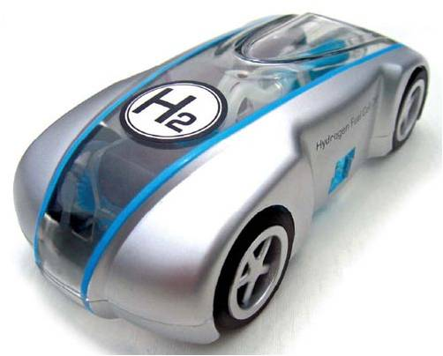

Integrating demand and supply into a flexible, secure and resilient energy system...

Slide 15
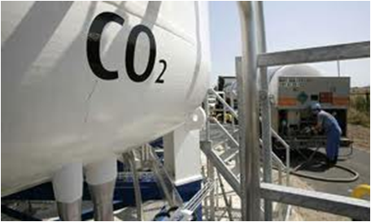
Reducing emissions at point of use
Find it at www.innovateuk.org

Slide 16
Thank You
Rob Saunders
rob.saunders@tsb.gov.uk

Slide 17
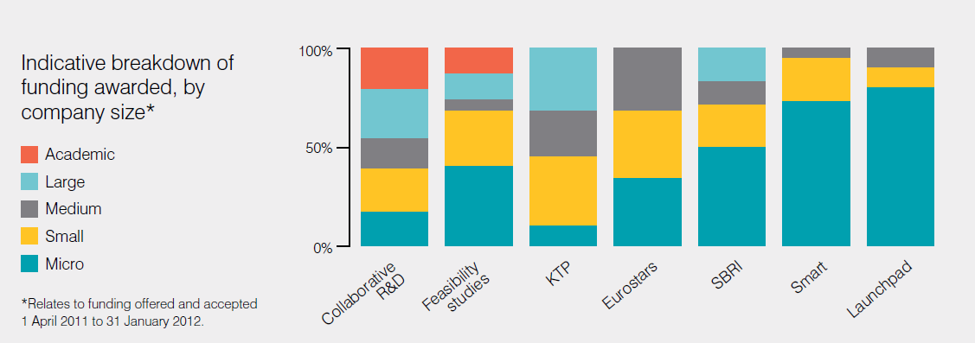
Where our money went (in 2011)

