Slide 1
Vector Runahead for Indirect Memory Accesses
Sam Ainsworth
2
5
1
6
…
3
7
4
8
…
…
9
…
…
…

Slide 2
Indirect Memory Accesses
for(int x=0; x<N; x++) {
C[B[A[x]]]++;
}

Slide 3
Indirect Memory Accesses:
Stalls, stalls, stalls
for(int x=0; x<N; x++) {
C[B[A[x]]]++;
}
A
...
0
8
3
...
B
1
8
1
C
2
5

Slide 4

Indirect Memory Accesses:
Still have memory-level parallelism
for(int x=0; x<N; x++) {
C[B[A[x]]]++;
}
A
...
0
8
3
...
B
1
8
1
C
2
5

Slide 5
Idea:
Memory-Level Parallelism == Thread-Level Parallelism

Slide 6
Event-Triggered Parallel Prefetcher (ASPLOS 2018, with Tim Jones)
Original Code:
for(int x=0; x<N; x++) {
C[B[A[x]]]++;
}

Slide 7
Event-Triggered Parallel Prefetcher
Original Code:
for(int x=0; x<N; x++) {
C[B[A[x]]]++;
}
Programmable Prefetcher Events:
Observe Load to A[n]

Slide 8
Event-Triggered Parallel Prefetcher
Original Code:
for(int x=0; x<N; x++) {
C[B[A[x]]]++;
}
Programmable Prefetcher Events:
Observe Load to A[n]
Prefetch A[n+N]

Slide 9
Event-Triggered Parallel Prefetcher
Original Code:
for(int x=0; x<N; x++) {
C[B[A[x]]]++;
}
Programmable Prefetcher Events:
Observe Load to A[n]
Prefetch A[n+N]
Prefetch B[A[n+N]]

Slide 10
Event-Triggered Parallel Prefetcher
Original Code:
for(int x=0; x<N; x++) {
C[B[A[x]]]++;
}
Programmable Prefetcher Events:
Observe Load to A[n]
Prefetch A[n+N]
Prefetch B[A[n+N]]
Prefetch C[B[A[n+N]]]

Slide 11
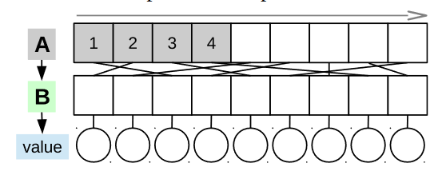
What about Runahead Execution?
for (int x=0; x<N; x++){
y += B[hash(A[x])]->value;
}
All about “work-skipping” as memory-level parallelism

Slide 12
What about Runahead Execution?
for (int x=0; x<N; x++){
y += B[hash(A[x])]->value;
}
All about “work-skipping” as memory-level parallelism
So it doesn’t work for indirect memory accesses!
But: It’s all microarchitectural and in-core, so no codesign required

Slide 13
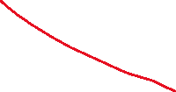

Idea:
Memory-Level Parallelism == Thread-Level Parallelism

Slide 14
Idea:
Memory-Level Parallelism == Data-Level Parallelism

Slide 15
Vector Runahead Execution
(ISCA 2021, with Ajeya Naithani, Tim Jones and Lieven Eeckhout)
Work-Skipping

Slide 16
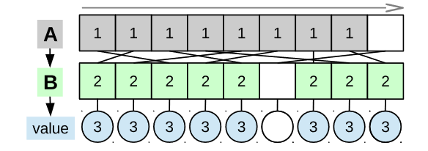
Vector Runahead Execution
(ISCA 2021, with Ajeya Naithani, Tim Jones and Lieven Eeckhout)
Work-Skipping
Stall-And-Vectorise
If you’re going to have cache misses, have lots of them at the same time!

Slide 17
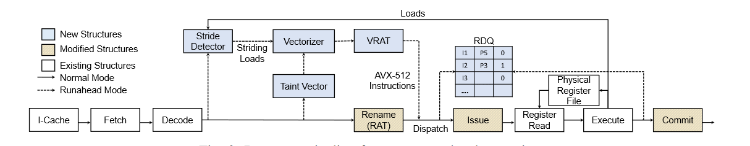
Vector Runahead: Change the Pipeline to reinterpret instructions
This isn’t real vectorisation, which may well be incorrect for the workload (data dependencies).
All of this is transient execution! (Just like the Event-Kernels in the Event Triggered Programmable Prefetcher)

Slide 18
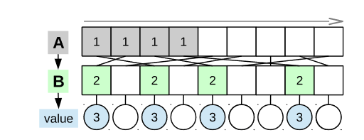
Turns out you need to Vectorise a lot to hide latency

Slide 19
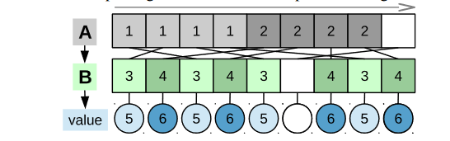
Turns out you need to Vectorise a lot to hide latency

Slide 20
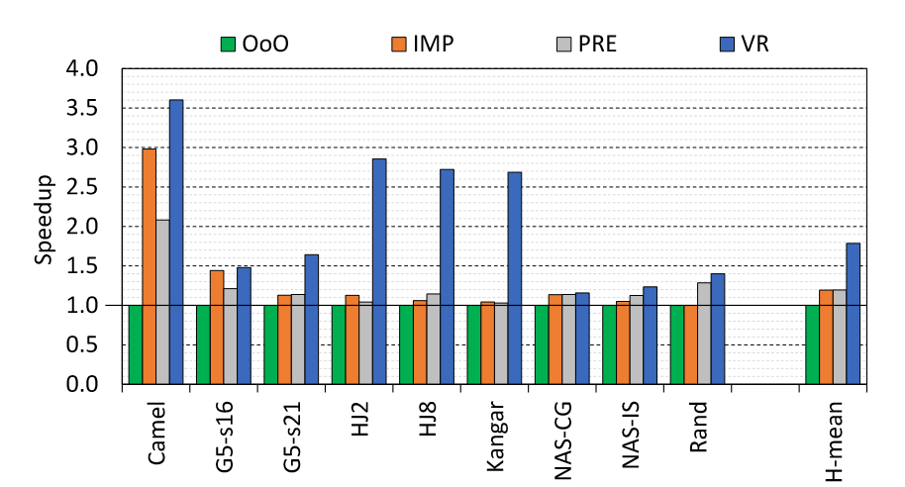
It works, and it got us an IEEE Micro Top Picks Top Picks

Slide 21
Vector Runahead for Indirect Memory Accesses
Sam Ainsworth

