Slide 1
Injecting instability into fluids:
The linear stability of annular Poiseuille-Couette flow with a compliant inner cylinder
Avni Chotai, supervised by Dr Walton

Slide 2
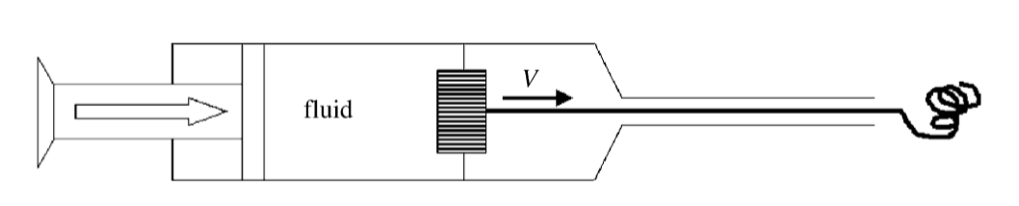



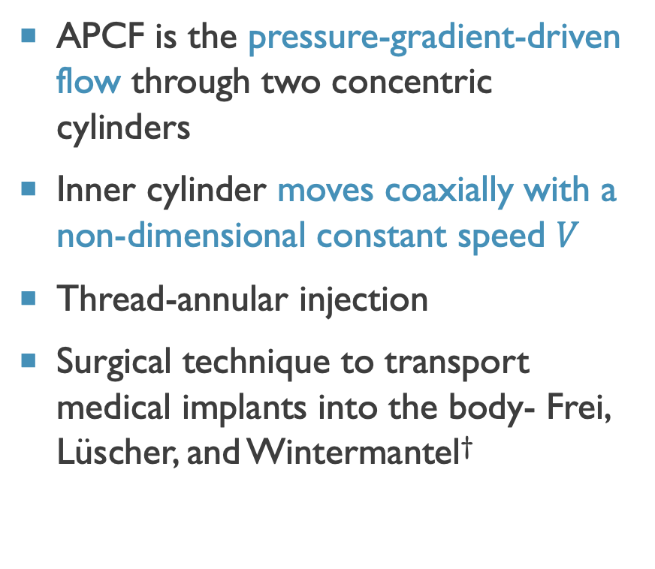
What is annular Poiseuille-Couette flow (APCF)?
APCF is the pressure-gradient-driven flow through two concentric cylinders
Inner cylinder moves coaxially with a non-dimensional constant speed $V$
Thread-annular injection
Surgical technique to transport medical implants into the body- Frei, Lüscher, and Wintermantel†
$$r=1$$
$r=δ$
$$V$$
Inner cylinder
Outer cylinder
†Thread-annular flow in vertical pipes, Frei, Lüsher and Wintermantel (2000).
Bottom image: The linear and nonlinear stability of thread-annular flow, Walton (2005).

Slide 3
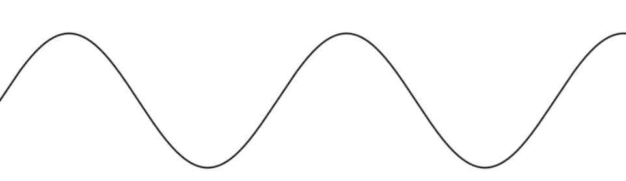
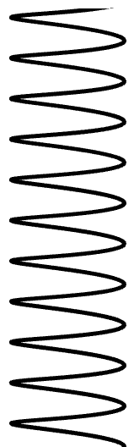
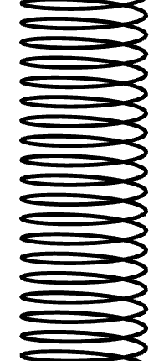

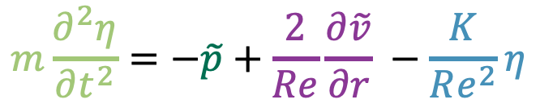
Mathematical model
Spring-backed plate model, Carpenter and Garrad†
resistive force
per unit area
(Hooke’s law)
fluid pressure
Elastic plate
Undisturbed boundary
$$m\frac{∂^{2}η}{∂t^{2}}=−\tilde{p}+\frac{2}{Re}\frac{∂\tilde{v}}{∂r} −\frac{K}{Re^{2}}η$$
$$η(x,t)$$
Array of springs
rate of change of momentum
per unit area
Rigid base
viscous shear stress
†The hydrodynamic stability of flow over Kramer-type compliant surfaces. Part 1. Tollmien-Schlichting instabilities, Carpenter and Garrad (1985)

Slide 4


Linear stability
Base flow:
Perturb the base state with axisymmetric disturbances
Does the perturbation grow, decay, or persist at the same magnitude?
$$U_{0}\left(r\right)=1 −r^{2}+ \frac{V −1+δ^{2}}{\ln\left(δ\right)} ln\left(r\right), δ≤r≤1$$
$$ε\hat{q}\left(r\right)\exp{(\text{i}α(x−ct))+c.c.}$$

Slide 5
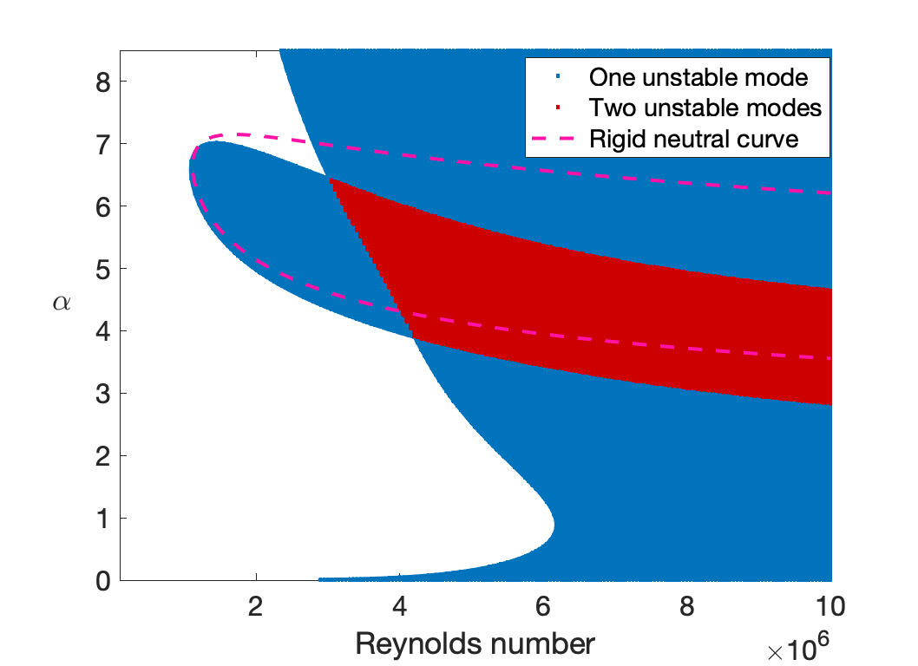


Stability regions for $δ = 0.7, V = 0$
$$Rigid$$
$$K = 1e11, m = 0.1$$
Flexibility introduces new modes of instability to the problem!

Slide 6
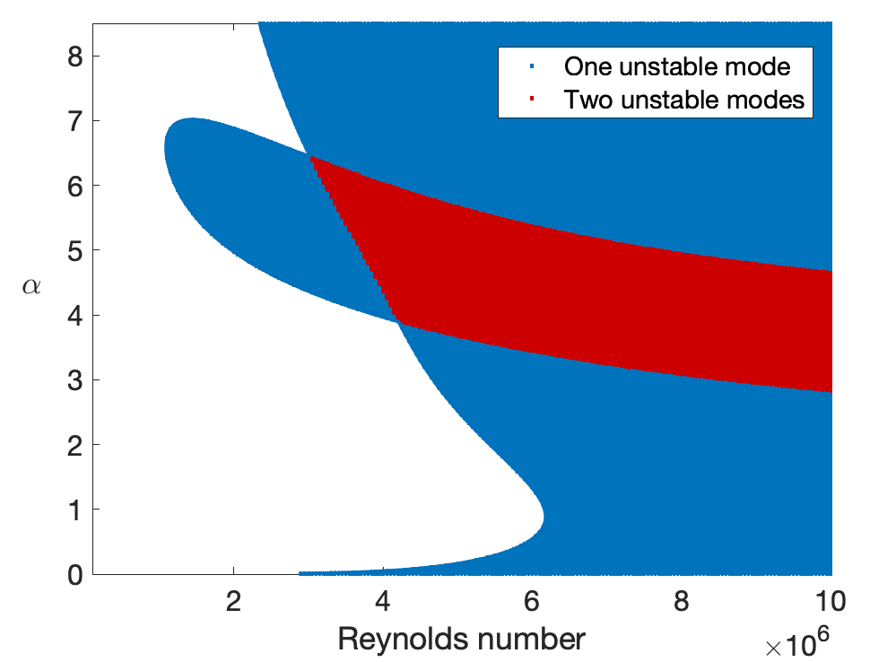
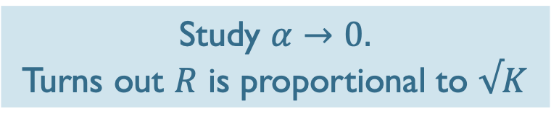

What properties can we deduce analytically?
$$δ = 0.7, V = 0 , K = 1e11, m = 0.1$$
Study $α→0.$
Turns out $R$ is proportional to $√K$
$$R≈2.66 ×{10}^{6}$$

Slide 7
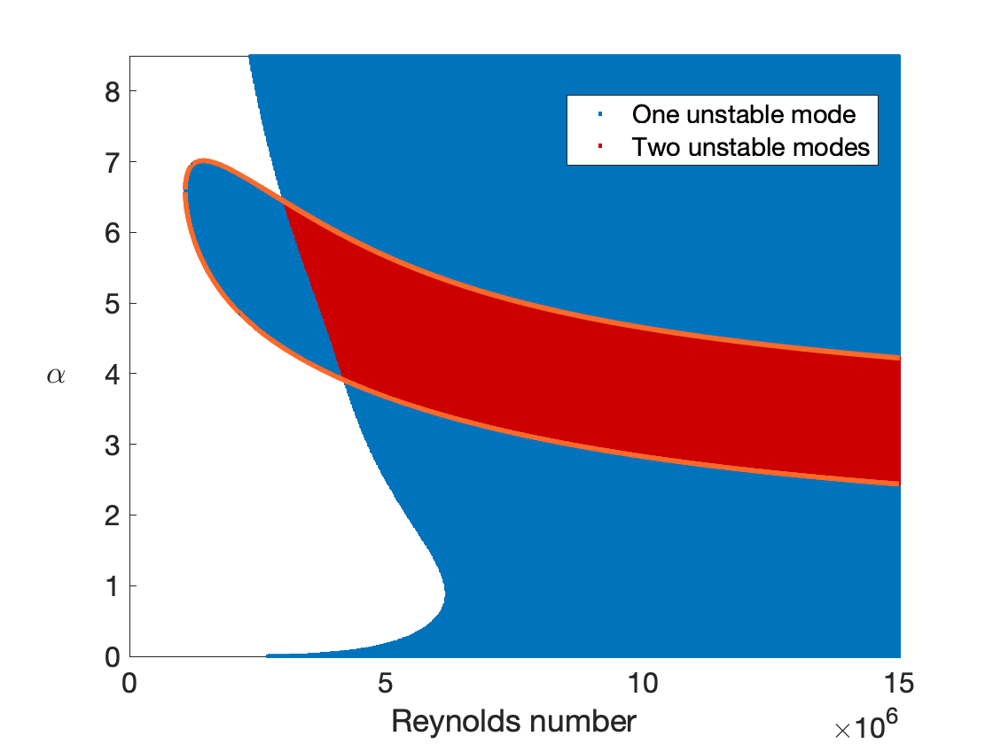
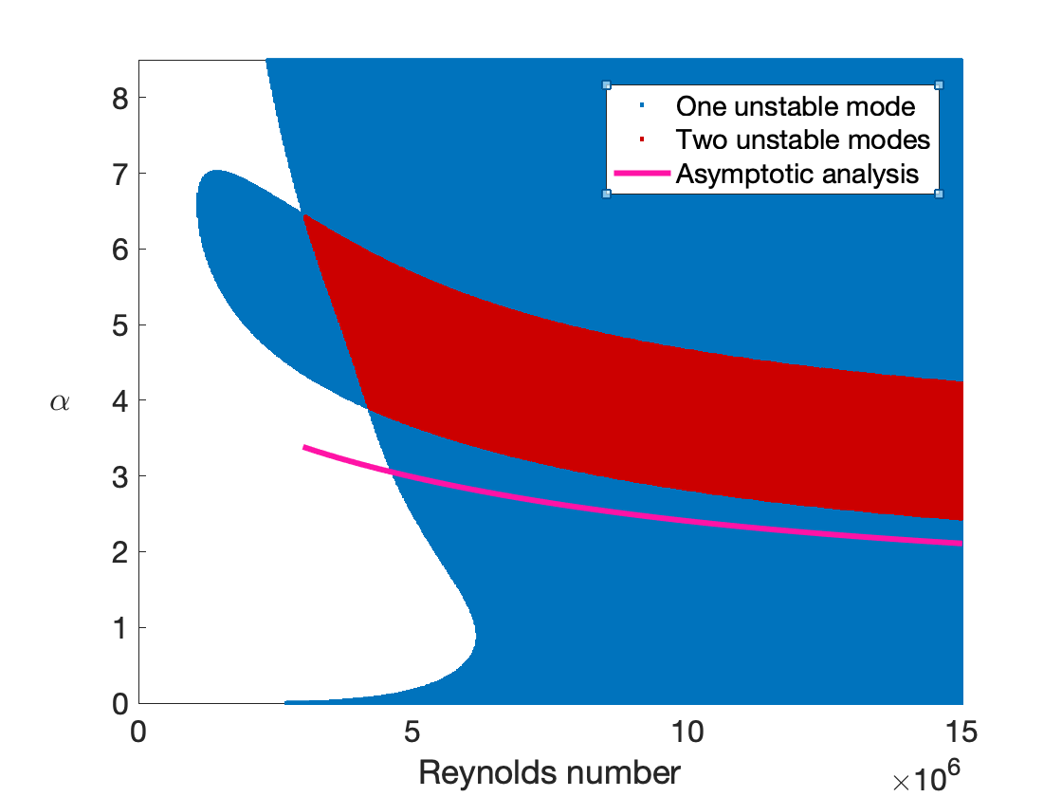
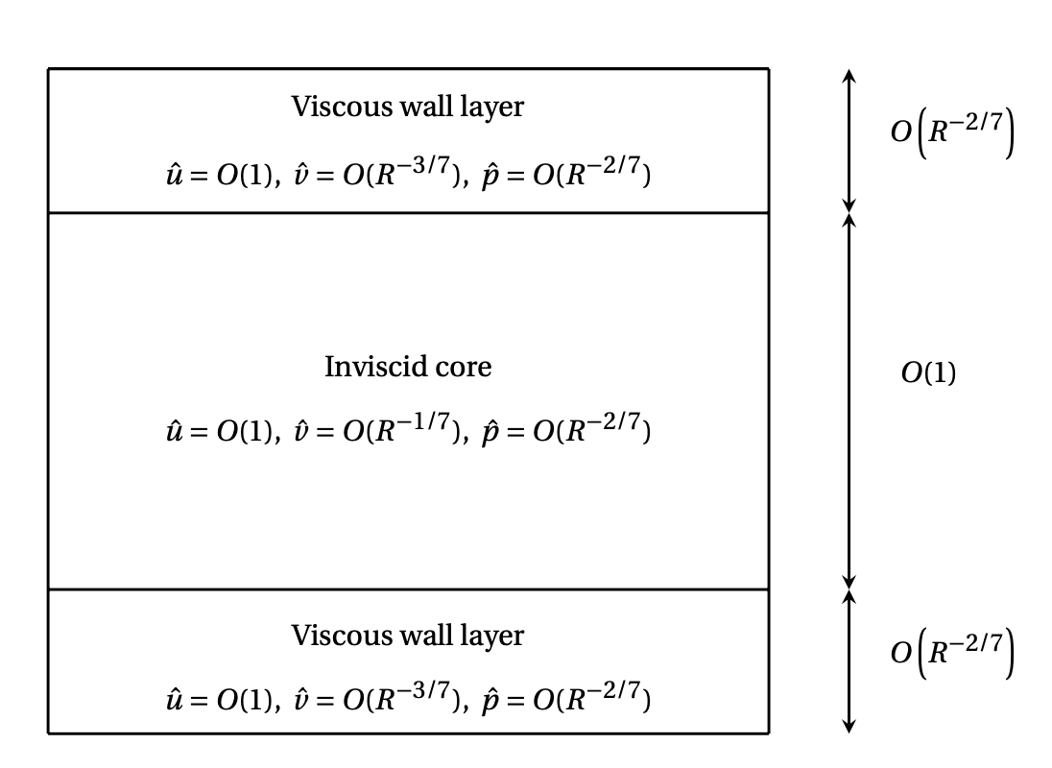



The viscous problem at large Reynolds numbers
A ‘maximal-interactions’ approach
Rigid, $r=1$
Viscous wall layer
Inviscid core
$$α=O(R^{−1/7})$$
Viscous wall layer
Compliant, $r=δ$
The Theory of Hydrodynamic Stability, Lin (1955). ‡Instability of flows through pipes of general cross-section, Smith (1979).

Slide 8
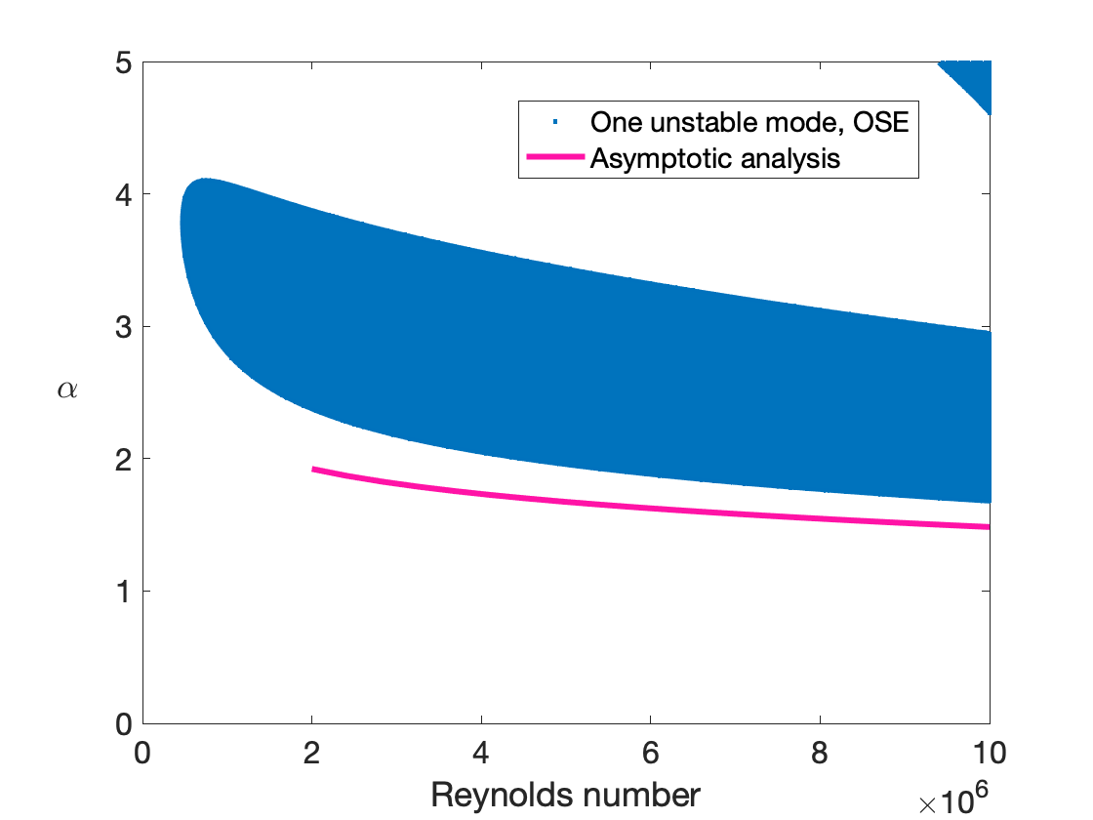
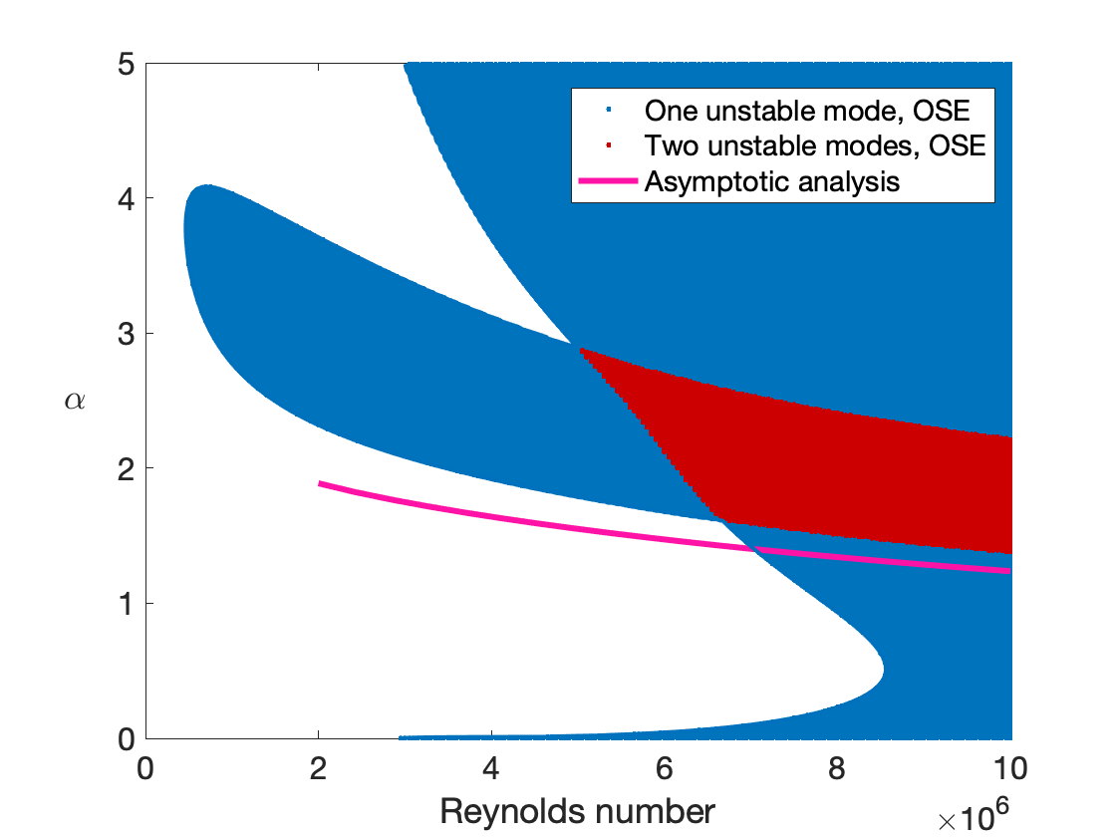
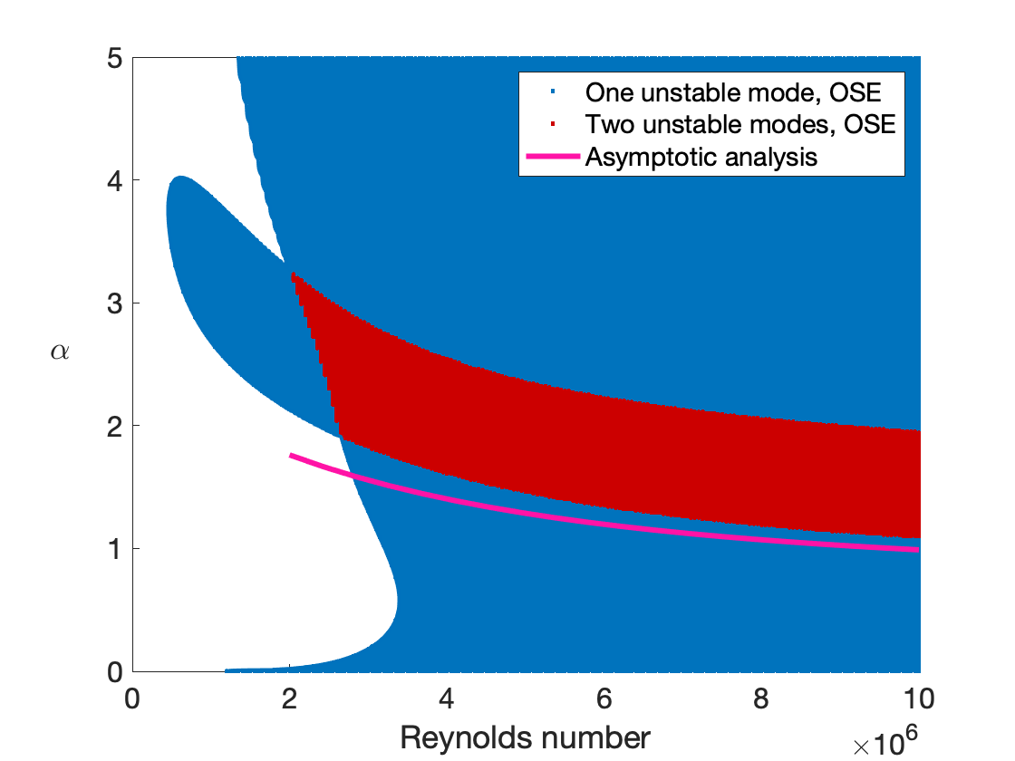



Comparisons between asymptotic results and OSE calculations:
$$δ = 0.5, V = 0, m = 0.1$$
$$K =5e12$$
$$K =5e11$$
$$K = 1e11$$
Increasing flexibility causes the viscous mode to become thinner.
Asymptotic analysis successfully describes the neutral mode for large Reynolds number!

