Slide 1

Methods for assessing human development in climate mitigation scenarios
Jarmo Kikstra
^{CEP PhD Symposium}
^{30 June 2022}
Grantham Institute and
Centre for Environmental Policy, Imperial College London
International Institute for Applied Systems Analysis (IIASA)
Notes:
In the coming decades, global society needs to reduce greenhouse gas emissions at an unprecedented pace.
At the same time, many poor regions require growth in energy access to lift people out of poverty.
This PhD project aims to bring together poverty eradication and climate mitigation through energy research.

Slide 2
The framework
“Decent Living Standards” to connect human wellbeing, multidimensional poverty, and climate mitigation.
Notes:
In the coming decades, global society needs to reduce greenhouse gas emissions at an unprecedented pace.
At the same time, many poor regions require growth in energy access to lift people out of poverty.
This PhD project aims to bring together poverty eradication and climate mitigation through energy research.

Slide 3
Research Framework
Goal 1: global human development.
?
Goal 2: climate stabilization.
Notes:
Bringing together different data and methods:
IAM pathways
Dowscaling
Income gini projections
IO table information on current energy inequality
Energy improvement projections: useful to final energy
DLE (all methods) + additional LCA
Impacts: (+climate emulator + buildings modelling)
Note Keywan:
The end-use tech improvement rate within regions is super different… Singapore e.g. does not have the same po
Maybe we can do some conditional convergence, somehow?
Regional improvement trend
+ add; base year performance (do we have country-level useful energy per country {e.g. Alessio and Paul provide some service indicators? – if good info, we can use it. If not available, useful first proxy.})
Can DLE intensities be a good proxy for starting values, where they can improve? Probably not.
Maybe use household energy intensity data?
Or can we disentangle:
Technologies ()
Country-specific factors ()
Question remains whether to stay consistent with IAM assumed EI improvements, or do something more detailed.

Slide 4
Research Framework
Goal 1: global human development.
Energy
Goal 2: climate stabilization.
Notes:
Bringing together different data and methods:
IAM pathways
Dowscaling
Income gini projections
IO table information on current energy inequality
Energy improvement projections: useful to final energy
DLE (all methods) + additional LCA
Impacts: (+climate emulator + buildings modelling)
Note Keywan:
The end-use tech improvement rate within regions is super different… Singapore e.g. does not have the same po
Maybe we can do some conditional convergence, somehow?
Regional improvement trend
+ add; base year performance (do we have country-level useful energy per country {e.g. Alessio and Paul provide some service indicators? – if good info, we can use it. If not available, useful first proxy.})
Can DLE intensities be a good proxy for starting values, where they can improve? Probably not.
Maybe use household energy intensity data?
Or can we disentangle:
Technologies ()
Country-specific factors ()
Question remains whether to stay consistent with IAM assumed EI improvements, or do something more detailed.

Slide 5
Research Framework
Human needs provisioning
Energy
Greenhouse gas emissions
Goal 1: global human development.
Goal 2: climate stabilization.
Notes:
Bringing together different data and methods:
IAM pathways
Dowscaling
Income gini projections
IO table information on current energy inequality
Energy improvement projections: useful to final energy
DLE (all methods) + additional LCA
Impacts: (+climate emulator + buildings modelling)
Note Keywan:
The end-use tech improvement rate within regions is super different… Singapore e.g. does not have the same po
Maybe we can do some conditional convergence, somehow?
Regional improvement trend
+ add; base year performance (do we have country-level useful energy per country {e.g. Alessio and Paul provide some service indicators? – if good info, we can use it. If not available, useful first proxy.})
Can DLE intensities be a good proxy for starting values, where they can improve? Probably not.
Maybe use household energy intensity data?
Or can we disentangle:
Technologies ()
Country-specific factors ()
Question remains whether to stay consistent with IAM assumed EI improvements, or do something more detailed.

Slide 6
Research Framework
Need satisfiers
Energy services
Energy supply
Human needs provisioning
Greenhouse gas emissions
Goal 1: global human development.
Goal 2: climate stabilization.
Brand-Correa and Steinberger (2017)
Ecological Economics.
https://doi.org/10.1016/j.ecolecon.2017.05.019
Notes:
Bringing together different data and methods:
IAM pathways
Dowscaling
Income gini projections
IO table information on current energy inequality
Energy improvement projections: useful to final energy
DLE (all methods) + additional LCA
Impacts: (+climate emulator + buildings modelling)
Note Keywan:
The end-use tech improvement rate within regions is super different… Singapore e.g. does not have the same po
Maybe we can do some conditional convergence, somehow?
Regional improvement trend
+ add; base year performance (do we have country-level useful energy per country {e.g. Alessio and Paul provide some service indicators? – if good info, we can use it. If not available, useful first proxy.})
Can DLE intensities be a good proxy for starting values, where they can improve? Probably not.
Maybe use household energy intensity data?
Or can we disentangle:
Technologies ()
Country-specific factors ()
Question remains whether to stay consistent with IAM assumed EI improvements, or do something more detailed.

Slide 7
Research Framework
Energy
Method 1: multidimensional material poverty through Decent Living Standards.
Eudaimonic Wellbeing
Eudaimonic need-centred understanding of human well-being.
Not “pleasure-seeking” (hedonic) but “flourishing” (eudemonic)
Decent Living Standards
“Material conditions for achieving basic human wellbeing”.
Not “outcome” but “means”: the capacity to achieve/flourish.
Human needs provisioning
Greenhouse gas emissions
Goal 1: global human development.
Goal 2: climate stabilization.
Notes:
Bringing together different data and methods:
IAM pathways
Dowscaling
Income gini projections
IO table information on current energy inequality
Energy improvement projections: useful to final energy
DLE (all methods) + additional LCA
Impacts: (+climate emulator + buildings modelling)
Note Keywan:
The end-use tech improvement rate within regions is super different… Singapore e.g. does not have the same po
Maybe we can do some conditional convergence, somehow?
Regional improvement trend
+ add; base year performance (do we have country-level useful energy per country {e.g. Alessio and Paul provide some service indicators? – if good info, we can use it. If not available, useful first proxy.})
Can DLE intensities be a good proxy for starting values, where they can improve? Probably not.
Maybe use household energy intensity data?
Or can we disentangle:
Technologies ()
Country-specific factors ()
Question remains whether to stay consistent with IAM assumed EI improvements, or do something more detailed.

Slide 8
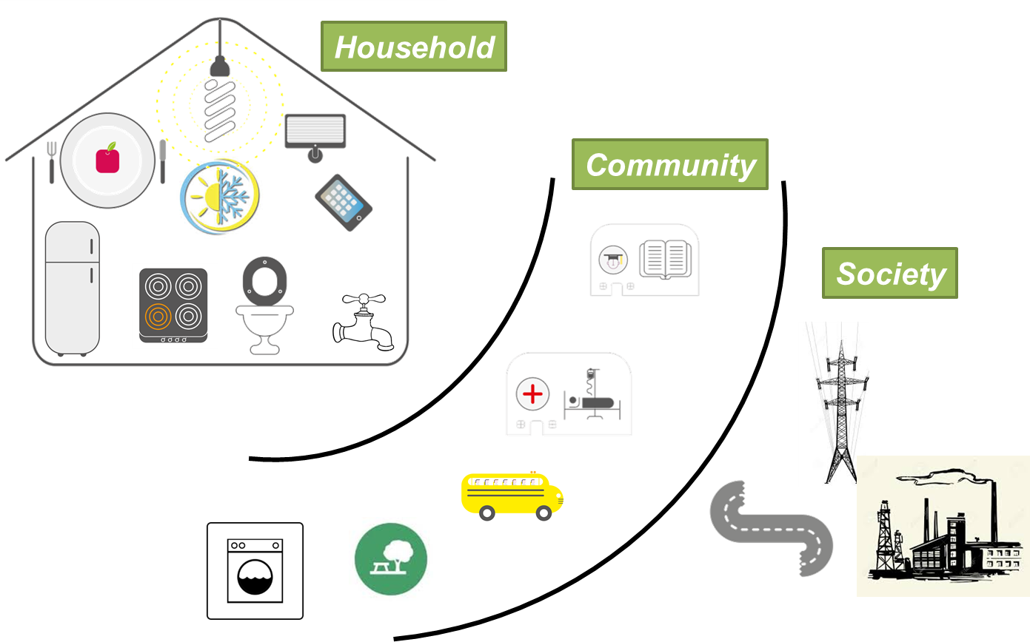
Decent Living Standards
Decent Living Standards
“Material conditions for achieving basic human wellbeing”.
Not “outcome” but “means”: the capacity to achieve/flourish.
Rao and Min (2018)
Social Indicators Research
10.1007/s11205-017-1650-0
Notes:
Bringing together different data and methods:
IAM pathways
Dowscaling
Income gini projections
IO table information on current energy inequality
Energy improvement projections: useful to final energy
DLE (all methods) + additional LCA
Impacts: (+climate emulator + buildings modelling)
Note Keywan:
The end-use tech improvement rate within regions is super different… Singapore e.g. does not have the same po
Maybe we can do some conditional convergence, somehow?
Regional improvement trend
+ add; base year performance (do we have country-level useful energy per country {e.g. Alessio and Paul provide some service indicators? – if good info, we can use it. If not available, useful first proxy.})
Can DLE intensities be a good proxy for starting values, where they can improve? Probably not.
Maybe use household energy intensity data?
Or can we disentangle:
Technologies ()
Country-specific factors ()
Question remains whether to stay consistent with IAM assumed EI improvements, or do something more detailed.

Slide 9
Decent Living Standards
Decent Living Standards
“Material conditions for achieving basic human wellbeing”.
Not “outcome” but “means”: the capacity to achieve/flourish.
Rao and Min (2018)
Social Indicators Research
10.1007/s11205-017-1650-0
Notes:
Bringing together different data and methods:
IAM pathways
Dowscaling
Income gini projections
IO table information on current energy inequality
Energy improvement projections: useful to final energy
DLE (all methods) + additional LCA
Impacts: (+climate emulator + buildings modelling)
Note Keywan:
The end-use tech improvement rate within regions is super different… Singapore e.g. does not have the same po
Maybe we can do some conditional convergence, somehow?
Regional improvement trend
+ add; base year performance (do we have country-level useful energy per country {e.g. Alessio and Paul provide some service indicators? – if good info, we can use it. If not available, useful first proxy.})
Can DLE intensities be a good proxy for starting values, where they can improve? Probably not.
Maybe use household energy intensity data?
Or can we disentangle:
Technologies ()
Country-specific factors ()
Question remains whether to stay consistent with IAM assumed EI improvements, or do something more detailed.

Slide 10
Decent Living Standards
Decent Living Standards
“Material conditions for achieving basic human wellbeing”.
Not “outcome” but “means”: the capacity to achieve/flourish.
Rao and Min (2018)
Social Indicators Research
10.1007/s11205-017-1650-0
Notes:
Bringing together different data and methods:
IAM pathways
Dowscaling
Income gini projections
IO table information on current energy inequality
Energy improvement projections: useful to final energy
DLE (all methods) + additional LCA
Impacts: (+climate emulator + buildings modelling)
Note Keywan:
The end-use tech improvement rate within regions is super different… Singapore e.g. does not have the same po
Maybe we can do some conditional convergence, somehow?
Regional improvement trend
+ add; base year performance (do we have country-level useful energy per country {e.g. Alessio and Paul provide some service indicators? – if good info, we can use it. If not available, useful first proxy.})
Can DLE intensities be a good proxy for starting values, where they can improve? Probably not.
Maybe use household energy intensity data?
Or can we disentangle:
Technologies ()
Country-specific factors ()
Question remains whether to stay consistent with IAM assumed EI improvements, or do something more detailed.

Slide 11
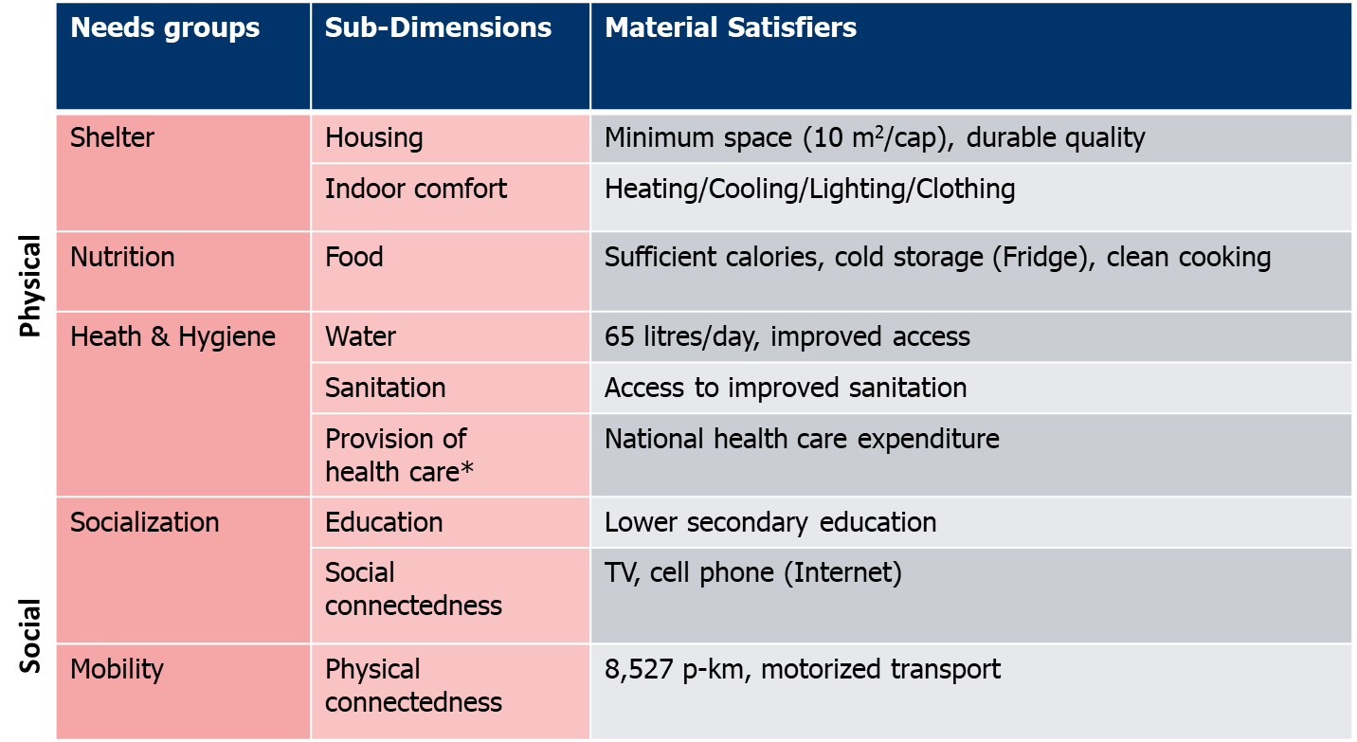
Decent Living Standards
Decent Living Standards
“Material conditions for achieving basic human wellbeing”.
Not “outcome” but “means”: the capacity to achieve/flourish.
Kikstra et al. (2021)
Environ. Res. Lett.
10.1088/1748-9326/ac1c27.
Notes:
Bringing together different data and methods:
IAM pathways
Dowscaling
Income gini projections
IO table information on current energy inequality
Energy improvement projections: useful to final energy
DLE (all methods) + additional LCA
Impacts: (+climate emulator + buildings modelling)
Note Keywan:
The end-use tech improvement rate within regions is super different… Singapore e.g. does not have the same po
Maybe we can do some conditional convergence, somehow?
Regional improvement trend
+ add; base year performance (do we have country-level useful energy per country {e.g. Alessio and Paul provide some service indicators? – if good info, we can use it. If not available, useful first proxy.})
Can DLE intensities be a good proxy for starting values, where they can improve? Probably not.
Maybe use household energy intensity data?
Or can we disentangle:
Technologies ()
Country-specific factors ()
Question remains whether to stay consistent with IAM assumed EI improvements, or do something more detailed.

Slide 12
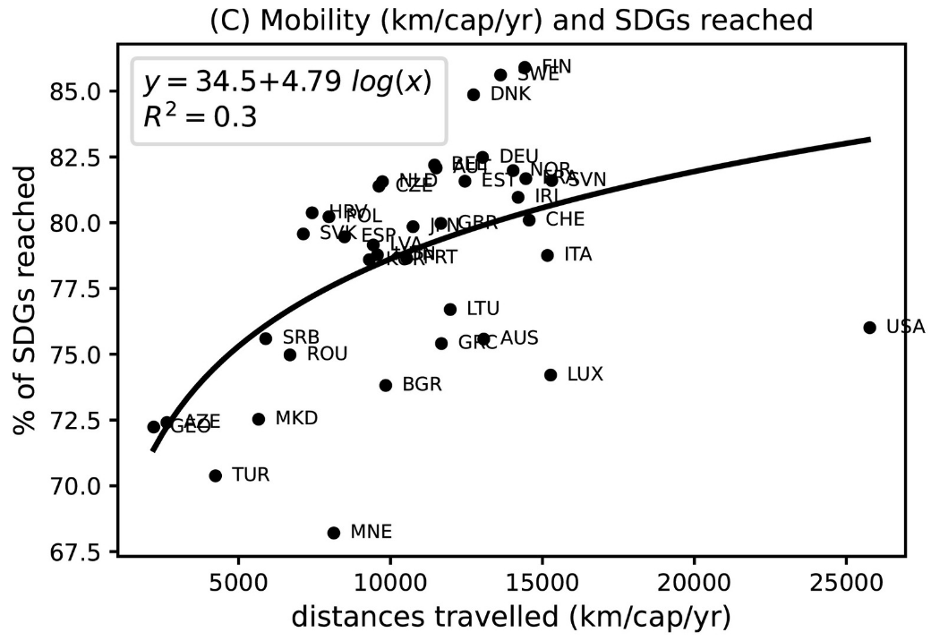
Decent Living Standards
Transport:
“Diminishing gains of well-being at high levels of mobility infrastructure”.
Virag et al. (2022)
Ecological Economics.
https://doi.org/10.1016/j.ecolecon.2022.107511
Notes:
Bringing together different data and methods:
IAM pathways
Dowscaling
Income gini projections
IO table information on current energy inequality
Energy improvement projections: useful to final energy
DLE (all methods) + additional LCA
Impacts: (+climate emulator + buildings modelling)
Note Keywan:
The end-use tech improvement rate within regions is super different… Singapore e.g. does not have the same po
Maybe we can do some conditional convergence, somehow?
Regional improvement trend
+ add; base year performance (do we have country-level useful energy per country {e.g. Alessio and Paul provide some service indicators? – if good info, we can use it. If not available, useful first proxy.})
Can DLE intensities be a good proxy for starting values, where they can improve? Probably not.
Maybe use household energy intensity data?
Or can we disentangle:
Technologies ()
Country-specific factors ()
Question remains whether to stay consistent with IAM assumed EI improvements, or do something more detailed.

Slide 13
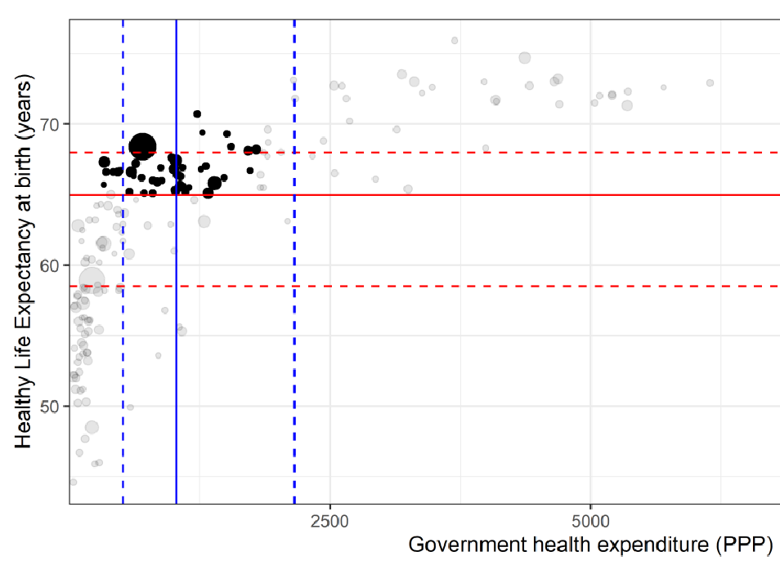
Decent Living Standards
Health Care
Kikstra et al. (2021)
Environ. Res. Lett.
10.1088/1748-9326/ac1c27.
Notes:
Bringing together different data and methods:
IAM pathways
Dowscaling
Income gini projections
IO table information on current energy inequality
Energy improvement projections: useful to final energy
DLE (all methods) + additional LCA
Impacts: (+climate emulator + buildings modelling)
Note Keywan:
The end-use tech improvement rate within regions is super different… Singapore e.g. does not have the same po
Maybe we can do some conditional convergence, somehow?
Regional improvement trend
+ add; base year performance (do we have country-level useful energy per country {e.g. Alessio and Paul provide some service indicators? – if good info, we can use it. If not available, useful first proxy.})
Can DLE intensities be a good proxy for starting values, where they can improve? Probably not.
Maybe use household energy intensity data?
Or can we disentangle:
Technologies ()
Country-specific factors ()
Question remains whether to stay consistent with IAM assumed EI improvements, or do something more detailed.

Slide 14
Decent Living Standards
Housing:
“in Taiwan, recommended minimum living space ranges from 7 to 13 m2 per person … in Korea … 12 m2 for one person, and 8–10 m2 for each additional member … 10 m2/cap, which is the actual floor space to which middle class Indian homes plateau”
Rao and Min (2018)
Social Indicators Research
10.1007/s11205-017-1650-0
Notes:
Bringing together different data and methods:
IAM pathways
Dowscaling
Income gini projections
IO table information on current energy inequality
Energy improvement projections: useful to final energy
DLE (all methods) + additional LCA
Impacts: (+climate emulator + buildings modelling)
Note Keywan:
The end-use tech improvement rate within regions is super different… Singapore e.g. does not have the same po
Maybe we can do some conditional convergence, somehow?
Regional improvement trend
+ add; base year performance (do we have country-level useful energy per country {e.g. Alessio and Paul provide some service indicators? – if good info, we can use it. If not available, useful first proxy.})
Can DLE intensities be a good proxy for starting values, where they can improve? Probably not.
Maybe use household energy intensity data?
Or can we disentangle:
Technologies ()
Country-specific factors ()
Question remains whether to stay consistent with IAM assumed EI improvements, or do something more detailed.

Slide 15
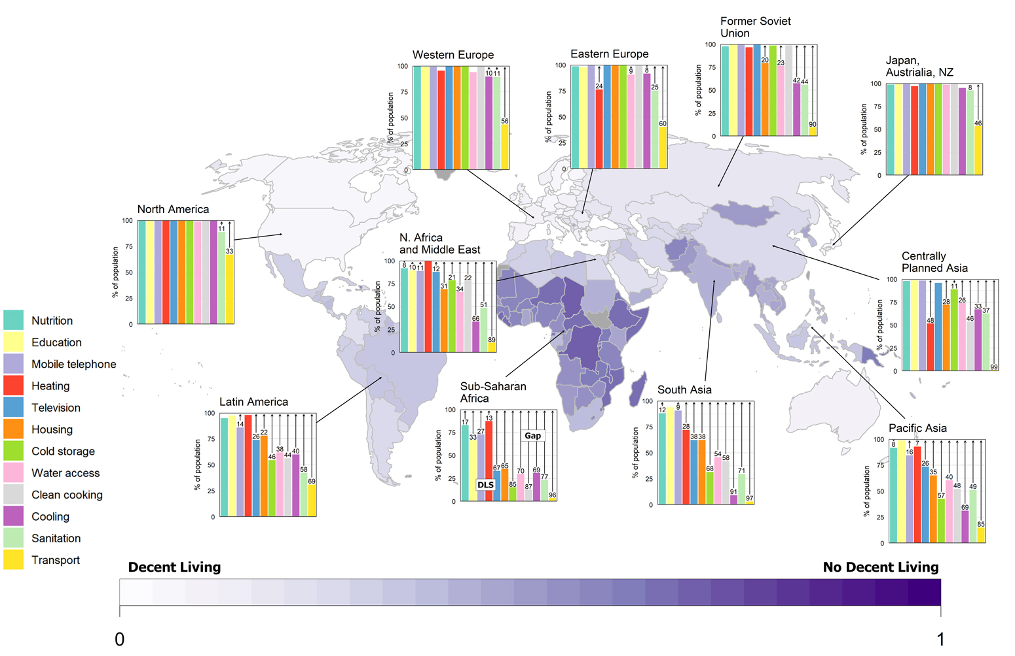

Multidimensional poverty
Deprivations across the world, e.g.:
  No safe water: ~3.8 bln
  Insufficient housing: ~2.2 bln
  No clean cooking: ~3.2 bln
Sources:
  World Bank, Household surveys, IPUMS, FAO, etc.
Beyond income:
  5.50$/day does not mean a decent life for all.
  Modelling GDP and income distributions thus of limited usefulness to inform policies.
Kikstra et al. (2021)
Environ. Res. Lett.
10.1088/1748-9326/ac1c27.
Notes:
If you want a new multidimensional poverty indicator, that is more focused on access and service provisioning, then we could choose to aggregate all of this information into a mean Decent Living Standards Deprivation Index by country, as shown here.
Mean of (mean physical, mean social)

Slide 16
Research Framework
Energy
Method 2: minimum energy requirements.
Method 1: multidimensional material poverty through Decent Living Standards.
Decent Living Energy
“the energy requirements to support decent living”
Human needs provisioning
Greenhouse gas emissions
Goal 1: global human development.
Goal 2: climate stabilization.
Notes:
Bringing together different data and methods:
IAM pathways
Dowscaling
Income gini projections
IO table information on current energy inequality
Energy improvement projections: useful to final energy
DLE (all methods) + additional LCA
Impacts: (+climate emulator + buildings modelling)
Note Keywan:
The end-use tech improvement rate within regions is super different… Singapore e.g. does not have the same po
Maybe we can do some conditional convergence, somehow?
Regional improvement trend
+ add; base year performance (do we have country-level useful energy per country {e.g. Alessio and Paul provide some service indicators? – if good info, we can use it. If not available, useful first proxy.})
Can DLE intensities be a good proxy for starting values, where they can improve? Probably not.
Maybe use household energy intensity data?
Or can we disentangle:
Technologies ()
Country-specific factors ()
Question remains whether to stay consistent with IAM assumed EI improvements, or do something more detailed.

Slide 17
Decent Living Energy methods
Life Cycle Analysis:
  Energy use of an end-use technology for
  (a) operation
  (b) production
  Dimensions:
  - Transport
  - Water supply
  - Household appliances
  Reason: transparently capturing direct and indirect energy.
Multiregional input-output tables:
  Main source: EXIOBASE3
  Dimensions:
  - Nutrition
  - Health care
  - Education
  - Clothing and Footware
  Reason: data availability or international or complex character without disaggregated information.
Simulation model:
  Main model:
  MESSAGEix-Buildings
  Dimensions:
  - Housing
  - Thermal comfort
  - Hot water
  Reason: integrated system.
Kikstra et al. (2021)
Environ. Res. Lett.
10.1088/1748-9326/ac1c27.
Notes:
MRIO +
LCA +
Modelling (simulation)

Slide 18
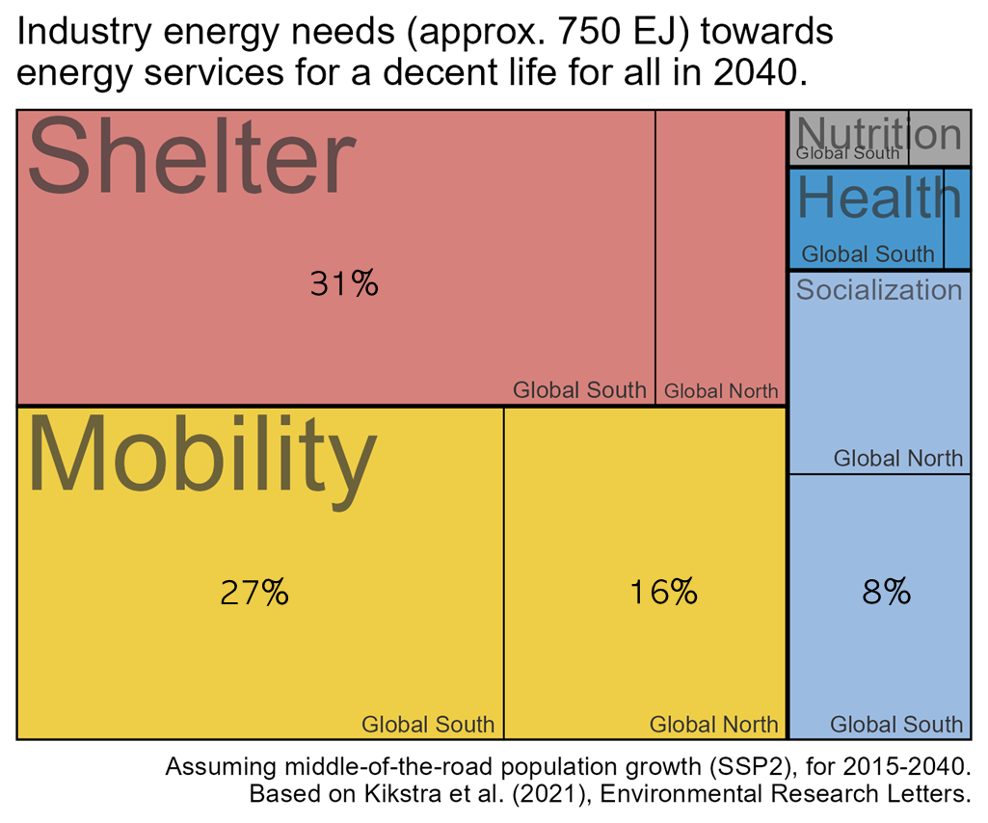
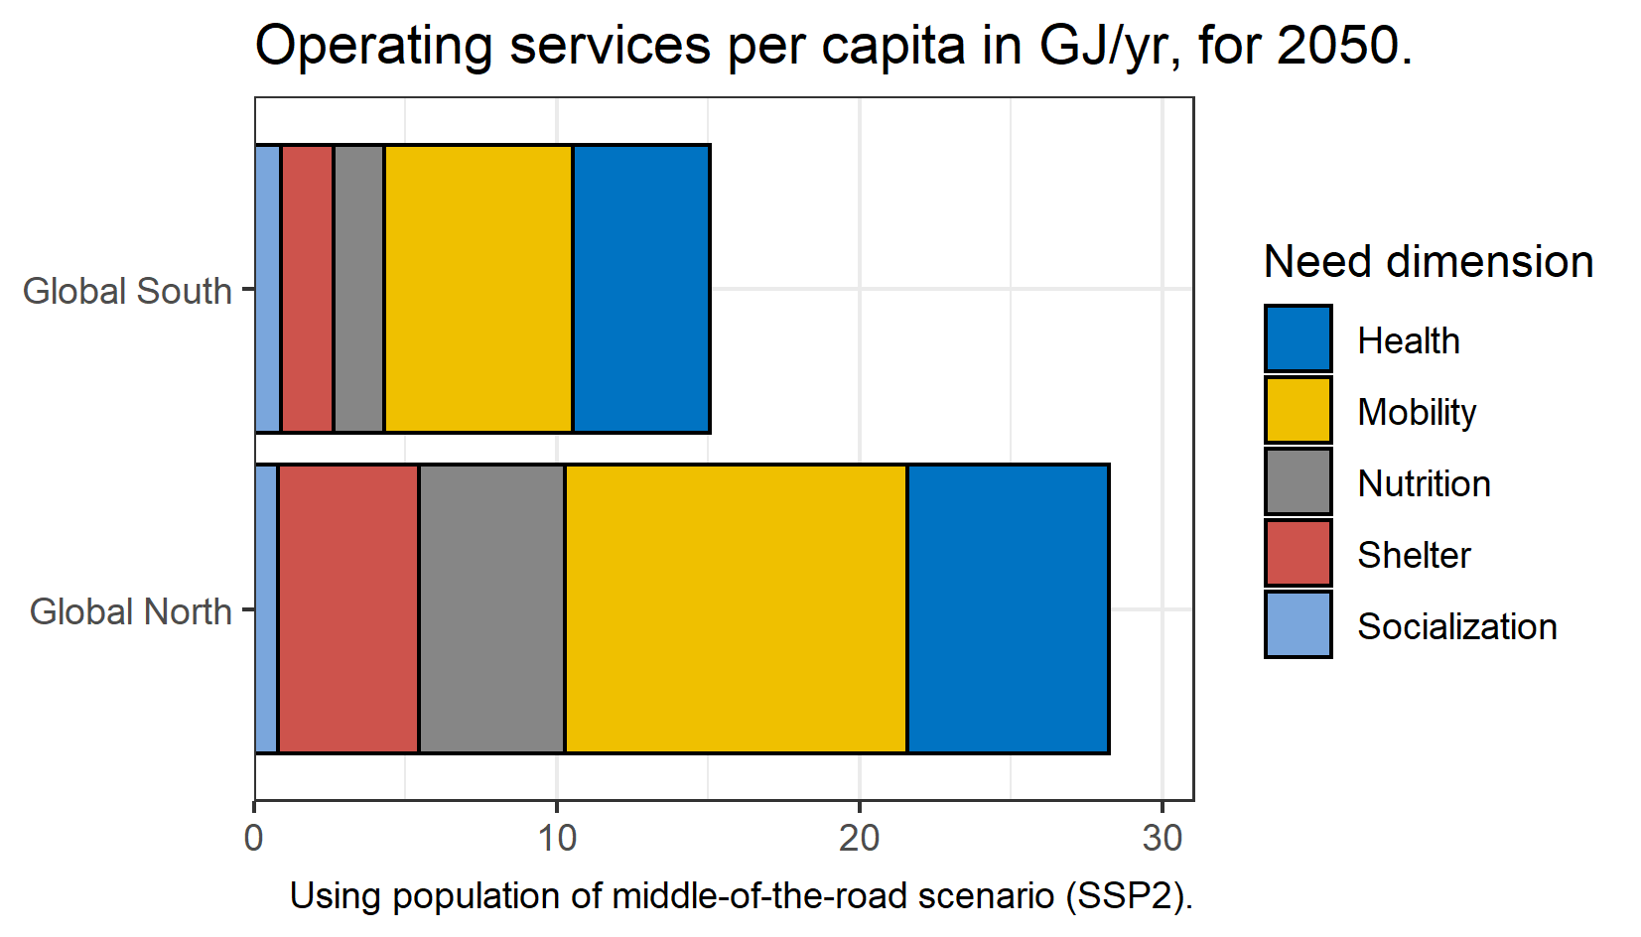
For what do we need energy?
Building new stuff:
  public transport, houses, roads, schools, etc.
  ~12EJ per year, until 2040, or <3% of current energy use
Operating services:
  Total: ~150-160 EJ/yr,
  or about 1/3 of current use
  About ~17 GJ/cap/yr
  Inefficient transport systems, and more heating need in Global North
Kikstra et al. (2021)
Environ. Res. Lett.
10.1088/1748-9326/ac1c27.
Notes:
MRIO +
LCA +
Modelling (simulation)

Slide 19
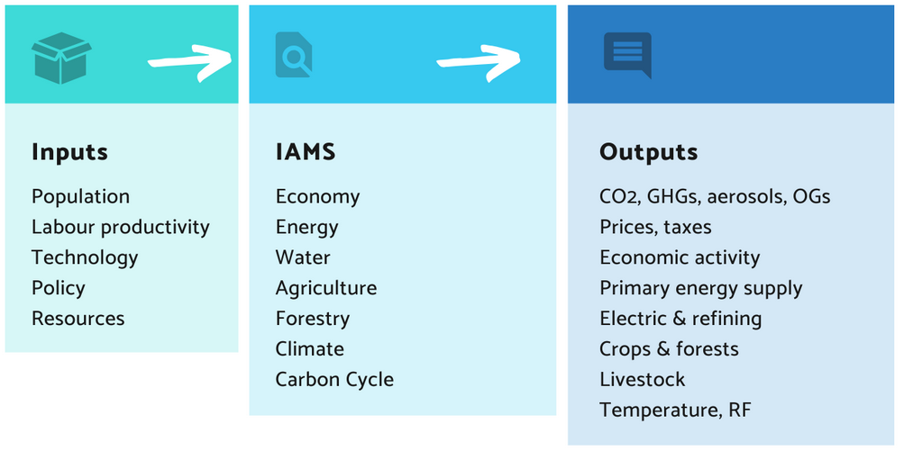
Research Framework
Energy
Method 2: minimum energy requirements.
Method 3: integrated assessment modelling.
Method 1: multidimensional material poverty through Decent Living Standards.
Human needs provisioning
Greenhouse gas emissions
Goal 1: global human development.
Goal 2: climate stabilization.
Notes:
Bringing together different data and methods:
IAM pathways
Dowscaling
Income gini projections
IO table information on current energy inequality
Energy improvement projections: useful to final energy
DLE (all methods) + additional LCA
Impacts: (+climate emulator + buildings modelling)
Note Keywan:
The end-use tech improvement rate within regions is super different… Singapore e.g. does not have the same po
Maybe we can do some conditional convergence, somehow?
Regional improvement trend
+ add; base year performance (do we have country-level useful energy per country {e.g. Alessio and Paul provide some service indicators? – if good info, we can use it. If not available, useful first proxy.})
Can DLE intensities be a good proxy for starting values, where they can improve? Probably not.
Maybe use household energy intensity data?
Or can we disentangle:
Technologies ()
Country-specific factors ()
Question remains whether to stay consistent with IAM assumed EI improvements, or do something more detailed.

Slide 20
Research Framework
Energy
Method 2: minimum energy requirements.
Method 3: integrated assessment modelling.
Method 1: multidimensional material poverty through Decent Living Standards.
Human needs provisioning
Greenhouse gas emissions
Method 3b: reflect poverty within the model and make new scenarios.
Goal 1: global human development.
Goal 2: climate stabilization.
Notes:
Bringing together different data and methods:
IAM pathways
Dowscaling
Income gini projections
IO table information on current energy inequality
Energy improvement projections: useful to final energy
DLE (all methods) + additional LCA
Impacts: (+climate emulator + buildings modelling)
Note Keywan:
The end-use tech improvement rate within regions is super different… Singapore e.g. does not have the same po
Maybe we can do some conditional convergence, somehow?
Regional improvement trend
+ add; base year performance (do we have country-level useful energy per country {e.g. Alessio and Paul provide some service indicators? – if good info, we can use it. If not available, useful first proxy.})
Can DLE intensities be a good proxy for starting values, where they can improve? Probably not.
Maybe use household energy intensity data?
Or can we disentangle:
Technologies ()
Country-specific factors ()
Question remains whether to stay consistent with IAM assumed EI improvements, or do something more detailed.

Slide 21
Research Framework
Energy
Method 2: minimum energy requirements.
Method 3: integrated assessment modelling.
Method 1: multidimensional material poverty through Decent Living Standards.
Human needs provisioning
Greenhouse gas emissions
Method 3b: reflect poverty within the model and make new scenarios.
Goal 1: global human development.
Goal 2: climate stabilization.
Method 3a: analyse existing scenarios.
Notes:
Bringing together different data and methods:
IAM pathways
Dowscaling
Income gini projections
IO table information on current energy inequality
Energy improvement projections: useful to final energy
DLE (all methods) + additional LCA
Impacts: (+climate emulator + buildings modelling)
Note Keywan:
The end-use tech improvement rate within regions is super different… Singapore e.g. does not have the same po
Maybe we can do some conditional convergence, somehow?
Regional improvement trend
+ add; base year performance (do we have country-level useful energy per country {e.g. Alessio and Paul provide some service indicators? – if good info, we can use it. If not available, useful first proxy.})
Can DLE intensities be a good proxy for starting values, where they can improve? Probably not.
Maybe use household energy intensity data?
Or can we disentangle:
Technologies ()
Country-specific factors ()
Question remains whether to stay consistent with IAM assumed EI improvements, or do something more detailed.

Slide 22
Research Framework
Energy
Method 2: minimum energy requirements.
Method 3: integrated assessment modelling.
Method 1: multidimensional material poverty through Decent Living Standards.
Human needs provisioning
What do (existing) IAM scenarios imply about decent living services?
Greenhouse gas emissions
Method 3b: reflect poverty within the model and make new scenarios.
Goal 1: global human development.
Goal 2: climate stabilization.
Method 3a: analyse existing scenarios.
Notes:
Bringing together different data and methods:
IAM pathways
Dowscaling
Income gini projections
IO table information on current energy inequality
Energy improvement projections: useful to final energy
DLE (all methods) + additional LCA
Impacts: (+climate emulator + buildings modelling)
Note Keywan:
The end-use tech improvement rate within regions is super different… Singapore e.g. does not have the same po
Maybe we can do some conditional convergence, somehow?
Regional improvement trend
+ add; base year performance (do we have country-level useful energy per country {e.g. Alessio and Paul provide some service indicators? – if good info, we can use it. If not available, useful first proxy.})
Can DLE intensities be a good proxy for starting values, where they can improve? Probably not.
Maybe use household energy intensity data?
Or can we disentangle:
Technologies ()
Country-specific factors ()
Question remains whether to stay consistent with IAM assumed EI improvements, or do something more detailed.

Slide 23
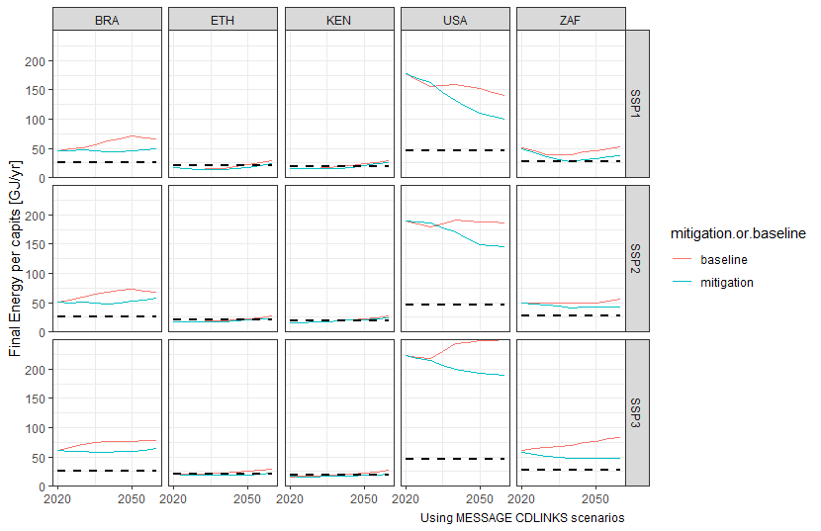
Future international inequality
and poverty
No climate policies
Regional scenarios of energy consumption downscaled to the country-level.
Different
socioeconomic futures
Mitigation
Decent Living threshold
Preliminary results.
Notes:
So, we don’t look at “soft needs”, which are hard to model, but rather just at the material and energy needs that are a pre-requisite for well-being.

Slide 24
Projections of energy inequality
Total final energy
National average energy consumption in BRA
Distribution within country
150
150
2020
2050
Brazil
100
100
Final Energy consumption per capita (GJ/year)
Projected share of population consuming more energy than the estimated energy needs.
Mitigation
50
50
Decent Living threshold
0
2030
0
2020
2040
2050
2020
2050
Projected share of population consuming less energy than the estimated energy needs.

Slide 25
Projections of energy inequality
Total final energy
National average energy consumption in BRA
Distribution within country
150
150
2020
2050
Brazil
100
100
Final Energy consumption per capita (GJ/year)
Projected share of population consuming more energy than the estimated energy needs.
Mitigation
50
50
Decent Living threshold
Possible adjustment with projected technological improvements
0
2030
0
2020
2040
2050
2020
2050
Projected share of population consuming less energy than the estimated energy needs.

Slide 26
Projections of energy inequality
Total final energy
National average energy consumption in BRA
Distribution within country
150
150
2020
2050
Brazil
100
100
Final Energy consumption per capita (GJ/year)
Projected share of population consuming more energy than the estimated energy needs.
Mitigation
50
50
Decent Living threshold
Possible adjustment with projected technological improvements
0
2030
0
2020
2040
2050
2020
2050
Current estimated energy per capita for decent living services
Projected share of population consuming less energy than the estimated energy needs.

Slide 27
Projections of energy inequality
Total final energy
National average energy consumption in BRA
Distribution within country
150
150
2020
2050
Brazil
100
100
No climate policies
Final Energy consumption per capita (GJ/year)
Mitigation
50
50
Decent Living threshold
With very strong projected technological improvements
Mitigation itself, without equity policies could lead to more poverty
0
2030
0
2020
2040
2050
2020
2050
Notes:
Current brazil DLE ~18 GJ/cap

Slide 28
Projections of energy inequality
Total final energy
National average energy consumption in BRA
Distribution within country
150
150
2020
2050
Brazil
100
100
No climate policies
Final Energy consumption per capita (GJ/year)
Mitigation
50
50
e.g., higher cooling need
Decent Living threshold
e.g., lower heating need
With very strong projected technological improvements
Mitigation itself, without equity policies could lead to more poverty
0
2030
0
2020
2040
2050
2020
2050
Notes:
Current brazil DLE ~18 GJ/cap

Slide 29
DLE Calculator
DLE Calculator
IAM scenario data
Data:
Average regional sectoral energy
Socioeconomic projections
Notes:
Bringing together different data and methods:
IAM pathways
Dowscaling
Income gini projections
IO table information on current energy inequality
Energy improvement projections: useful to final energy
DLE (all methods) + additional LCA
Impacts: (+climate emulator + buildings modelling)
Note Keywan:
The end-use tech improvement rate within regions is super different… Singapore e.g. does not have the same po
Maybe we can do some conditional convergence, somehow?
Regional improvement trend
+ add; base year performance (do we have country-level useful energy per country {e.g. Alessio and Paul provide some service indicators? – if good info, we can use it. If not available, useful first proxy.})
Can DLE intensities be a good proxy for starting values, where they can improve? Probably not.
Maybe use household energy intensity data?
Or can we disentangle:
Technologies ()
Country-specific factors ()
Question remains whether to stay consistent with IAM assumed EI improvements, or do something more detailed.

Slide 30
DLE Calculator
DLE Calculator
IAM scenario data
DLE calculator
country-level, per capita
Assume lognormal distribution
Adjust DLE threshold by regional end-use technology improvement
Sectors:
  Transportation
  Residential and Commercial
  Industry
Project average
energy consumption
Project energy
inequality
Project minimum
energy needs
Notes:
Bringing together different data and methods:
IAM pathways
Dowscaling
Income gini projections
IO table information on current energy inequality
Energy improvement projections: useful to final energy
DLE (all methods) + additional LCA
Impacts: (+climate emulator + buildings modelling)
Note Keywan:
The end-use tech improvement rate within regions is super different… Singapore e.g. does not have the same po
Maybe we can do some conditional convergence, somehow?
Regional improvement trend
+ add; base year performance (do we have country-level useful energy per country {e.g. Alessio and Paul provide some service indicators? – if good info, we can use it. If not available, useful first proxy.})
Can DLE intensities be a good proxy for starting values, where they can improve? Probably not.
Maybe use household energy intensity data?
Or can we disentangle:
Technologies ()
Country-specific factors ()
Question remains whether to stay consistent with IAM assumed EI improvements, or do something more detailed.

Slide 31
DLE Calculator
DLE Calculator
IAM scenario data
DLE calculator
country-level, per capita
Assume lognormal distribution
Adjust DLE threshold by regional end-use technology improvement
Sectors:
  Transportation
  Residential and Commercial
  Industry
Downscaling of
Final Energy variables to national level
Sferra et al. 2021
(historical + theoretical model)
Data:
Country-level final energy consumption
Notes:
Bringing together different data and methods:
IAM pathways
Dowscaling
Income gini projections
IO table information on current energy inequality
Energy improvement projections: useful to final energy
DLE (all methods) + additional LCA
Impacts: (+climate emulator + buildings modelling)
Note Keywan:
The end-use tech improvement rate within regions is super different… Singapore e.g. does not have the same po
Maybe we can do some conditional convergence, somehow?
Regional improvement trend
+ add; base year performance (do we have country-level useful energy per country {e.g. Alessio and Paul provide some service indicators? – if good info, we can use it. If not available, useful first proxy.})
Can DLE intensities be a good proxy for starting values, where they can improve? Probably not.
Maybe use household energy intensity data?
Or can we disentangle:
Technologies ()
Country-specific factors ()
Question remains whether to stay consistent with IAM assumed EI improvements, or do something more detailed.

Slide 32
DLE Calculator
DLE Calculator
IAM scenario data
Could be moderated
Basic needs
Country-specifics
Improvement in efficiency of technologies providing energy services
(assume constant for countries within region)
DLE calculator
country-level, per capita
Assume lognormal distribution
Adjust DLE threshold by regional end-use technology improvement
Sectors:
  Transportation
  Residential and Commercial
  Industry
SSP data
Calculated per capita DLE threshold by sector.
Kikstra et al. 2021
(historical + theoretical model)
Map DLE to IAM sectors
This paper
(mapping matrix)
Data:
Bottom-up DLE threshold mapped on IAM sectoral data
Scaled DLE threshold with innovation
Notes:
Bringing together different data and methods:
IAM pathways
Dowscaling
Income gini projections
IO table information on current energy inequality
Energy improvement projections: useful to final energy
DLE (all methods) + additional LCA
Impacts: (+climate emulator + buildings modelling)
Note Keywan:
The end-use tech improvement rate within regions is super different… Singapore e.g. does not have the same po
Maybe we can do some conditional convergence, somehow?
Regional improvement trend
+ add; base year performance (do we have country-level useful energy per country {e.g. Alessio and Paul provide some service indicators? – if good info, we can use it. If not available, useful first proxy.})
Can DLE intensities be a good proxy for starting values, where they can improve? Probably not.
Maybe use household energy intensity data?
Or can we disentangle:
Technologies ()
Country-specific factors ()
Question remains whether to stay consistent with IAM assumed EI improvements, or do something more detailed.

Slide 33
DLE Calculator
DLE Calculator
IAM scenario data
SSP variant
DLE calculator
country-level, per capita
Assume lognormal distribution
Adjust DLE threshold by regional end-use technology improvement
Sectors:
  Transportation
  Residential and Commercial
  Industry
Income Gini pathways from Rao et al. 2019
(assume constant across mitigation within SSP)
Assume changes in energy inequality are driven by changes in income.
Data:
Income inequality projections
Notes:
Bringing together different data and methods:
IAM pathways
Dowscaling
Income gini projections
IO table information on current energy inequality
Energy improvement projections: useful to final energy
DLE (all methods) + additional LCA
Impacts: (+climate emulator + buildings modelling)
Note Keywan:
The end-use tech improvement rate within regions is super different… Singapore e.g. does not have the same po
Maybe we can do some conditional convergence, somehow?
Regional improvement trend
+ add; base year performance (do we have country-level useful energy per country {e.g. Alessio and Paul provide some service indicators? – if good info, we can use it. If not available, useful first proxy.})
Can DLE intensities be a good proxy for starting values, where they can improve? Probably not.
Maybe use household energy intensity data?
Or can we disentangle:
Technologies ()
Country-specific factors ()
Question remains whether to stay consistent with IAM assumed EI improvements, or do something more detailed.

Slide 34
DLE Calculator
DLE Calculator
IAM scenario data
SSP variant
DLE calculator
country-level, per capita
Assume lognormal distribution
Adjust DLE threshold by regional end-use technology improvement
Sectors:
  Transportation
  Residential and Commercial
  Industry
Gini pathways from Rao et al. 2019
(assume constant across mitigation within SSP)
Income-to-energy Gini coefficients
Oswald et al. 2021
(theoretical model)
Project Gini Final energy
Data:
Household inequality starting point
(global) Relationship energy and income inequality
Household energy inequality data
Oswald et al. 2020
(historical)
Notes:
Bringing together different data and methods:
IAM pathways
Dowscaling
Income gini projections
IO table information on current energy inequality
Energy improvement projections: useful to final energy
DLE (all methods) + additional LCA
Impacts: (+climate emulator + buildings modelling)
Note Keywan:
The end-use tech improvement rate within regions is super different… Singapore e.g. does not have the same po
Maybe we can do some conditional convergence, somehow?
Regional improvement trend
+ add; base year performance (do we have country-level useful energy per country {e.g. Alessio and Paul provide some service indicators? – if good info, we can use it. If not available, useful first proxy.})
Can DLE intensities be a good proxy for starting values, where they can improve? Probably not.
Maybe use household energy intensity data?
Or can we disentangle:
Technologies ()
Country-specific factors ()
Question remains whether to stay consistent with IAM assumed EI improvements, or do something more detailed.

Slide 35
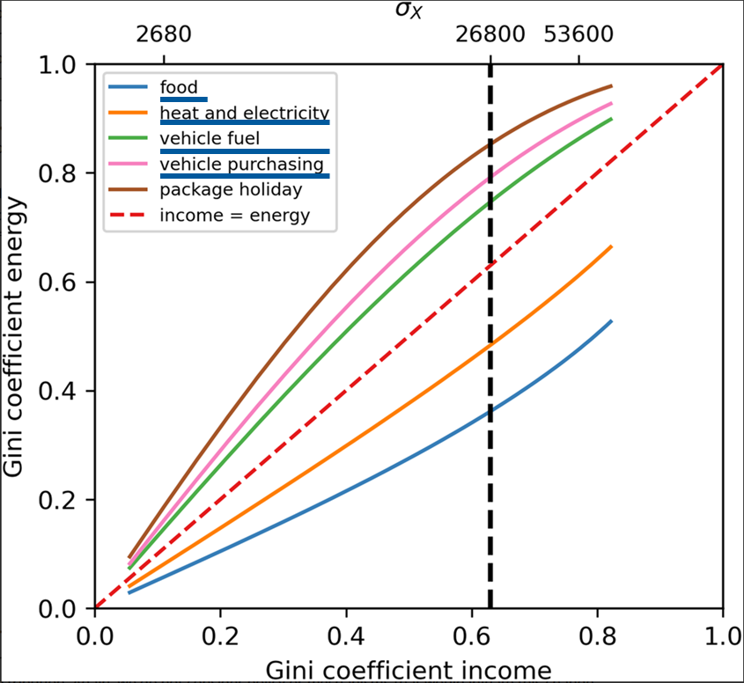
DLE Calculator
DLE Calculator
IAM scenario data
SSP variant
DLE calculator
country-level, per capita
Assume lognormal distribution
Adjust DLE threshold by regional end-use technology improvement
Sectors:
  Transportation
  Residential and Commercial
  Industry
Gini pathways from Rao et al. 2019
(assume constant across mitigation within SSP)
Income-to-energy Gini coefficients
Oswald et al. 2021
(theoretical model)
Project Gini Final energy
Data:
Household inequality starting point
(global) income elasticity: relationship energy and income inequality
Household energy inequality data
Oswald et al. 2020
(historical)
Notes:
Bringing together different data and methods:
IAM pathways
Dowscaling
Income gini projections
IO table information on current energy inequality
Energy improvement projections: useful to final energy
DLE (all methods) + additional LCA
Impacts: (+climate emulator + buildings modelling)
Note Keywan:
The end-use tech improvement rate within regions is super different… Singapore e.g. does not have the same po
Maybe we can do some conditional convergence, somehow?
Regional improvement trend
+ add; base year performance (do we have country-level useful energy per country {e.g. Alessio and Paul provide some service indicators? – if good info, we can use it. If not available, useful first proxy.})
Can DLE intensities be a good proxy for starting values, where they can improve? Probably not.
Maybe use household energy intensity data?
Or can we disentangle:
Technologies ()
Country-specific factors ()
Question remains whether to stay consistent with IAM assumed EI improvements, or do something more detailed.

Slide 36
DLE Calculator
DLE Calculator
IAM scenario data
SSP variant
Could be moderated
Basic needs
Country-specifics
Gini pathways from Rao et al. 2019
(assume constant across mitigation within SSP)
Improvement in efficiency of technologies providing energy services
(assume constant for countries within region)
DLE calculator
country-level, per capita
Assume lognormal distribution
Adjust DLE threshold by regional end-use technology improvement
Sectors:
  Transportation
  Residential and Commercial
  Industry
SSP data
Downscaling of
Final Energy variables to national level
Sferra et al. 2021
(historical + theoretical model)
Income-to-energy Gini coefficients
Oswald et al. 2021
(theoretical model)
Project Gini Final energy
Calculated per capita DLE threshold by sector.
Kikstra et al. 2021
(historical + theoretical model)
Map DLE to IAM sectors
This paper
(mapping matrix)
Household energy inequality data
Oswald et al. 2020
(historical)
Output variables of interest:
Estimated share of population below DLE threshold
Average gap
(final energy/cap below DLE threshold)
Notes:
Bringing together different data and methods:
IAM pathways
Dowscaling
Income gini projections
IO table information on current energy inequality
Energy improvement projections: useful to final energy
DLE (all methods) + additional LCA
Impacts: (+climate emulator + buildings modelling)
Note Keywan:
The end-use tech improvement rate within regions is super different… Singapore e.g. does not have the same po
Maybe we can do some conditional convergence, somehow?
Regional improvement trend
+ add; base year performance (do we have country-level useful energy per country {e.g. Alessio and Paul provide some service indicators? – if good info, we can use it. If not available, useful first proxy.})
Can DLE intensities be a good proxy for starting values, where they can improve? Probably not.
Maybe use household energy intensity data?
Or can we disentangle:
Technologies ()
Country-specific factors ()
Question remains whether to stay consistent with IAM assumed EI improvements, or do something more detailed.

Slide 37
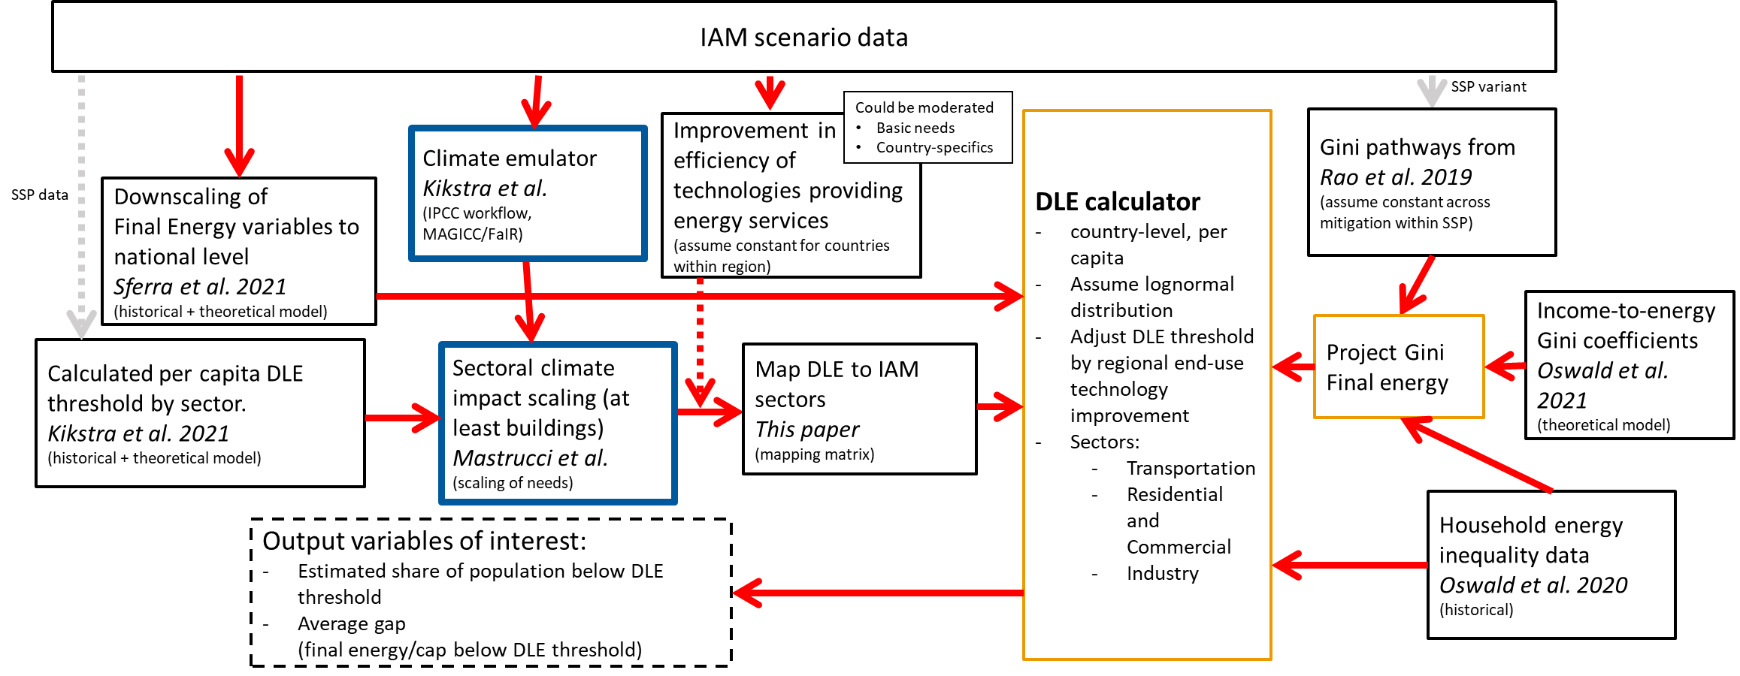
DLE Calculator – with climate impacts
Notes:
Note Keywan:
The end-use tech improvement rate within regions is super different… Singapore e.g. does not have the same po
Maybe we can do some conditional convergence, somehow?
Regional improvement trend
+ add; base year performance (do we have country-level useful energy per country {e.g. Alessio and Paul provide some service indicators? – if good info, we can use it. If not available, useful first proxy.})
Can DLE intensities be a good proxy for starting values, where they can improve? Probably not.
Maybe use household energy intensity data?
Or can we disentangle:
Technologies ()
Country-specific factors ()
Question remains whether to stay consistent with IAM assumed EI improvements, or do something more detailed.

Slide 38
Wrap-up
Method 1: multidimensional material poverty.
Goal 1: development.
Method 2: minimum energy requirements.
Energy services
Method 3: integrated assessment modelling.
Goal 2: temperature stabilization.
Notes:
Bringing together different data and methods:
IAM pathways
Dowscaling
Income gini projections
IO table information on current energy inequality
Energy improvement projections: useful to final energy
DLE (all methods) + additional LCA
Impacts: (+climate emulator + buildings modelling)
Note Keywan:
The end-use tech improvement rate within regions is super different… Singapore e.g. does not have the same po
Maybe we can do some conditional convergence, somehow?
Regional improvement trend
+ add; base year performance (do we have country-level useful energy per country {e.g. Alessio and Paul provide some service indicators? – if good info, we can use it. If not available, useful first proxy.})
Can DLE intensities be a good proxy for starting values, where they can improve? Probably not.
Maybe use household energy intensity data?
Or can we disentangle:
Technologies ()
Country-specific factors ()
Question remains whether to stay consistent with IAM assumed EI improvements, or do something more detailed.

Slide 39
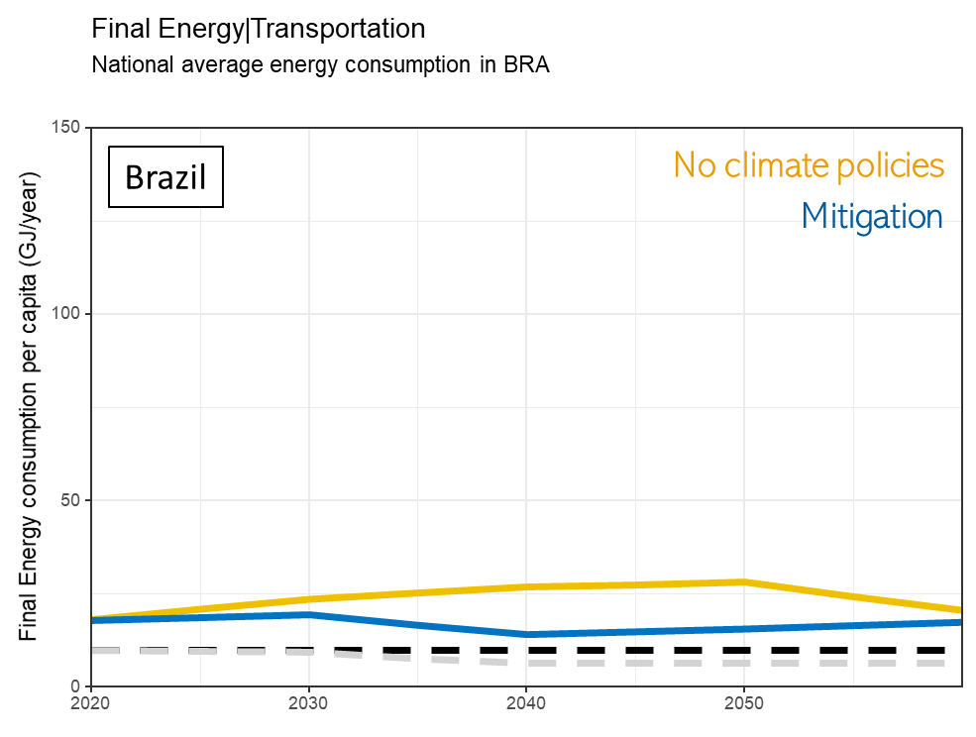
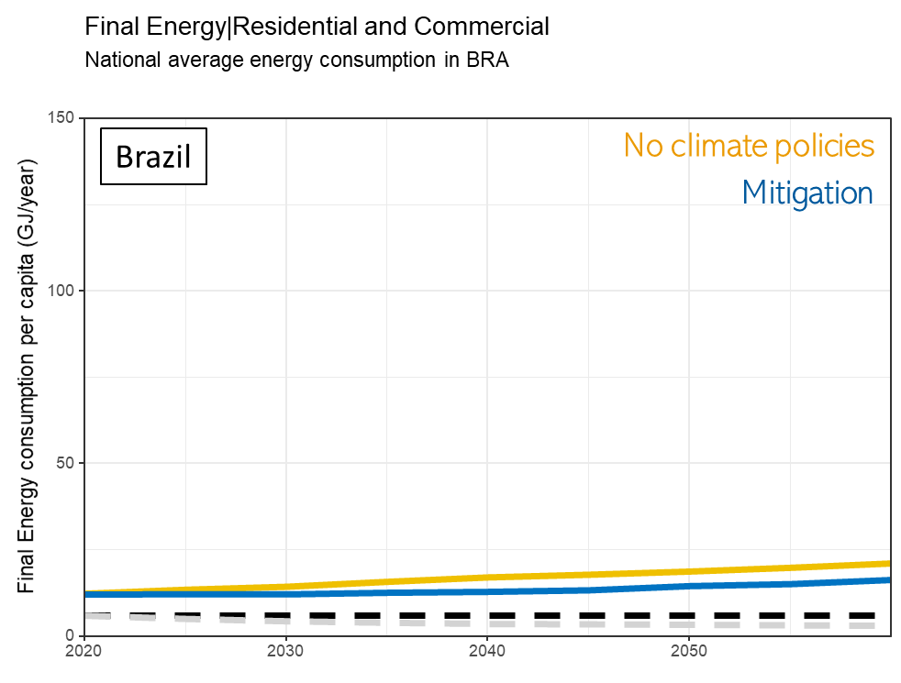
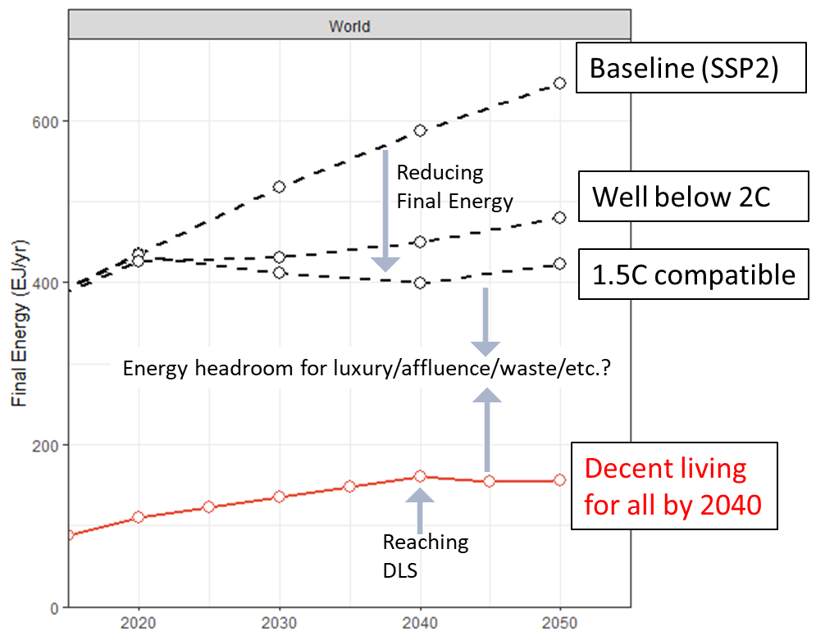
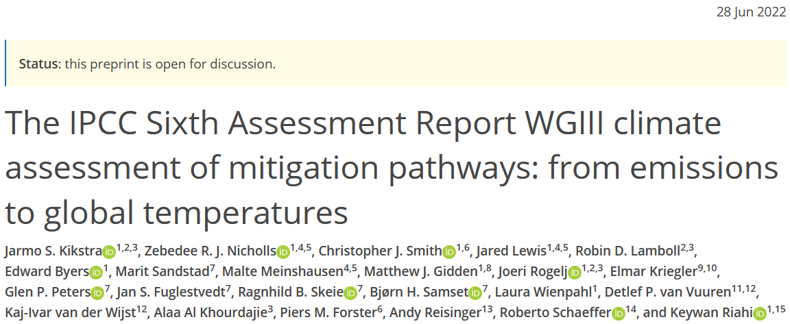


Next steps
Method 1: multidimensional material poverty.
Goal 1: development.
Method 2: minimum energy requirements.
Energy services
Method 3: integrated assessment modelling.
Goal 2: temperature stabilization.
Sectoral analysis
Integrating climate change
New full-economy scenarios
Notes:
Bringing together different data and methods:
IAM pathways
Dowscaling
Income gini projections
IO table information on current energy inequality
Energy improvement projections: useful to final energy
DLE (all methods) + additional LCA
Impacts: (+climate emulator + buildings modelling)
Note Keywan:
The end-use tech improvement rate within regions is super different… Singapore e.g. does not have the same po
Maybe we can do some conditional convergence, somehow?
Regional improvement trend
+ add; base year performance (do we have country-level useful energy per country {e.g. Alessio and Paul provide some service indicators? – if good info, we can use it. If not available, useful first proxy.})
Can DLE intensities be a good proxy for starting values, where they can improve? Probably not.
Maybe use household energy intensity data?
Or can we disentangle:
Technologies ()
Country-specific factors ()
Question remains whether to stay consistent with IAM assumed EI improvements, or do something more detailed.

Slide 40
Thank you for your attention!
Jarmo Kikstra
^{CEP PhD Symposium}
^{30 June 2022}
Grantham Institute and
Centre for Environmental Policy, Imperial College London
International Institute for Applied Systems Analysis (IIASA)
Notes:
In the coming decades, global society needs to reduce greenhouse gas emissions at an unprecedented pace.
At the same time, many poor regions require growth in energy access to lift people out of poverty.
This PhD project aims to bring together poverty eradication and climate mitigation through energy research.

Slide 41
Acknowledgments
Thanks to supervisors and collaborators:
Joeri Rogelj
Jihoon Min
Narasimha Rao
Alessio Mastrucci
Keywan Riahi
Shonali Pachauri
Bas van Ruijven
Fabio Sferra
Zebedee Nicholls
… more …

Slide 42
References
Brand-Correa, Lina I., and Julia K. Steinberger. "A framework for decoupling human need satisfaction from energy use." Ecological Economics 141 (2017): 43-52.
Kikstra, Jarmo S., et al. "Decent living gaps and energy needs around the world." Environmental Research Letters 16.9 (2021): 095006.
Kikstra, Jarmo S., et al.: The IPCC Sixth Assessment Report WGIII climate assessment of mitigation pathways: from emissions to global temperatures, EGUsphere [preprint], https://doi.org/10.5194/egusphere-2022-471, 2022.
Oswald, Yannick, Anne Owen, and Julia K. Steinberger. "Large inequality in international and intranational energy footprints between income groups and across consumption categories." Nature Energy 5.3 (2020): 231-239.
Oswald, Yannick, et al. "Global redistribution of income and household energy footprints: a computational thought experiment." Global Sustainability 4 (2021).
Rao, Narasimha D., and Jihoon Min. "Decent living standards: material prerequisites for human wellbeing." Social indicators research 138.1 (2018): 225-244.
Sferra, Fabio, Bas van Ruijven, and Keywan Riahi. "Downscaling IAMs results to the country level–a new algorithm." (2021).
Virág, Doris, et al. "How much infrastructure is required to support decent mobility for all? An exploratory assessment." Ecological Economics 200 (2022): 107511.

Slide 43
Starting question:
What do (existing) IAM scenarios imply about decent living services?
Notes:
In the coming decades, global society needs to reduce greenhouse gas emissions at an unprecedented pace.
At the same time, many poor regions require growth in energy access to lift people out of poverty.
This PhD project aims to bring together poverty eradication and climate mitigation through energy research.

Slide 44
DLE Calculator
DLE Calculator
IAM scenario data
SSP variant
Could be moderated
Basic needs
Country-specifics
Gini pathways from Rao et al. 2019
(assume constant across mitigation within SSP)
Improvement in efficiency of technologies providing energy services
(assume constant for countries within region)
DLE calculator
country-level, per capita
Assume lognormal distribution
Adjust DLE threshold by regional end-use technology improvement
Sectors:
  Transportation
  Residential and Commercial
  Industry
SSP data
Downscaling of
Final Energy variables to national level
Sferra et al. 2021
(historical + theoretical model)
Income-to-energy Gini coefficients
Oswald et al. 2021
(theoretical model)
Project Gini Final energy
Calculated per capita DLE threshold by sector.
Kikstra et al. 2021
(historical + theoretical model)
Map DLE to IAM sectors
This paper
(mapping matrix)
Household energy inequality data
Oswald et al. 2020
(historical)
Output variables of interest:
Estimated share of population below DLE threshold
Average gap
(final energy/cap below DLE threshold)
Notes:
Bringing together different data and methods:
IAM pathways
Dowscaling
Income gini projections
IO table information on current energy inequality
Energy improvement projections: useful to final energy
DLE (all methods) + additional LCA
Impacts: (+climate emulator + buildings modelling)
Note Keywan:
The end-use tech improvement rate within regions is super different… Singapore e.g. does not have the same po
Maybe we can do some conditional convergence, somehow?
Regional improvement trend
+ add; base year performance (do we have country-level useful energy per country {e.g. Alessio and Paul provide some service indicators? – if good info, we can use it. If not available, useful first proxy.})
Can DLE intensities be a good proxy for starting values, where they can improve? Probably not.
Maybe use household energy intensity data?
Or can we disentangle:
Technologies ()
Country-specific factors ()
Question remains whether to stay consistent with IAM assumed EI improvements, or do something more detailed.

Slide 45
DLE Calculator
DLE Calculator
IAM scenario data
Data:
Average regional sectoral energy
Socioeconomic projections
Notes:
Bringing together different data and methods:
IAM pathways
Dowscaling
Income gini projections
IO table information on current energy inequality
Energy improvement projections: useful to final energy
DLE (all methods) + additional LCA
Impacts: (+climate emulator + buildings modelling)
Note Keywan:
The end-use tech improvement rate within regions is super different… Singapore e.g. does not have the same po
Maybe we can do some conditional convergence, somehow?
Regional improvement trend
+ add; base year performance (do we have country-level useful energy per country {e.g. Alessio and Paul provide some service indicators? – if good info, we can use it. If not available, useful first proxy.})
Can DLE intensities be a good proxy for starting values, where they can improve? Probably not.
Maybe use household energy intensity data?
Or can we disentangle:
Technologies ()
Country-specific factors ()
Question remains whether to stay consistent with IAM assumed EI improvements, or do something more detailed.

Slide 46
DLE Calculator
DLE Calculator
IAM scenario data
DLE calculator
country-level, per capita
Assume lognormal distribution
Adjust DLE threshold by regional end-use technology improvement
Sectors:
  Transportation
  Residential and Commercial
  Industry
Downscaling of
Final Energy variables to national level
Sferra et al. 2021
(historical + theoretical model)
Data:
Country-level final energy consumption
Notes:
Bringing together different data and methods:
IAM pathways
Dowscaling
Income gini projections
IO table information on current energy inequality
Energy improvement projections: useful to final energy
DLE (all methods) + additional LCA
Impacts: (+climate emulator + buildings modelling)
Note Keywan:
The end-use tech improvement rate within regions is super different… Singapore e.g. does not have the same po
Maybe we can do some conditional convergence, somehow?
Regional improvement trend
+ add; base year performance (do we have country-level useful energy per country {e.g. Alessio and Paul provide some service indicators? – if good info, we can use it. If not available, useful first proxy.})
Can DLE intensities be a good proxy for starting values, where they can improve? Probably not.
Maybe use household energy intensity data?
Or can we disentangle:
Technologies ()
Country-specific factors ()
Question remains whether to stay consistent with IAM assumed EI improvements, or do something more detailed.

Slide 47
DLE Calculator
DLE Calculator
IAM scenario data
Could be moderated
Basic needs
Country-specifics
Improvement in efficiency of technologies providing energy services
(assume constant for countries within region)
DLE calculator
country-level, per capita
Assume lognormal distribution
Adjust DLE threshold by regional end-use technology improvement
Sectors:
  Transportation
  Residential and Commercial
  Industry
SSP data
Calculated per capita DLE threshold by sector.
Kikstra et al. 2021
(historical + theoretical model)
Map DLE to IAM sectors
This paper
(mapping matrix)
Data:
Bottom-up DLE threshold mapped on IAM sectoral data
Scaled DLE threshold with innovation
Notes:
Bringing together different data and methods:
IAM pathways
Dowscaling
Income gini projections
IO table information on current energy inequality
Energy improvement projections: useful to final energy
DLE (all methods) + additional LCA
Impacts: (+climate emulator + buildings modelling)
Note Keywan:
The end-use tech improvement rate within regions is super different… Singapore e.g. does not have the same po
Maybe we can do some conditional convergence, somehow?
Regional improvement trend
+ add; base year performance (do we have country-level useful energy per country {e.g. Alessio and Paul provide some service indicators? – if good info, we can use it. If not available, useful first proxy.})
Can DLE intensities be a good proxy for starting values, where they can improve? Probably not.
Maybe use household energy intensity data?
Or can we disentangle:
Technologies ()
Country-specific factors ()
Question remains whether to stay consistent with IAM assumed EI improvements, or do something more detailed.

Slide 48
DLE Calculator
DLE Calculator
IAM scenario data
SSP variant
DLE calculator
country-level, per capita
Assume lognormal distribution
Adjust DLE threshold by regional end-use technology improvement
Sectors:
  Transportation
  Residential and Commercial
  Industry
Gini pathways from Rao et al. 2019
(assume constant across mitigation within SSP)
Data:
Income inequality projections
Notes:
Bringing together different data and methods:
IAM pathways
Dowscaling
Income gini projections
IO table information on current energy inequality
Energy improvement projections: useful to final energy
DLE (all methods) + additional LCA
Impacts: (+climate emulator + buildings modelling)
Note Keywan:
The end-use tech improvement rate within regions is super different… Singapore e.g. does not have the same po
Maybe we can do some conditional convergence, somehow?
Regional improvement trend
+ add; base year performance (do we have country-level useful energy per country {e.g. Alessio and Paul provide some service indicators? – if good info, we can use it. If not available, useful first proxy.})
Can DLE intensities be a good proxy for starting values, where they can improve? Probably not.
Maybe use household energy intensity data?
Or can we disentangle:
Technologies ()
Country-specific factors ()
Question remains whether to stay consistent with IAM assumed EI improvements, or do something more detailed.

Slide 49
DLE Calculator
DLE Calculator
IAM scenario data
SSP variant
DLE calculator
country-level, per capita
Assume lognormal distribution
Adjust DLE threshold by regional end-use technology improvement
Sectors:
  Transportation
  Residential and Commercial
  Industry
Gini pathways from Rao et al. 2019
(assume constant across mitigation within SSP)
Income-to-energy Gini coefficients
Oswald et al. 2021
(theoretical model)
Project Gini Final energy
Data:
Household inequality starting point
(global) Relationship energy and income inequality
Household energy inequality data
Oswald et al. 2020
(historical)
Notes:
Bringing together different data and methods:
IAM pathways
Dowscaling
Income gini projections
IO table information on current energy inequality
Energy improvement projections: useful to final energy
DLE (all methods) + additional LCA
Impacts: (+climate emulator + buildings modelling)
Note Keywan:
The end-use tech improvement rate within regions is super different… Singapore e.g. does not have the same po
Maybe we can do some conditional convergence, somehow?
Regional improvement trend
+ add; base year performance (do we have country-level useful energy per country {e.g. Alessio and Paul provide some service indicators? – if good info, we can use it. If not available, useful first proxy.})
Can DLE intensities be a good proxy for starting values, where they can improve? Probably not.
Maybe use household energy intensity data?
Or can we disentangle:
Technologies ()
Country-specific factors ()
Question remains whether to stay consistent with IAM assumed EI improvements, or do something more detailed.

Slide 50
DLE Calculator
DLE Calculator
IAM scenario data
SSP variant
DLE calculator
country-level, per capita
Assume lognormal distribution
Adjust DLE threshold by regional end-use technology improvement
Sectors:
  Transportation
  Residential and Commercial
  Industry
Gini pathways from Rao et al. 2019
(assume constant across mitigation within SSP)
Income-to-energy Gini coefficients
Oswald et al. 2021
(theoretical model)
Project Gini Final energy
Data:
Household inequality starting point
(global) Relationship energy and income inequality
Household energy inequality data
Oswald et al. 2020
(historical)
Notes:
Bringing together different data and methods:
IAM pathways
Dowscaling
Income gini projections
IO table information on current energy inequality
Energy improvement projections: useful to final energy
DLE (all methods) + additional LCA
Impacts: (+climate emulator + buildings modelling)
Note Keywan:
The end-use tech improvement rate within regions is super different… Singapore e.g. does not have the same po
Maybe we can do some conditional convergence, somehow?
Regional improvement trend
+ add; base year performance (do we have country-level useful energy per country {e.g. Alessio and Paul provide some service indicators? – if good info, we can use it. If not available, useful first proxy.})
Can DLE intensities be a good proxy for starting values, where they can improve? Probably not.
Maybe use household energy intensity data?
Or can we disentangle:
Technologies ()
Country-specific factors ()
Question remains whether to stay consistent with IAM assumed EI improvements, or do something more detailed.

Slide 51
DLE Calculator
DLE Calculator
IAM scenario data
SSP variant
Could be moderated
Basic needs
Country-specifics
Gini pathways from Rao et al. 2019
(assume constant across mitigation within SSP)
Improvement in efficiency of technologies providing energy services
(assume constant for countries within region)
DLE calculator
country-level, per capita
Assume lognormal distribution
Adjust DLE threshold by regional end-use technology improvement
Sectors:
  Transportation
  Residential and Commercial
  Industry
SSP data
Downscaling of
Final Energy variables to national level
Sferra et al. 2021
(historical + theoretical model)
Income-to-energy Gini coefficients
Oswald et al. 2021
(theoretical model)
Project Gini Final energy
Calculated per capita DLE threshold by sector.
Kikstra et al. 2021
(historical + theoretical model)
Map DLE to IAM sectors
This paper
(mapping matrix)
Household energy inequality data
Oswald et al. 2020
(historical)
Output variables of interest:
Estimated share of population below DLE threshold
Average gap
(final energy/cap below DLE threshold)
Notes:
Bringing together different data and methods:
IAM pathways
Dowscaling
Income gini projections
IO table information on current energy inequality
Energy improvement projections: useful to final energy
DLE (all methods) + additional LCA
Impacts: (+climate emulator + buildings modelling)
Note Keywan:
The end-use tech improvement rate within regions is super different… Singapore e.g. does not have the same po
Maybe we can do some conditional convergence, somehow?
Regional improvement trend
+ add; base year performance (do we have country-level useful energy per country {e.g. Alessio and Paul provide some service indicators? – if good info, we can use it. If not available, useful first proxy.})
Can DLE intensities be a good proxy for starting values, where they can improve? Probably not.
Maybe use household energy intensity data?
Or can we disentangle:
Technologies ()
Country-specific factors ()
Question remains whether to stay consistent with IAM assumed EI improvements, or do something more detailed.

Slide 52
DLE Calculator – with climate impacts
IAM scenario data
SSP variant
Could be moderated
Basic needs
Country-specifics
Gini pathways from Rao et al. 2019
(assume constant across mitigation within SSP)
Improvement in efficiency of technologies providing energy services
(assume constant for countries within region)
DLE calculator
country-level, per capita
Assume lognormal distribution
Adjust DLE threshold by regional end-use technology improvement
Sectors:
  Transportation
  Residential and Commercial
  Industry
Climate emulator
Kikstra et al.
(IPCC workflow, MAGICC/FaIR)
SSP data
Downscaling of
Final Energy variables to national level
Sferra et al. 2021
(historical + theoretical model)
Income-to-energy Gini coefficients
Oswald et al. 2021
(theoretical model)
Project Gini Final energy
Calculated per capita DLE threshold by sector.
Kikstra et al. 2021
(historical + theoretical model)
Sectoral climate impact scaling (at least buildings)
Mastrucci et al.
(scaling of needs)
Map DLE to IAM sectors
This paper
(mapping matrix)
Household energy inequality data
Oswald et al. 2020
(historical)
Output variables of interest:
Estimated share of population below DLE threshold
Average gap
(final energy/cap below DLE threshold)
Notes:
Note Keywan:
The end-use tech improvement rate within regions is super different… Singapore e.g. does not have the same po
Maybe we can do some conditional convergence, somehow?
Regional improvement trend
+ add; base year performance (do we have country-level useful energy per country {e.g. Alessio and Paul provide some service indicators? – if good info, we can use it. If not available, useful first proxy.})
Can DLE intensities be a good proxy for starting values, where they can improve? Probably not.
Maybe use household energy intensity data?
Or can we disentangle:
Technologies ()
Country-specific factors ()
Question remains whether to stay consistent with IAM assumed EI improvements, or do something more detailed.

Slide 53
DLE Calculator – with climate impacts
IAM scenario data
SSP variant
Could be moderated
Basic needs
Country-specifics
Gini pathways from Rao et al. 2019
(assume constant across mitigation within SSP)
Climate simulation (global emulator {+downscaling tools?})
Improvement in efficiency of technologies providing energy services
(assume constant for countries within region)
DLE calculator
country-level, per capita
Assume lognormal distribution
Adjust DLE threshold by regional end-use technology improvement
Sectors:
  Transportation
  Residential and Commercial
  Industry
SSP data
Downscaling of
Final Energy variables to national level
Sferra et al. 2021
(historical + theoretical model)
Income-to-energy Gini coefficients
Oswald et al. 2021
(theoretical model)
Project Gini Final energy
Calculated per capita DLE threshold by sector.
Kikstra et al. 2021
(historical + theoretical model)
Scaling of sectoral needs because of climate impacts (of risks/extremes and means)
Map DLE to IAM sectors
This paper
(mapping matrix)
Household energy inequality data
Oswald et al. 2020
(historical)
Output variables of interest:
Estimated share of population below DLE threshold
Average gap
(final energy/cap below DLE threshold)
Notes:
Note Keywan:
The end-use tech improvement rate within regions is super different… Singapore e.g. does not have the same po
Maybe we can do some conditional convergence, somehow?
Regional improvement trend
+ add; base year performance (do we have country-level useful energy per country {e.g. Alessio and Paul provide some service indicators? – if good info, we can use it. If not available, useful first proxy.})
Can DLE intensities be a good proxy for starting values, where they can improve? Probably not.
Maybe use household energy intensity data?
Or can we disentangle:
Technologies ()
Country-specific factors ()
Question remains whether to stay consistent with IAM assumed EI improvements, or do something more detailed.

Slide 54
DLE Calculator – with (partial) climate impacts
Notes:
Note Keywan:
The end-use tech improvement rate within regions is super different… Singapore e.g. does not have the same po
Maybe we can do some conditional convergence, somehow?
Regional improvement trend
+ add; base year performance (do we have country-level useful energy per country {e.g. Alessio and Paul provide some service indicators? – if good info, we can use it. If not available, useful first proxy.})
Can DLE intensities be a good proxy for starting values, where they can improve? Probably not.
Maybe use household energy intensity data?
Or can we disentangle:
Technologies ()
Country-specific factors ()
Question remains whether to stay consistent with IAM assumed EI improvements, or do something more detailed.

Slide 55
Thinking about national scenarios
Inequality within countries
Using MESSAGEix-GLOBIOM CD-LINKS scenarios as an example
Notes:
In the coming decades, global society needs to reduce greenhouse gas emissions at an unprecedented pace.
At the same time, many poor regions require growth in energy access to lift people out of poverty.
This PhD project aims to bring together poverty eradication and climate mitigation through energy research.

Slide 56
Projections of energy inequality
Total final energy
National average energy consumption in BRA
Distribution within country
150
150
2020
2050
Brazil
100
100
No climate policies
Final Energy consumption per capita (GJ/year)
Mitigation
50
50
e.g., higher cooling need
Decent Living threshold
e.g., lower heating need
Mitigation itself, without equity policies could lead to more poverty
0
2030
0
2020
2040
2050
2020
2050
Notes:
Current brazil DLE ~18 GJ/cap

Slide 57
Total final energy
National average energy consumption in KEN
Distribution within country
150
150
2020
2050
Kenya
No climate policies
Mitigation
100
100
Final Energy consumption per capita (GJ/year)
50
50
0
2030
0
2020
2040
2050
2020
2050

Slide 58
Total final energy
National average energy consumption in ZAF
Distribution within country
150
150
2020
2050
South Africa
No climate policies
Mitigation
100
100
Final Energy consumption per capita (GJ/year)
50
50
0
2030
0
2020
2040
2050
2020
2050

Slide 59
Total final energy
National average energy consumption in ETH
Distribution within country
150
150
2020
2050
Ethiopia
No climate policies
Mitigation
100
100
Final Energy consumption per capita (GJ/year)
50
50
0
2030
0
2020
2040
2050
2020
2050

Slide 60
Total final energy
National average energy consumption in GBR
Distribution within country
150
150
2020
2050
United Kingdom
No climate policies
Mitigation
100
100
Final Energy consumption per capita (GJ/year)
50
50
0
2030
0
2020
2040
2050
2020
2050

Slide 61
Total final energy
National average energy consumption in USA
Distribution within country
150
150
2020
2050
USA
No climate policies
100
Mitigation
100
Final Energy consumption per capita (GJ/year)
50
50
0
2030
0
2020
2040
2050
2020
2050

Slide 62
Total final energy
National average energy consumption in BRA
Distribution within country
150
150
2020
2050
Brazil
No climate policies
Mitigation
100
100
Final Energy consumption per capita (GJ/year)
50
50
0
2030
0
2020
2040
2050
2020
2050

Slide 63
Some preliminary sectoral results

Slide 64
Final Energy|Transportation
National average energy consumption in BRA
Distribution within country
150
150
2020
2050
Brazil
No climate policies
Mitigation
100
100
Final Energy consumption per capita (GJ/year)
50
50
0
2030
0
2020
2040
2050
2020
2050

Slide 65
Final Energy|Residential and Commercial
National average energy consumption in BRA
Distribution within country
150
150
2020
2050
Brazil
No climate policies
Mitigation
100
100
Final Energy consumption per capita (GJ/year)
50
50
0
2030
0
2020
2040
2050
2020
2050

Slide 66
Final Energy|Industry
National average energy consumption in BRA
Distribution within country
150
150
2020
2050
Brazil
No climate policies
Mitigation
100
100
Final Energy consumption per capita (GJ/year)
50
50
0
2030
0
2020
2040
2050
2020
2050

Slide 67
How to use for SHAPE?

Slide 68
Visualize different scenarios
Total final energy
National average energy consumption in BRA
Distribution within country
150
150
2020
2050
Brazil
Mitigation
100
100
Final Energy consumption per capita (GJ/year)
50
50
0
2030
0
2020
2040
2050
2020
2050

Slide 69
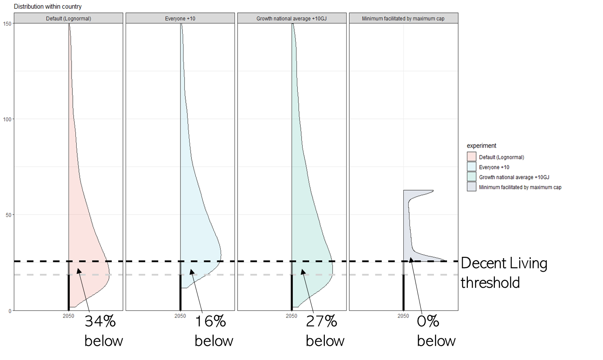
Different forms of growth and redistribution

Slide 70
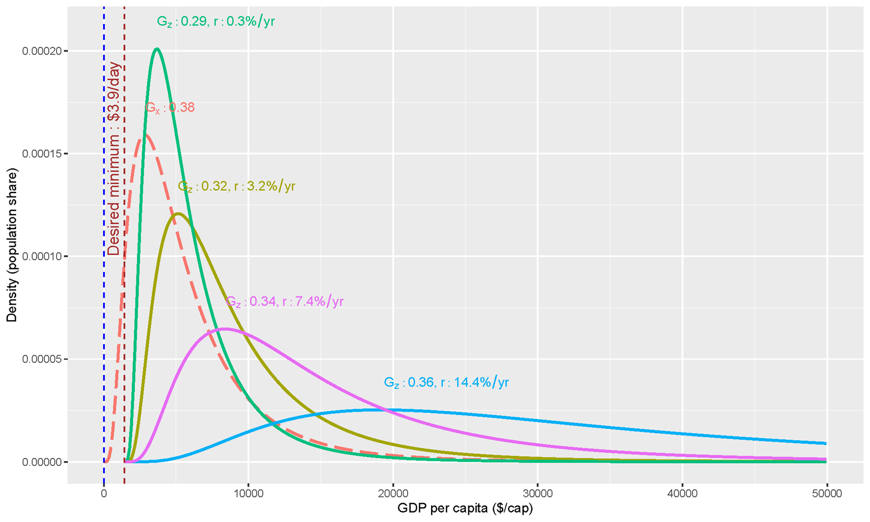
Different forms of growth and redistribution
…a way to vet our scenarios?
…input assumptions may help validate this rather rough and uncertain method.
…a way to visualize differences between our scenarios?
…add and visualize the distributional shift from Jihoon?
…or otherwise think about the interaction of growth and redistribution?

Slide 71
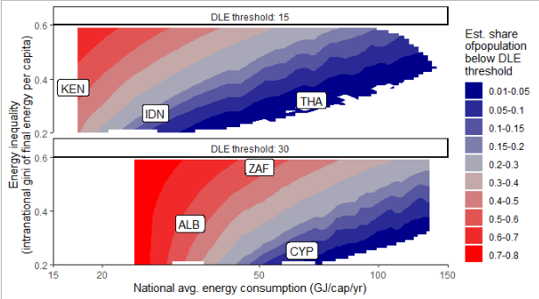
Different potential paths of development
Below DLE threshold

Slide 72
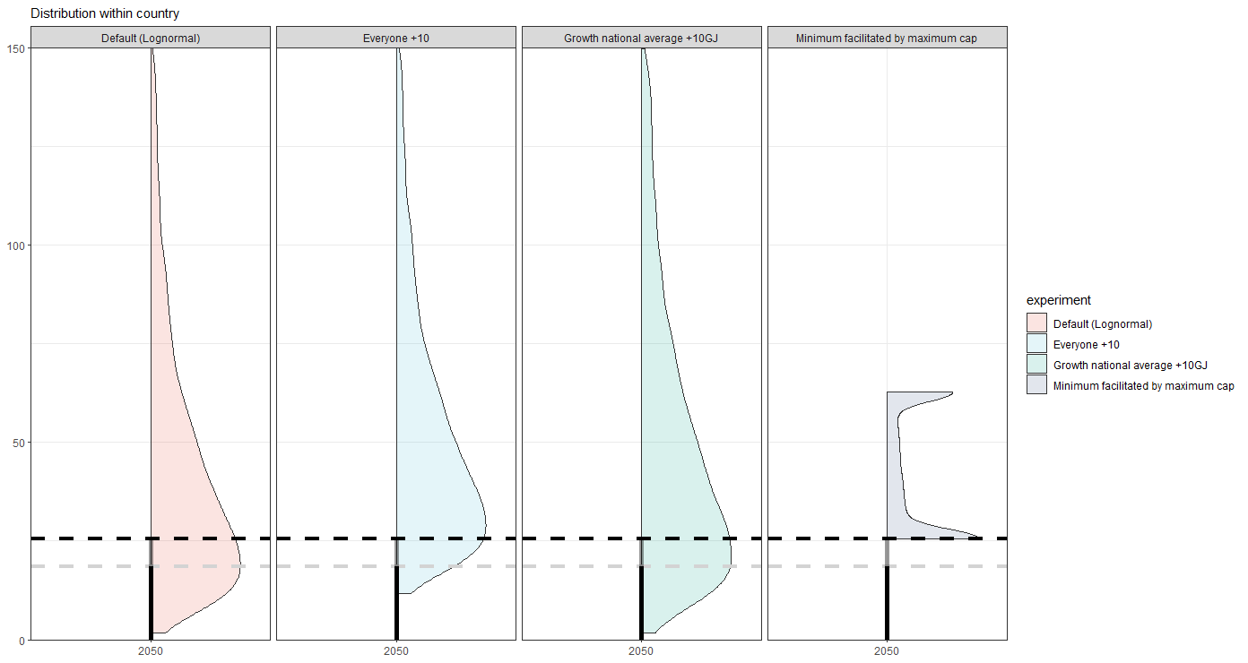
Growth or other distribution?
…sufficiency ceiling, or reducing energy services of the rich, or just increasing average?
…only within-country or also international shifts?
Decent Living threshold
34%
below
16%
below
27%
below
0%
below

Slide 73
DLE Calculator - discussion
Bringing together different data and methods:
IAM pathways
Downscaling
Income gini projections
IO table information on current energy inequality
Energy improvement projections: useful to final energy
DLE (all methods) + additional LCA
Impacts: (+climate emulator + buildings modelling)
What is next:
Vetting results
  Downscaled sectoral final energy
  Projected gini pathways
  DLE estimates
Constraining attempt for scaling of DLE threshold (innovation/service provisioning), by looking at historical trends
Understanding downscaling robustness/uncertainty better
Possible other improvements:
Add more IO data estimates for the historical energy inequality
Explore possibility to use Weibull distribution
(data probably not allowing – for top-end)
SHAPE-specific:
Bottom vs top-down comparison
Consideration of the incorporation of the inequality projections
Needs discussion on how to deal with sectoral structural changes (i.e. how to assign patterns of service provisioning improvements or other end-use tech innovation) – from the modelled service level narratives + projections

Slide 74
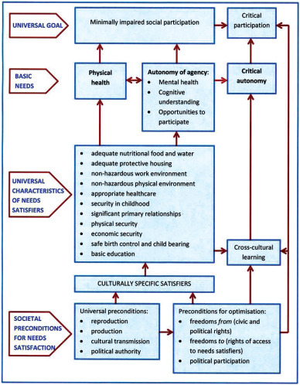
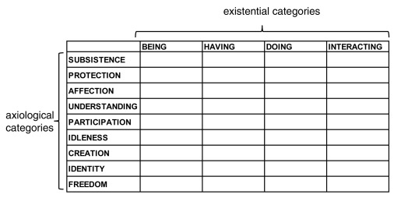
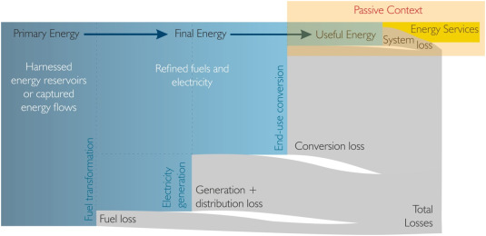
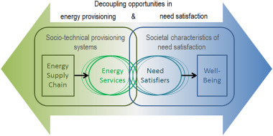
Needs theory
Brand-Correa and Steinberger (2017)
Ecological Economics.
https://doi.org/10.1016/j.ecolecon.2017.05.019
Notes:
Bringing together different data and methods:
IAM pathways
Dowscaling
Income gini projections
IO table information on current energy inequality
Energy improvement projections: useful to final energy
DLE (all methods) + additional LCA
Impacts: (+climate emulator + buildings modelling)
Note Keywan:
The end-use tech improvement rate within regions is super different… Singapore e.g. does not have the same po
Maybe we can do some conditional convergence, somehow?
Regional improvement trend
+ add; base year performance (do we have country-level useful energy per country {e.g. Alessio and Paul provide some service indicators? – if good info, we can use it. If not available, useful first proxy.})
Can DLE intensities be a good proxy for starting values, where they can improve? Probably not.
Maybe use household energy intensity data?
Or can we disentangle:
Technologies ()
Country-specific factors ()
Question remains whether to stay consistent with IAM assumed EI improvements, or do something more detailed.

Slide 75
Downscaling IAMs (Integrated Assessment Models) results to the country level
A new algorithm
Fabio Sferra, Bas van Ruijven, Keywan Riahi,
Florian Maczek, Philip Hackstock
WDL-IIASA Emissions Clock Data, 13 December 2021

Slide 76
Introduction
  Integrated Assessment Models (IAMs) models are used to evaluate feasibility of climate goals such as the Paris Agreement’s long-term temperature (well below 2˚C and pursue efforts to limit this warming to 1.5˚C).
  However the regional resolution of IAMs is limited to few regions
  We present a new downscaling algorithm focusing on Energy variables and energy-related CO2 emissions

Slide 77
Conceptual framework

Slide 78
Conceptual framework

Slide 79
Conceptual framework

Slide 80
Conceptual framework

Slide 81
Final Energy

Slide 82
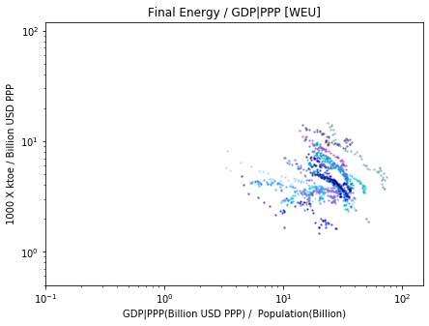
Final Energy
Final Energy / GDP|PPP [WEU]
EJ / Billion USD (log scale)
Thousand USD per capita (log scale)

Slide 83
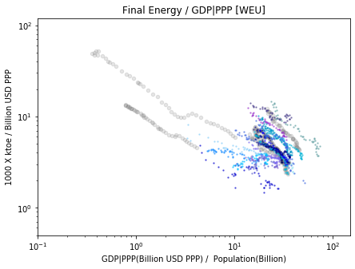
Final Energy
Final Energy / GDP|PPP [WEU]
CHN
IND
EJ / Billion USD (log scale)
OECD
Thousand USD per capita (log scale)

Slide 84
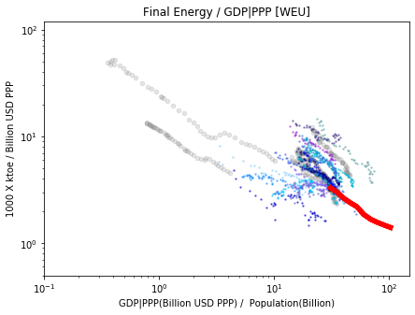
Final Energy
Final Energy / GDP|PPP [WEU]
EJ / Billion USD (log scale)
WEU baseline
Thousand USD per capita (log scale)

Slide 85
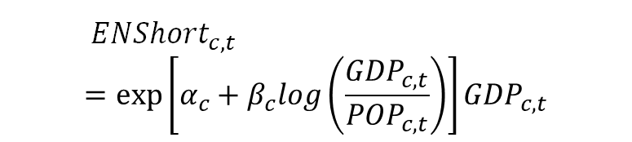
Final Energy
Final Energy / GDP|PPP [WEU]
$${{ ENShort}_{c,t}}^{}=exp\left[α_{c}+β_{c}log\left(\frac{{GDP}_{c,t}}{{POP}_{c,t}}\right)\right]{GDP}_{c,t}$$
Short term projections
1)
EJ / Billion USD (log scale)
Thousand USD per capita (log scale)

Slide 86
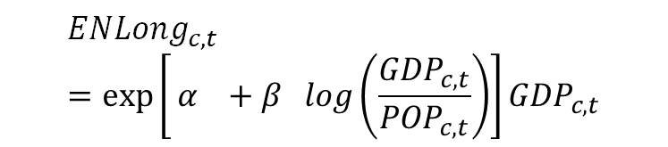
Final Energy
Final Energy / GDP|PPP [WEU]
$${{ ENShort}_{c,t}}^{}=exp\left[α_{c}+β_{c}log\left(\frac{{GDP}_{c,t}}{{POP}_{c,t}}\right)\right]{GDP}_{c,t}$$
Short term projections
1)
$${{ENLong}_{c,t}}^{ }=exp\left[⁡α_{}+β_{}log\left(\frac{{GDP}_{c,t}}{{POP}_{c,t}}\right)\right]{GDP}_{c,t}$$
EJ / Billion USD (log scale)
2)
Long term projections
Thousand USD per capita (log scale)

Slide 87
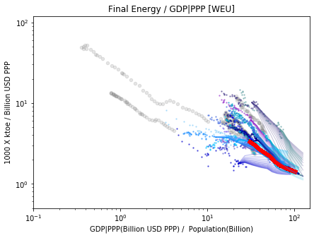
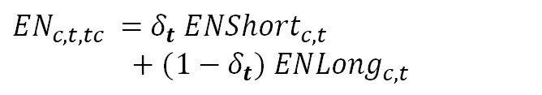

Final Energy
Final Energy / GDP|PPP [WEU]
$${{ ENShort}_{c,t}}^{}=exp\left[α_{c}+β_{c}log\left(\frac{{GDP}_{c,t}}{{POP}_{c,t}}\right)\right]{GDP}_{c,t}$$
Short term projections
1)
$${{ENLong}_{c,t}}^{ }=exp\left[⁡α_{}+β_{}log\left(\frac{{GDP}_{c,t}}{{POP}_{c,t}}\right)\right]{GDP}_{c,t}$$
EJ / Billion USD (log scale)
2)
Long term projections
$$δ_{t}=\frac{t−tc}{2010−tc}$$
Convergence Assumptions
3)
Thousand USD per capita (log scale)
${{EN}_{c,t,tc}}^{ }=$ ${δ_{t} ENShort}_{c,t}$
$+$ $(1−δ_{t}) {ENLong}_{c,t}$
4)
Projections

Slide 88
Final Energy
Final Energy / GDP|PPP [WEU]
$${{ ENShort}_{c,t}}^{}=exp\left[α_{c}+β_{c}log\left(\frac{{GDP}_{c,t}}{{POP}_{c,t}}\right)\right]{GDP}_{c,t}$$
Short term projections
1)
$${{ENLong}_{c,t}}^{ }=exp\left[⁡α_{}+β_{}log\left(\frac{{GDP}_{c,t}}{{POP}_{c,t}}\right)\right]{GDP}_{c,t}$$
EJ / Billion USD (log scale)
2)
Long term projections
$$δ_{t}=\frac{t−tc}{2010−tc}$$
Convergence Assumptions
3)
Thousand USD per capita (log scale)
${{EN}_{c,t,tc}}^{ }=$ ${δ_{t} ENShort}_{c,t}$
$+$ $(1−δ_{t}) {ENLong}_{c,t}$
4)
Projections
Convergence parameter tc depends on the robustness of historical trends (regression)

Slide 89
Robustness of historical data

Slide 90
Discussion
Going beyond just income by using multidimensional bottom-up indicators
  More direct policies (both mitigation and development) towards targets
Could help in steering scenario development?
Model intercomparison: potential to be used to analyse any energy model?
Ideas to validate methods?
Jarmo Kikstra
kikstra@iiasa.ac.at
^{Scenarios Forum 2022}
Collaborators:
Jihoon Min, Narasimha Rao, Alessio Mastrucci,
Keywan Riahi, Joeri Rogelj, Bas van Ruijven, Fabio Sferra
Notes:
Take only 30 DLE (range 25-35), and add some rich countries. ALB,

Slide 91
What next for scenarios?
Growth or redistribution?
In many poor countries, both redistribution (meaning some ) and growth are likely required to achieve a situation with enough energy for all.
Notes:
Take only 30 DLE (range 25-35), and add some rich countries. ALB,

Slide 92
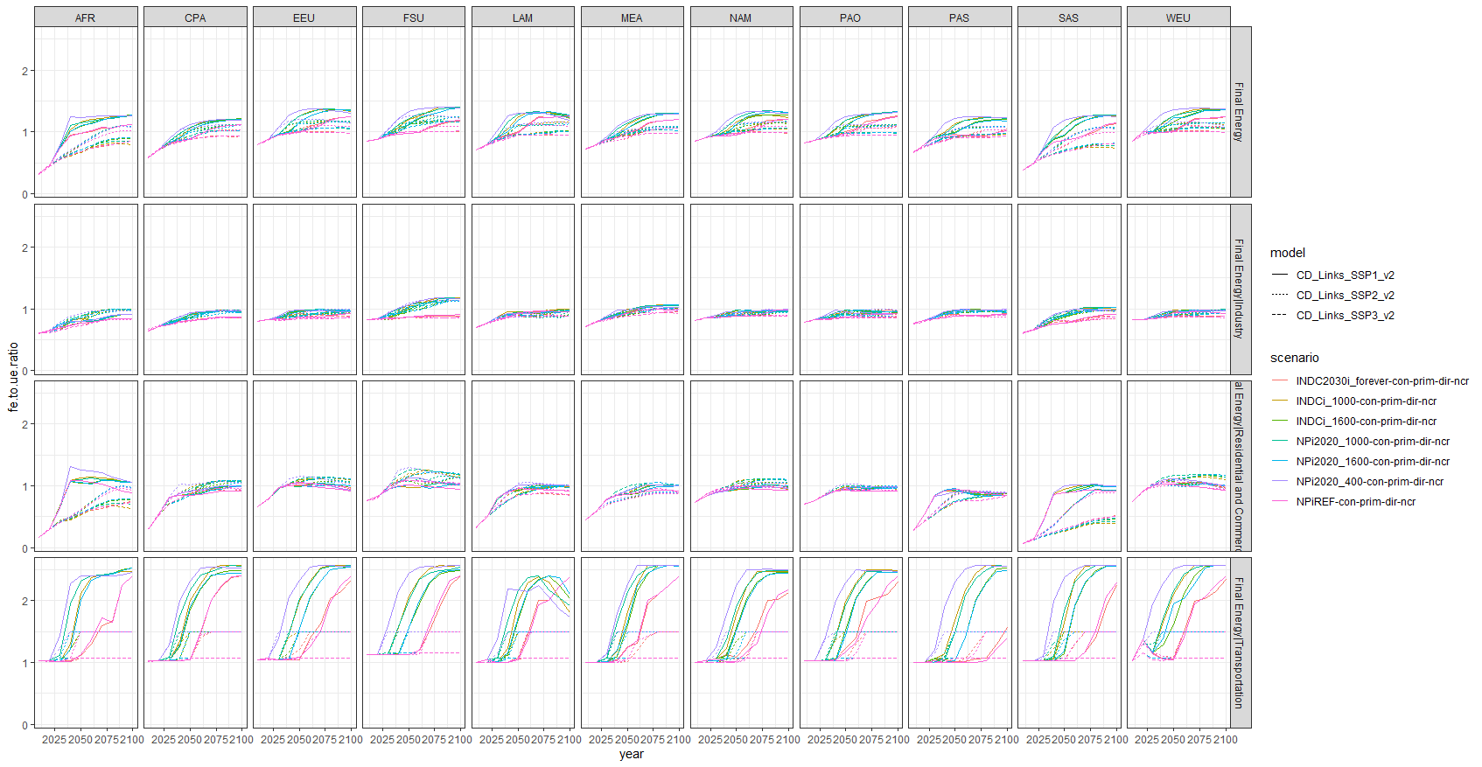
How much innovation/shifts to assume for end-use DLE services?
Notes:
Explain what each line is supposed to be

Slide 93
What’s the problem?
No robust and multi-model implementations of multidimensional poverty in IAMs, despite climate change and inequality being crucially linked.
This while there is globally sufficient energy.
Energy as a crucial link between emissions and development?
Notes:
In the coming decades, global society needs to reduce greenhouse gas emissions at an unprecedented pace.
At the same time, many poor regions require growth in energy access to lift people out of poverty.
This PhD project aims to bring together poverty eradication and climate mitigation through energy research.

Slide 94
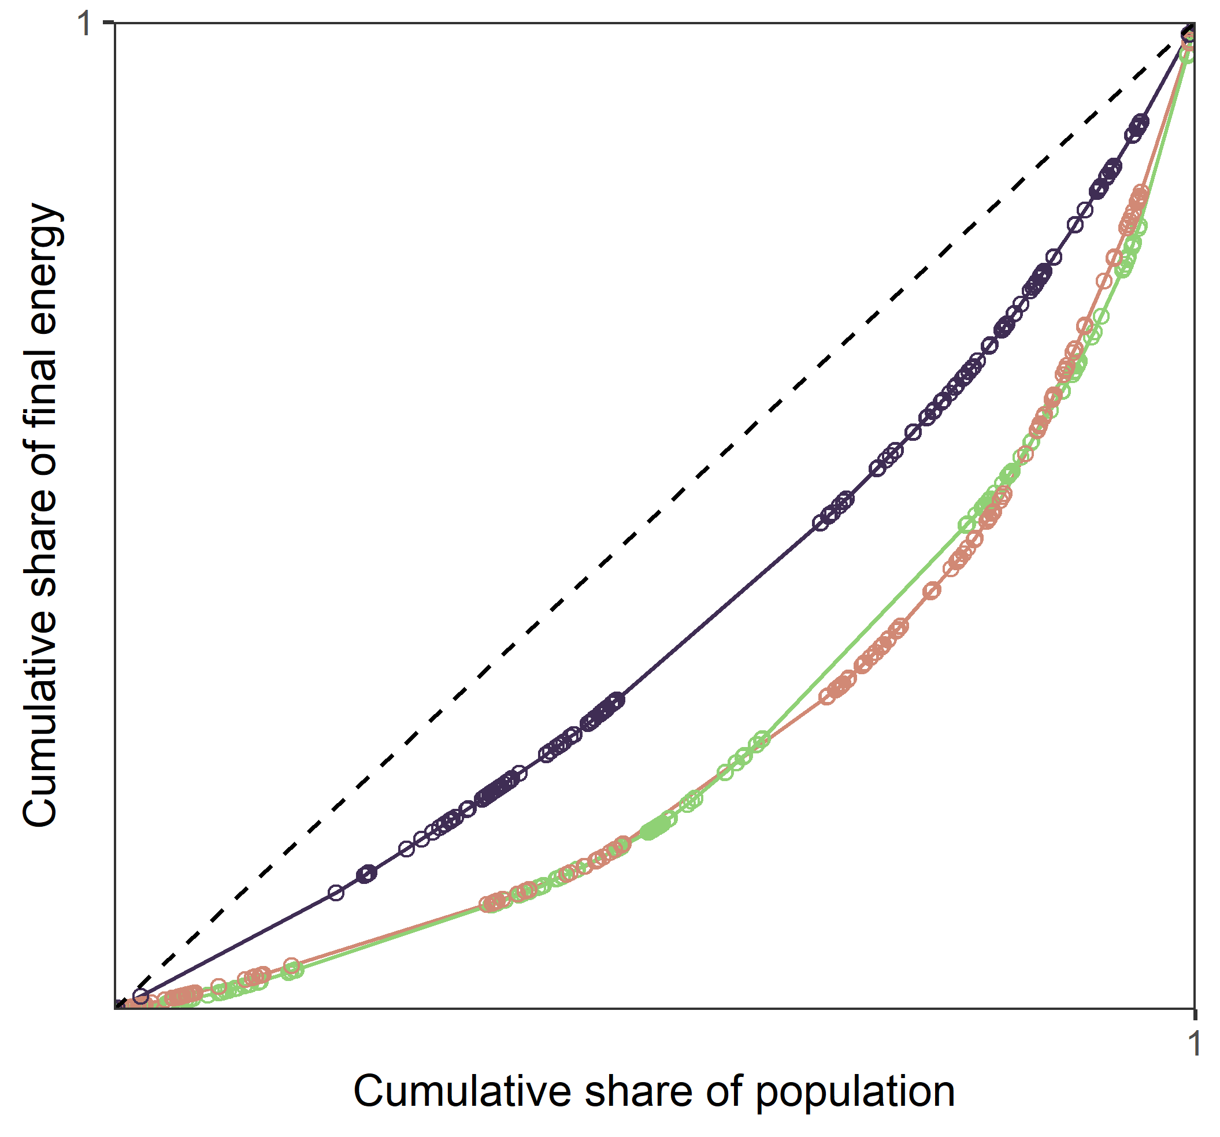
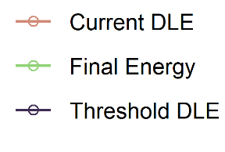
Current international inequality
Large international energy inequality in both affluence and basic provisioning
Notes:
Explain what each line is supposed to be

Slide 95
Future international inequality and poverty
Using country-level downscaling tool developed by Sferra et al.
Decent Living threshold
CD-LINKS scenarios
Downscaled by Fabio Sferra
Notes:
So, we don’t look at “soft needs”, which are hard to model, but rather just at the material and energy needs that are a pre-requisite for well-being.

Slide 96
Thinking about global scenarios
Climate change is a global issue
Notes:
In the coming decades, global society needs to reduce greenhouse gas emissions at an unprecedented pace.
At the same time, many poor regions require growth in energy access to lift people out of poverty.
This PhD project aims to bring together poverty eradication and climate mitigation through energy research.

Slide 97
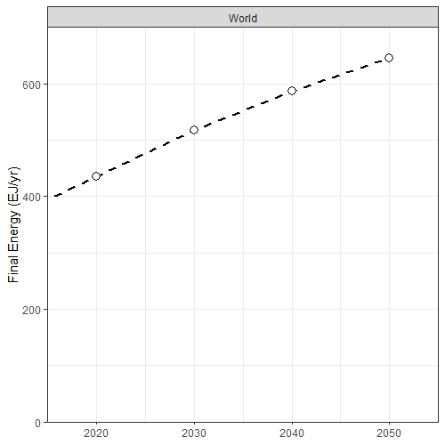
Comparing to global mitigation
No-climate-policy energy projections grow energy demand
Baseline (SSP2)
Kikstra et al. (2021)
Environ. Res. Lett.
10.1088/1748-9326/ac1c27.
Notes:
SSP2 is a middle-of-the-road scenario, projecting past trends into the future.
Showing here median lines of SR15

Slide 98
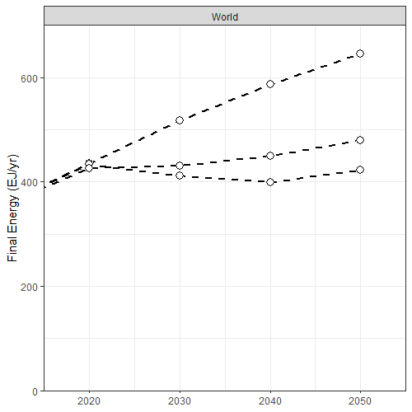
Comparing to global mitigation
No-climate-policy energy projections grow energy demand
To meet climate targets, very fast decarbonization is needed.
This usually paired with little to no energy demand growth, compared to baseline scenarios.
Baseline (SSP2)
Reducing Final Energy
Well below 2C
1.5C compatible
Kikstra et al. (2021)
Environ. Res. Lett.
10.1088/1748-9326/ac1c27.
Notes:
SSP2-26
SSP2-19

Slide 99
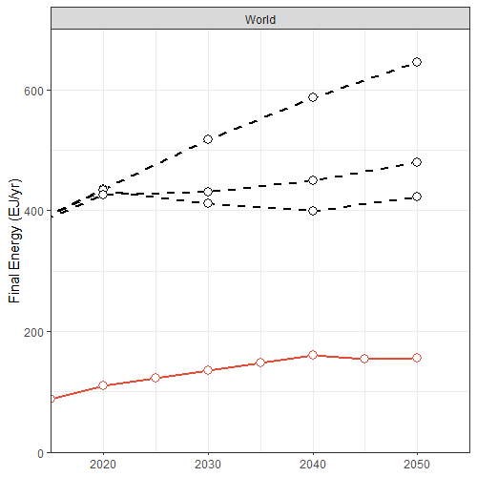
Comparing to global mitigation
Energy projections (figure on the right)
To meet climate targets, very fast decarbonization is needed.
This usually paired with little to no energy demand growth, compared to baseline scenarios.
Basic energy needs are much lower.
Baseline (SSP2)
Reducing Final Energy
Well below 2C
1.5C compatible
Decent living for all by 2040
Reaching DLS
Kikstra et al. (2021)
Environ. Res. Lett.
10.1088/1748-9326/ac1c27.
Notes:
Reaching DLE for all (only basic needs)
-> good news: lots of room for a more comfortable life, even when
But is this really true? Is the picture so rosy?
Let’s looks at a regional breakdown, because nothing is distributed equally…
- so let’s collapse these higher lines with totals, and look at what the share of the total over time of energy for basic needs would be, split out by regions.

Slide 100
Comparing to global mitigation
Energy projections (figure on the right)
To meet climate targets, very fast decarbonization is needed.
This usually paired with little to no energy demand growth, compared to baseline scenarios.
Basic energy needs are much lower.
Baseline (SSP2)
Reducing Final Energy
Well below 2C
1.5C compatible
Energy headroom for luxury/affluence/waste/etc.?
Decent living for all by 2040
Reaching DLS
Kikstra et al. (2021)
Environ. Res. Lett.
10.1088/1748-9326/ac1c27.
Notes:
Reaching DLE for all (only basic needs)
-> good news: lots of room for a more comfortable life, even when
But is this really true? Is the picture so rosy?
Let’s looks at a regional breakdown, because nothing is distributed equally…
- so let’s collapse these higher lines with totals, and look at what the share of the total over time of energy for basic needs would be, split out by regions.

Slide 101
Comparing to mitigation scenarios
Energy projections (figure on the right)
To meet climate targets, very fast decarbonization is needed.
This usually paired with little to no energy demand growth, compared to baseline scenarios.
Basic energy needs are much lower.
Baseline (SSP2)
Reducing Final Energy
Well below 2C
1.5C compatible
Decent living for all by 2040
But nothing is distributed equally…
→ need to look at within-country and international inequality and differentiated needs
Reaching DLS
Kikstra et al. (2021)
Environ. Res. Lett.
10.1088/1748-9326/ac1c27.
Notes:
Reaching DLE for all (only basic needs)
-> good news: lots of room for a more comfortable life, even when
But is this really true? Is the picture so rosy?
Let’s looks at a regional breakdown, because nothing is distributed equally…
- so let’s collapse these higher lines with totals, and look at what the share of the total over time of energy for basic needs would be, split out by regions.

Slide 102
What is a decent life?
Without trying to be too philosophical about it.
Notes:
Let’s start with step 1 and 2, focusing on what I mean when I talk about a decent life, and how this relates to the material world.

Slide 103
What is a decent life?
Decent Living Standards:
“material conditions for achieving basic human wellbeing”
‘capacity to achieve’
  Measurable, modellable, and policy-relevant?
Rao and Min (2018)
Social Indicators Research
10.1007/s11205-017-1650-0

Slide 104
What does a “decent life” include?
Kikstra et al. (2021)
Environ. Res. Lett.
10.1088/1748-9326/ac1c27.

Slide 105
Who has a decent life?
Multidimensional poverty around the world
Notes:
In the coming decades, global society needs to reduce greenhouse gas emissions at an unprecedented pace.
At the same time, many poor regions require growth in energy access to lift people out of poverty.
This PhD project aims to bring together poverty eradication and climate mitigation through energy research.

Slide 106
Multidimensional lack of access
Deprivations across the world, e.g.:
  No safe water: ~3.8 bln
  Insufficient housing: ~2.2 bln
  No clean cooking: ~3.2 bln
Sources:
  World Bank, Household surveys, IPUMS, FAO, etc.
Beyond income:
  5.50$/day does not mean a decent life for all.
  Modelling GDP and income distributions thus of limited usefulness to inform policies.
Kikstra et al. (2021)
Environ. Res. Lett.
10.1088/1748-9326/ac1c27.
Notes:
If you want a new multidimensional poverty indicator, that is more focused on access and service provisioning, then we could choose to aggregate all of this information into a mean Decent Living Standards Deprivation Index by country, as shown here.
Mean of (mean physical, mean social)

Slide 107
How much energy is needed to provide a decent life?
From material satisfiers to energy
From material satisfiers to energy
Notes:
In the coming decades, global society needs to reduce greenhouse gas emissions at an unprecedented pace.
At the same time, many poor regions require growth in energy access to lift people out of poverty.
This PhD project aims to bring together poverty eradication and climate mitigation through energy research.

Slide 108
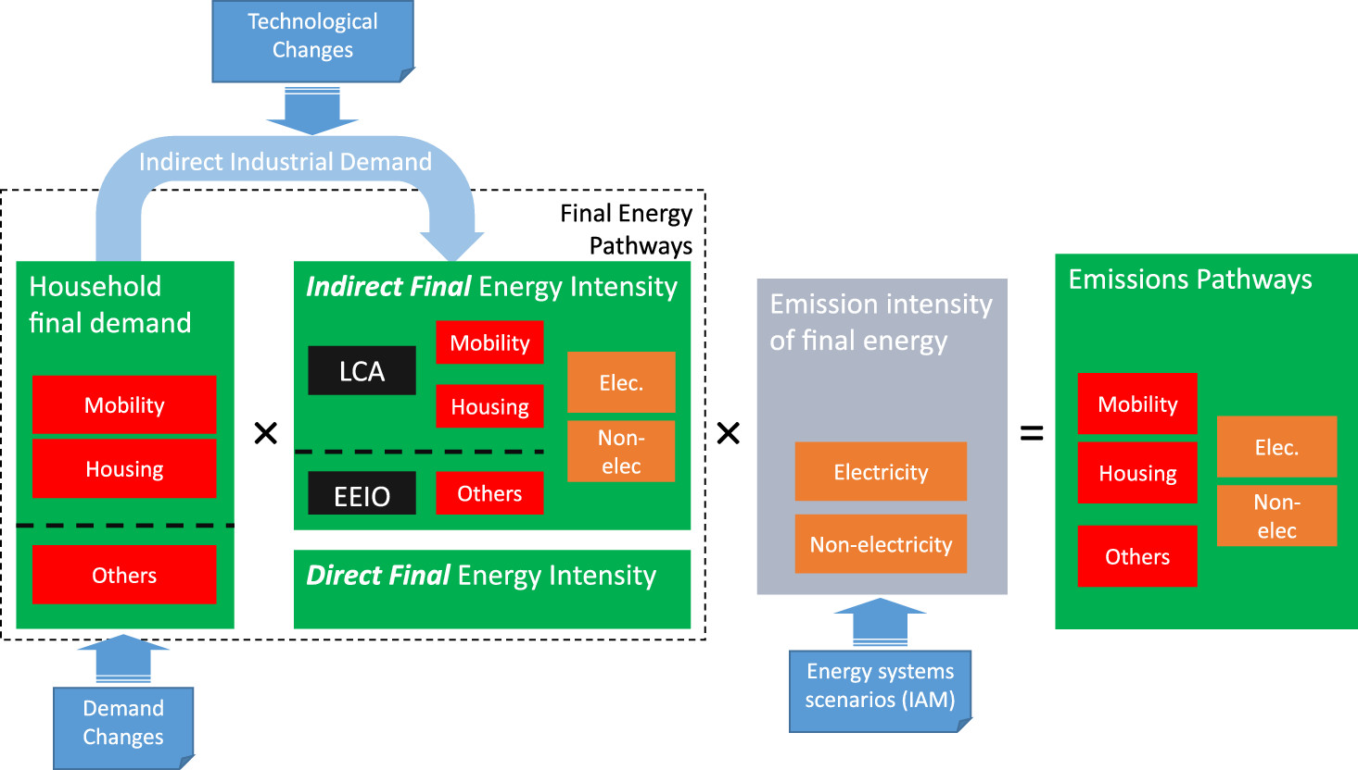
How to calculate energy needs?
Kikstra et al. (2021)
Environ. Res. Lett.
10.1088/1748-9326/ac1c27.
Notes:
MRIO +
LCA +
Modelling (simulation)

Slide 109
For what do we need energy?
Building new stuff:
  public transport, houses, roads, schools, etc.
  ~12EJ per year, until 2040, or <3% of current energy use
Operating services:
  Total: ~150-160 EJ/yr,
  or about 1/3 of current use
  About ~17 GJ/cap/yr
  Inefficient transport systems, and more heating need in Global North
Kikstra et al. (2021)
Environ. Res. Lett.
10.1088/1748-9326/ac1c27.
Notes:
MRIO +
LCA +
Modelling (simulation)

Slide 110
Thinking about national scenarios (I)
International inequality
Notes:
In the coming decades, global society needs to reduce greenhouse gas emissions at an unprecedented pace.
At the same time, many poor regions require growth in energy access to lift people out of poverty.
This PhD project aims to bring together poverty eradication and climate mitigation through energy research.

Slide 111
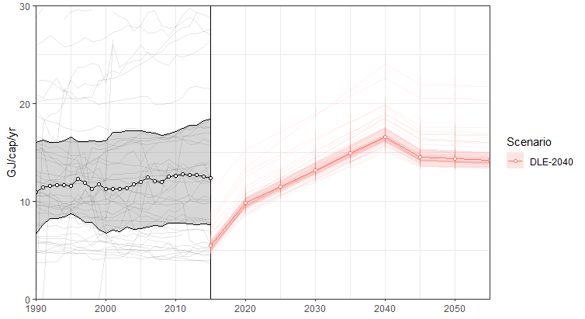
Sub-Saharan African countries
International inequality: looking at countries reveals a huge development challenge
Total energy growth has not outpaced population growth.

Slide 112
A difficult development challenge
Country-level look (Sub-Saharan Africa) reveals size of challenge.
For some countries, DLE only is multiple times higher than current total energy use

Slide 113
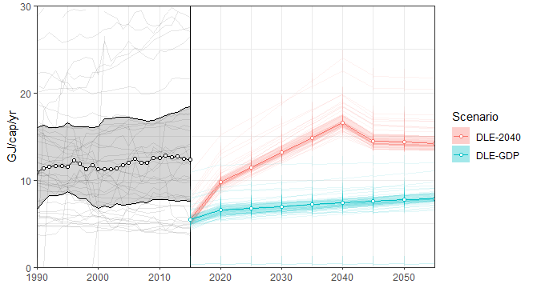
A difficult development challenge
Country-level look (Sub-Saharan Africa) reveals size of challenge.
Trickle-down economics does not work.

Slide 114
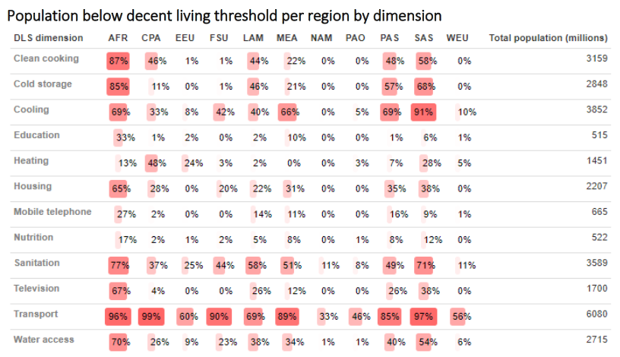
How many without a decent life?
Kikstra et al. (2021)
Environ. Res. Lett.
10.1088/1748-9326/ac1c27.
Notes:
We assessed this for 11 regions, across 12 indicators.

Slide 115
What does a “decent life” include?
Figure by Narasimha Rao.

Slide 116
What does a “decent life” include?
Figure by Narasimha Rao.

Slide 117
What does a “decent life” include?
Figure by Narasimha Rao.

Slide 118
The decent living framework across disciplines
Notes:
In the coming decades, global society needs to reduce greenhouse gas emissions at an unprecedented pace.
At the same time, many poor regions require growth in energy access to lift people out of poverty.
This PhD project aims to bring together poverty eradication and climate mitigation through energy research.

Slide 119
Methods for calculating current energy needs
Mastrucci etl al. (2020).
Environmental Science and Technology
10.1021/acs.est.9b05968
Notes:
Bunch of mixed methods, specific to each dimension.
Calculate both direct and indirect energy, which we split up in construction energy an operational energy.
For instance, for mobility we draw on LCAs of different transport types, while for education, health care, and nutrition we use the Environmentally Extended Multi-region Input Output analysis tables from EXIOBASE.
For buildings, we use a more detailed simulation model with specific building types with parameters varying by region.

Slide 120
Methods (so far)
Mastrucci etl al. (2020).
Environmental Science and Technology
10.1021/acs.est.9b05968

Slide 121
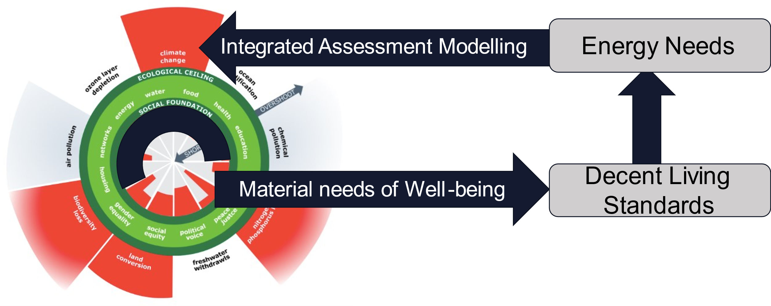
Next steps
Adapted from
Kate Raworth and Christian
Guthier/The Lancet Planetary Health
Notes:
If you remember, we did not yet close the loop back to planetary boundaries.

Slide 122
Future work: emissions as final link
Mastrucci etl al. (2020).
Environmental Science and Technology
10.1021/acs.est.9b05968
Notes:
For this, we need to look at the emissions intensities of final energy.
This can be done by using simple emissions factors, but that may not be so informative, as climate change is caused by cumulative emissions over time.
Thus, we want to look at future scenarios, where we also see some technological improvements.

Slide 123
Future work: Integrated Assessment Modelling
Understand basic service efficiency improvement
Climate mitigation pathways with different levels of human wellbeing
Mastrucci etl al. (2020).
Environmental Science and Technology
10.1021/acs.est.9b05968
Integrated Assessment Models
accounting for with Decent Living
Notes:
One way to do this is by using Integrated Assessment Models, which have a detailed representations of energy systems and their emissions (alongside economy and landuse changes).
This could allow for many things, including specifying how different technologies could be used for basic provisioning, compared to non-basic services, as well as how their efficiency changes over time.
One thing I am interested in, is how this will allow for instance for implementing progressive carbon tax systems.
With that, I mean that we could for instance simulate futures that would introduce higher carbon tax on highly affluent energy consumption, while exempting basic energy requirements from any carbon tax.

Slide 124
Future work: empirical analysis
Understand future basic service projection and decent living drivers
Mastrucci etl al. (2020).
Environmental Science and Technology
10.1021/acs.est.9b05968
Notes:
Previous projections have based itself just on macro trends of society.
But, to provide an analysis as we want it, we need to know the drivers of trends in basic services, and how they relate to each other.
For instance, education and clean energy access drive fertility rates downward, affecting population projections, and thus required construction scaleup.
Similarly, sanitation, health care, and education come with multiple side-benefits and are probably mutually reinforcing.
So, there are many interlinkages to consider!

Slide 125
Future work: climate impacts
Simple climate model
Climate impacts
Notes:
It is also worth looking at the outcomes a bit more.
Because emissions are of course not strongly affecting human lives directly; to determine such impacts we need to run climate models.

Slide 126
Future work: adaptive capacities
Simple climate model
Climate resilience
Climate impacts
Decent Living achievement:
- Education
- Health care
- Cold storage
- Shelter
- Air conditioning
- etc.
Notes:
Climate impacts are mitigated by development, which yields stronger adaptive capacities and climate resilience.

Slide 127
Inequality and Equity
Notes:
In the coming decades, global society needs to reduce greenhouse gas emissions at an unprecedented pace.
At the same time, many poor regions require growth in energy access to lift people out of poverty.
This PhD project aims to bring together poverty eradication and climate mitigation through energy research.

Slide 128
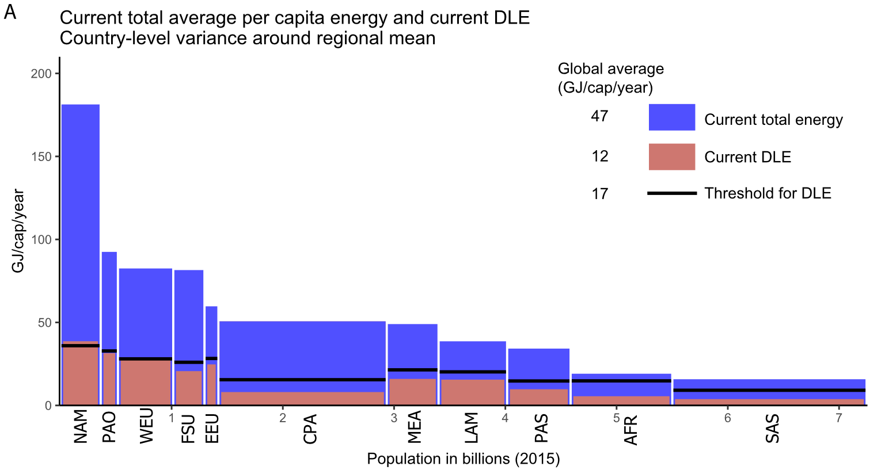
Human needs are the same,
Decent Living Energy (DLE) needs are not.
Regional energy needs vary from about 9 to 36 GJ/cap/yr
Regional energy need difference
Kikstra et al. (2021)
Environ. Res. Lett.
10.1088/1748-9326/ac1c27.
Notes:
Looking at total needs for every person.

Slide 129
Energy gaps are small compared to total energy use (and affluence).
Large international energy inequality in both affluence and basic provisioning
Needs very much less, so a more equitable world also requires more equality
Kikstra et al. (2021)
Environ. Res. Lett.
10.1088/1748-9326/ac1c27.
Notes:
In the bigger picture,
(total energy here is just consumption, is from a different source with other accounting [not everything] compared to the previous 55GJ/cap)

Slide 130
Zooming in on energy gaps
Kikstra et al. (2021)
Environ. Res. Lett.
10.1088/1748-9326/ac1c27.
Notes:
Looking at marginal needs.
(the need for growth)

Slide 131
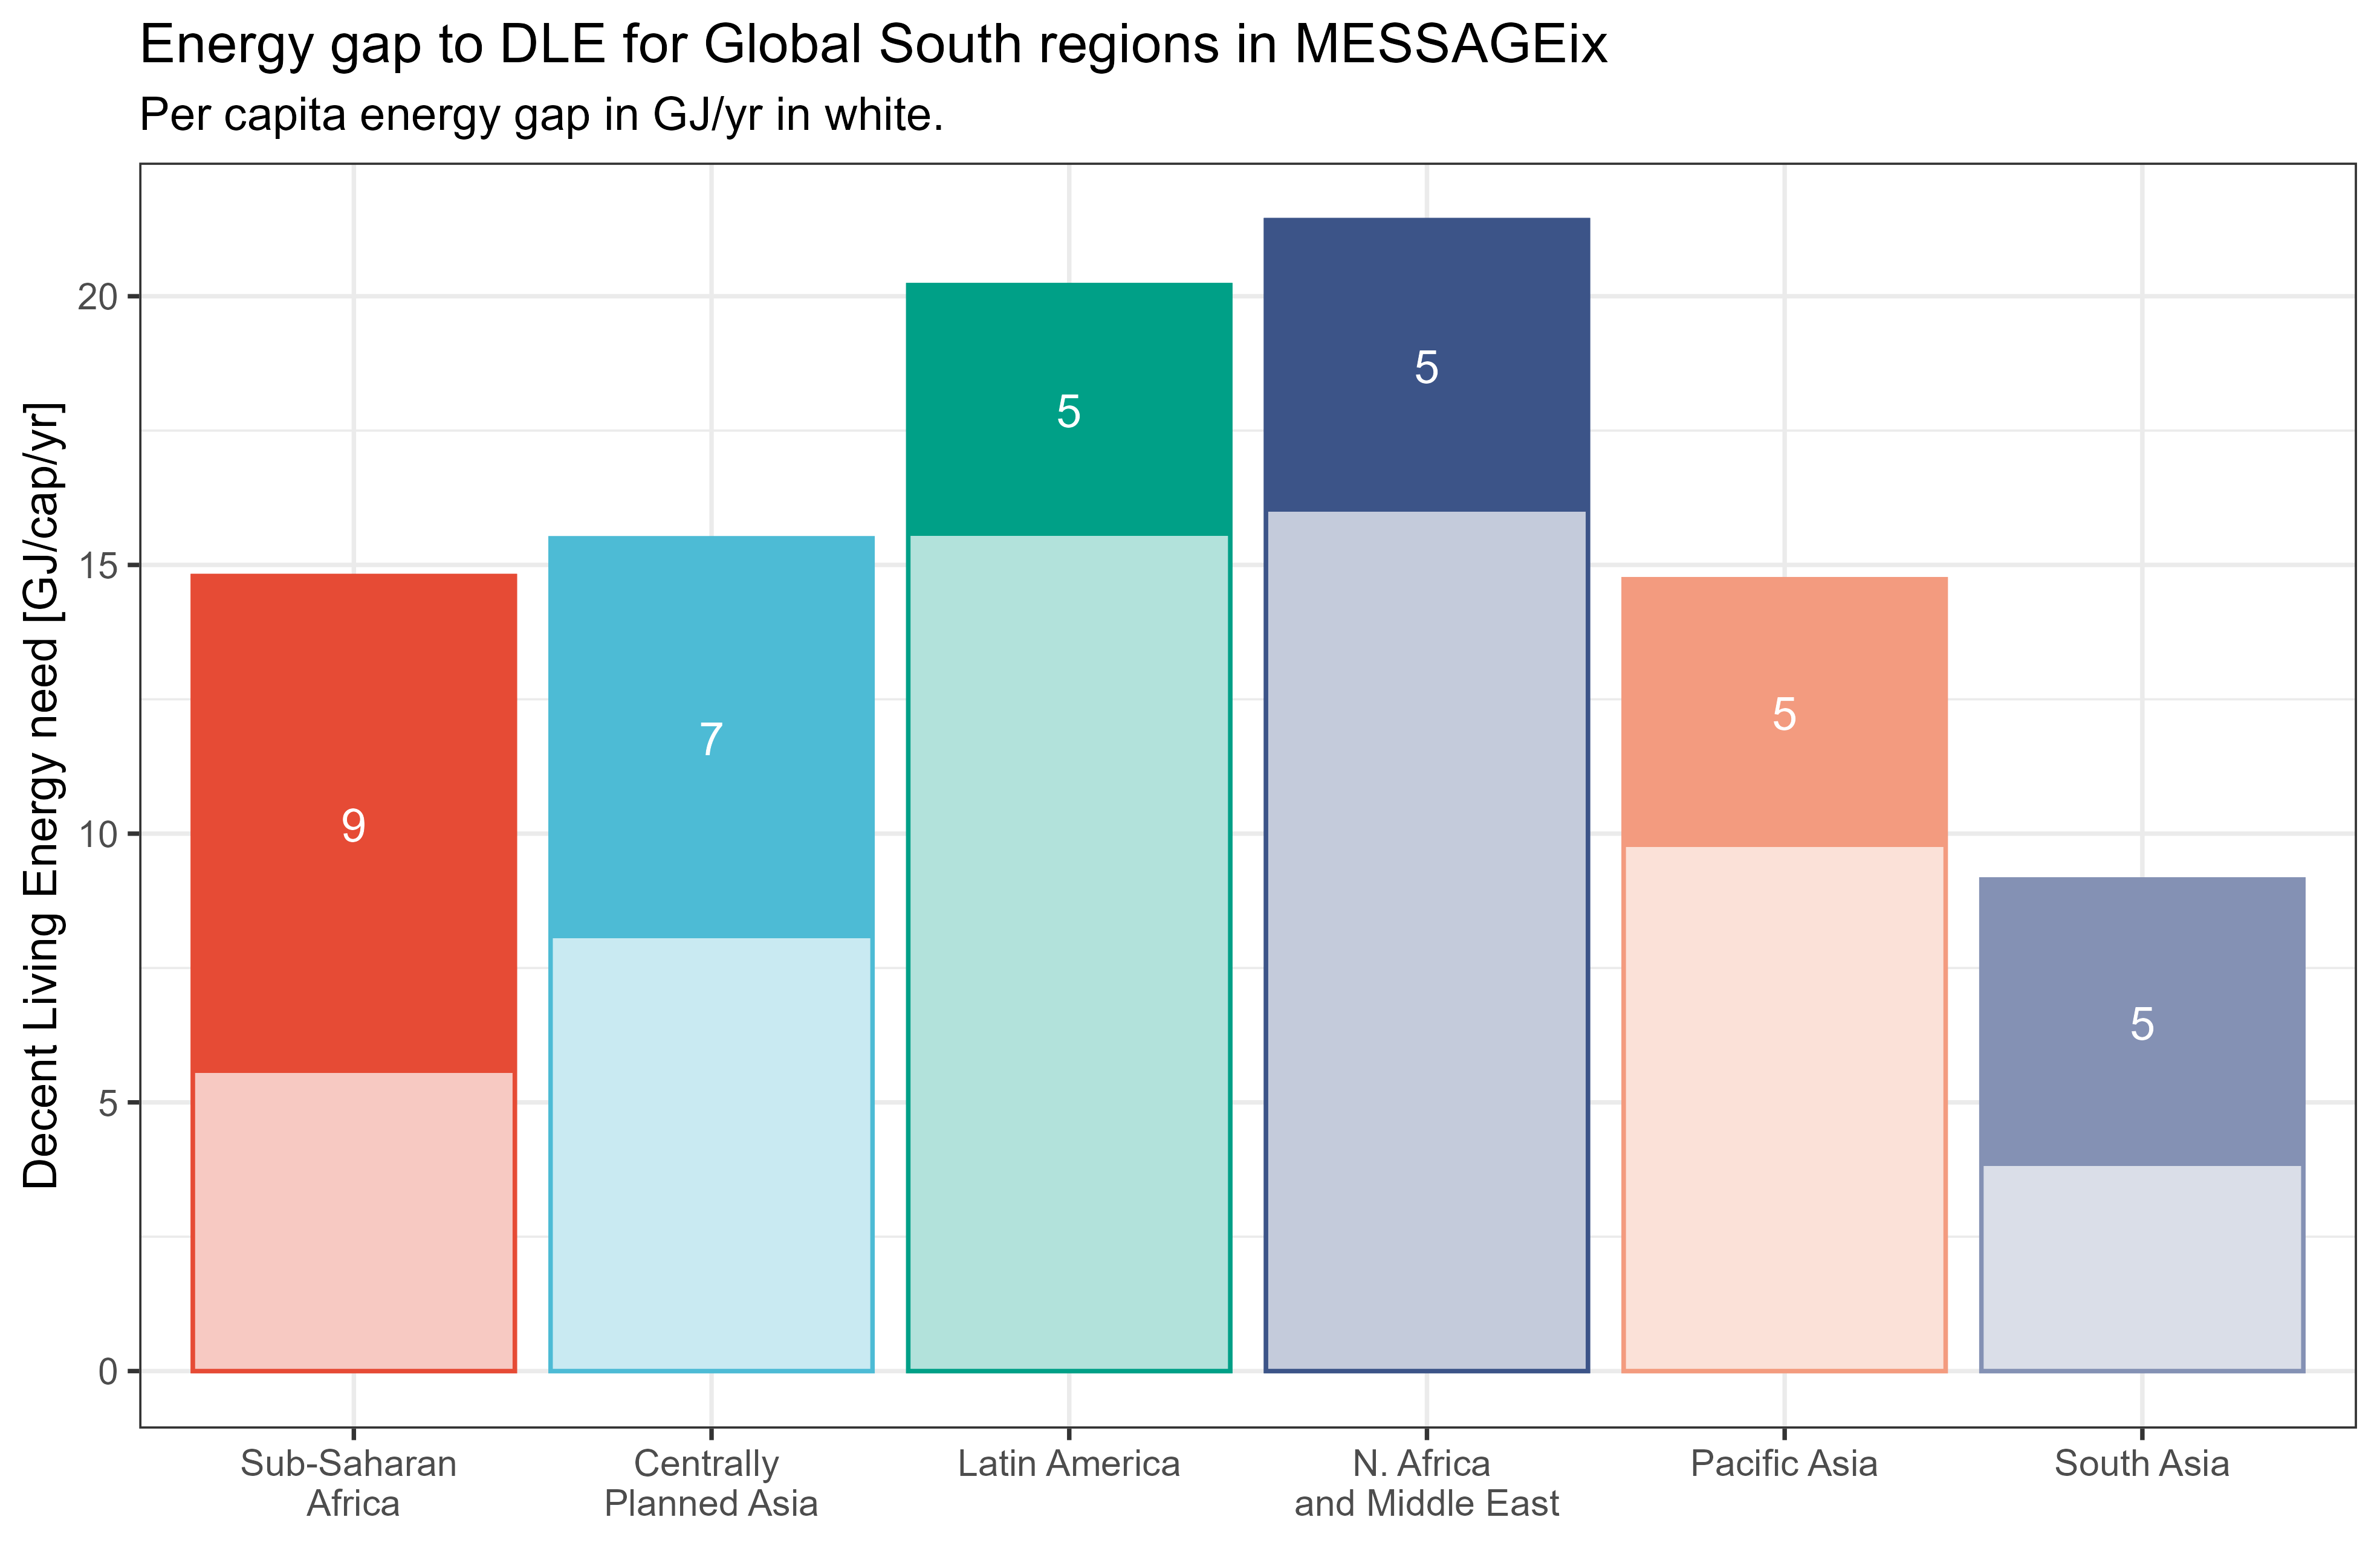
Energy gaps largest in Africa
(per capita)
Gap
Current
Kikstra et al. (2021)
Environ. Res. Lett.
10.1088/1748-9326/ac1c27.
Notes:
Looking at marginal needs.
(the need for growth)
Average gap. Some more deprived than others (accounted for in some, but not all human need dimensions).

Slide 132
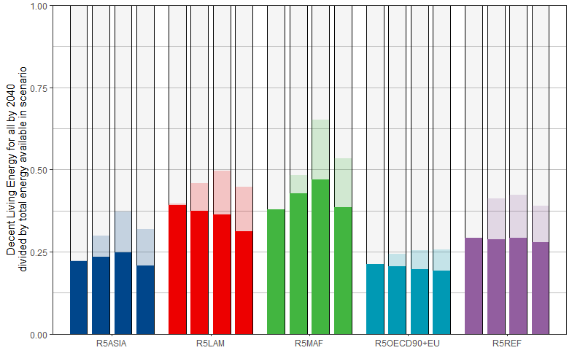
In a regional picture, headroom remains
Share of energy that needs to go to basic needs provisioning (goal 2040)
Affluence
share
Baseline (SSP2)
2020
2050
2020
2050
2020
2050
2020
2050
2020
2050
Asia
Latin America
Middle-East and Africa
OECD and EU
Former Soviet Union
Kikstra et al. (2021)
Environ. Res. Lett.
10.1088/1748-9326/ac1c27.

Slide 133
In a regional picture, headroom remains
Share of energy that needs to go to basic needs provisioning (goal 2040)
Affluence
share
“affluence energy” or
“remaining inequality”
Less than 50%.
Decent Living Energy needs
Baseline (SSP2)
2020
2050
2020
2050
2020
2050
2020
2050
2020
2050
Asia
Latin America
Middle-East and Africa
OECD and EU
Former Soviet Union
Kikstra et al. (2021)
Environ. Res. Lett.
10.1088/1748-9326/ac1c27.
Notes:
Generally, Less than 50% of total energy is needed for meeting all basic needs.

Slide 134
In a regional picture, headroom remains
Share of energy that needs to go to basic needs provisioning (goal 2040)
Affluence
share
“affluence energy” or
“remaining inequality”
Generally holds under strong climate mitigation.
1.5C compatible
Less than 50%.
Decent Living Energy needs
2020
2050
2020
2050
2020
2050
2020
2050
2020
2050
Asia
Latin America
Middle-East and Africa
OECD and EU
Former Soviet Union
Kikstra et al. (2021)
Environ. Res. Lett.
10.1088/1748-9326/ac1c27.
Notes:
Generally, Less than 50% of total energy is needed for meeting all basic needs.

Slide 135
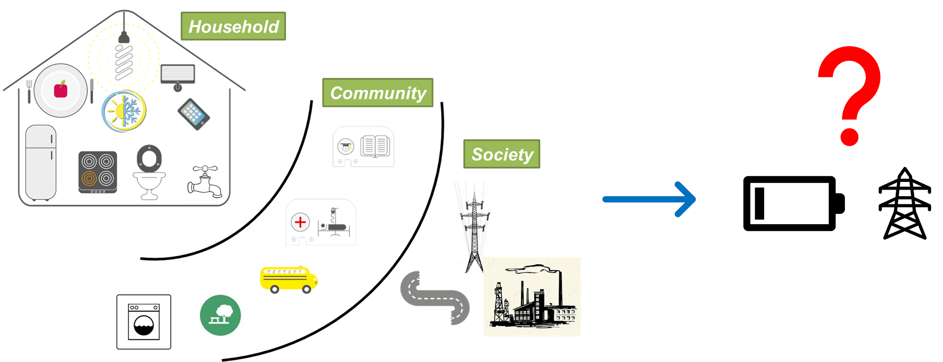
From material satisfiers to energy

Slide 136
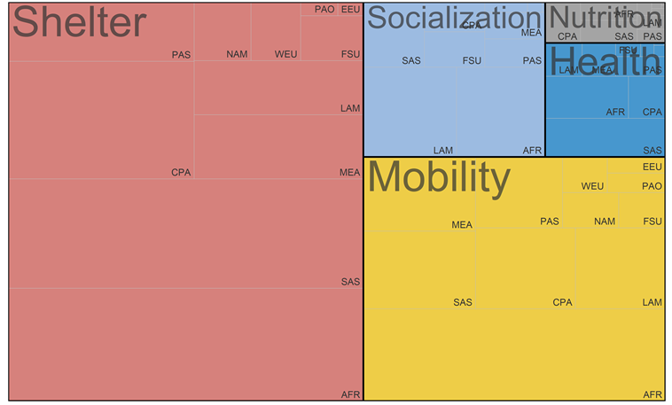
Energy for building new stuff
Includes new provisioning like public transport, houses, roads, schools, etc.
In the order of 12EJ per year, until 2040.
  <3% of current energy use
Some regions (Africa, South Asia) need much more new stuff than others!
Energy for constructing new infrastructure
Dominated by shelter
Kikstra et al. (2021)
Environ. Res. Lett.
10.1088/1748-9326/ac1c27.
Notes:
Construction energy is relatively small.

Slide 137
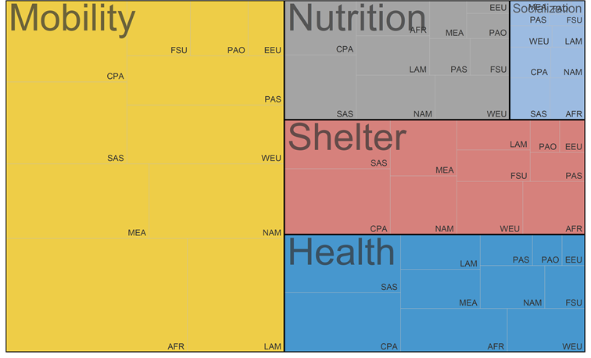
Energy for running new stuff
Includes all energy, being:
  Operational energy
  Replacement of stock
  New stock due to (national) population growth
About 156 EJ with 2050
  ~17 GJ/cap for basic needs
  compared to ~55GJ/cap current average use
Annual total energy need to support a decent life
Dominated by mobility
Kikstra et al. (2021)
Environ. Res. Lett.
10.1088/1748-9326/ac1c27.
Notes:
Operational energy is dominated by mobility.

Slide 138
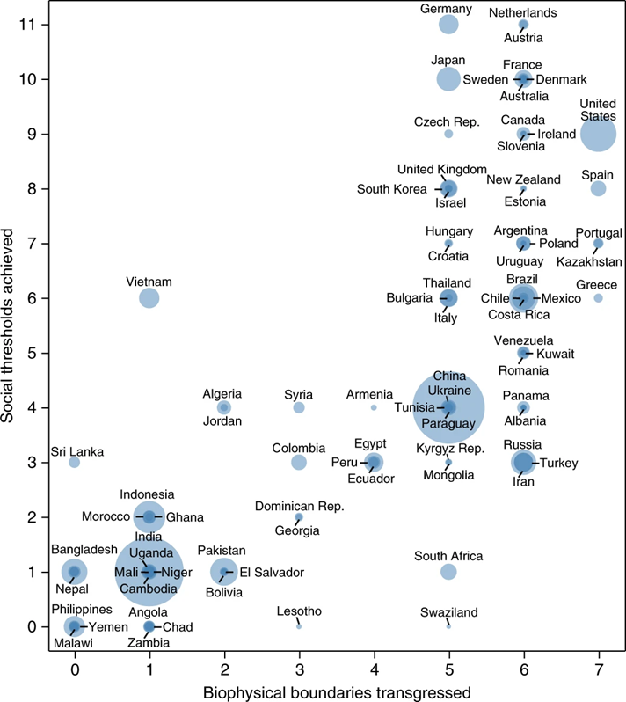
A dual challenge
etc.
Biodiversity policies
Climate Mitigation
Target
Multidimensional
Poverty eradication
  How to combine social development with planetary boundaries?
  Requires global modelling!
  Mitigation scenarios in IPCC don’t model inequality or poverty eradication well!
O’Neill et al. (2018)
Nature sustainability
10.1038/s41893-018-0021-4
Notes:
Development as

Slide 139
Connecting human well-being with planetary boundaries
4
3
2
1
Steps 1-4
Adapted from
Kate Raworth and Christian
Guthier/The Lancet Planetary Health
Notes:
So, we don’t look at “soft needs”, which are hard to model, but rather just at the material and energy needs that are a pre-requisite for well-being.

