Slide 1
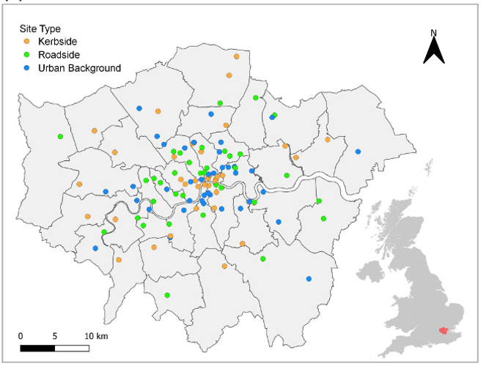
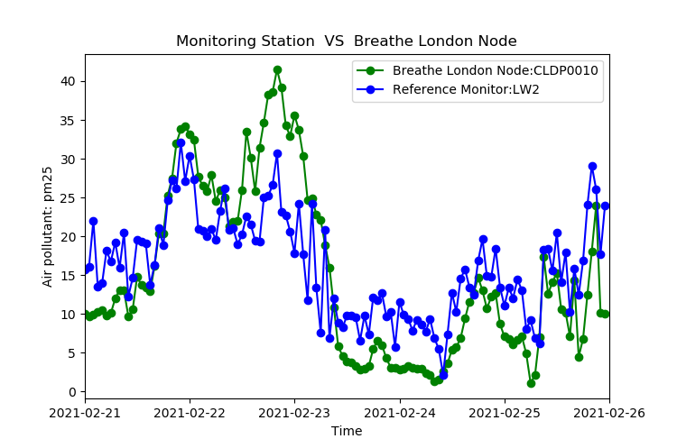
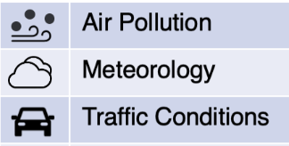
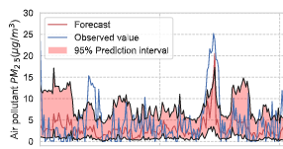
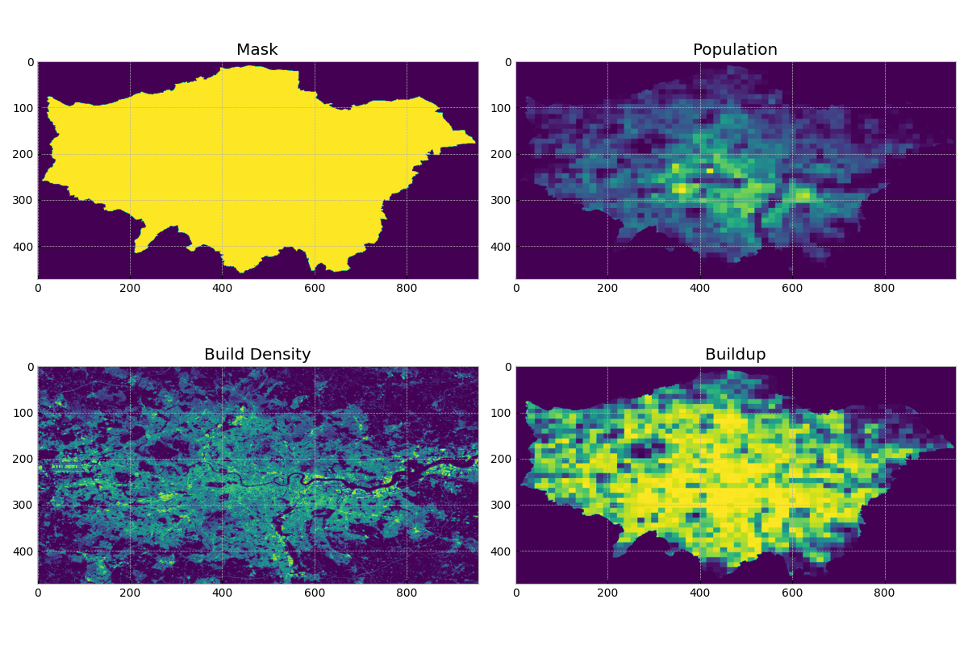
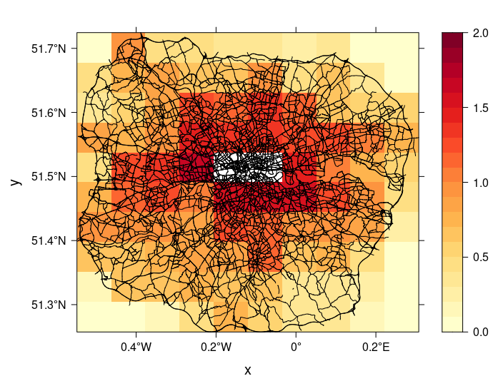
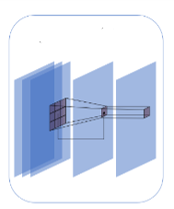

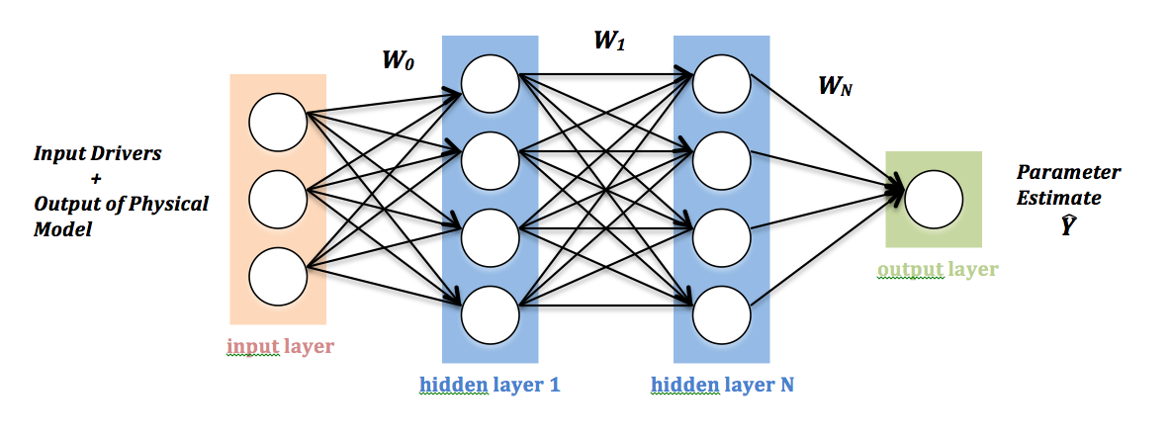
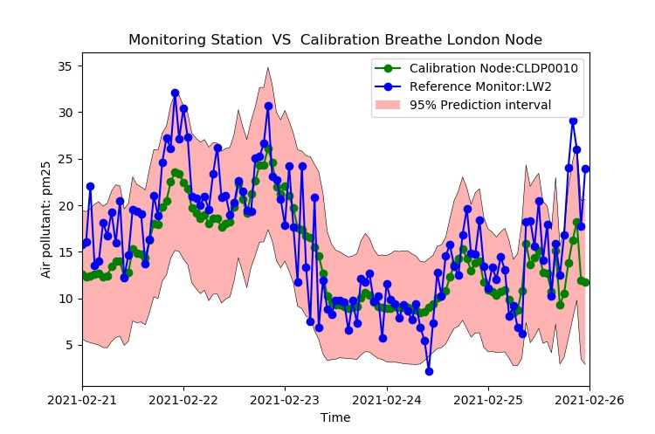
A fine-scale spatiotemporal air quality modeling framework by combining big but noisy data
Hongwei Fan¹, Arcucci, Rossella² , de Nazelle, Audrey J¹
¹Centre for Environmental Policy; ²Department of Earth Science & Engineering
      Introduction
        Machine learning methods bring improvements over classical methods by combing big data, and have been shown in air quality research to improve accuracy. Low-cost sensors can add a high spatiotemporal resolution to sparsely scattered monitoring stations. However, they are typically unevenly deployed in urban areas, and their measurements include noise and uncertainty, both of which are incompatible with advanced machine learning methods.
        This research aims to develop a fine-scale spatiotemporal air quality modeling framework by combining big but noisy and unstructured data with machine learning methods.
      Research Framework
        Overview:
        Pipeline of air quality modeling framework for each research objectives are as follows:
      Preliminary Data Collection and Preprocessing
        London is used as a case study, using the following data:
        Air pollution monitoring measurements. London Regulatory Monitor Network and low-cost sensor data from Breathe London.
        Land use characteristics. Population density, road structure and build density data, projected to a fine-scale grid data.
        Weather data. Historical weather stations and UK-Grid weather.
Part1: Calibrate Low-cost Sensors(LCS) and Estimate Levels of Uncertainty
Probabilistic Deep Learning for uncertainty estimation
Neural Network for calibration
Collected Land use Characteristics in London
Collocation reference sites and LCS
Reference sites VS LCS measurements
Calibrate LCS
Quantify Uncertainty
Part2: Deep Learning framework for air pollution estimation
Design Deep Learning framework for capturing spatial interaction in Urban Environments.
Air pollution observations
Build density
Population density
Road Structure
      Uncertainty Measurement & Calibrate Method
        We use probabilistic neural network for air quality calibration and calculate associated uncertainty of low-cost sensors.
      Objectives
        The objectives of this study are as follows:
        Design a probabilistic machine learning framework that can calibrate the low-cost sensor data and calculate the corresponding levels of uncertainty.
        Design a machine learning framework that can handle unstructured monitoring data and urban big data to generate the air pollutant concentrations estimation at fine-scale spatiotemporal resolution (100*100 and hourly or better) in Urban area.
        Design a data fusion framework to combine data with different levels of uncertainty (monitoring stations, low-cost sensors, and covariates) and air quality model output to improve the performance of air quality estimation in real-time.
Sensors location
Unstructured sensor placements
A patch of grid-like input data : Meteorology, Traffic, etc.
Air pollution map output
Before calibration
Part3: Deep learning with uncertainty for air quality mapping by combine calibrated LCS and air quality model output
Co-located Measurements:
Reference Regulatory Monitors
Low-cost sensors
Part1
Train
Test
Air pollution measurements of LCS
Calibrated value
Correspond uncertainty
Unmonitored area
Build Probabilistic Neural Network model for each LCS
Calibration and estimate uncertainty for each LCS
Output of part 1:
Calibrated values and levels of Uncertainty of low-cost sensors.
After calibration
LCS network
Environmental Characteristic:
1. Humidity
2. Temperature
…
Output of part3:
Better performance of air pollution estimation by combining different levels of uncertainty data.
Mean+
Variance
Air quality model in Part 2
Data Fusion Framework
Other land use characters
      Expected outcome
        To develop a fine-scale air pollution map in real-time utilizing the capacity of machine learning methods and increasing big but noise data by designing uncertainty measurement methods, a novel machine learning method for air pollution estimation and a data fusion framework.
Output of part 2: Air pollution estimation by combining big data

