Slide 1
Environmental Assessment of Road Transport in Qatar and its policy implications:
Current Emissions and Projections for Future Reductions
Abdulla Alishaq
Supervisor: Jeremy Woods

Slide 2
Background: GHG and Air Pollution
The Transport Sector
Research Aim
Research Methods
Initial Results
Conclusion and Future Work
Reference
Presentation Outline

Slide 3
Background: GHG and Air Pollution
01
02
03
Highest CO2 per capita
31.1 tonnes vs 4.8 tonnes
Heavily involved in oil and gas business
Hydrocarbons accounted for 91% of exports
126 million tonnes of LNG production by 2027
12th most polluted city
PM2.5
WHO Standard: 10 μg/m^3
Qatar: 90 μg/m^3
PM10
WHO Standard: 20 μg/m^3
Qatar: 50 μg/m^3

Slide 4
The Transport Sector
8.5 billion tonnes of CO2eq in 2019
Road vehicles are responsible for 45%
50% of PM emissions in OECD
GHG emissions
7.67/12 mega tons of CO2eq in 2019
7% of national emissions
1.5 million road vehicles
300,000 vehicles in 2000
800,000 vehicles in 2010
1.5 million vehicles in 2018
Targets
Electricity 4% of road fleet by 2022
Electricity 10% of road fleet by 2030
Reduce road emissions by 25% by 2030

Slide 5
Research Aim
The aim of this research is to determine which policies should Qatar adopt for road transport this decade to put it on track to achieve 2030 and 2050 goals.
Research questions:
What fleet configuration of would achieve the GHG reduction goals by 2030 and how would vehicle ban scenarios affect emissions?
What are the necessary measures to decarbonize the transportation sector in Qatar by 2050?
What is the dynamic LCA from cradle to grave of a BEV in comparison to an ICEV operating in Qatar?

Slide 6
Methodology
Scenarios analysis for road transport
1- Current GHG and air pollution emissions?
2- How to get a 25% reduction?
3- Impact of 10% electrification by 2030?
4- Impact of ICEV ban?
Stock Flow Model
Inflow and outflow of vehicles
LDV, HDV, buses, and motorcycles
LDV: sedans, SUV, and sports vehicles
Survival and scrappage rate
Fuel source
Fuel economy
Vehicle kilometres travelled
Curb mass

Slide 7
Methodology
Scenarios analysis for road transport
Average transport activity per person per mode (pkm/person)
Population
Total average transport activity per mode (pkm)
Occupancy rate (pkm/vkm)
Vehicle transport distance per mode (vkm)
Technology Share (%)
Vehicle transport distance per mode per technology (vkm)
Energy intensity per mode per technology (MJ/vkm)
Emission factor per mode per technology (kgCO2eq/MJ)
Total GHG emissions (kgCO2eq)

Slide 8
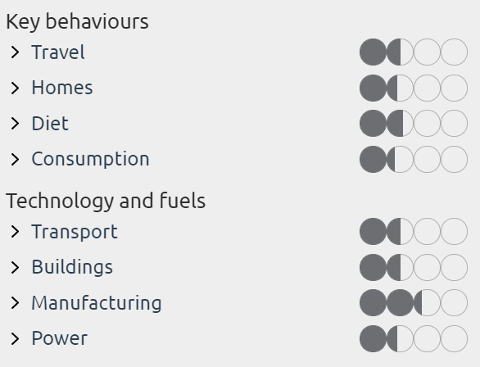
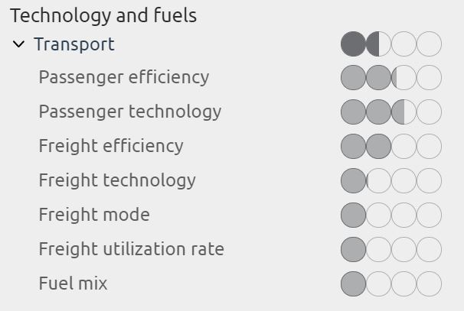
Methodology
Emission projections using the transition pathway explorer

Slide 9
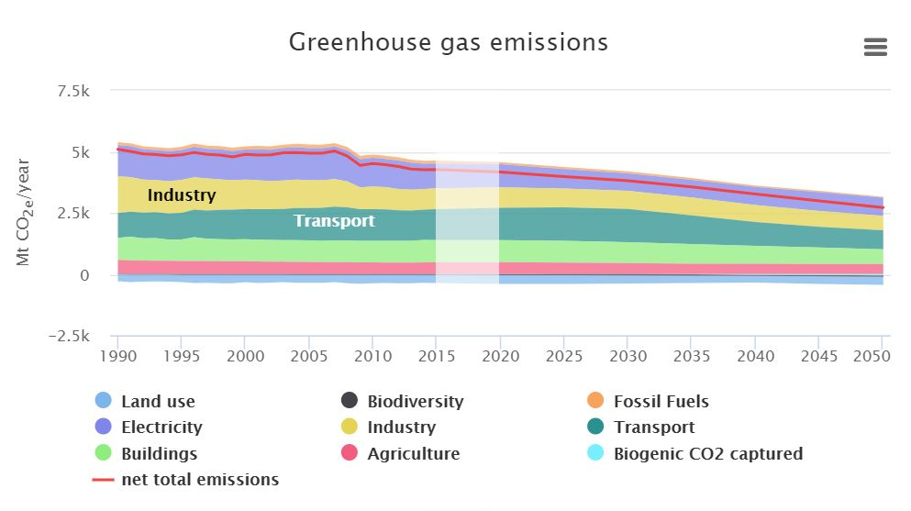
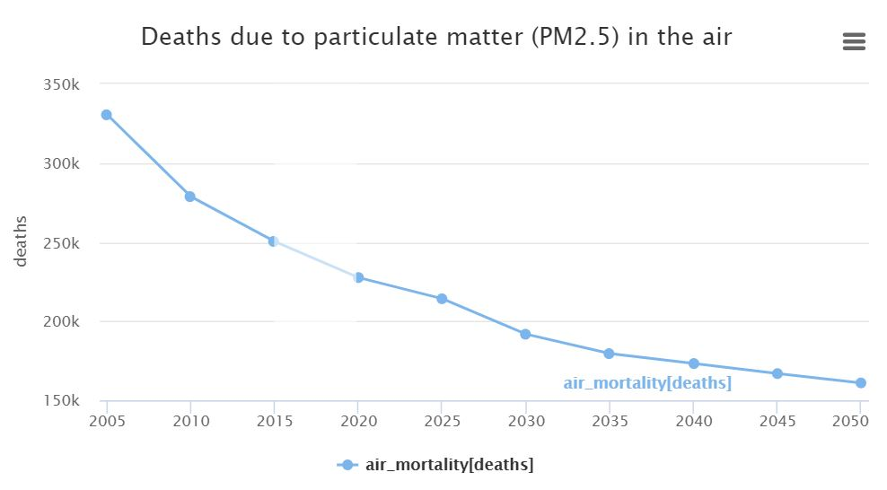
Methodology
Emission projections using the transition pathway explorer

Slide 10
Methodology
Life Cycle Assessment
Life Cycle Assessment
Dynamic Life Cycle Assessment
LDV+ HDV+ Buses
LDV: Sedans, SUV, Sports Vehicles
BEV + ICEV + Diesel
Literature | Powertrain | Type of LDV | Impact Assessment Method | Database | Boundary
Al-Thawadi, Weldu and Al-Ghamdi | ICEV | Not Specified | TRACI | GaBi Database | Gate to Gate
Al-Thawadi and Al-Ghamdi | ICEV | Not Specified | ReCiPe | GaBi Database | Gate to Gate
Onat, Kucukvar, Aboushaqrah, and Jabbar | ICEV, HEV, PHEV, BEV | SUV | Multi-Region Input-Output | EXIOBASE 3.4 | Gate to Gate
This Study | ICEV and BEV | Sedans, SUVs, and Sports Cars | CML | Ecoinvent | Cradle to Grave

Slide 11
Initial Results
Scenarios analysis for road transport

Slide 12
Initial Results
Life Cycle Assessment

Slide 13
Conclusion and Future Work
01
Develop road scenarios to achieve local goals, and measure the effectiveness of ban policies
02
Begin working on the transition pathway explorer model
03
Model the dynamic LCA for different vehicle types and classes

Slide 14
References
1
Al-Thawadi, F. E., & Al-Ghamdi, S. G. (2019). Evaluation of sustainable urban mobility using comparative environmental life cycle assessment: A case study of Qatar. Transportation Research Interdisciplinary Perspectives, 1(2019), 100003.
5
Garcia, R., & Freire, F. (2017). A review of fleet-based life-cycle approaches focusing on energy and environmental impacts of vehicles. Renewable and Sustainable Energy Reviews, 79(August 2016), 935–945.
2
Al-Thawadi, F. E., Weldu, Y. W., & Al-Ghamdi, S. G. (2020). Sustainable Urban Transportation Approaches: Life-Cycle Assessment Perspective of Passenger Transport Modes in Qatar. Transportation Research Procedia, 48, 2056–2062.
6
Taylor, E., Martin, B., Latiers, M., Cornet, M., & Pestiaux, J. (2020). Transport Module Documentation.
3
Onat, N. C., Kucukvar, M., Aboushaqrah, N. N. M., & Jabbar, R. (2019). How sustainable is electric mobility? A comprehensive sustainability assessment approach for the case of Qatar. Applied Energy, 250, 461–477.
7
eucalc. (n.d.). Retrieved June 20, 2022, from http://tool.european-calculator.eu/app/emissions/ghg-emissions/?levers=1j12112ffl11211mp2b111fffffpppppp11f411111e3211r211l21n221
4
Qatargas. (2020b). Retrieved December 1, 2020, from https://www.qatargas.com/english/MediaCenter/Pages/Press Releases/Qatar-Petroleum-Announce-the-Start-of-the-Development-Drilling-Campaign-of-the-North-Field-East-Project.aspx
8
Ministry of Interior. (2019). TRANSPORT AND COMMUNICATIONS STATISTICS.

Slide 15
Thank you

