Slide 1



A STATISTICAL APPROACH
FOR
PORE-SCALE MODELLING
OF
INTERMITTENCY AND OSTWALD RIPENING
Ademola Isaac Adebimpe
January 2024

Slide 2



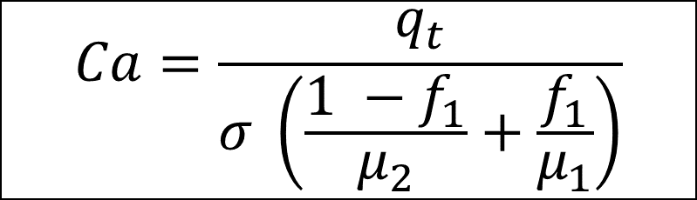
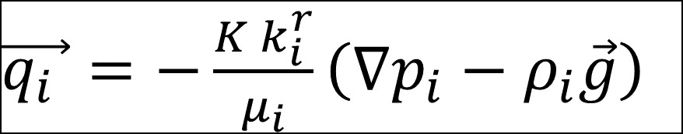
Fluid intermittency during two-phase flow
Extended Darcy’s law for two-phase flow:
Capillary number for two-phase flow:
$$Ca=\frac{q_{t}}{σ \left(\frac{1 −f_{1}}{μ_{2}}+\frac{f_{1}}{μ_{1}}\right)}$$
$\vec{q_{i} }=−\frac{K k_{i}^{r}}{μ_{i}}\left(∇p_{i}−ρ_{i}\vec{g}\right)$
Traditional expectation/knowledge is that there is always a linear relationship between pressure gradient and capillary number.
Recent experimental findings have shown that the relationship between pressure gradient and capillary number is not always linear;
(major research groups establishing this being Tallakstad and co-researchers; Hansen and co-researchers; Blunt and co-researchers).

Slide 3


Fluid intermittency during two-phase flow
Expected
$$\left(∇p ∝ \text{Ca}\right)$$
Observed
$$\left(∇p ∝ {Ca}^{β}\right)$$
Fluid intermittency is caused by the nonwetting phase periodically finding more conductive pathways through the pore space, usually when the viscous force becomes comparable to the capillary forces. Areas of the pore space exhibiting intermittent flow behavior were detected from their scan’s greyscale value.
Intermittent flow pathways could provide significant connectivity for seemly trapped nonwetting phase clusters, altering relative permeabilities and how much is trapped. Thus, it is of relevance to applications of subsurface flow.

Slide 4
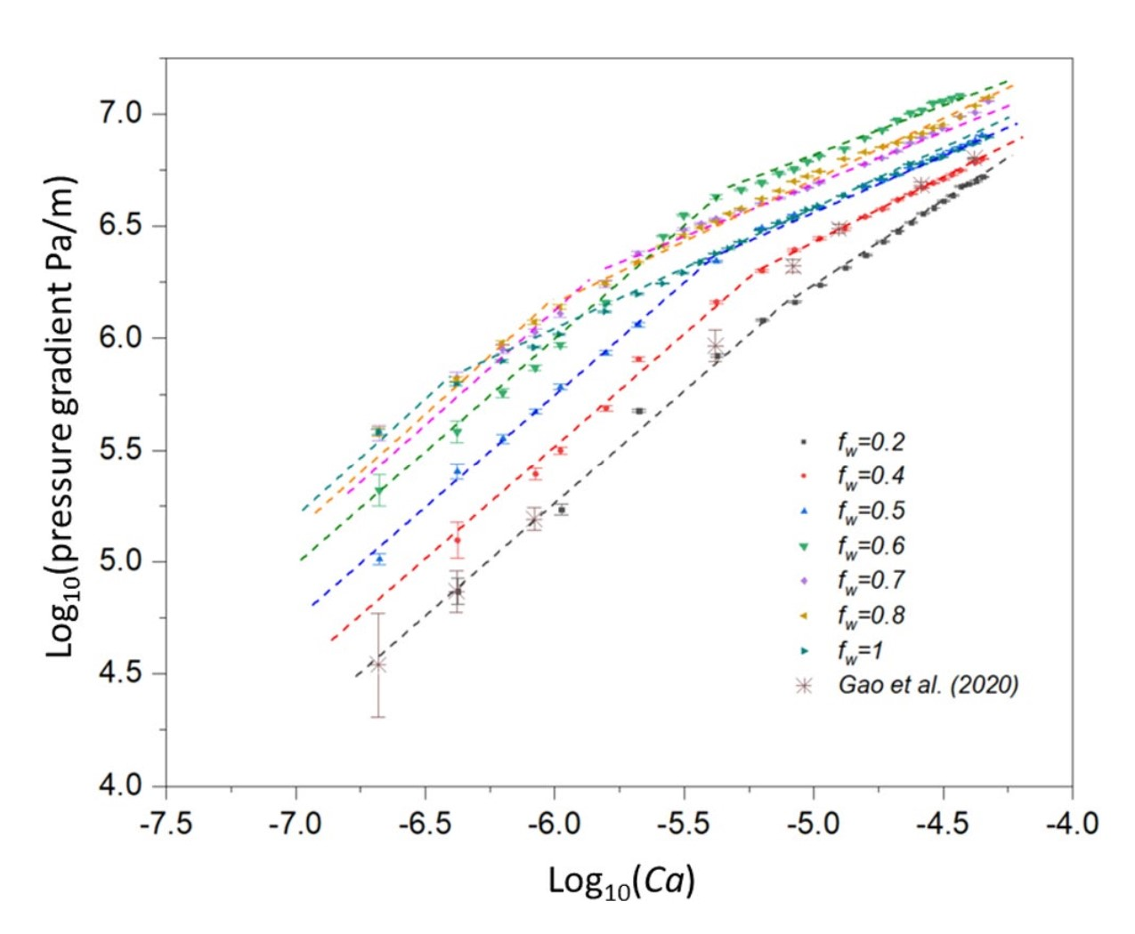
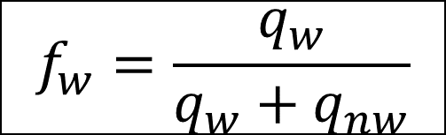
Experimental Results on Intermittency
$$f_{w}=\frac{q_{w}}{q_{w}+q_{nw}}$$
phase 1: wetting (w)
phase 2: non-wetting (nw)
Zhang et al., 2021

Slide 5

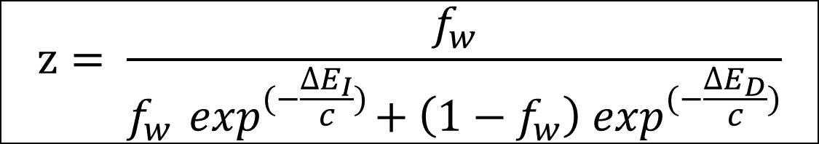

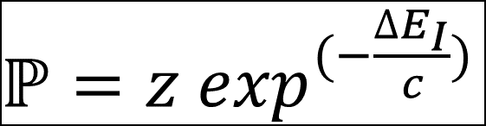

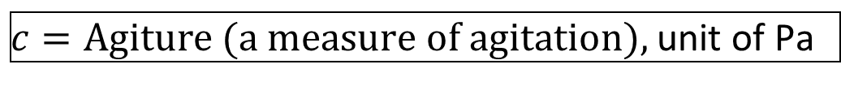
Modelling of Fluid Intermittency
$ℙ=z\exp^{(−\frac{{∆E}_{I}}{c})}$
Can two-phase intermittency behavior be simulated using a
statistical thermodynamic approach?
$$z= \frac{f_{w}}{f_{w}\exp^{(−\frac{{∆E}_{I}}{c})}+\left(1−f_{w}\right)\exp^{(−\frac{{∆E}_{D}}{c})}}$$
$${∆E}_{I}=P_{c}^{∗} −{x.P}_{c}^{I}$$
$${∆E}_{D}={{x.P}_{c}^{D} − P}_{c}^{∗}$$
$$P_{c}^{D}=\text{Entry} \text{capillary} \text{pressure} \text{for} \text{drainage}$$
$$P_{c}^{I}=\text{Entry} \text{capillary} \text{pressure} \text{for} \text{imbibition}$$
$$P_{c}^{∗}=\text{Prevailing} \text{capillary} \text{pressure}$$
$c=\text{Agiture}\text{ (}\text{a} \text{measure} \text{of} \text{agitation}\text{),}$ unit of Pa
$$x=\text{Tuning} \text{parameter}$$

Slide 6
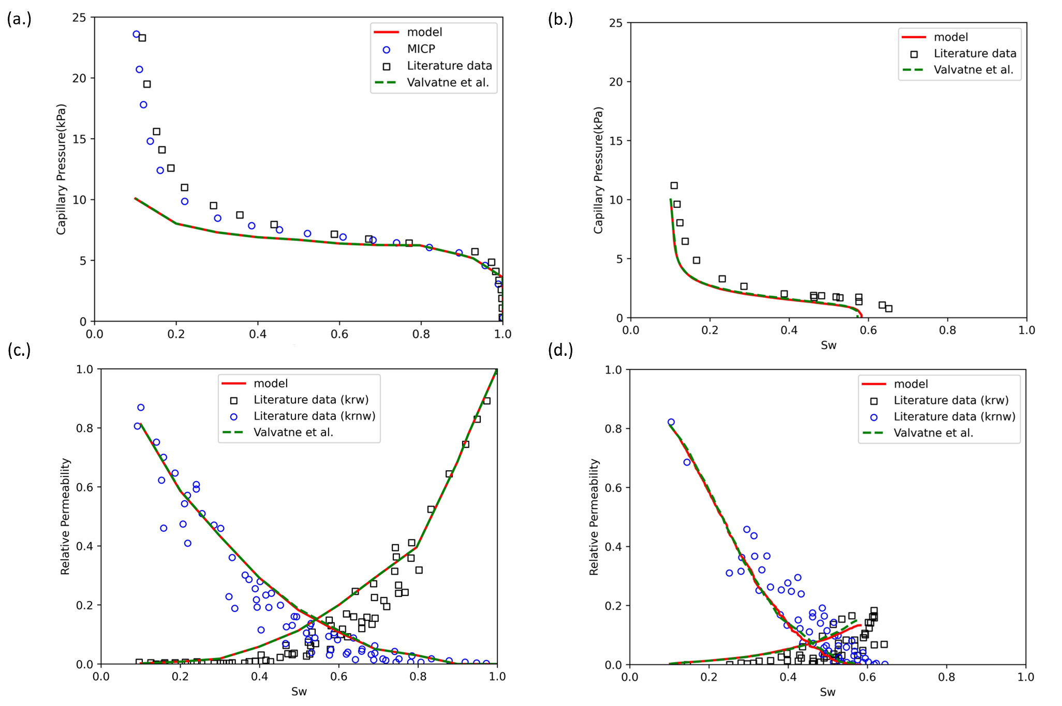
Methodology for Implementing Model
Simulate quasi-static drainage to the desired residual wetting phase saturation
A quasi–static code to simulate drainage and imbibition was written in Python and validated with experimental data and a previous model.
Simulate quasi-static imbibition to the desired fractional flow
Implement the model at that fractional flow

Slide 7
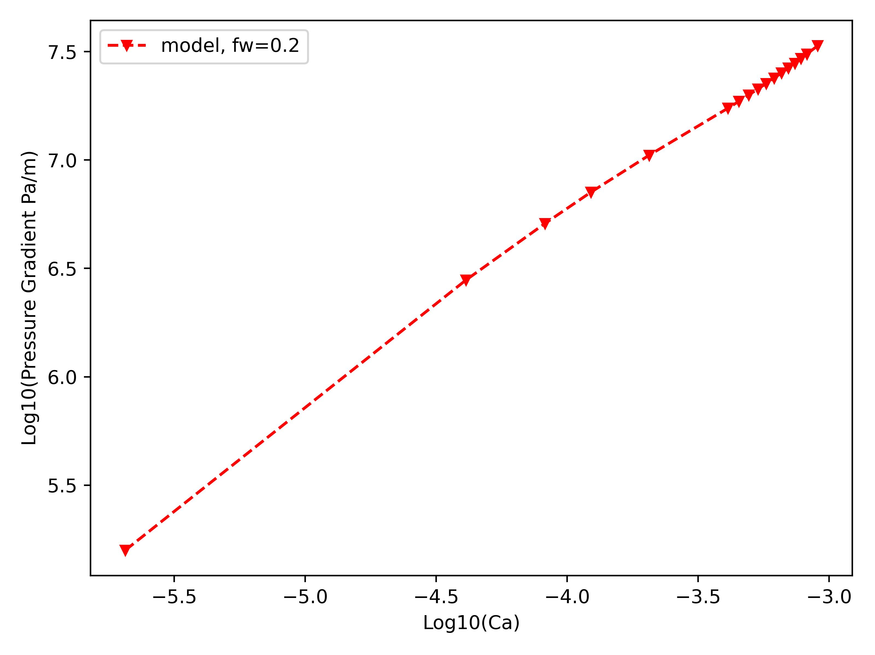
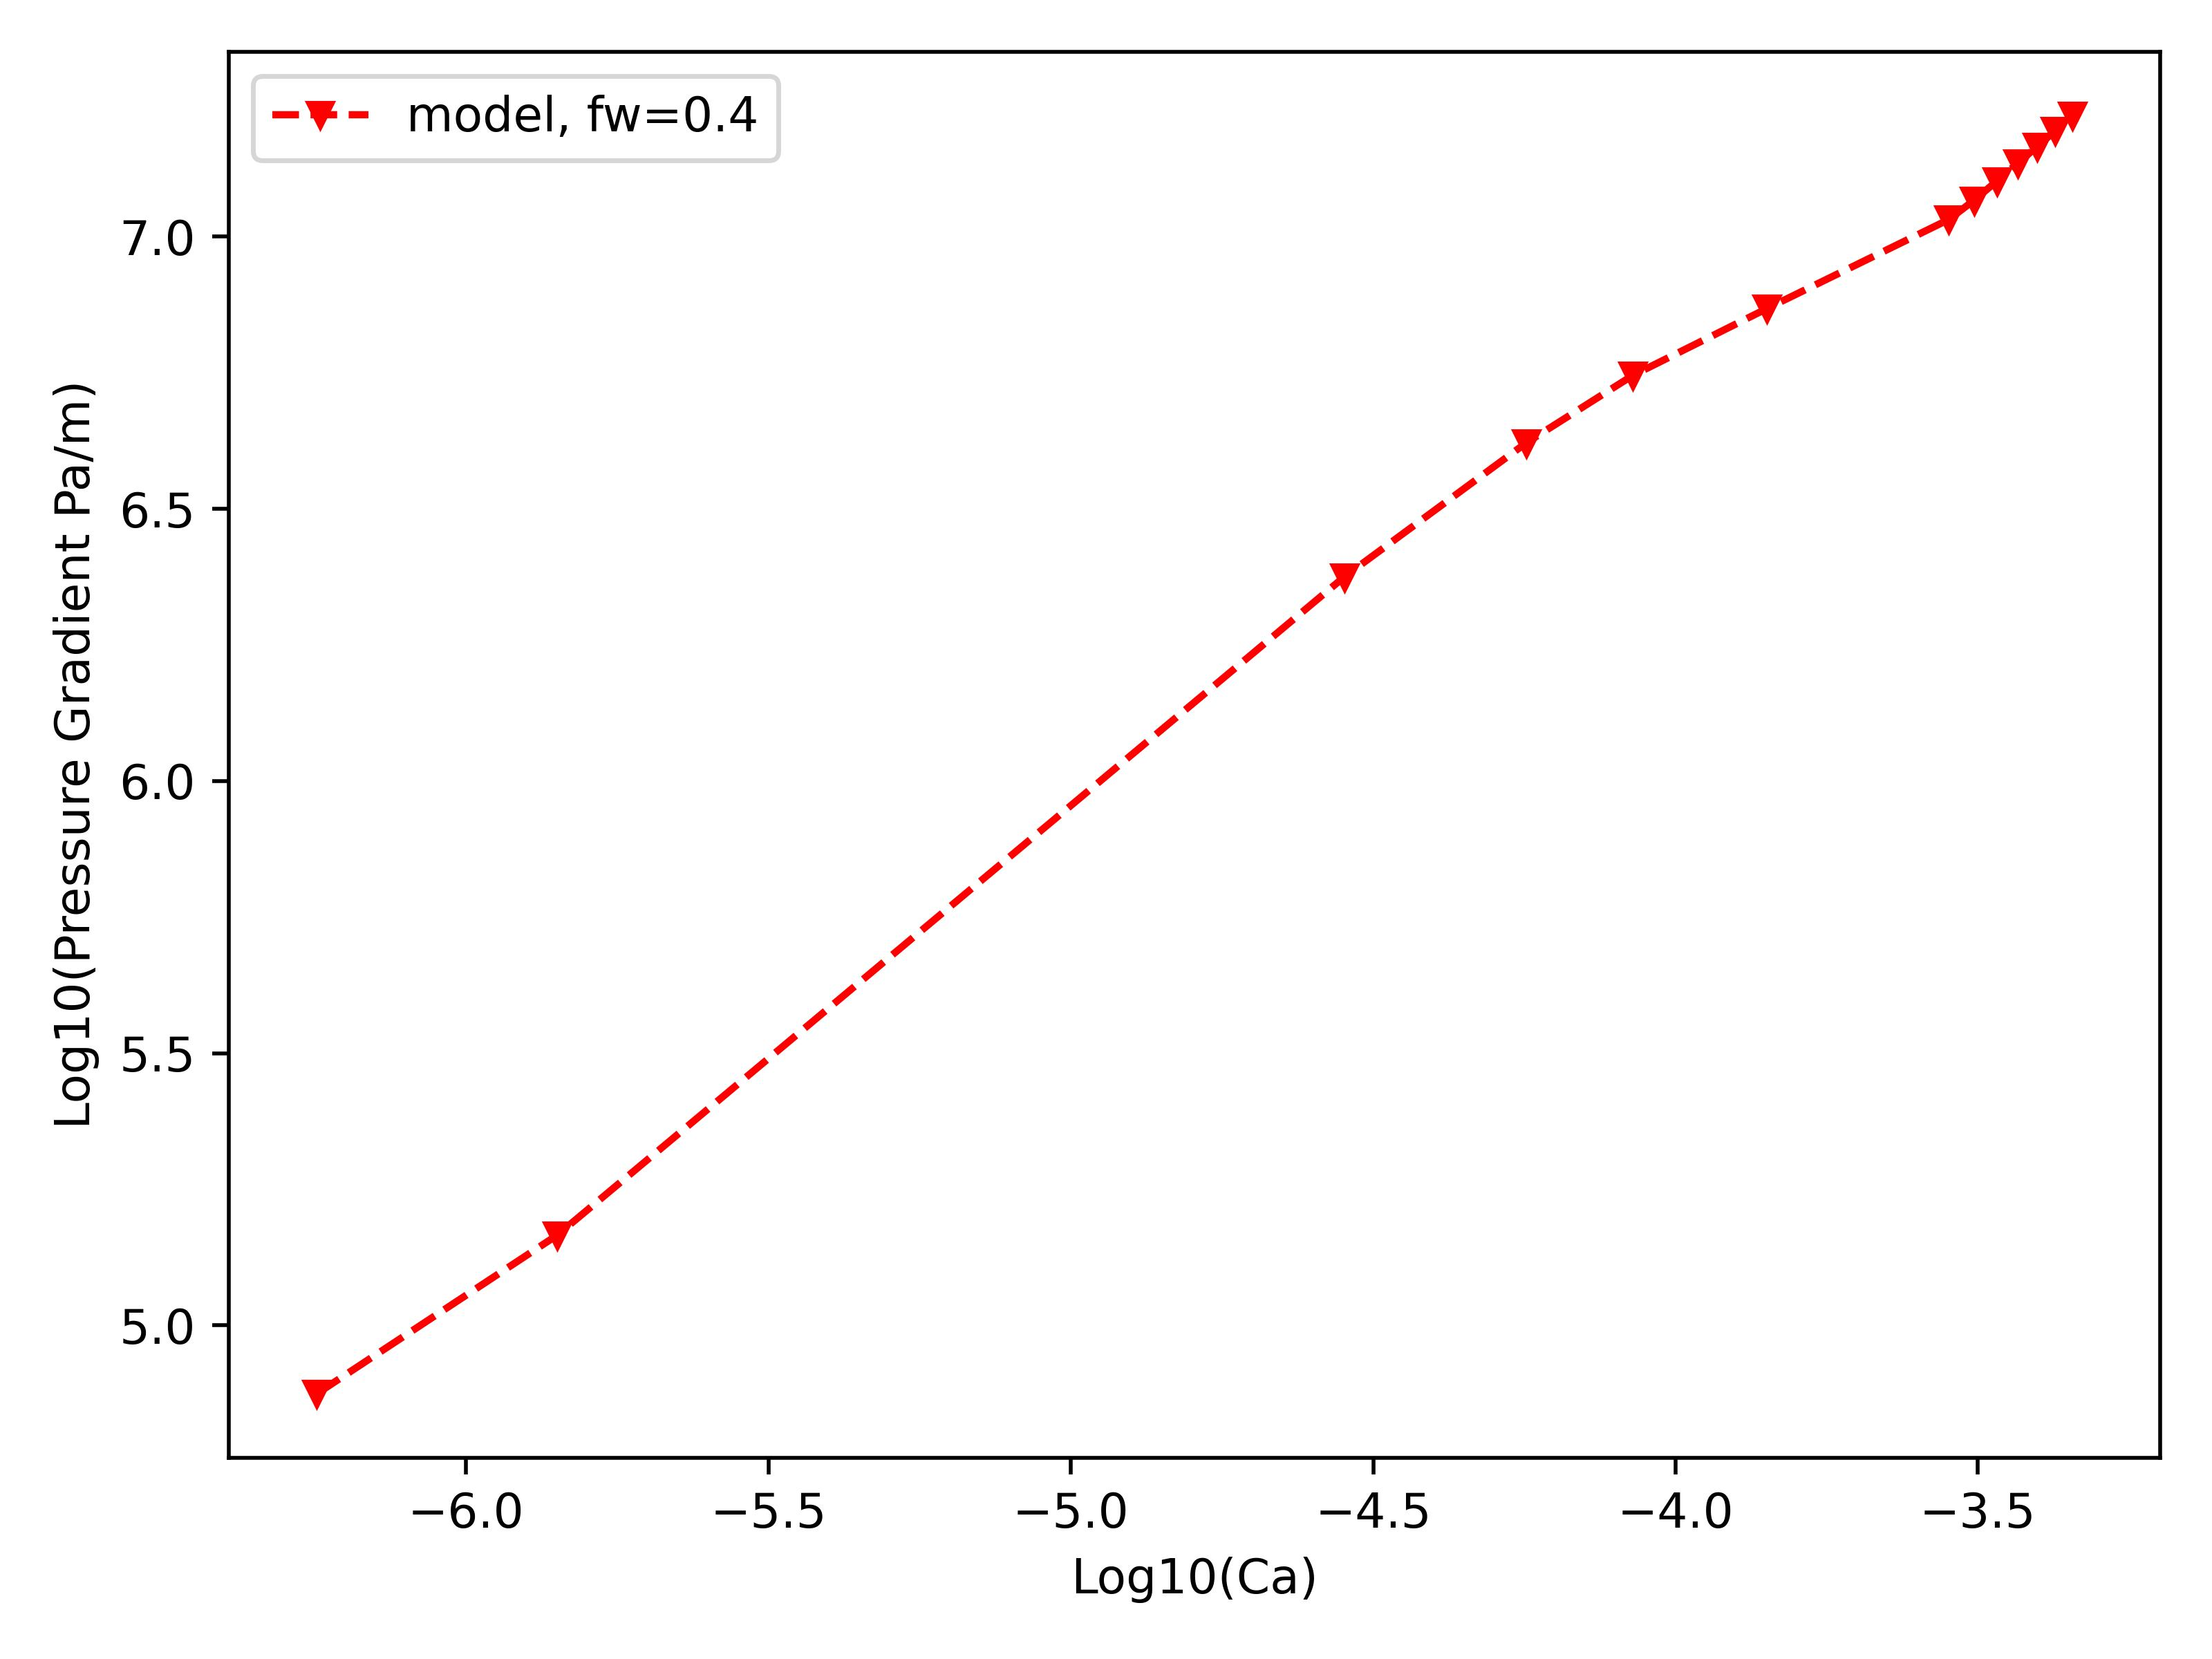
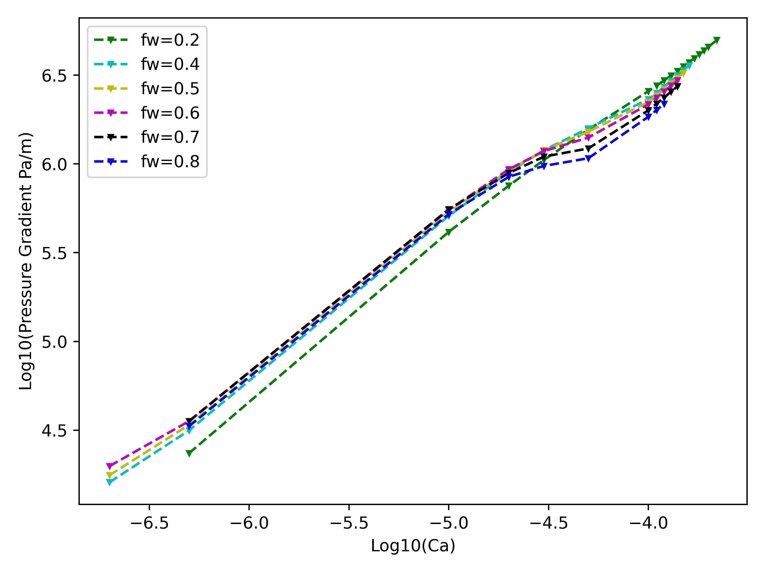
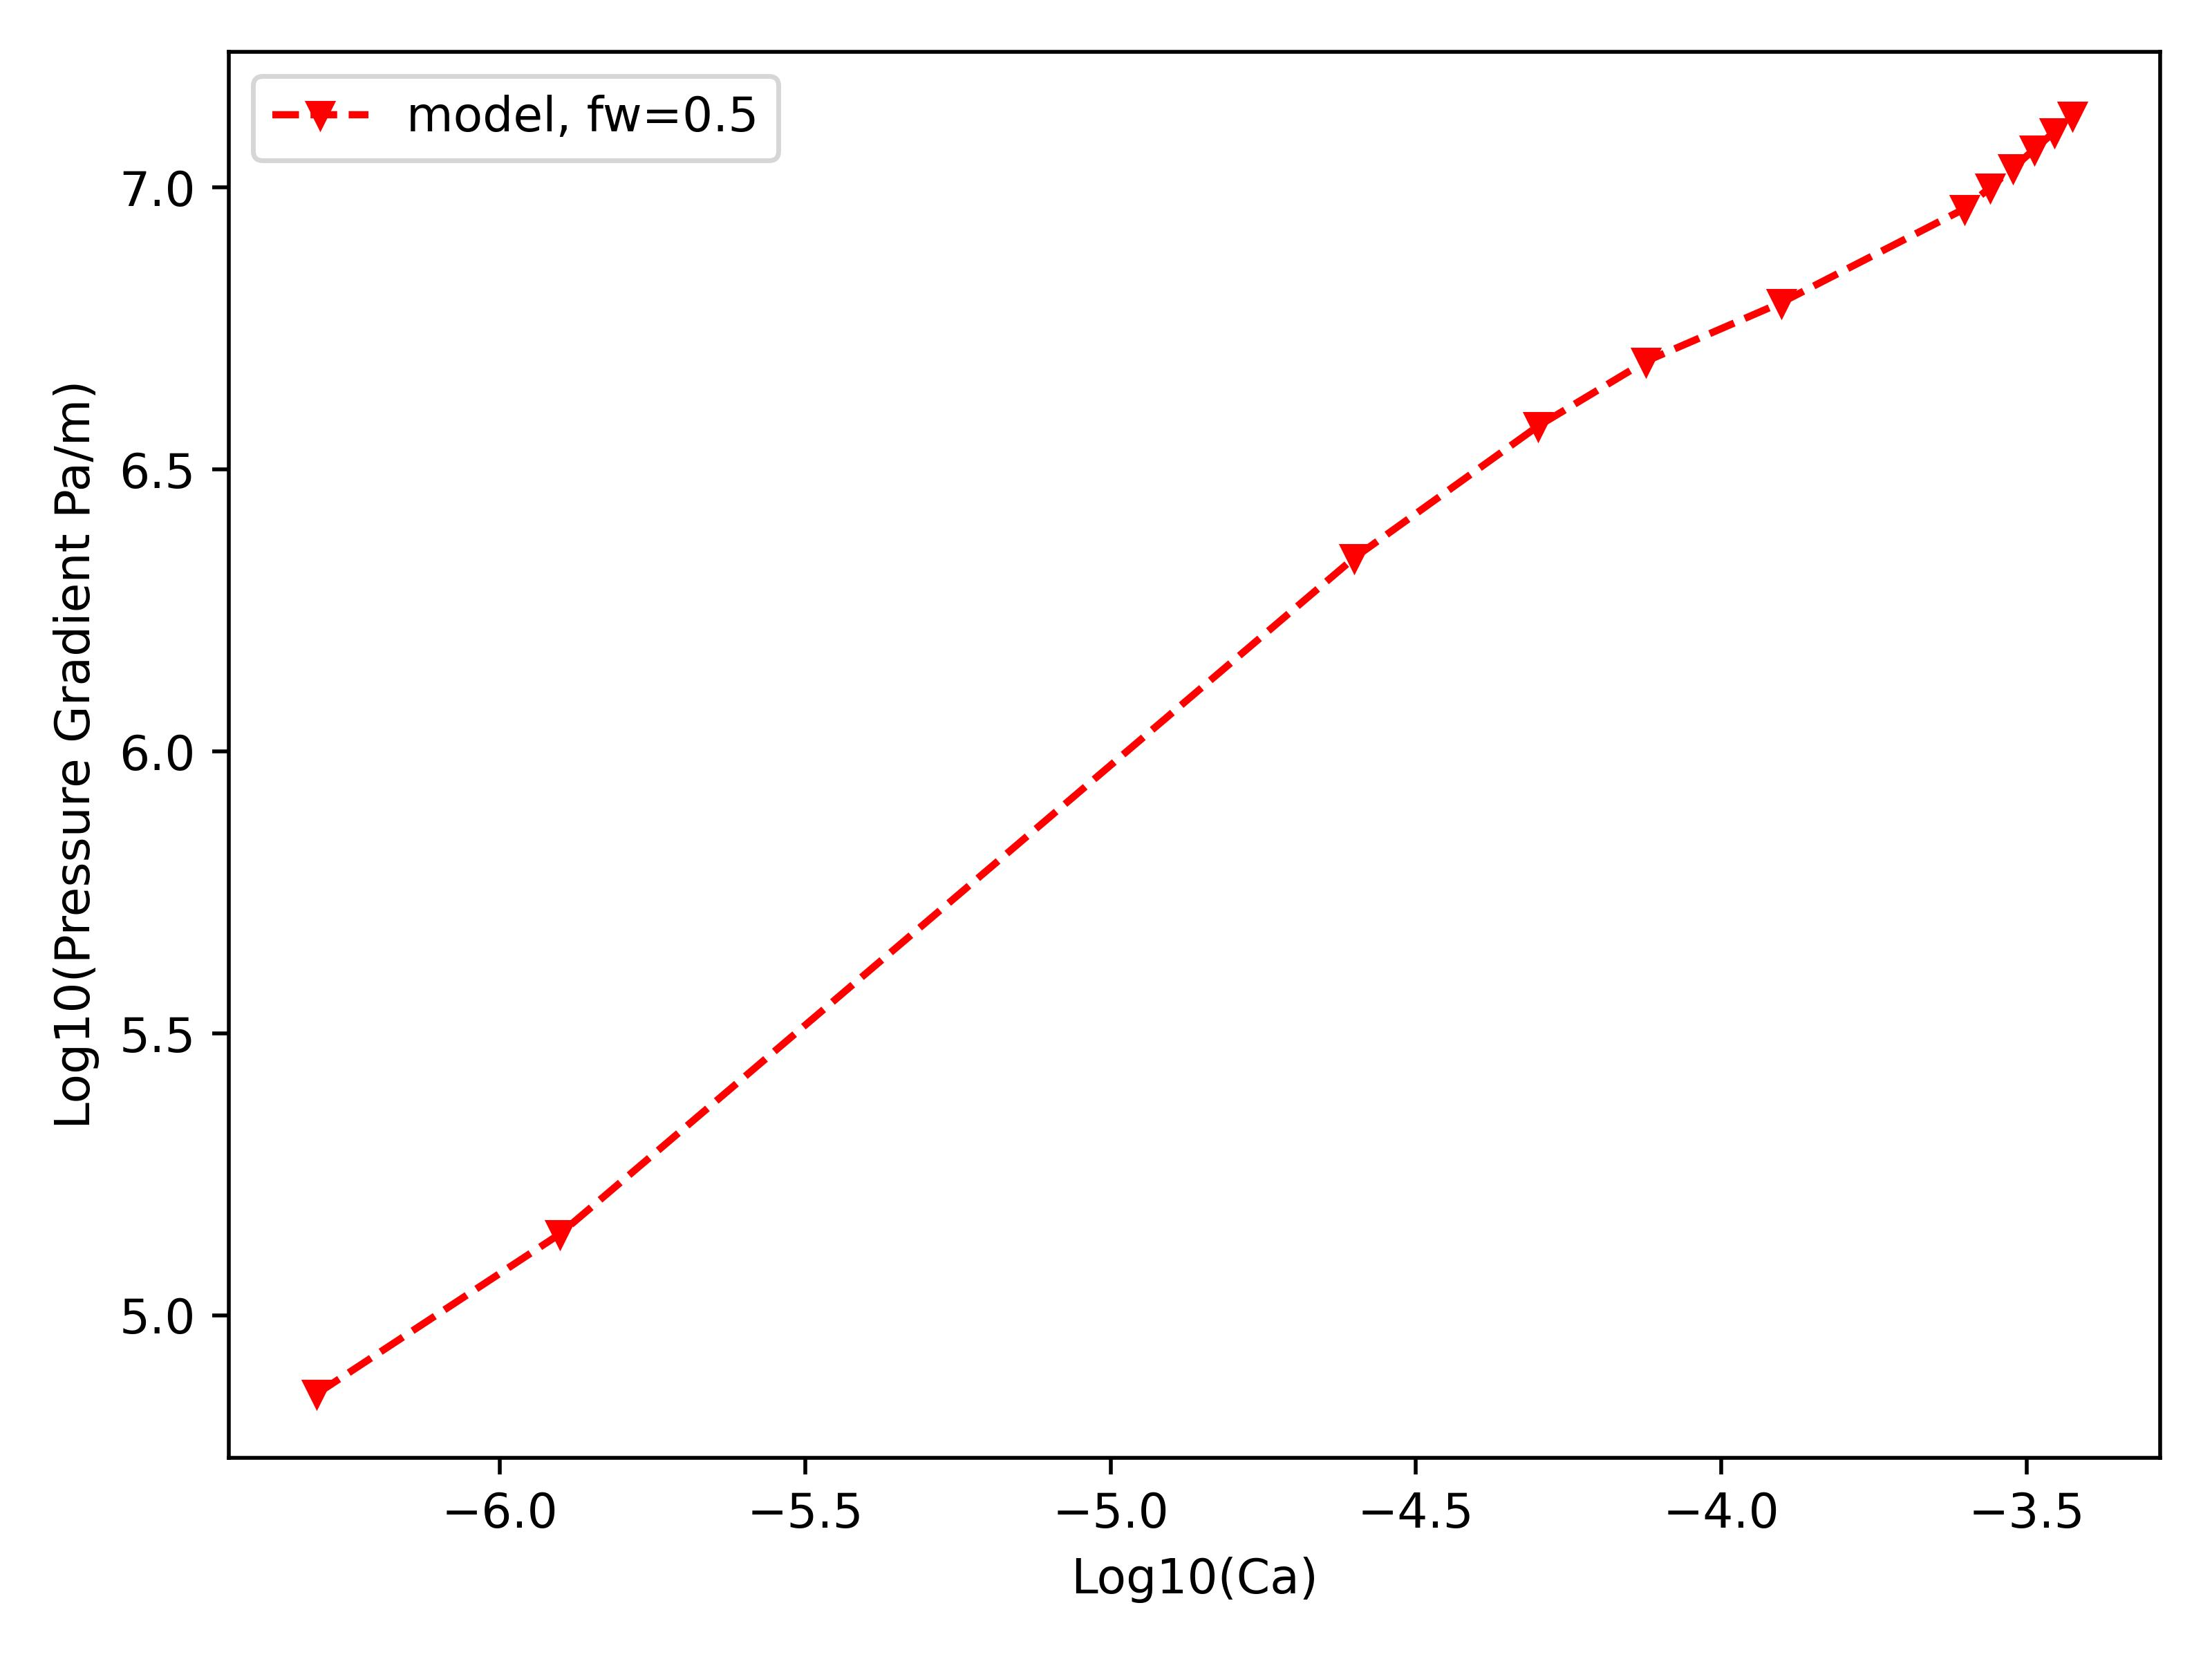
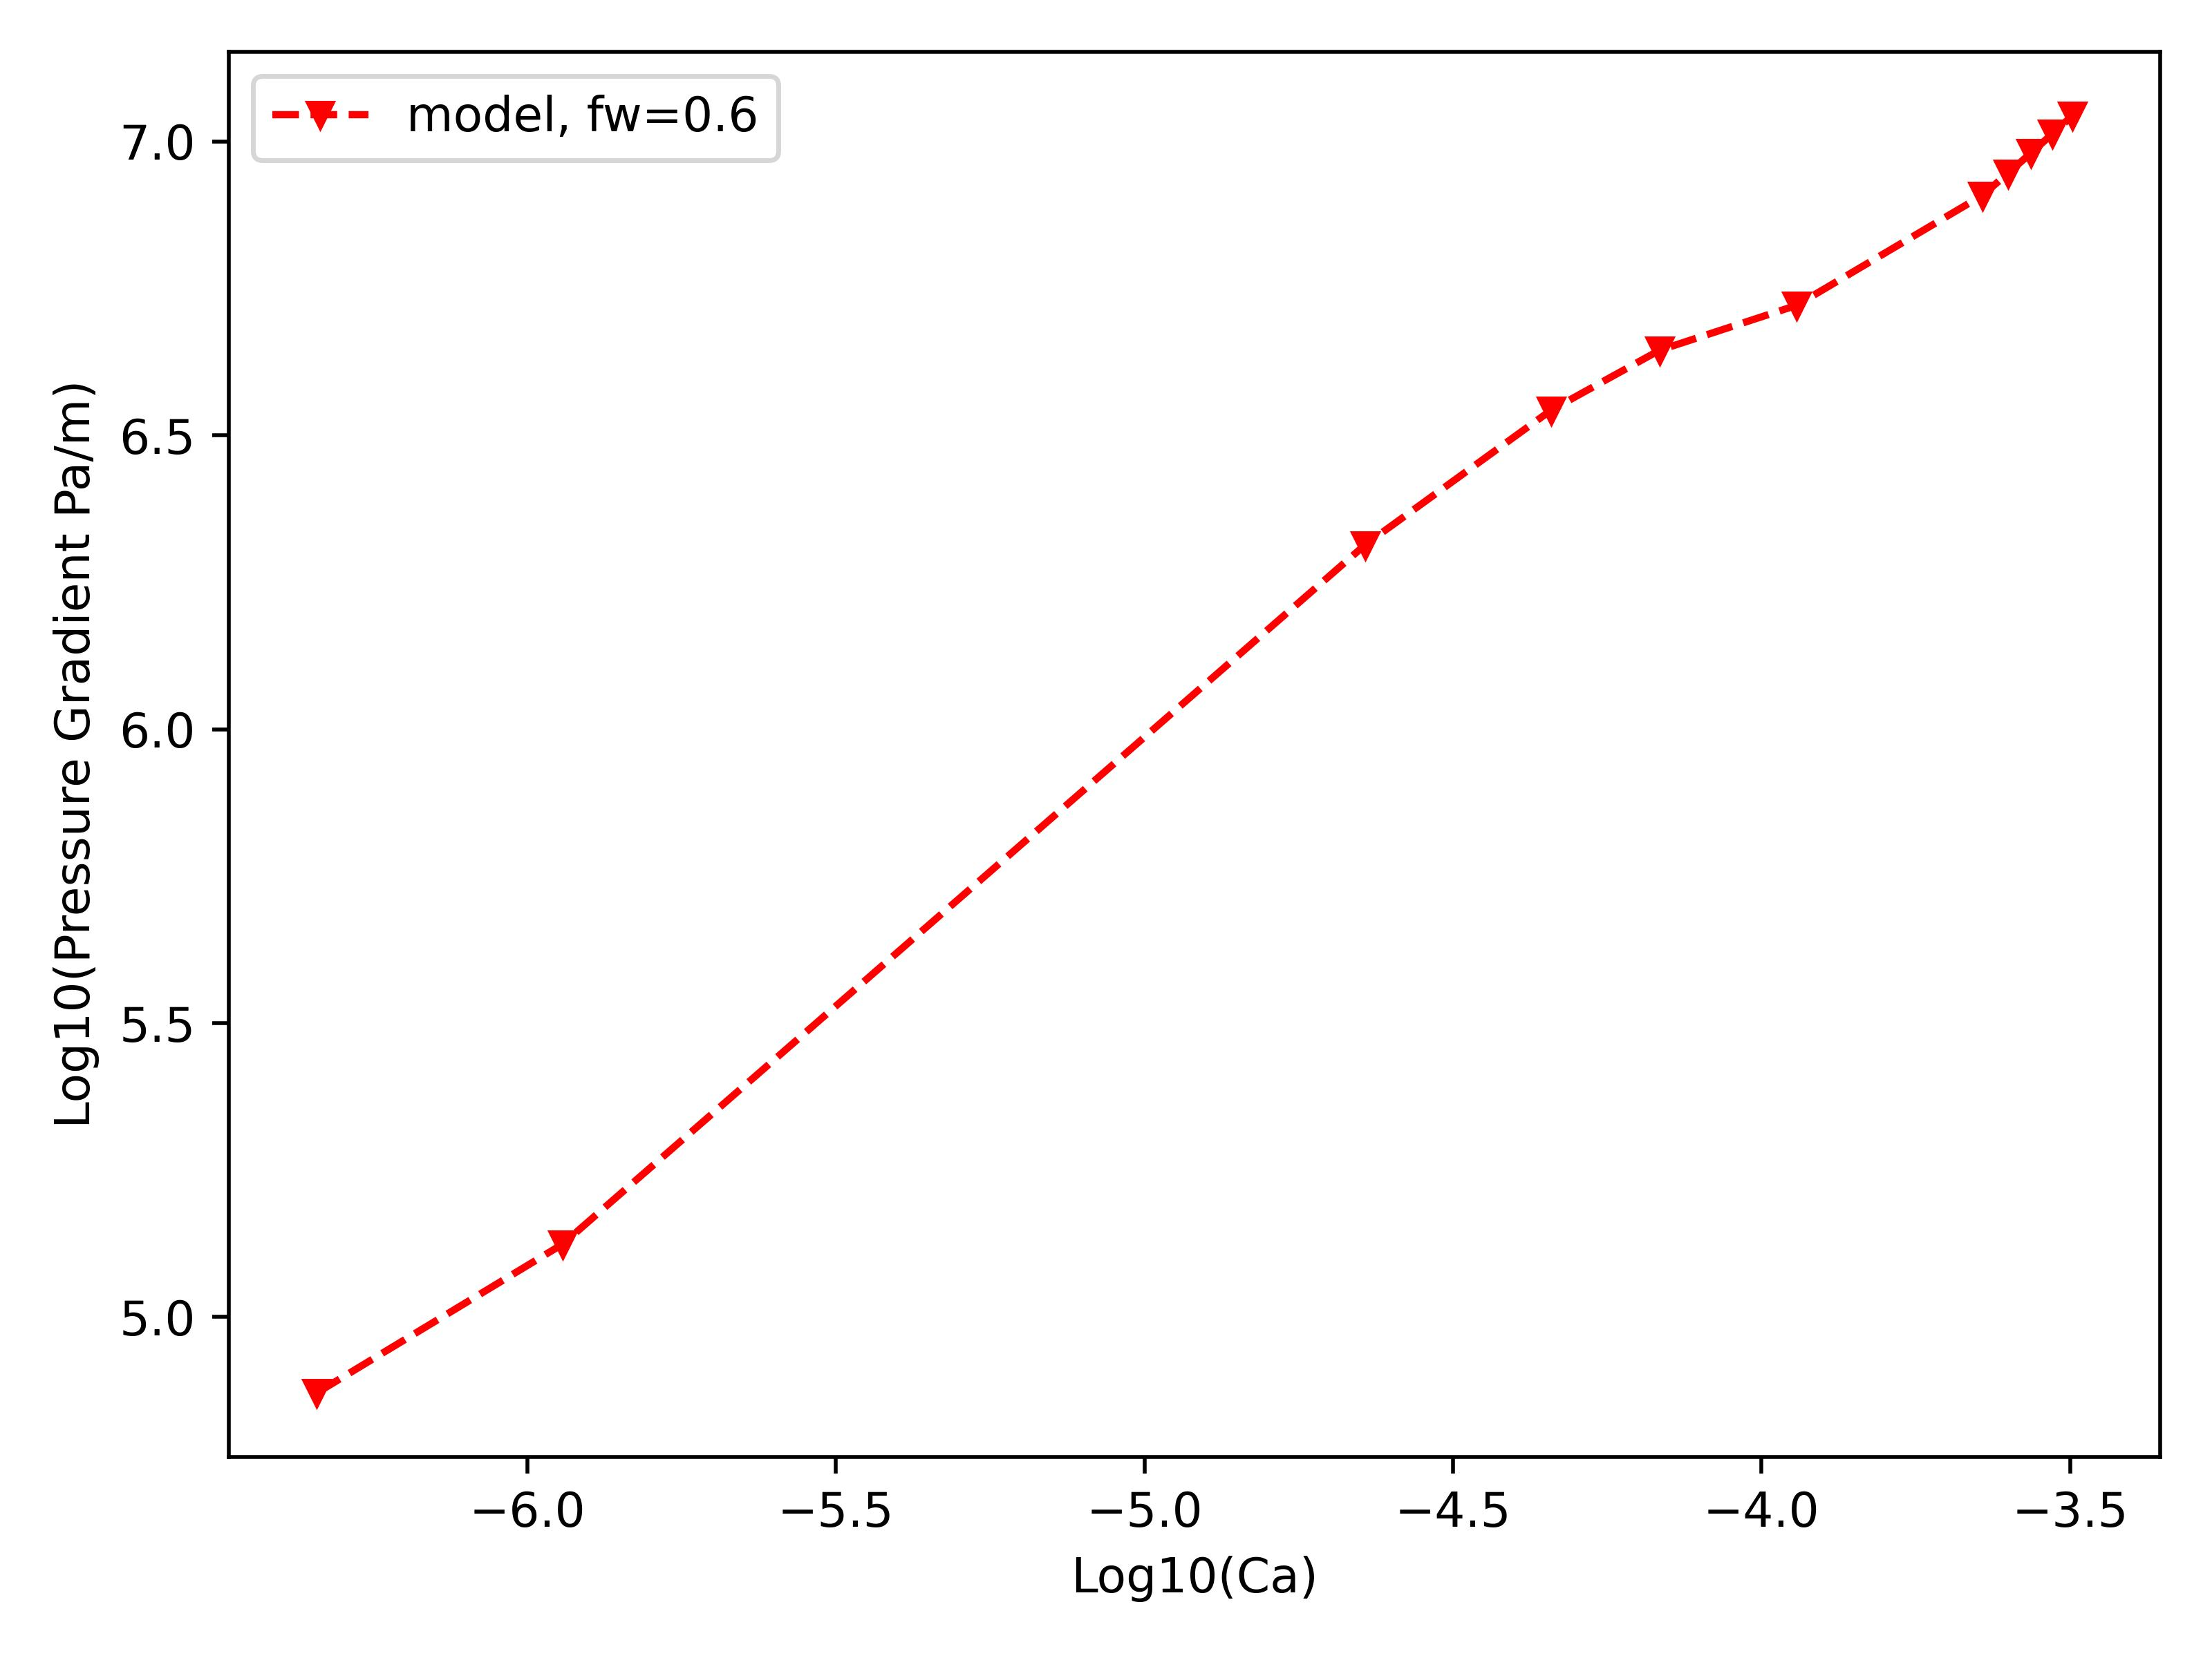
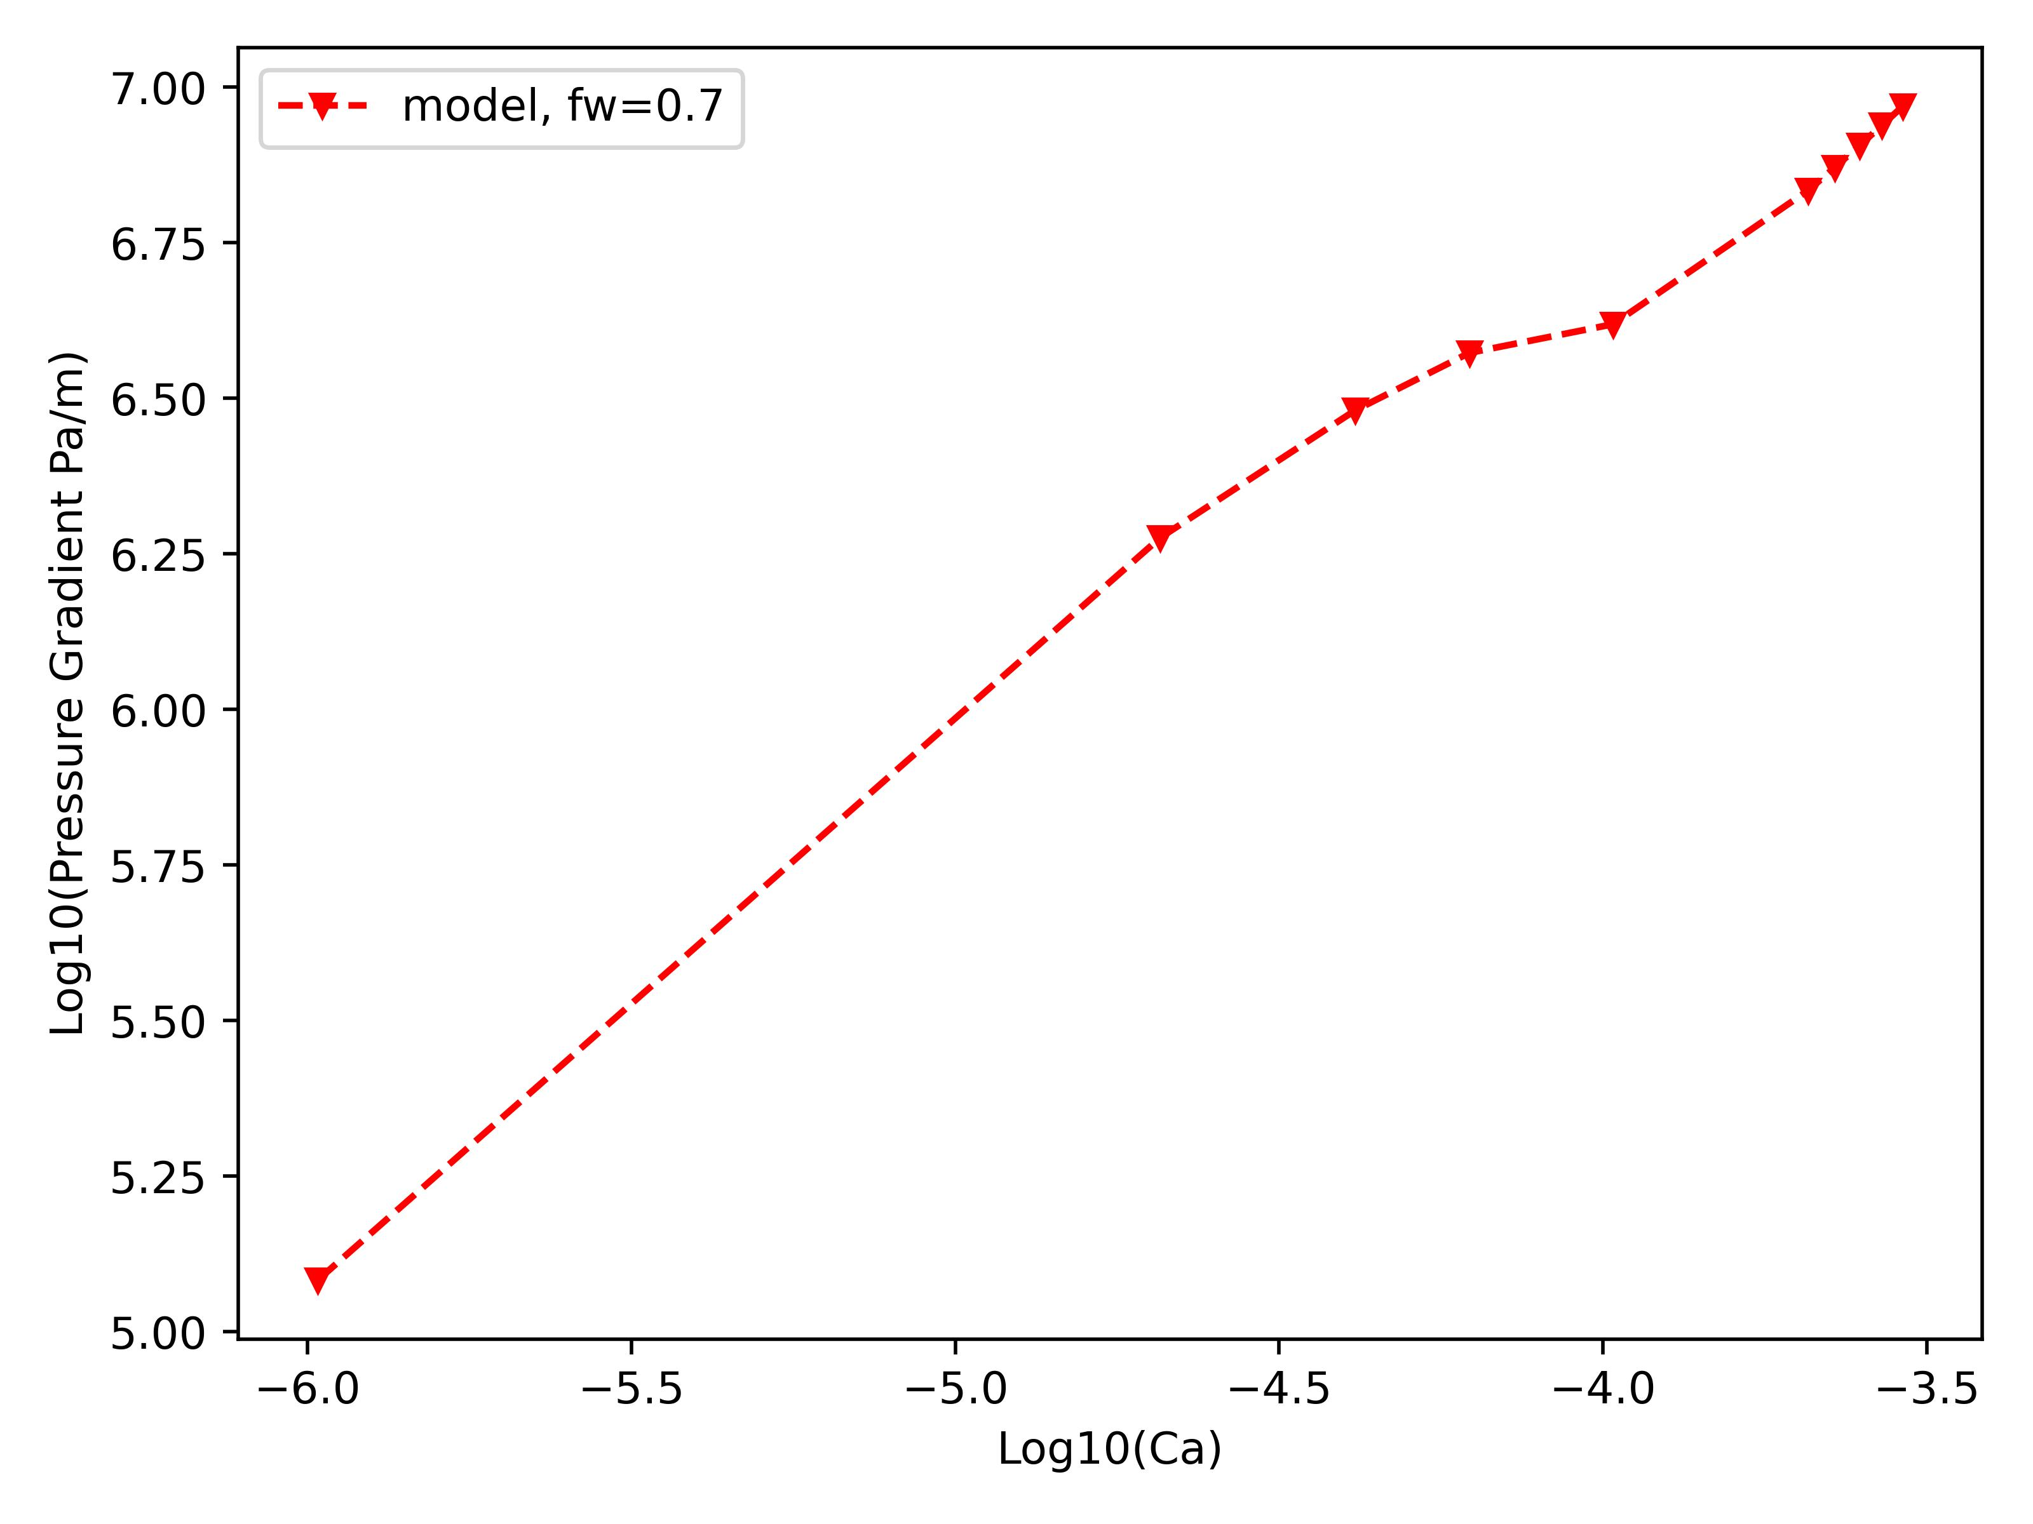
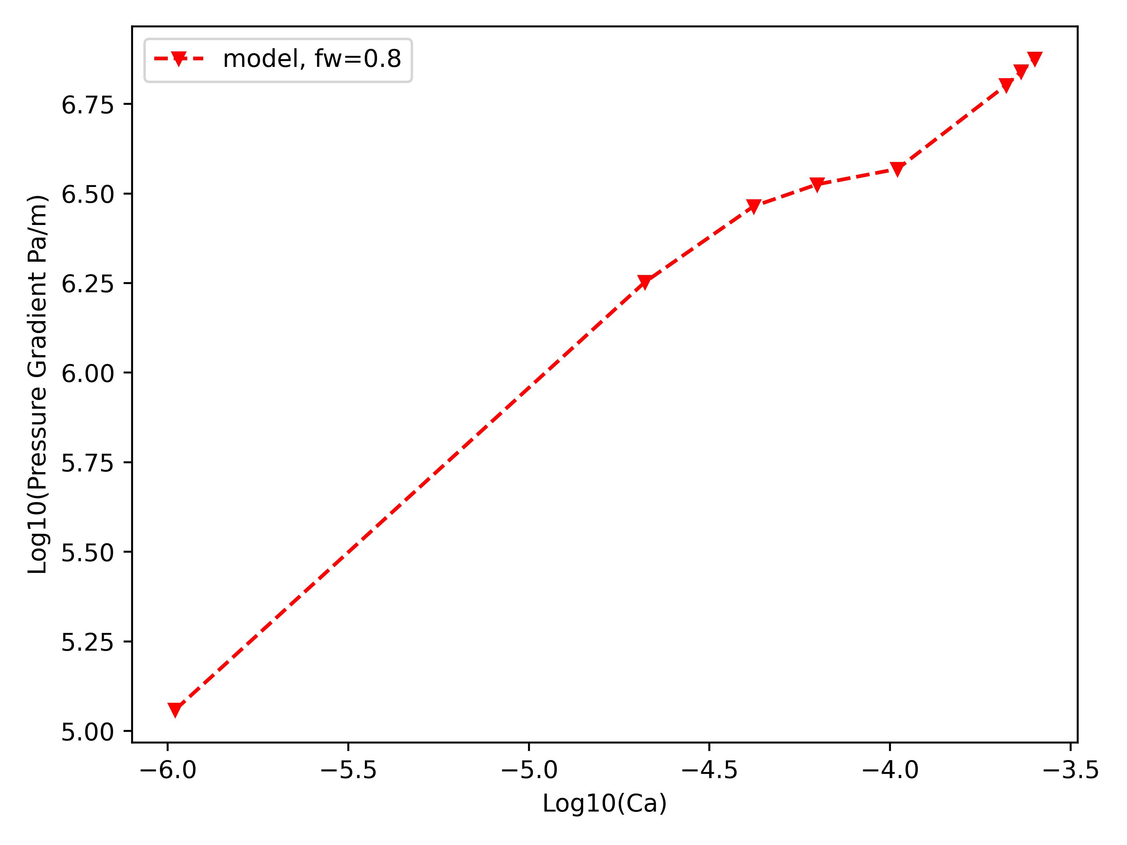
Simulation Results of Fluid Intermittency

Slide 8
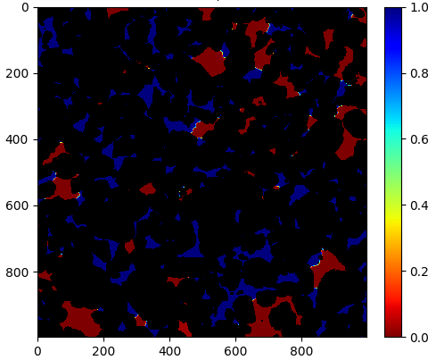
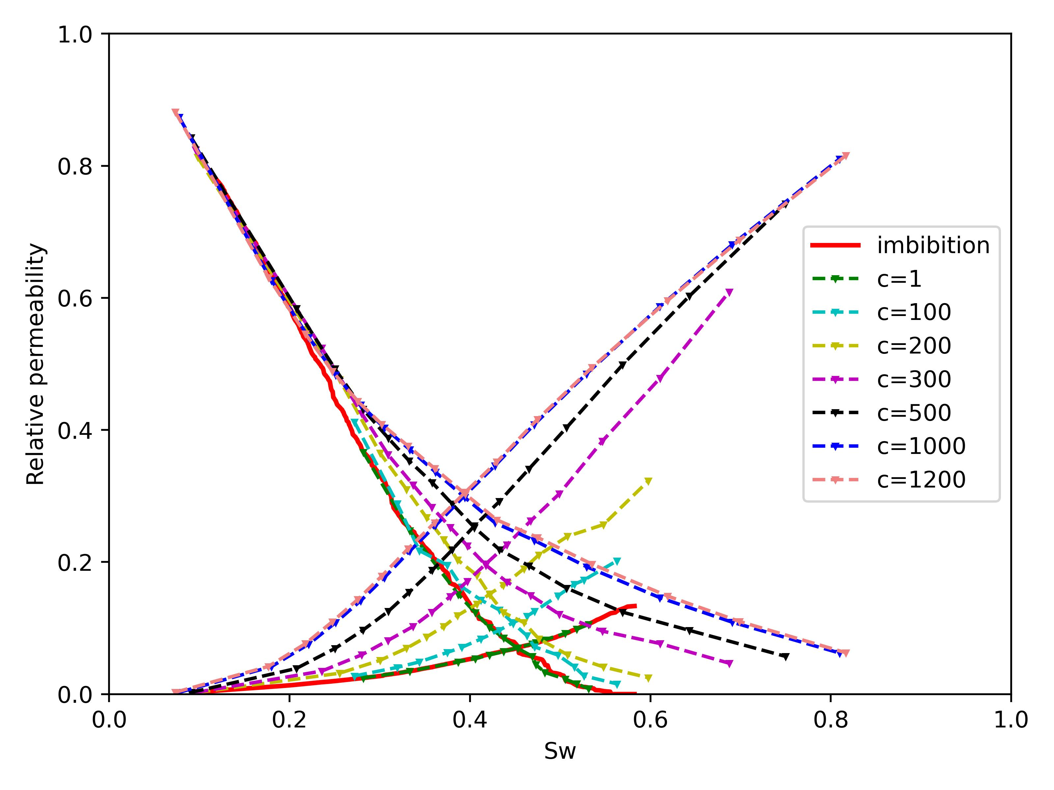
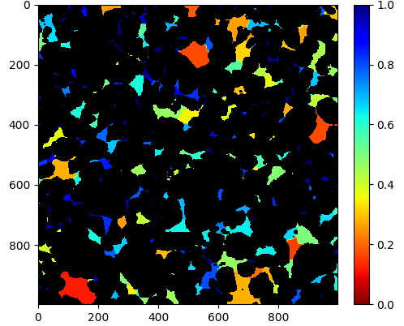
Simulation Results of Fluid Intermittency

Slide 9
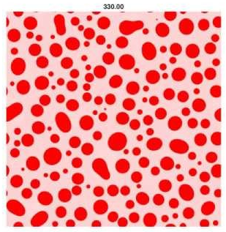
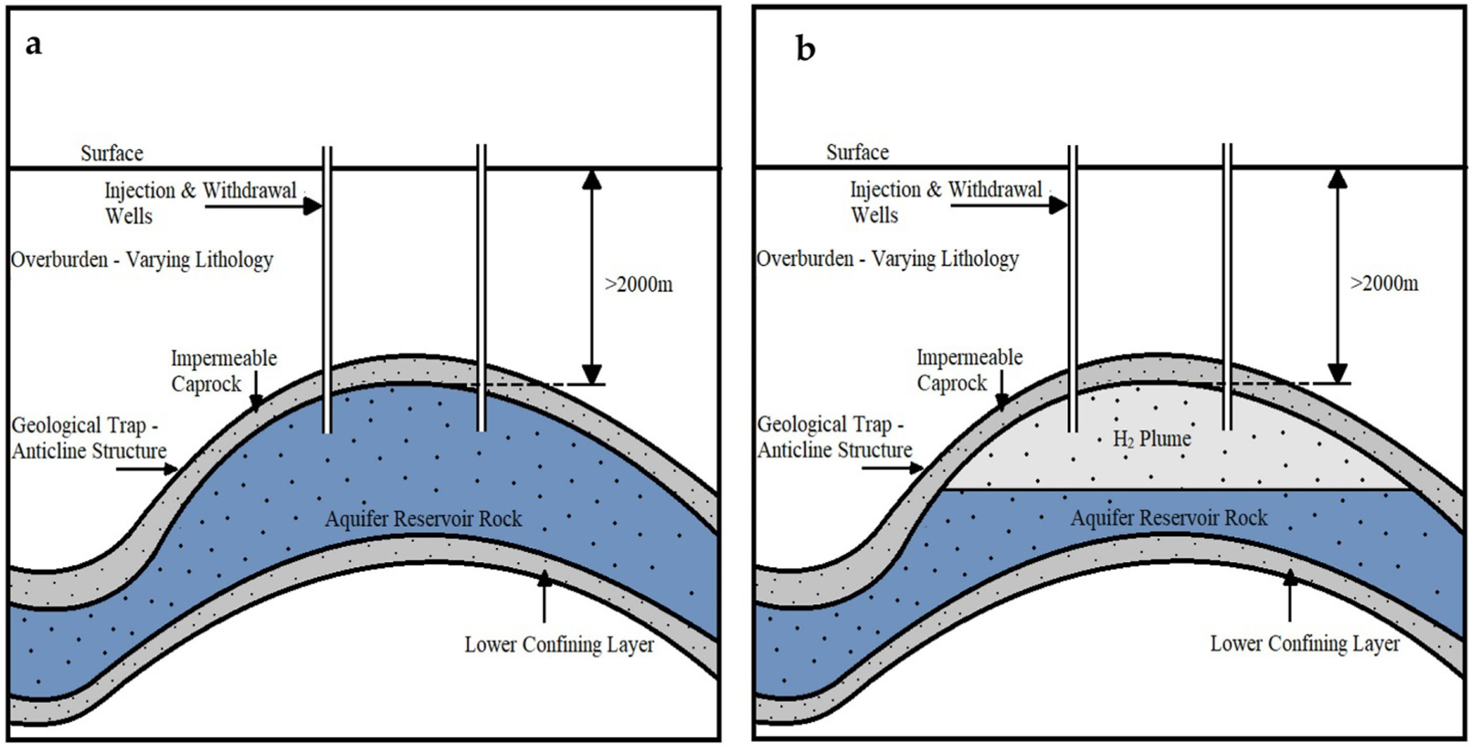
Ostwald Ripening
Ostwald ripening refers to diffusion-driven transport to eliminate concentration gradients in the aqueous phase.
Differences in local capillary pressure of trapped ganglia result in differences in the gas pressure and consequently lead to concentration gradients in the aqueous phase
https://youtu.be/REcr2l7miVg?list=PL4AOcbv0op0RYx5ktcI2xijiSPRFUDkB2
Ostwald ripening leads to the growth of low-pressure ganglia and the shrinkage, if not complete disappearance of higher-pressure ganglia.

Slide 10
Modelling of Ostwald ripening
There are existing Ostwald ripening models:
Li and Yortsos (1995); Dominguez et al. (2000) – 2D models, modelled bubble growth as an invasion percolation process, pressure-volume relations.
de Chalendar et al. (2017) – 3D model (using maximal ball algorithm), sequential algorithm (phenomenon decoupled into two processes), mass balance equations.
Mehmani and Xu (2022) – 2D model, fully-implicit algorithm, mass balance equations.
Can Ostwald ripening phenomenon be simulated using a
statistical mechanical approach?
Our propositions:
Model bubble growth as an invasion percolation process (drainage).
Model bubble shrinkage as a percolation process (imbibition).
Devise a means of including time-dependency.

Slide 11
Methodology for Implementing Model
Simulate several cycles of drainage and imbibition using a modified version of the quasi-static code
shrinkage
growth
Here, the trapping of gas ganglia/clusters are tracked as done in the quasi-static code. However, the modifications include:
  Allowing the filling of pores and throats even if
trapped in imbibition, this leads to ganglia
shrinkage/disappearance.
Allowing neighboring pores and throats to the ganglia to be filled with the non-wetting phase during drainage, this leads to ganglia growth.
Drainage simulation
Imbibition simulation

Slide 12
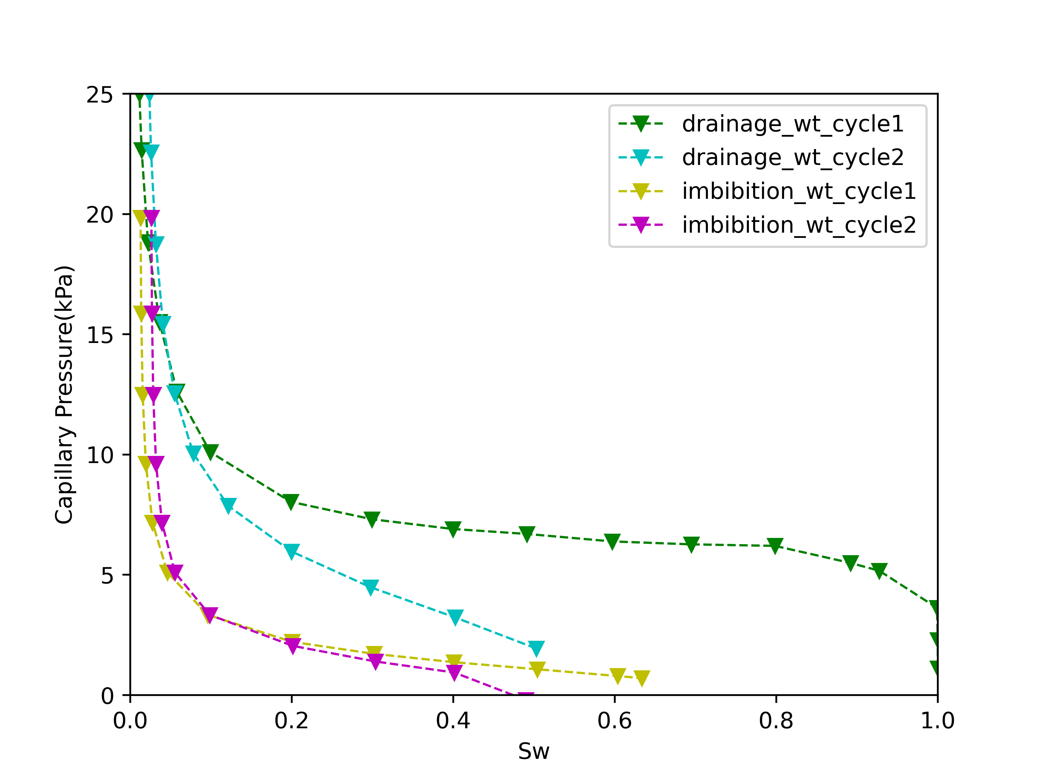
Preliminary Results of Ostwald Ripening

Slide 13
Future Works
A. Fluid Intermittency model
  Full development of the Intermittency model.
  Study of the impact of geometry (sandstones and carbonates) on fluid intermittency.
  Study of the impact of wettability on fluid intermittency.
  B. Ostwald ripening model
  Full development of the Ostwald ripening model
  Study of time dependency of Ostwald ripening
  Study of impact of wettability and geometry on Ostwald ripening.

Slide 14
References
  P. H. Valvatne and M. J. Blunt, “Predictive pore-scale modeling of two-phase flow in mixed wet media,” Water resources research, vol. 40, no. 7, 2004.
  Y. Gao, Q. Lin, B. Bijeljic, and M. J. Blunt, “Pore-scale dynamics and the multiphase darcy law,” Physical Review Fluids, vol. 5, no. 1, p. 013 801, 2020.
  M. J. Blunt, Multiphase flow in permeable media: A pore-scale perspective. Cambridge university press, 2017.
  C. Spurin, T. Bultreys, B. Bijeljic, M. J. Blunt, and S. Krevor, “Intermittent fluid connectivity during two-phase flow in a heterogeneous carbonate rock,” Physical Review E, vol. 100, no. 4, p. 043 103, 2019.
  Y. Zhang, B. Bijeljic, Y. Gao, Q. Lin, and M. J. Blunt, “Quantification of nonlinear multiphase flow in porous media,” Geophysical Research Letters, vol. 48, no. 5, e2020GL090477, 2021.
  K. T. Tallakstad, G. Løvoll, H. A. Knudsen, T. Ramstad, E. G. Flekkøy, and K. J. M ̊aløy, “Steady-state, simultaneous two-phase flow in porous media: An experimental study,” Physical Review E, vol. 80, no. 3, p. 036 308, 2009.
  A. Hansen, E. G. Flekkøy, S. Sinha, and P. A. Slotte, “A statistical mechanics framework for immiscible and incompressible two-phase flow in porous media,” Advances in Water Resources, vol. 171, p. 104 336, 2023.
  H. Fyhn, S. Sinha, and A. Hansen, “Local statistics of immiscible and incompressible two-phase flow in porous media,” Physica A: Statistical Mechanics and its Applications, vol. 616, p. 128 626, 2023.
  B. Raeesi, N. R. Morrow, and G. Mason, “Capillary pressure hysteresis behavior of three sandstones measured with a multistep outflow–inflow apparatus,” Vadose Zone Journal, vol. 13, no. 3, 2014.
  M. J., Blunt Ostwald ripening and gravitational equilibrium: Implications for long-term subsurface gas storage. Physical Review E, 2022, 106(4): 45-103.
  de Chalendar, J. A., Garing, C. & Benson, S. M. 2017 Pore-scale considerations on Ostwald ripening in rocks. Energy Proc. 114C, 484–489.
  Y. Mehmani, K. Xu 2022 Pore-network modeling of Ostwald ripening in porous media: how do trapped bubbles equilibrate? J. Comput. Phys., 457 (2022), Article 111041.
  N.S. Muhammed, B. Haq, D. Al Shehri, A. Al-Ahmed, M.M. Rahman, E. Zaman. 2022 A review on underground hydrogen storage: insight into geological sites, influencing factors and future outlook Energy Rep, 8 (2022), pp. 461-499.
  Li, X. and Yortsos, Y.C. 1995. Theory of multiple bubble growth in porous media by solute diffusion. Chemical Engineering Science, 50, 1247-1271.
  A. Dominguez, S. Bories & M. Prat 2000 Gas cluster growth by solute diffusion in porous media. Experiments and automaton simulation on pore network. Intl J. Multiphase Flow 26 (12), 1951–1979.

Slide 15


Questions/Discussions
For suggestions, comments and questions:
a.adebimpe21@imperial.ac.uk

