Slide 1
Field Work Safety – Process Update
Presentation Content
Where is the Info on Our ESE pages?
What-to-do ? …….. in 5 STEPS
Flowchart – General Fieldtrips
Flowchart – Research Fieldtrips (New)
Use of Private Cars
This ppt link

Slide 2
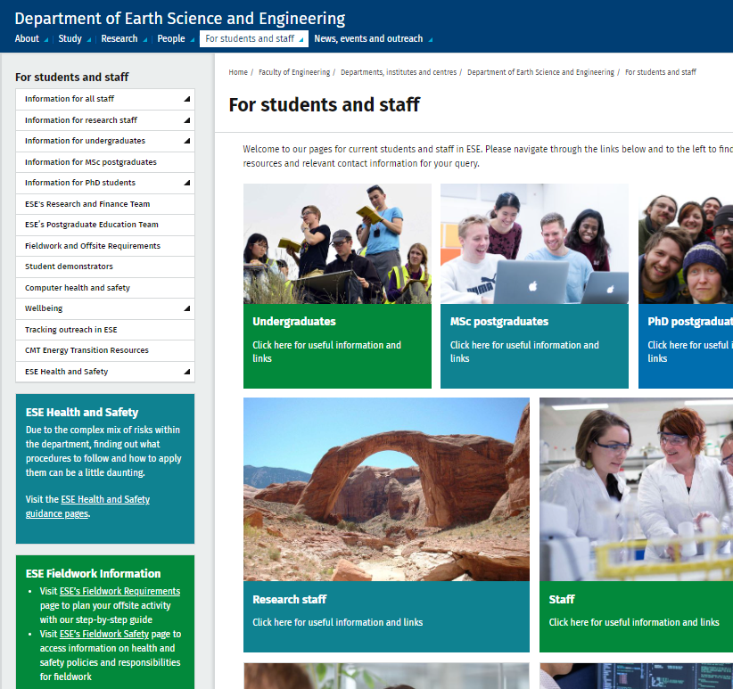
1. Where is the Info - ESE pages?
https://www.imperial.ac.uk/earth-science/current-student-staff-info/
Drop down menu / Left Column
Two Ways IN! →
https://www.imperial.ac.uk/earth-science/current-student-staff-info/offsite/
Fieldwork and Offsite Requirements page:
What to do ? – our 5-Step guide
https://www.imperial.ac.uk/earth-science/current-student-staff-info/health-safety/
Fieldwork info and links page:
Fieldwork Safety

Slide 3
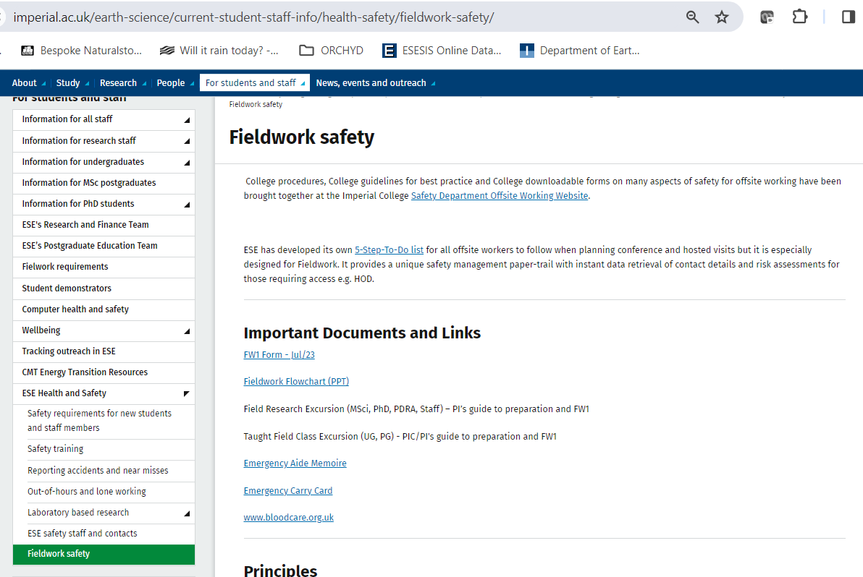
1. ESE Fieldwork Safety
our 5-Step guide
FW1 form
Flow Charts
Emergency Aide Memoire etc

Slide 4
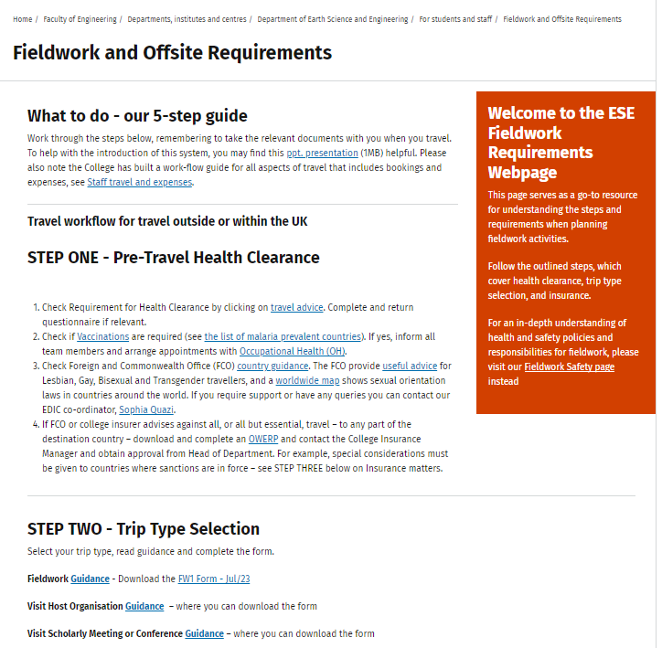
2. 5-Step Guide
https://www.imperial.ac.uk/earth-science/current-student-staff-info/offsite/
STEP ONE - Pre-Travel Health Clearance
STEP TWO - Offsite Trip Types
Fieldwork
Visit Host Organisation
Visit Scholarly Meeting or Conference
STEP THREE - Travel Insurance
STEP FOUR - Notification of Travel Details on Sharepoint (OSW)
STEP FIVE - Communication

Slide 5
2. Why this ESE SYSTEM ?
ESE staff and students – welfare, duty of care
The OSW sharepoint site travel questionnaire info is input just once on ESE system (no need to go through college travel questionnaire)
Document Trail All the traveller(s) risk assessment forms etc, FW1, Hosted1, Offsite Contact Record (e.g. Conferences) and contact details are logged together in one (safe restricted access) place on OSW
HOD ‘at-a-glance’ in regional emergency/crisis, know approximately staff whereabouts + on further opening of attached files, more detailed info of traveller whereabouts can be found in the specifically attached forms of that traveller.
Compatibility IC Safety Dept. (Offsite procedures) and IC Finance Dept. (Insurance)

Slide 6
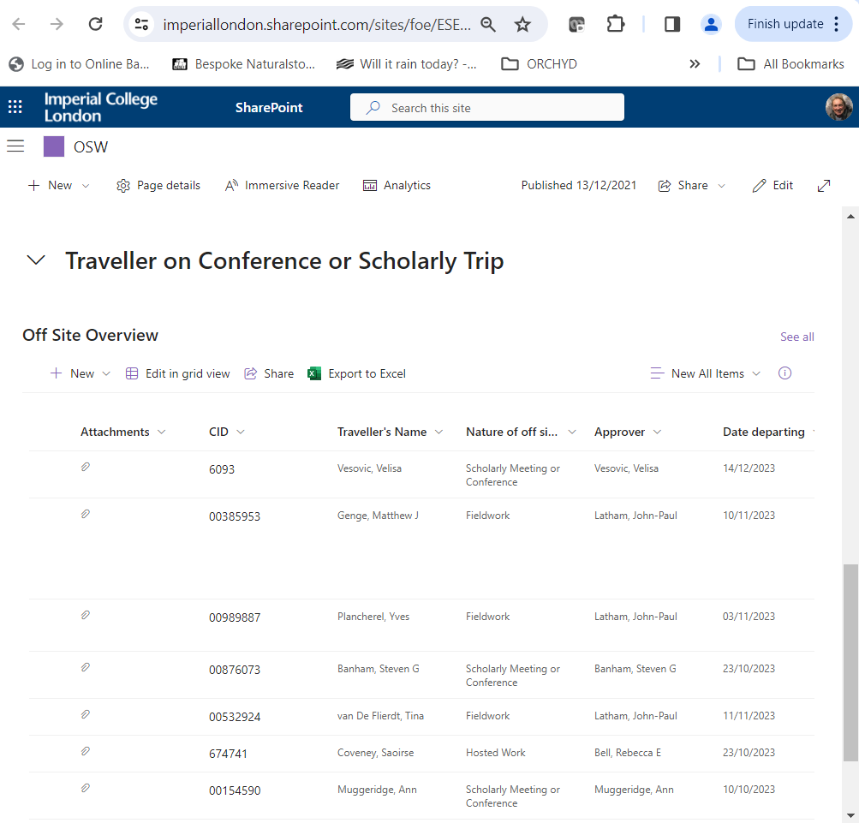
2. SharePoint Site (OSW)
https://imperiallondon.sharepoint.com/sites/foe/ESE/OSW/SitePages/OSWOV.aspx
Scroll down to the table part and click on the + sign
Fill traveller info questionnaire
Attach your approved e.g. FW1

Slide 7
2. Sharepoint Site (OSW)
The user/traveller first prepares their appropriate form (FW1, Hosted1, Conf= Offsite Contact Record) in consultation with PI and obtains their approval.
If it is a group travel activity, a Group Leader (GL) should coordinate all traveller details to be entered under one form and one data entry process (especially important for fieldwork that the fieldtrip leader organises this)
GL/User logs on to OSW Sharepoint site and completes new Sharepoint travel questionnaire, - automatically info goes to the insurance database, but you are advised to take your travel insurance certificate
GL/User, after completing sharepoint data entry, attaches approved relevant form before submitting. “For Info Only” notification is automatically emailed to DSO (if Hosted1) or FO (if FW1) or PhD Supervisor (if PhD is off to a Conference)
HoD (& EA) automatically receives notification of each travel submission
HoD (and key staff only) have ‘at-a-glance’ access to staff (+ students) travels

Slide 8
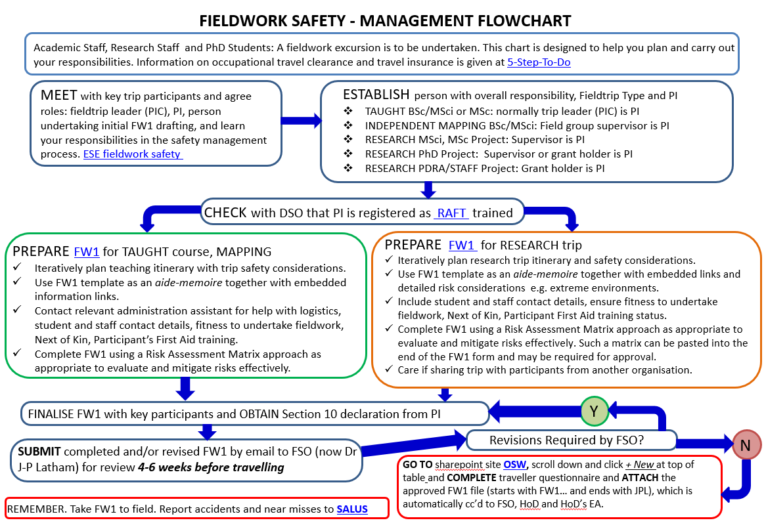
3. Flowchart – General Fieldtrips

Slide 9
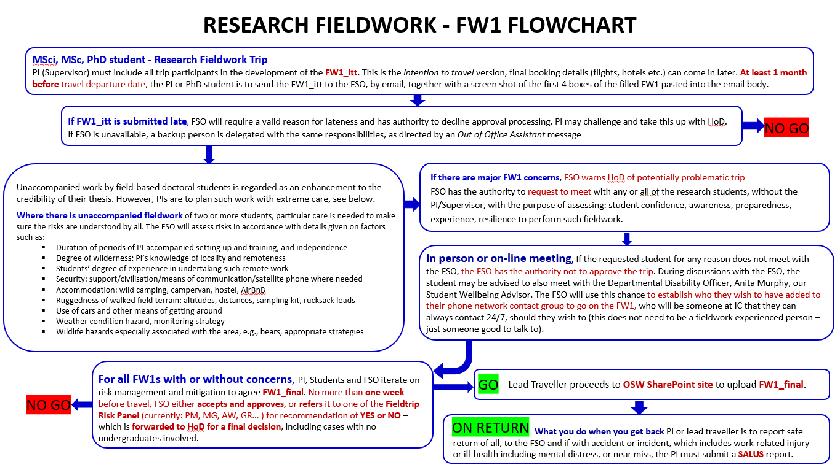
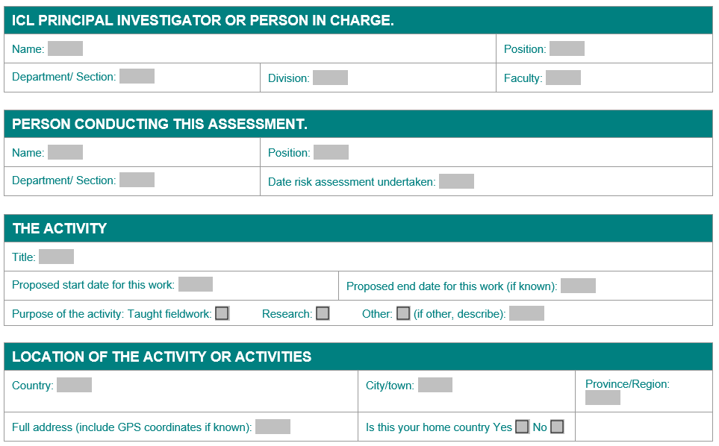
4. Flowchart – Research Fieldtrips
FW1_itt
email FSO >1 month, with screenshot of first 4 boxes filled.
Unaccompanied Fieldwork!
If complex risks/ logistics/ and major concerns by FSO? Then What ….??
Warn HoD
Meet with any participants
24/7 IC contact for student
1 week to travel – Decision!
Approval
Refer to FieldTrip Risk Panel for HoD Recommendation of Yes or No

Slide 10
5. Use of Private and Hired Cars
ESE Staff
ESE Students
ESE internal Fieldwork policy on Independent Mapping
ESE Staff, when travelling in a privately owned car on a trip that involves a phase that is related to college (i.e. academic) business (and therefore for which they would wish to have accident and liability insurance cover), should be aware they will not be covered by their normal personal use only car insurance, nor by college travel insurance. To use a car for such a college business purpose, either extend your personal private car policy to include business use e.g. for the limited period intended or drive a hired vehicle and use the hire company’s insurance provision.
For ESE students (e.g. undergraduates engaging in their compulsory independent mapping training, or students embarking on independent undergraduate or postgraduate travel for degree activity) planning on driving a car, e.g. for the purpose of doing fieldwork or getting to the fieldwork site, you will only be insured by the college travel insurance if you are insured and using a hired car or are driving college vehicles (e.g. student union vehicles).
Ban on long distance driving due to unnecessary added risk
ESE has an internal policy of not allowing students to take long drives e.g. from UK right across Europe, to facilitate transport for daily fieldwork mapping, whether in private or hired cars. However, it does appreciate the financial burden to the student of getting to mapping sites is high. The room for cost optimisation needs to be weighed carefully during mapping selection and planning, together with consulting mapping coordinator staff to help make viable plans.

Slide 11
6. Accessing this Presentation
Fieldwork Safety Update – ppt link
Will be available from ‘Fieldwork Safety’ page

