Slide 1
Room Booking
Guide for Room Stewards

Slide 2
Contents
Roles and Responsibilities of a Room Steward | 3
Navigation in the ‘Back Office’ | 5
Setting up Filters | 14
Updating Room Data | 20
Amending and Cancelling Bookings | 24
Reporting | 30
Appendix 1 – Full list of room data and Room Steward permissions | 40

Slide 3
Room Steward Roles & Responsibilities

Slide 4
Room Steward Roles & Responsibilities
Each department will have one key room steward and one or more backups.
Planon Room Stewards are expected to:
Maintain room details in Planon for rooms “owned” by their department:
Update as changes occur;
Review once a year.
Provide content for the Room Booking website and notify system administrators in the Estates Operations Customer Service Centre of any updates required.
Room Stewards are able to modify and cancel bookings in rooms “owned” by their particular department using Planon back office functionality.

Slide 5
Navigation in the Back Office

Slide 6
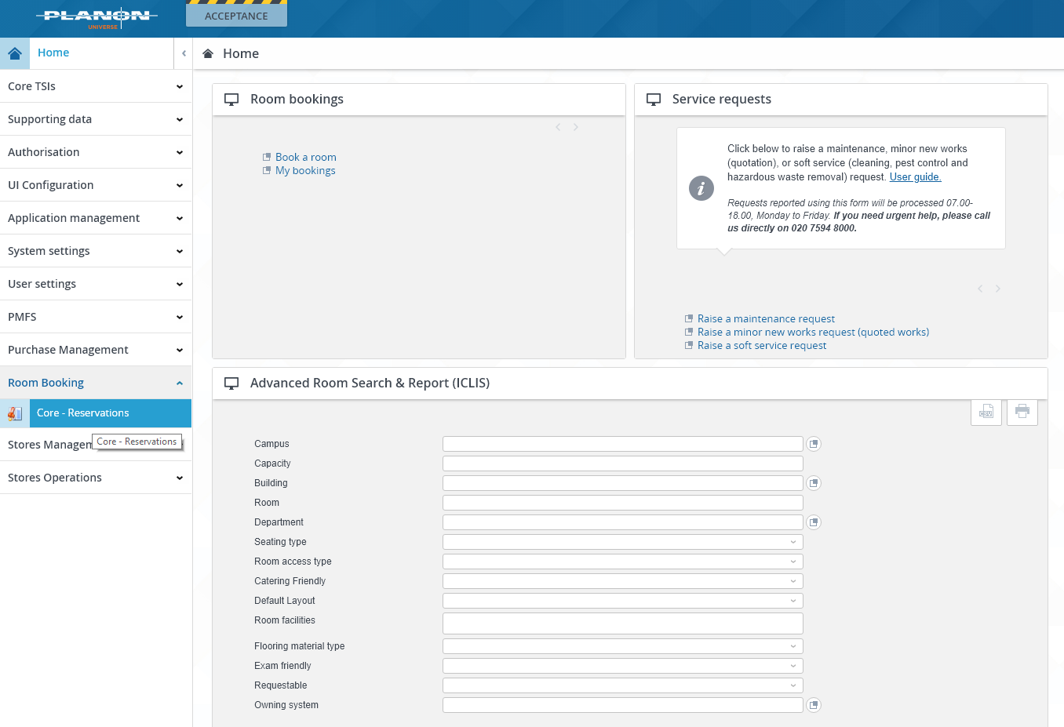
Navigation in the Back Office
Room Stewards have been granted access to the ‘back office’ room booking functions.
To access this area, log into Planon, and navigate to the menu on the left-hand side.
Click on “Room Booking” and then “Core – Reservations”.

Slide 7
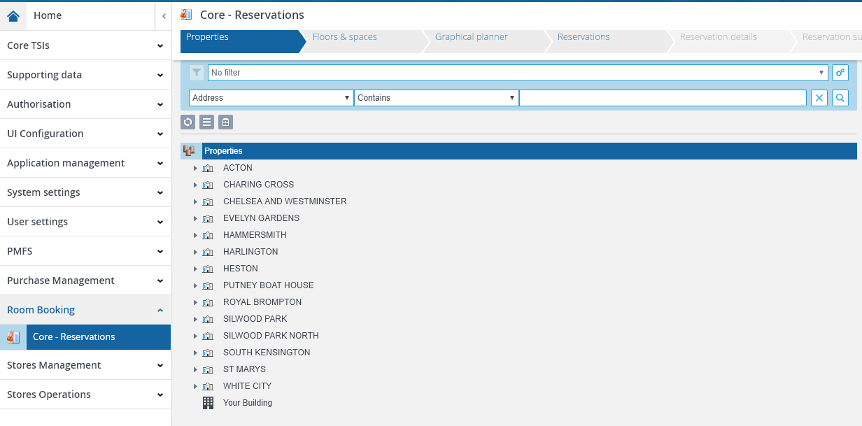
Navigation in the Back Office
The menu along the top of the gadget can be thought of as layers, from campus level, down to individual bookings. Each offers an opportunity to filter on what will be seen on the next screen.
Summary of screens
Properties – lists campuses and buildings
Floors & spaces – lists floors of buildings
Graphical Planner – lists rooms
Graphical planner tab displays bookings per room
Data view tab displays room information
Reservations – lists room bookings

Slide 8
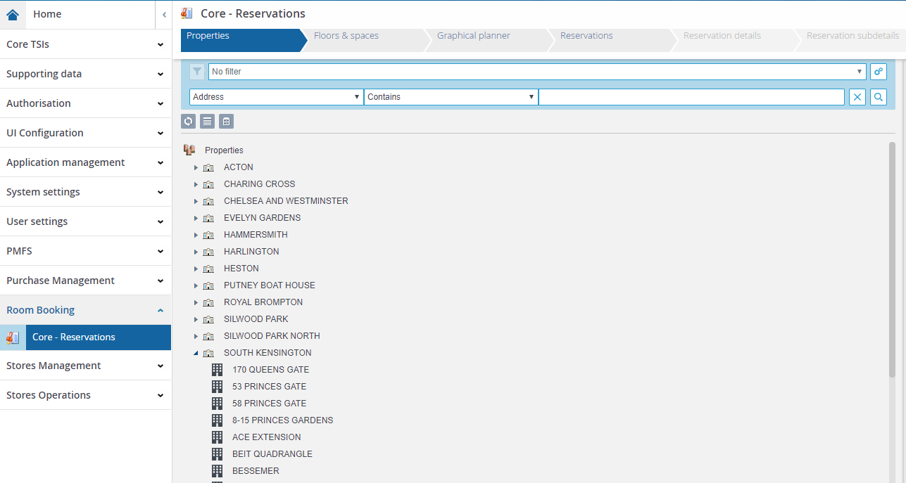
Navigation in the Back Office
Properties tab lists campuses and buildings:
To see buildings, click on the arrow to the left of the campus name
Select a campus or building to narrow down what is listed on the following screens.

Slide 9
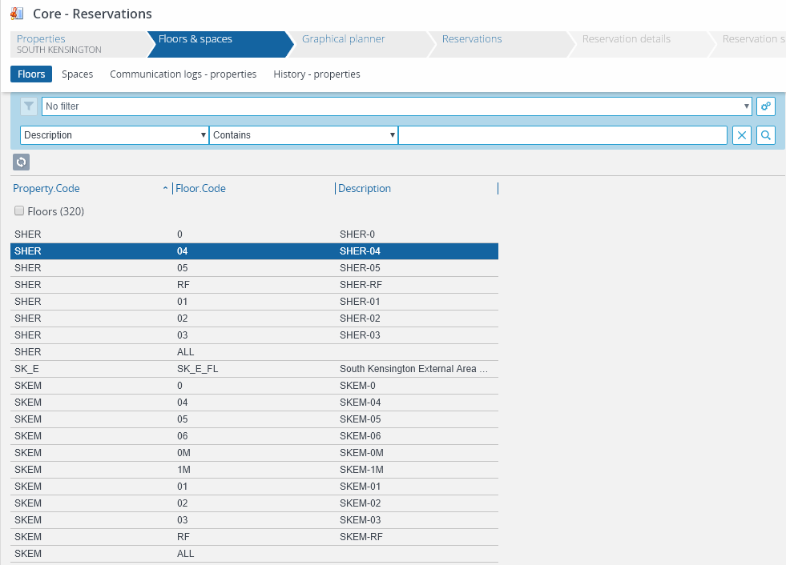
Navigation in the Back Office
Floors and spaces tab lists floors within buildings:
Select a floor to narrow down what is listed on the Graphical Planner and Reservations screens.

Slide 10
Navigation in the Back Office
Graphical Planner tab shows rooms and their bookings. There are two display tabs:
Graphical planner
Data view
Graphical planner tab shows room bookings:
Select a room to narrow what is displayed on the “Reservations” screen.
Display by day, week or month.
Double-click on a booking to open a window with the details.
Move and extend bookings in this view.
Data view tab shows detailed room information:
Use to maintain room data.
1)
2)

Slide 11
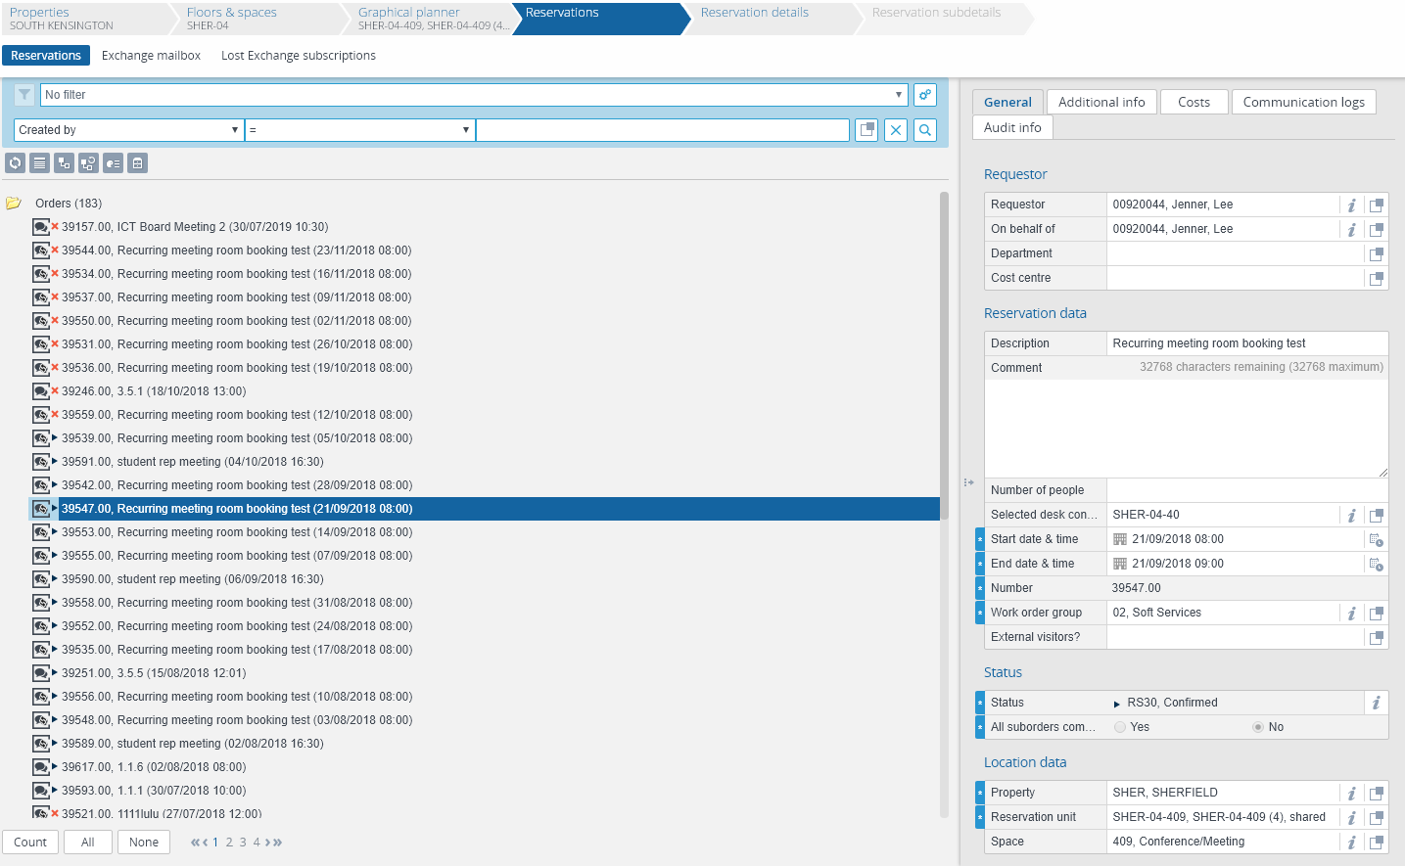
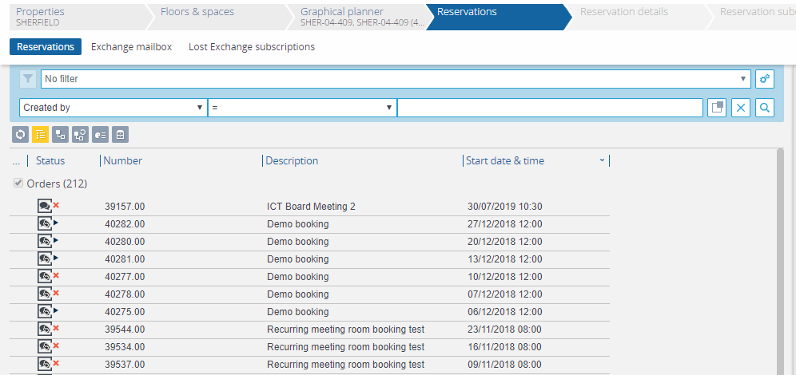
Navigation in the Back Office
Reservations tab lists room bookings:
Select a booking to display the details in the window on the right.
Click list view icon to display information in separate columns.
Click on any column heading to change the sort.
e.g. Click to change sort ascending/descending

Slide 12
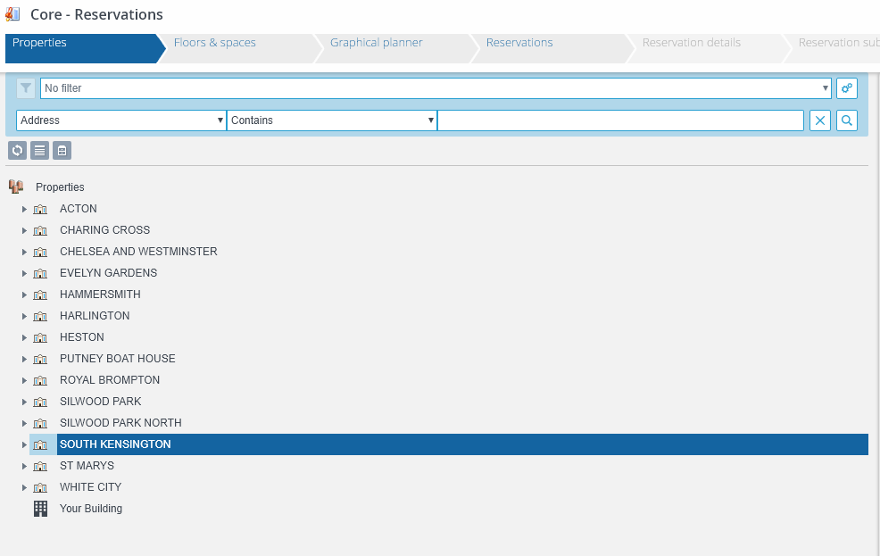
Navigation in the Back Office - example
1) In “Properties” South Kensington is selected
2) In “Floors & spaces”, only buildings on the South Kensington campus are displayed.
Sherfield, floor 4, is selected

Slide 13
Navigation in the Back Office - example
3) In “Graphical Planner”, only meeting rooms on Sherfield, level 4, are displayed. Room SHER-04-409 is selected.
4) In “Reservations”, only bookings in SHER-04-409 are displayed. An individual booking can be selected from the list, with more details displayed on the panel on the right-hand side.

Slide 14
Setting up filters

Slide 15
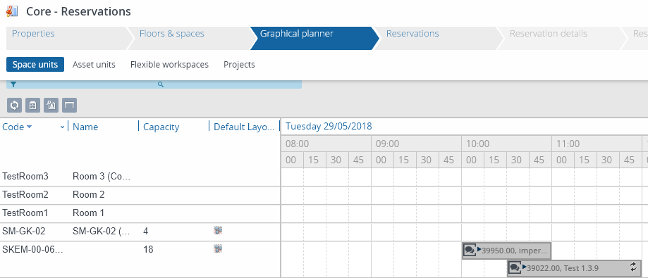
Setting up a filter – Department level
Filters can be created so that you only see relevant information in the back office, for instance just rooms in your department, or one particular room.
To set up a filter for your department, navigate to the “Graphical Planner”. Click the filter button.
Click on the cogs button and then “Add filter”
1)
2)

Slide 16
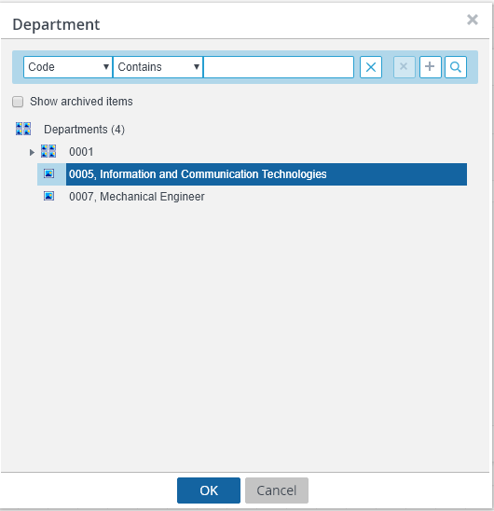
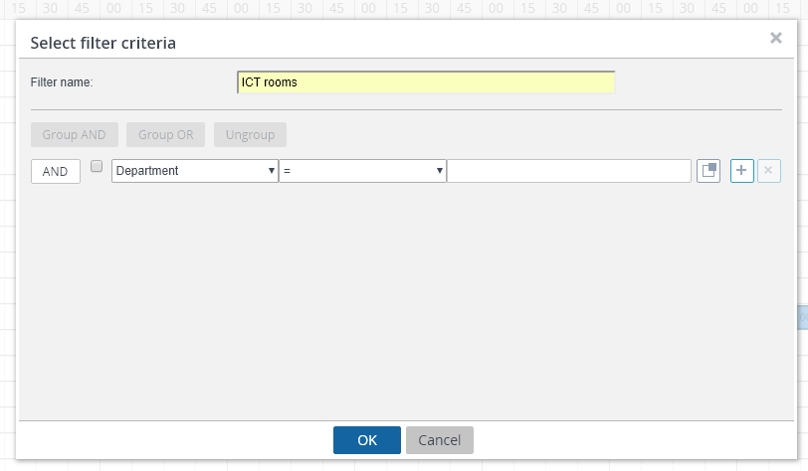
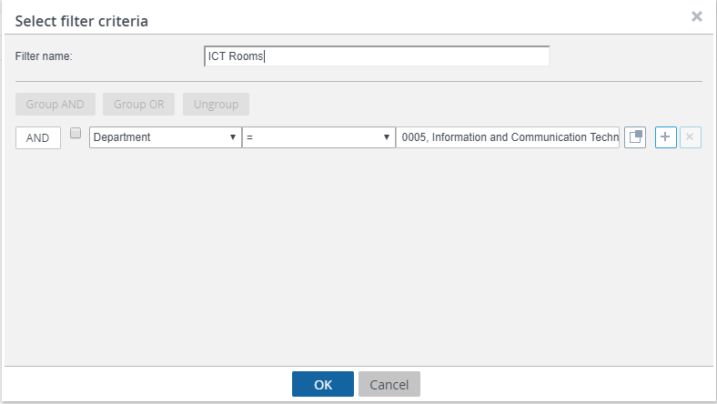
Setting up a filter – Department level
3) Give your filter a memorable name. In the drop-down menu, select “Department”. Click the pop-up button at the end of the row to bring up the options.
4) Select your department and the “OK”.
5) Click “OK”. You will now only see a list of the rooms in your department. This filter is now saved and can be turned on or off.

Slide 17
Setting up a filter – Room level
1) To set up a filter for a particular room, navigate to the “Reservations” tab. Click the cogs button and then “Add filter”

Slide 18
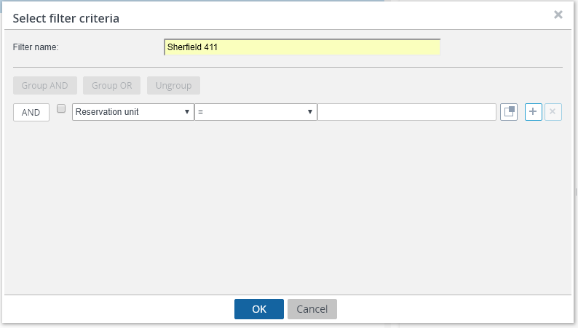
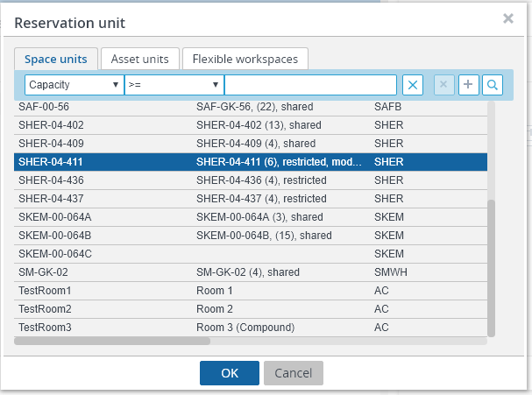
Setting up a filter – Room level
2) Give your filter a memorable name. In the drop-down menu, select “Reservation Unit”. Click the pop-up button at the end of the row to bring up the options.
3) Select the room you’d like to see and the “OK”.
4) Click “OK” again. You will now only see a list of bookings in this room. This filter is now saved and can be turned on or off.

Slide 19
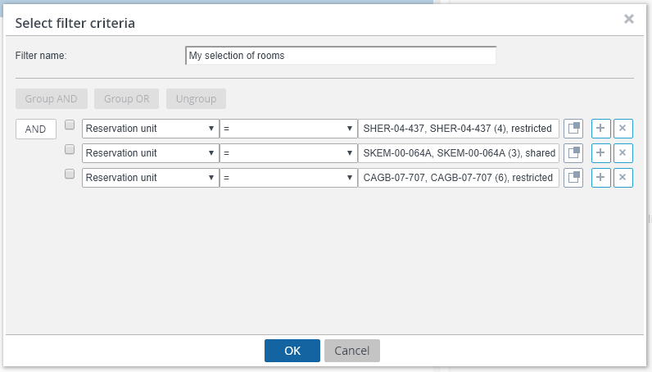
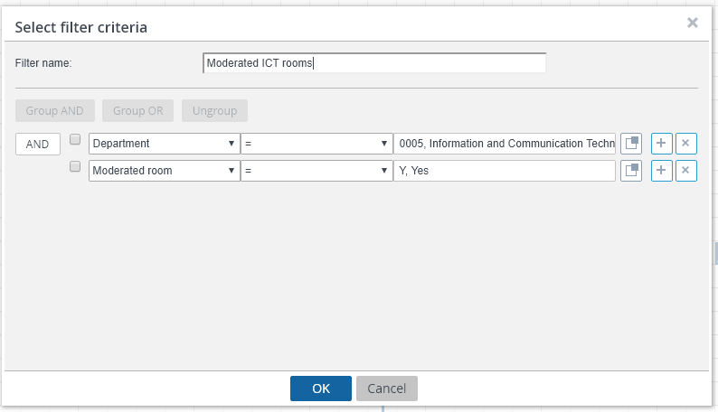
Setting up a filter – multiple criteria
1) You can add multiple criteria to your filter. In this example, a filter has been created in order to view the bookings in a bespoke selection of rooms.
To do this, navigate to the “Reservations” screen and add a new filter. Next, click the plus sign at the end of the row, which will add a new set of criteria below. Another room can be added in this row.
2) In this example, a filter has been created in order to only view the moderated rooms in a given department.
To do this, navigate to the “Graphical Planner” screen and add a new filter. Firstly, add the Department filter. Next, click the plus sign at the end of the row, which will add a new set of criteria below. In this row, select “Moderated room” and then “Y, Yes”.

Slide 20
Updating Room Data

Slide 21
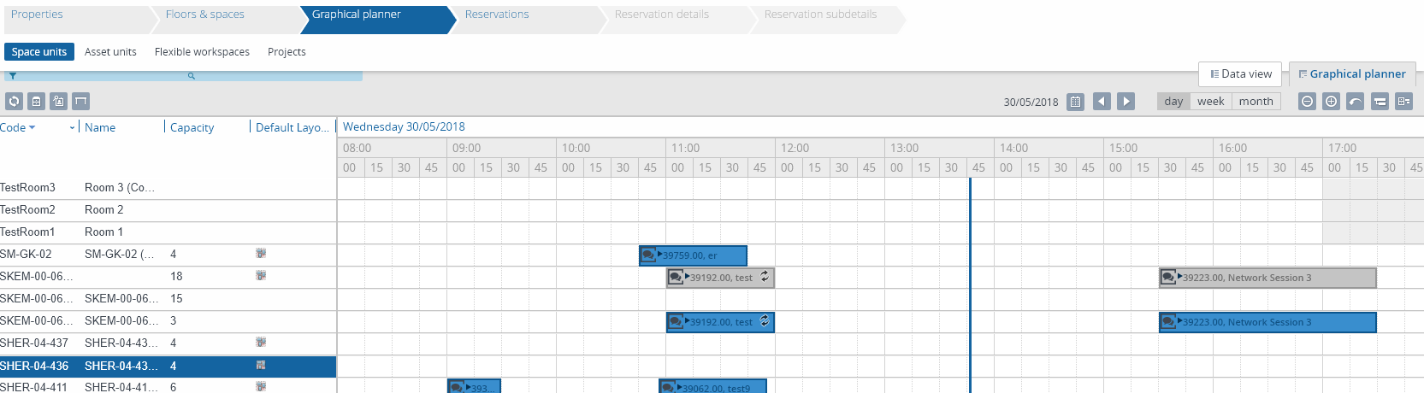
Updating Room Data
Room Stewards are responsible for keeping data about rooms in their area up-to-date, including:
Facilities contained in the room, e.g. projector, hearing loop, whiteboard
Room capacity and default layout
Room access and directions
Room photo
Room contact details
To view the data held against a room, navigate to the “Graphical planner”. Next, select the room you would like to view, and then the “Data view” tab.

Slide 22
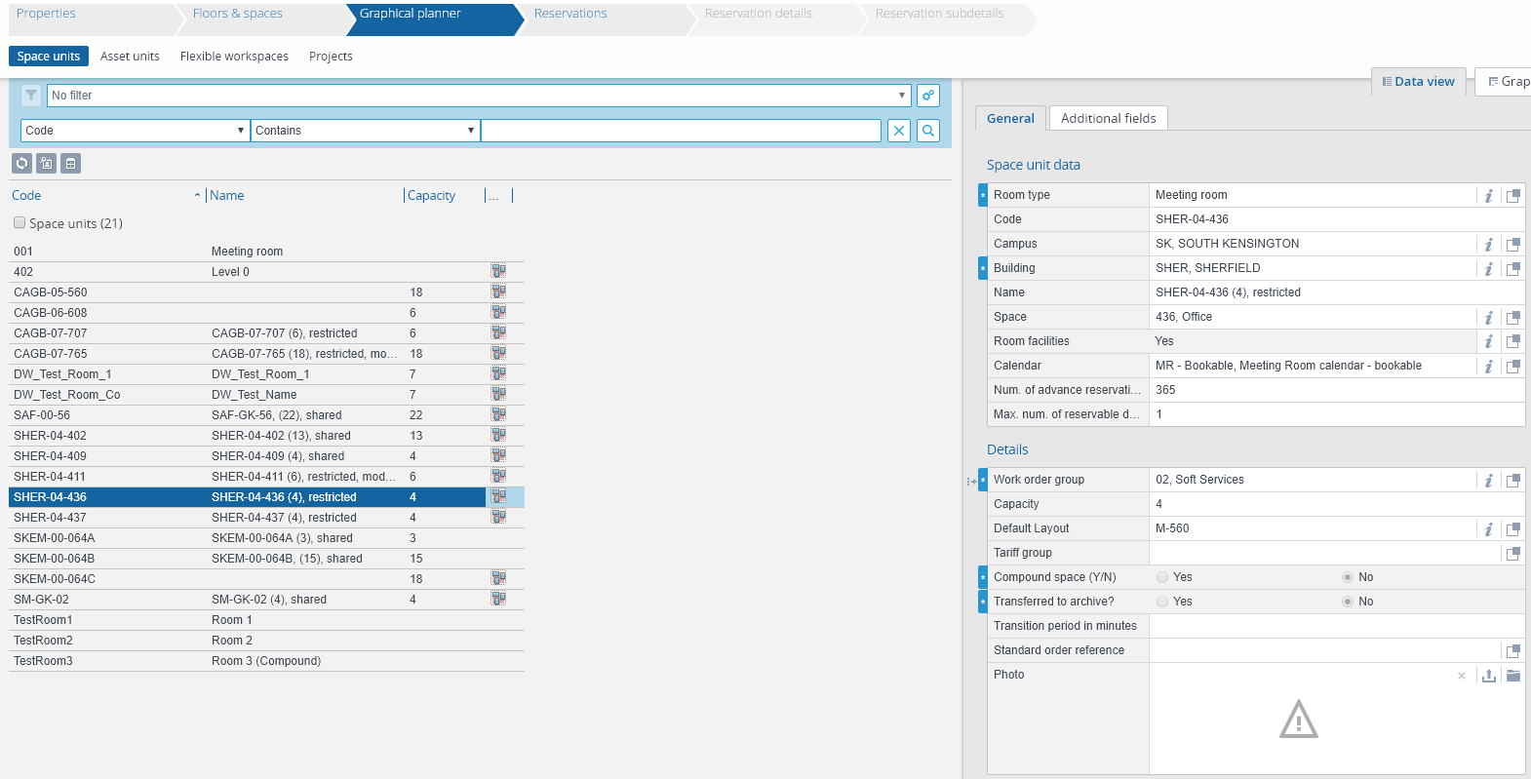
Updating Room Data
Once in the “Data view”, all the data held against an individual room can be found in the “General” and “Additional fields” tabs.
In Appendix 1 (page 40) of this guide, a full list of the data fields which should or should not be amended by Room Stewards, can be found.
If data needs to be changed in a field which Room Stewards should not update, contact the Planon System Administrators in the Estates Operations Customer Service Centre.

Slide 23
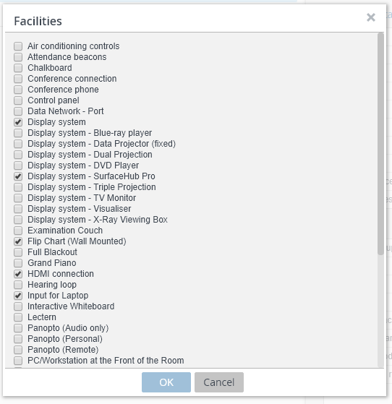
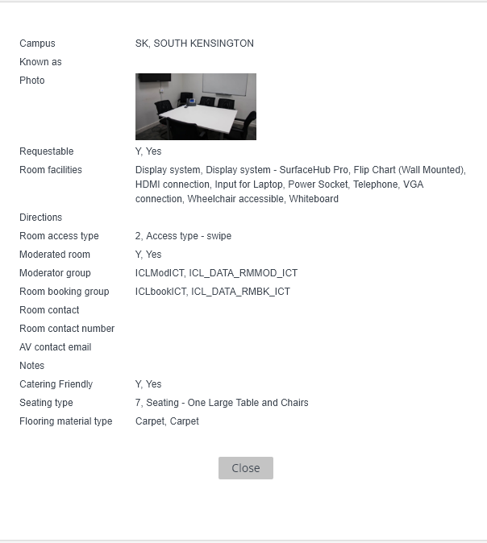
Updating Room Data
To change data, navigate to the field you would like to change, and click the pop-up button.
In this example, the “Room facilities” need to be updated. In the pop-up window, select or deselect the facilities as required.
This information will be reflected in the “More info” section of the Room Booking Wizard, for general users.

Slide 24
Amending & Cancelling Bookings

Slide 25
Amending & Cancelling Bookings
Room Stewards can amend or cancel their own and others’ bookings in the back office of Planon.
Warnings:
It is recommended that in most cases Room Stewards advise general users to amend, or cancel, their own bookings. However, this functionality is useful in the following cases:
A user is away or has left the College, but their room bookings remain in the system, which will not be used.
A room swap has been agreed between room users, and a Room Steward can more easily swap these around in the back office, rather than users cancelling and rebooking in the Room Booking Wizard.
Room Stewards have access to ALL rooms in the system. Therefore, they must be very careful not to amend bookings in areas where they don’t have authority to do so and it is recommended filters are set up to prevent this (see page 14).
As room bookings can be made in Outlook or Planon, it is important the Room Steward checks the source of the booking before attempting to amend it (see page 27). There are limitations to what can be changed when the booking was originally made in Outlook.

Slide 26
Amending a Booking
To amend a booking, first navigate to the “Graphical Planner” and ensure your have filtered the view to only show rooms in your area (see page 14). Use the calendar button to change the date. It is recommend that the “day” view is selected, in order to easily see all the bookings across the day.

Slide 27
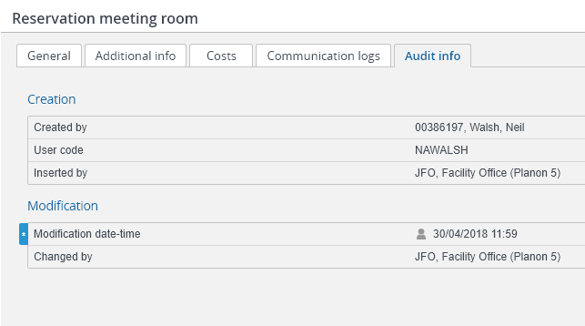
Amending a Booking
Find the booking you wish to amend and double click on it. This will open a new window, showing all the details of the booking.
Select the “Audit info” tab. In the “Inserted by” field, you will find whether the booking was originally made in Outlook or Planon:
“JFO, Facility Office (Planon 5)”, means the booking was made in Planon
“PEXI, Planon Exchange Integration”, means the booking was made in Outlook.
If the booking was made in Planon, the date, time, duration and/or location can be amended.
If the booking was made in Outlook, the booking can be extended and/or moved to a different room at the same time. However, the start time or date cannot be amended in the back office, the user must change it in their own Outlook calendar.

Slide 28
Amending a Booking
Back in the “Graphical Planner” view, the booking can be extended by dragging the end of the appointment out.
To change the location, the booking can be dragged and dropped into an empty slot in another room. As this booking was made in Planon, the time of the booking can also be changed.
Warning: When a booking is amended, Planon does not keep a record of the original date/time/location. Therefore, if a booking is moved accidentally, there is no way to know where it should be moved back to.
4)
5)

Slide 29
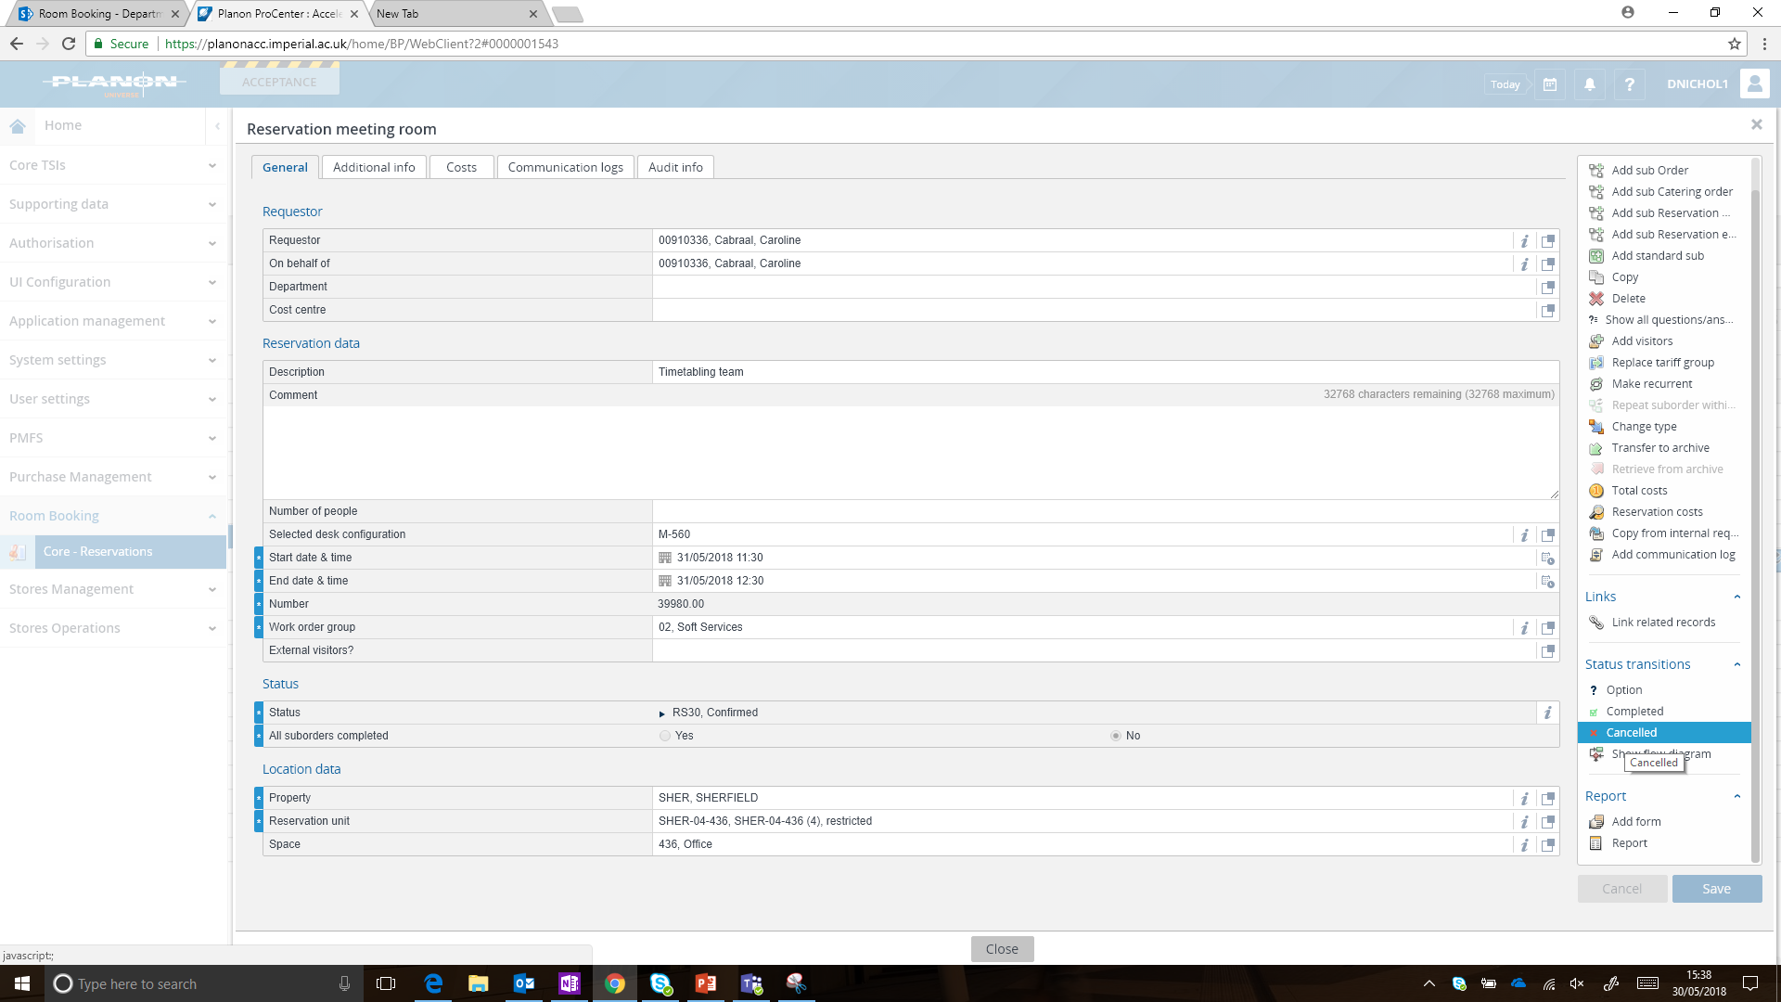
Cancelling a Booking
To cancel a booking, navigate to the “Graphical planner” view and ensure your have filtered the view to only show rooms in your area (see page 11).
Double click on the booking you wish to cancel, which will open a new window.
In the menu on the right-hand side, scroll down to the “Status transitions” heading and click “Cancelled”. Close the window.
This booking will now be removed from the “Graphical Planner”.
Warning: Clicking Cancel will immediately cancel the booking. The system does not ask you to confirm and you cannot un-cancel a booking.

Slide 30
Reporting

Slide 31
Reporting
Room Stewards have access to run reports in Planon, including:
A report listing all the reservations in one room, or a group of rooms, on a given day;
A report on the hours occupied in a room, or group of rooms, across a day, week, or month;
A summary of moderated room bookings, showing the number of requests accepted or rejected;
A report showing all the moderated booking rejection reasons.

Slide 32
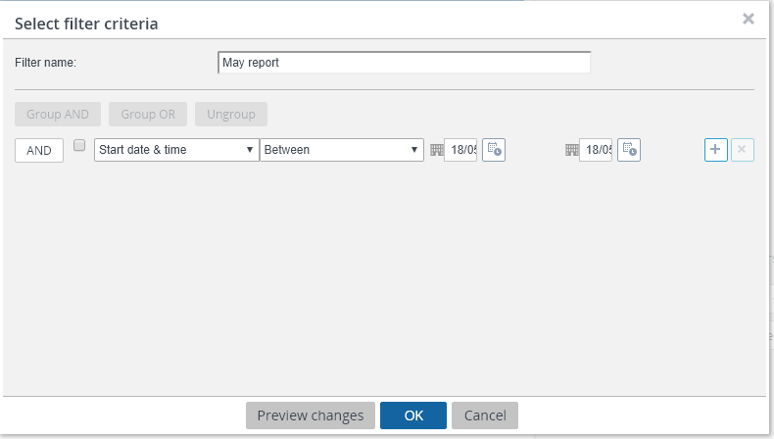
Reporting – reservations in one day
This report can be used to view all the bookings in a department’s rooms for an upcoming day.
To create this report, navigate to the “Graphical planner” and set up a filter for the group of rooms to be reported on (see page 14).
Next navigate to the “Reservations” screen. Create a new filter on the “Start date & time” and select the relevant date. Click OK.
Click the “Report” button from the right-hand menu.
2)
3)

Slide 33
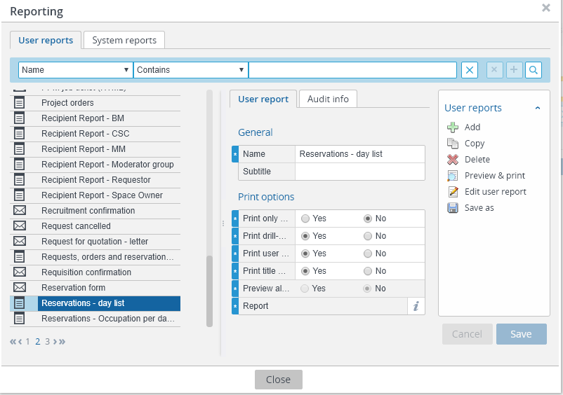
Reporting – reservations in one day
On the right hand side are the options for viewing and saving the report.
Select ‘Preview & print’ to generate a PDF of the report, which can be printed or downloaded.
Select ‘Save as’ to save a copy in Excel (XLS/XLSX format), which you can then edit further if wished.
a)
b)
In the Reporting window, select “Reservations – day list”

Slide 34
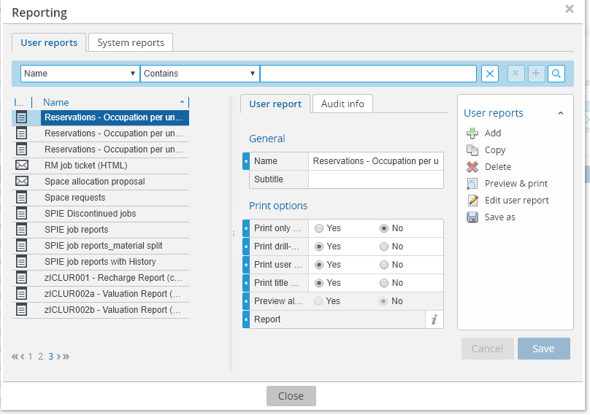
Reporting – hours occupied
This report can be used to view the total hours a room(s) in booked per month across the year.
To create this report, navigate to the “Graphical planner” and set up a filter for the group of rooms to be reported on (see page 14).
Click the “Report” button from the right-hand menu.
In the Reporting window, select “Reservations – Occupation per unit per month in hours”
Print your report or save as an excel file to edit further.
3)
4)

Slide 35
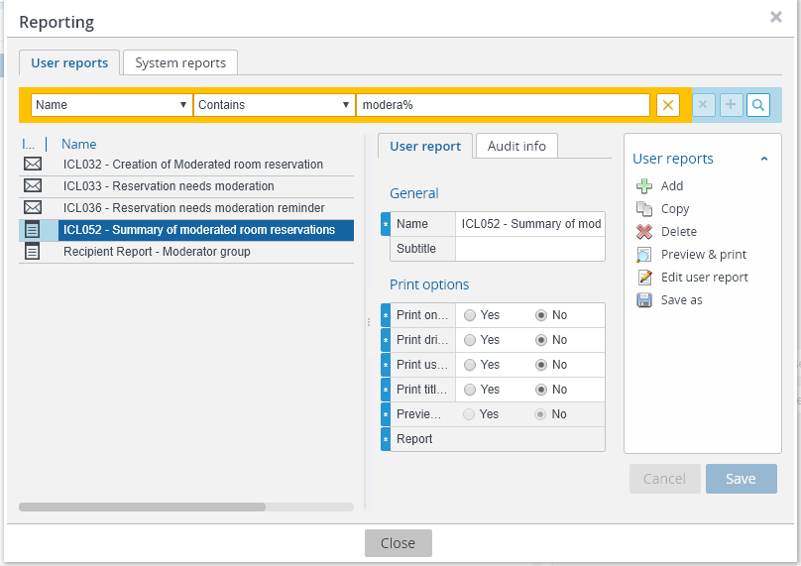
Reporting – Moderated rooms summary
This report can be used to view whether room booking requests have been “Confirmed”, “Declined” or are still “Awaiting approval”, and the time taken to respond.
To create this report, navigate to the “Graphical planner” and set up a filter for the group of rooms to be reported on (see page 19 for how to set up a filter for moderated rooms).
Next navigate to the “Reservations” screen. Create a new filter on:
“Start date & time” - select the dates to be covered in the report. In this example the month of May 2018 has been selected
Click the “Report” button in the right-hand menu. In the Reporting window, select “ICL052 – Summary of moderated room reservations”
2)
3)

Slide 36
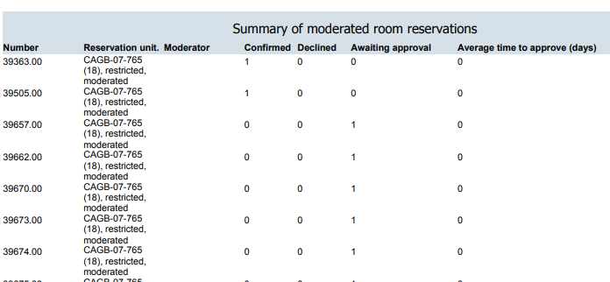
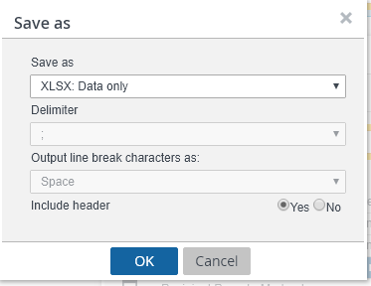
Reporting – Moderated rooms summary
Exporting your report:
The report will generate a list of every booking in each room over your selected time period and whether it was “Confirmed”, “Declined” or still “Awaiting approval”.
To view a summary of the total number of confirmations, declinations or requests awaiting approval, it is recommended that the report is downloaded to Excel. To do this click “Save as” and change the file type to “XLSX: Data only”.
In Excel, create a pivot table to view a summary for the month.
1)
2)
3)

Slide 37
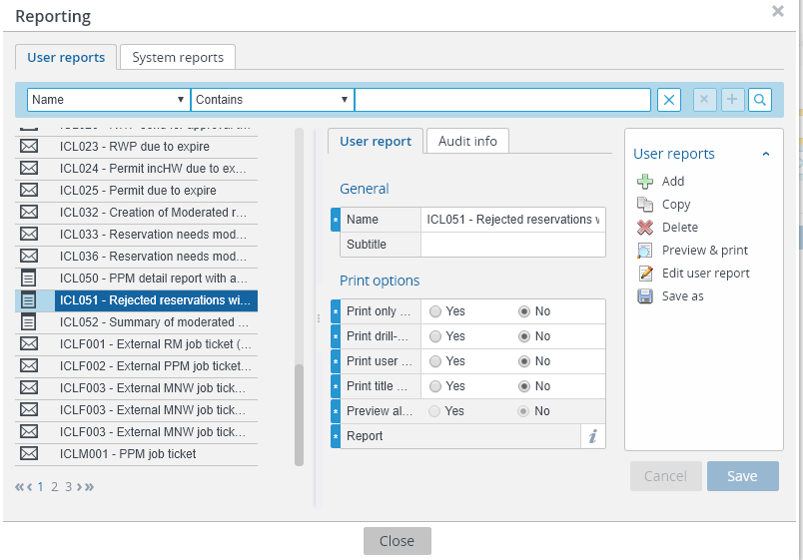
Reporting – Rejection reasons for moderated rooms
This report can be used to view the rejection reasons provided when the use of a moderated room is declined.
To create this report, navigate to the “Graphical planner” and set up a filter for the group of rooms to be reported on (see page 15 for how to set up a filter for moderated rooms).
Next navigate to the “Reservations” screen. Create a new filter on:
“Start date & time” - select the dates to be covered in the report
“Status” – select “RS70, Declined”
In the Reporting window, select “ICL051 – Rejected reservations with reasons”
2)
3)

Slide 38
Reporting – Rejection reasons for moderated rooms
If you would like to include the date and time of the reservation in your report, select “edit user report” in the right-hand menu.
In the pop-up window, select “Start date & time” and move it across to the “Selected fields” window. The order of the fields in the report can also be adjusted using the arrows at the side.

Slide 39
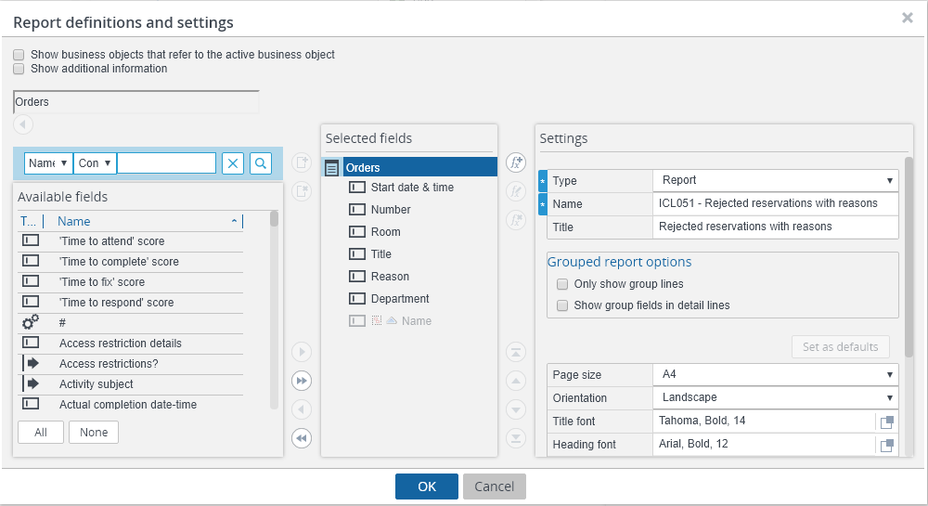
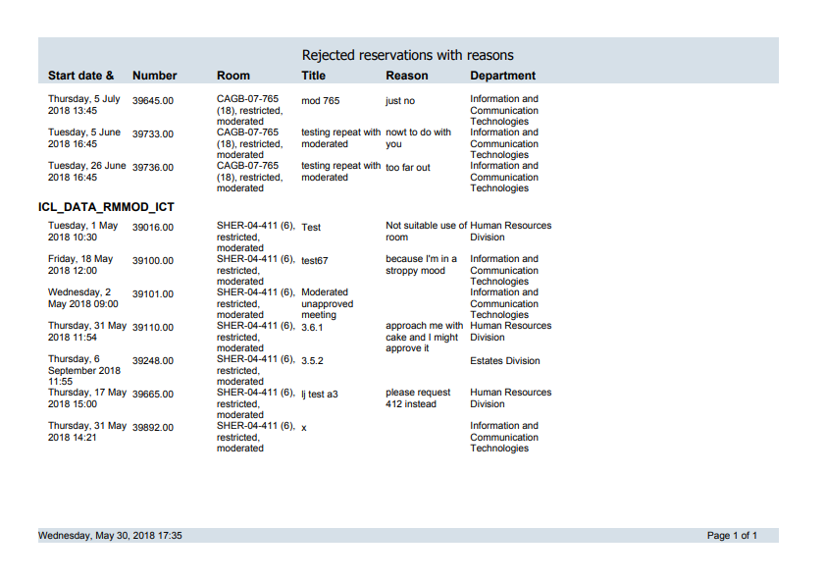
Reporting – Rejection reasons for moderated rooms
The appearance of the report can also be edited here. For example, the orientation of the report can be changed from Portrait to Landscape to ensure it fits on the page to be printed.
Once you are happy with the report, either select ‘Preview & print’ to generate a PDF of the report, or select ‘Save as’ to save a copy.

Slide 40
Appendix

Slide 41
Updating Room Data – Appendix 1
Space unit data (General) | Should Room Steward edit?*
Room type | No
Code | No
Campus | No
Building | No
Name | No
Space | No
Room facilities | Yes
Calendar | No
Num. of advance reservation days | No
Max. num. of reservable days | No
Details (General) | Should Room Steward edit?
Work order group | No
Capacity | Yes
Default Layout | Yes
Tariff group | No
Compound space (Y/N) | No
Transferred to archive? | No
Transition period in minutes | No
Standard order reference | No
Photo | Yes
*If data needs to be changed in a field which Room Stewards should not update, contact the Planon System Administrators in the Estates Operations Customer Service Centre.

Slide 42
Updating Room Data – Appendix 1
Room features (Additional fields) | Should Room Steward edit?
Requestable | Yes
Moderated room | No
Catering Friendly | Yes
Exam friendly | Yes
Seating type | Yes
Quiet room | Yes
Student bookable | Yes
Flooring material type | Yes
Area sqm | No
Access (Additional fields) | Should Room Steward edit?
Room access type | Yes
Directions | Yes
Accessibility link | Yes

Slide 43
Updating Room Data – Appendix 1
Contacts (Additional fields) | Should Room Steward edit?
Room contact | Yes
Room contact email | Yes
Room contact number | Yes
AV contact | Yes
AV contact email | Yes
Moderator team email | No
Moderator group | No
Room booking group | No
Room steward | No
Room steward email | No
Room data (Additional fields) | Should Room Steward edit?
Department | No
Start Date | No
End date | No
Known as | Yes
Calendar | No
Owning system | No
Last Updated By | No
Late update Date | No
Notes | Yes
Notes (private) | Yes
Celcat export data (Additional fields) | Should Room Steward edit?
KX ID | No
Year availability | No
Celcat ID | No
Demand category | No

