Slide 1
Recruitment workshop
Recruitment workshop
November 2022
Positive Action and Know Your Pool
Kani Kamara, Head of the Equality Diversity and Inclusion Team Rob Farace, Interim Deputy HR Director (HR Operations) Natasha Boyd, Recruitment Project Manager

Slide 2
The Inclusive Recruiters’ Mindset
Recruitment workshop
November 2022
Be aware that, as humans, we have a propensity to favour those people who remind us of ourselves (homophily).
Be aware of affinity bias. Choosing these people feels more comfortable and less risky.
Avoid notions of team ‘fit’ unless this can be accurately measured in some way (e.g., through psychometric profiling).
Concerns about ‘fit’ may also influence where advertise, how we design jobs, and how we assess talent (e.g., men are more likely to demonstrate ‘leader like’ qualities such as boldness, assertiveness).
No-one is insulated from having biases – no matter how rational they believe themselves to be! If you believe you are exempt, it will stop you from taking any conscious action to mitigate biases.
Optimise the diversity of the people involved in your process in its widest sense, not just focusing on race or gender.
Aim to make criteria as objective as possible.
No decisions are informed by gut instinct. They are evidence-based.
Each part of the process is therefore measurable.

Slide 3
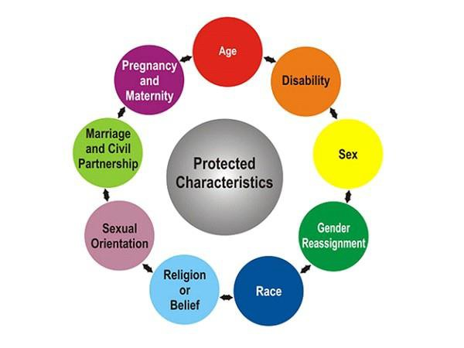
What is positive action in the workplace?
Recruitment workshop
November 2022
Proportionate steps are taken to compensate for any disadvantage that an organisation reasonably believes are faced by people from protected groups.
A form of encouragement to increase candidates for a post by exploring all ways to attract the best candidates.

Slide 4
Positive action vs positive discrimination?
Recruitment workshop
November 2022
Refers to the automatic favouring, without proper consideration of merit, of disadvantaged or under-represented individuals from protected groups.
Merit
Positive discrimination is unlawful discrimination.
Quotas

Slide 5

Positive Action - Disability?
Recruitment workshop
November 2022
If a candidate request adjustments to be made
To overcome any barriers created
by a disability
During the selection process
Future employment
Must consider and implement
those adjustments.

Slide 6
Dos and Don'ts
Recruitment workshop
November 2022
Do document your reasoning and decisions
Do act proportionately
Do keep your actions under constant review
Ask for support!
Don’t recruit specifically to remedy a lack of diversity
Don’t have a knee-jerk reaction

Slide 7
Diversity & Inclusion in Recruitment
Recruitment workshop
November 2022
Consider your approach at each of these key stages:
Job Design
Attraction
Selection
Onboarding/induction
And remember:
Unconscious bias!
The candidate experience

Slide 8
Job Design
Recruitment workshop
November 2022
Should be free from features that could inhibit diversity and inclusion.
Duties
Do not exaggerate duties/the role
Essential criteria
The criteria must be relevant, clear, demonstrable and avoid bias in wording.
Length of experience should be replaced by relevance of experience.
Avoid using superfluous qualifications.
Language is checked for gender bias (Textio)
Sentences are succinct and written in Plain English.
There are no abbreviations, or language that only certain people would understand. Do not assume candidates understand Imperial-specific information.
Language

Slide 9
Attraction
Recruitment workshop
November 2022
Where are you advertising?
Word of mouth – is it good or bad?
Language
Hybrid working The offer

Slide 10
Selection
Recruitment workshop
November 2022
Decision makers
  Everyone’s opinion and perspective are of equal value. Try to avoid conformity bias
Techniques/process
  Don’t rely on one method
  Ensure process is inclusive
Timing
  Set out timelines in advance
  Notice you provide candidates to complete tasks
  Potential impact of dates e.g. religious holidays

Slide 11
Your interview panel
Recruitment workshop
November 2022
It is important you ensure as far as possible your interview panel is balanced/representative and has the relevant people needed for the decision-making process
You should avoid single-gender panels
Consider involving stakeholders/users/subject experts (can be helpful with
balance)
New initiative to support hiring managers in recruitment

Slide 12
How to get the most out of your interviews
Recruitment workshop
November 2022
Brief the panel members thoroughly in advance
Prepare a list of core interview questions to ask all applicants
Use open questions (what, why, how)
Imperial template is available online to help you
Make LOTS of notes
Do not try to evaluate the candidate during the interview

Slide 13
Ask ….
Recruitment workshop
November 2022
Challenging questions (but not in an intimidatory tone or
manner)
For examples of real situations & check what the candidate
learnt from the experience
Factual questions about past experience and behaviour (refrain from making assumptions) that provide an insight into the scale/results of a candidates work

Slide 14
At interviews be aware of….
Recruitment workshop
November 2022
Primacy and Recency effects
Psychological phenomenon associated with memory that says items at the beginning (primacy) and items
at the end (recency) of a string of information are more easily recalled than items in the middle
Unconscious bias
Implicit or unconscious bias happens by our brains making incredibly quick judgments and assessments of people and situations without us realising. Our biases are influenced by our background, cultural environment and personal experiences.
Helpful Links:
https://www.imperial.ac.uk/equality/resources/unconscious-bias/
https://www.imperial.ac.uk/careers/about/careers-library/exclusive-online-resources/linkedin-learning/

Slide 15
Onboarding & induction
Recruitment workshop
November 2022
Keep in touch with your candidate before they start
Help candidates understand Imperial/your team before they start
Use information gained during the interview to plan their induction
Prepare the induction in advance e.g.
  What happens on their first day
  Who do they need to meet
  College essentials
  Introduction to staff networks
Contact your Strategic HR Partner for more support and advice

Slide 16
Recruitment Hub Support
Recruitment workshop
November 2022
Anonymous recruitment
Online testing
LinkedIn
Recruitment Agencies
External partnerships
How to guides
Programmes e.g. PVP and Julia Anderson Training Programme
Workshops
Training and development
Don't forget EDIC can support you too!

Slide 17
Don’t forget
Recruitment workshop
November 2022
Recruitment & Selection Training
All staff on recruitment panels are expected to have attended a recruitment and selection training course. The Learning and Development Centre offers a variety of options for both initial and refresher training - course content, dates and booking details are available on the Learning and Development website.
Please note: that it is College policy that at least one member of the panel must have been trained in recruitment and selection.

Slide 18
Ethnicity Confident Recruitment Scheme
Recruitment workshop
November 2022

Slide 19
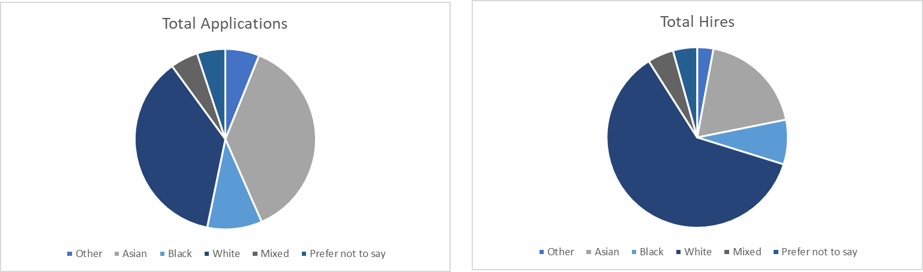
Diversity in the recruitment process
Recruitment workshop
November 2022
White applicants are disproportionately more likely to be hired at Imperial than applicants of
colour
There are many reasons for this, some of them beyond the College’s control, but it is highly likely unconscious bias is playing a role
Recruitment data for the whole College taken from 28/7/21 to 27/7/22

Slide 20

The scheme
Recruitment workshop
November 2022
A ethnically diverse pool of staff who can volunteer sit on recruitment panels to offer their expertise and a different point of view
For the first 12 months this will be an opt in scheme open to all recruitments
Volunteers will receive training and support

Slide 21
Diversity in the recruitment process
Recruitment workshop
November 2022
Why ethnically diverse recruitment panels work:
Visible forms of diversity can put candidates at ease
More effective challenge from a diverse perspective
Observer effect

Slide 22
Getting involved
Recruitment workshop
November 2022
We will be putting out a call for volunteers early 2023 via the staff briefing and other communication channels
Training planned for March
Volunteers ready to sit on panels during the summer term

Slide 23
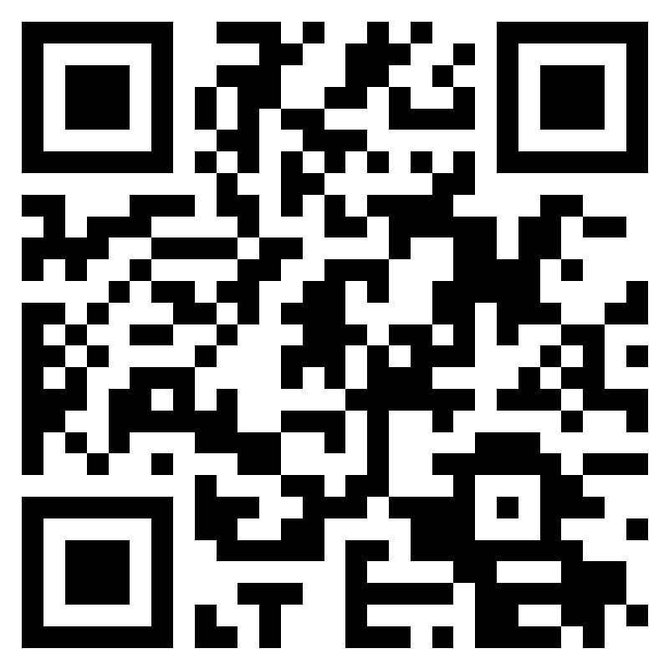
Register your interest
Recruitment workshop
November 2022
https://forms.office.com/r
/R3wSC2TZ8R

Slide 24
Additional Support
Recruitment workshop
November 2022
Inclusive Recruitment Webpages
– Guidance, tools and advice from vacancy creation to onboarding

