Slide 1
Adding the Room Booking Gadget
Click the “Edit mode” cog in the top right-corner of Planon.

Slide 2
Adding the Room Booking Gadget
Select the “Room bookings” gadget. Note gadgets can be re-ordered on the homepage by dragging and dropping whilst in this mode. Finally, close the window by clicking on the arrow in the top-right corner.

Slide 3
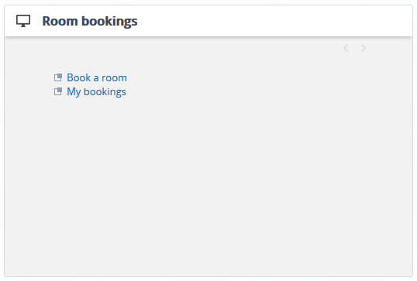
Adding the Room Booking Gadget
3) The new widget is now on your desktop.

